Slide 1
Application of Lean+ in Systems Engineering
Midwest Gateway Chapter of INCOSE
10 July 2007
Saint Louis, MO
Presented by Randolph Tarin with major input from Marlo Stebner and Benny Leppert
Notes:
Benny Leppert 425-446-1207 benny.j.leppert@boeing.com
Marlo Stebner 425-231-4516 marlo.stebner@boeing.com
Randolph Tarin 314-232-1863 randolph.tarin@boeing.com

Slide 2
A Modern Inter-Related History
Value Analysis / Value Engineering
1948 Engineering Council of the General Electric Co. established a Value Analysis unit to make the VA system and techniques available to the whole company. They appointed L.D. Miles to head the new unit.
OMB Circular A-131 requires all Federal Departments and Agencies use VE
Value (to the customer) =
Cust Needs / Price Paid
Or
Worth / Cost
Or
Function / Cost
Systems Engineering
British Multi-disciplined Team Formed (1937) to Analyze Air Defense System
USAF founded RAND Corp (1946) and created systems analysis
USAF published Systems Engineering Handbook 375-5 [1966]
NASA publishes Systems Engineering Handbook [1995]
Lean
Just-In-Time
Toyota Production System
Drawing conventions
Assembly Lines
Modern Machine Tool Development
Time Study & Work Standards
SPC
TQM
Lean Manufacturing
Interchangeable parts
1850
1860
1870
1880
1890
1900
1910
1920
1930
1940
1950
1960
1970
1980
1990
2000
Notes:
A version of lean history is located on the following link:
http://www.strategosinc.com/lean_manufacturing_history.htm
A version of systems engineering history is located on the following links:
http://www.sjsu.edu/faculty/ekujawski/SE_briefing.ppt
http://www.incose.org/mediarelations/briefhistory.aspx
systems engineering described as a function with five phases: (1) system studies or program planning; (2) exploratory planning, which includes problem definition, selecting objectives, systems synthesis, systems analysis, selecting the best system, and communicating the results; (3) development planning, which repeats phase 2 in more detail; (4) studies during development, which includes the development of parts of the system and the integration and testing of these parts; and (5) current engineering, which is what takes place while the system is operational and being refined.
A version of value engineering history is located on the following link:
http://vm.web.boeing.com/History_Origin.htm
http://wendt.library.wisc.edu/miles/miles.html
http://rtoc.ida.org/ve/documents/IDAPaperP-4114.pdf
The DoD VE program continues to have two distinct components:
• An in-house effort performed by DoD military and civilian personnel; and
• An external effort performed by DoD contractors and applied to contracts after
Department approval. This latter component is extremely important. The mandatory VE provisions in most DoD contracts encourage contractor participation and thereby realize the full benefits from cost reduction opportunities and innovations. These contract provisions provide the basis for the contractor to obtain a share of the savings that result from an approved VE effort. Before this development, submitting a cost-reduction change led to a commensurate decrease in the size of the contract and usually reduced profit by a proportional amount. The VE provisions changed this paradigm by providing the contractor with an incentive to submit proposals to reduce cost.

Slide 3
Customer Determines Value
WORTH
VALUE =
(To the Customer)
COST
Worth is a Customer Perception
Cost value - the summation of the labor, material, overhead, and all other elements of cost required to produce an item or provide a service compared to a base.
Use value - the properties and qualities, which accomplish a use, work, or service, compared to a base. The use value is equal to the value of the functions performed.
Esteem value - the properties, features, or attractiveness, which create the desire to possess the article but are not necessarily required so far as functional performance is concerned.
Exchange value- the properties or qualities, which will remain attractive enough to other people to permit, market resale in the future.

Slide 4
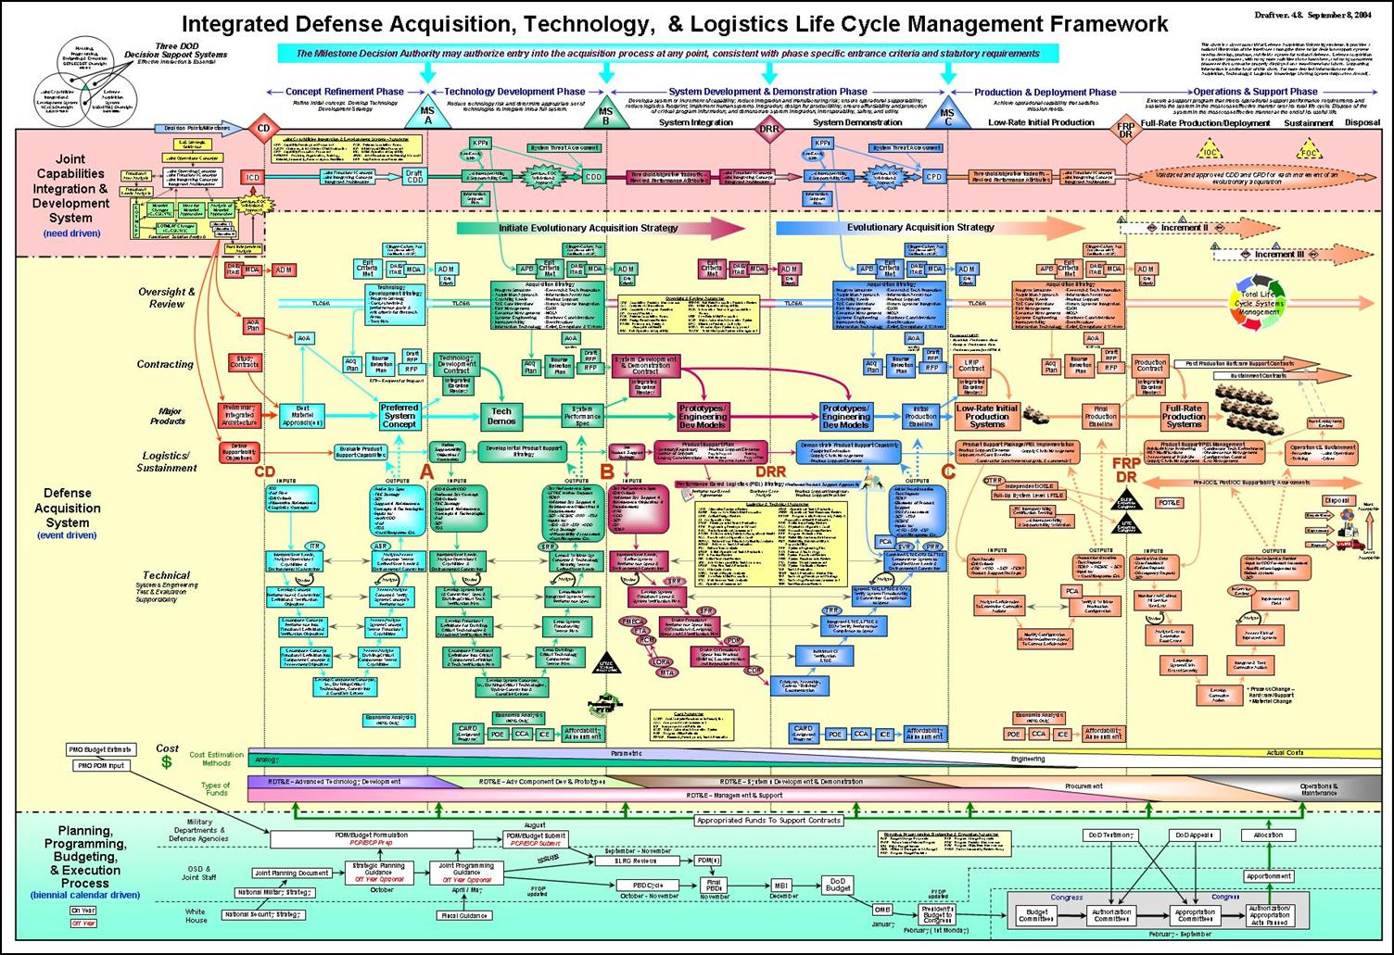
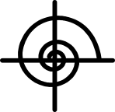
Systems Engineering in the System Life Cycle “The Wall Chart”
Notes:
Slide is copied from slide 22 of “ DAU Hot Topics Forum, July 12, 2006” located at:
https://acc.dau.mil/CommunityBrowser.aspx?id=105657

Slide 5
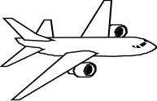

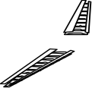


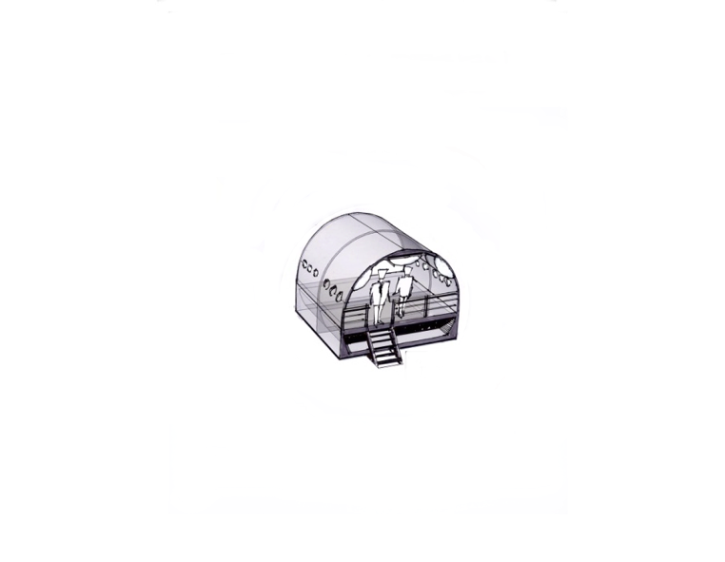

Lean+ and Systems Engineering
Does your product have an improvement strategy?
Make to Use
No Waste
Zero Defects
Time in minutes
Profit
Reliability
System
Major Sub-Systems
Sub-Systems/Box
Parts / Details
Assembly
Installation
In Service
Dispatch
Reqments
Capture
Lean
Design
Lean
Design
AIW
AIW
Lean
Design
Reqments
Capture
3P
Reqments
Capture
3P
3P
3P
FAST
TOC
TOC
Teaming
VALIDA-
TION
System
Trade
Studies
Teaming
VALIDA-
TION
System
Trade
Studies
Teaming
VALIDA-
TION
System
Trade
Studies
Value
Stream
VALIDA-
TION
System
Flow
Analysis
Value
Stream
VALIDA-
TION
System
VECP
Concept Definition
Firm
Concept
Joint Definition
Firm
Config.
Detail Definition
Design
Release
Part
Build
Service
Build
Service
Concept
Development
Joint Definition
Detail
Definition
Build
Test
Production
Lean Design
Lean Process
Defects are
Not Made,
Passed or
Accepted
Lean Build
People
Link the
System
Notes:
Lean+ should be integrated into the iterative nature of SE and documented in the program plans such as the SEP/SEMP.
The circles and arrows represent the iterative nature of the lean design build process.

Slide 6
Some Example Considerations for Applying Lean+ Into Systems Engineering
1) Team
Building
Paradigm shifting
Identify stakeholders/team
Framing
Shared vision
2) Value Management
Create a functional map of the intended design
Establish high level design goals
Establish weighted attributes to guide evaluation of competing concepts
Identify potential trade studies and areas of focus for DFMA
3) Systems
Engineering
Merge FAST model with system functional architecture in requirements tool
Establish functional and performance requirements
Map requirements to functions
4) DFMA
High level build simulation of baseline design
Apply Design for Manufacturing & Assembly principles to develop better designs in terms of cost, performance, and quality
Notes:
All team building exercises….

Slide 7
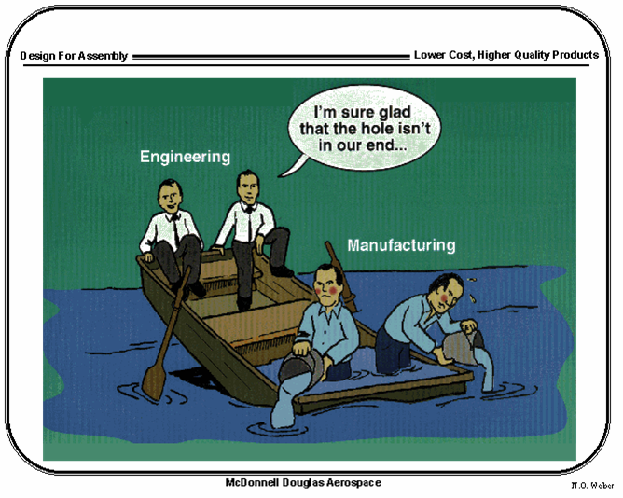
Teaming Recipe
Start off with some basic engineering stock
Add marketing and finance
Spice up your team with mechanics and suppliers
Add one executive for credibility
Add a pinch of service
If you like it hot, go crazy and add customers
Stir constantly with an outsider until done
A word of caution: the only thing that will spoil the brew is internal politics.

Slide 8
Team Work Brings Power
The Crowd
The Team
Notes:
A Mile Wide
An Inch deep
Everybody Out For A Pass

Slide 9








Teaming Compared to Traditional Approach
Rework
Rework
Rework
Rework
Rework
Configuration
Design
Analyze
Build Plan
Schedule
Build
Traditional Product Cycle
Concurrent Engineering Product Cycle
Savings
TEAM
Configuration
Design / Analyze / Build Plan / Schedule
Build

Slide 10
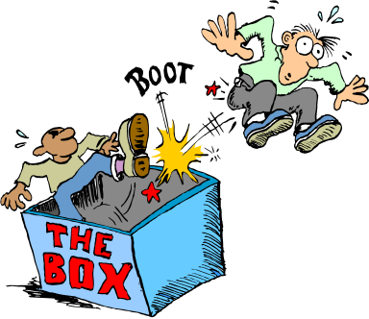
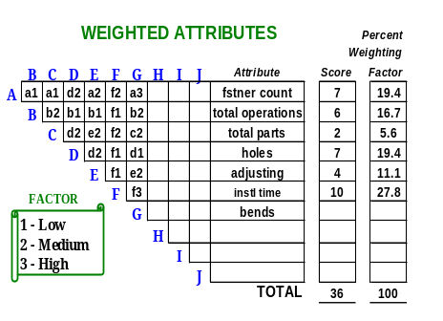
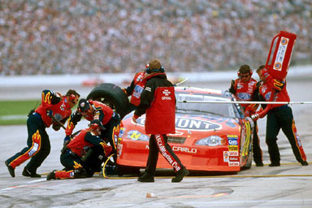
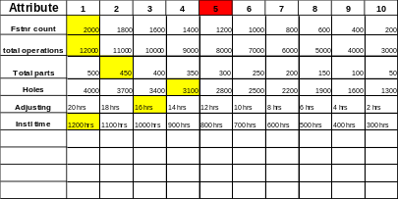
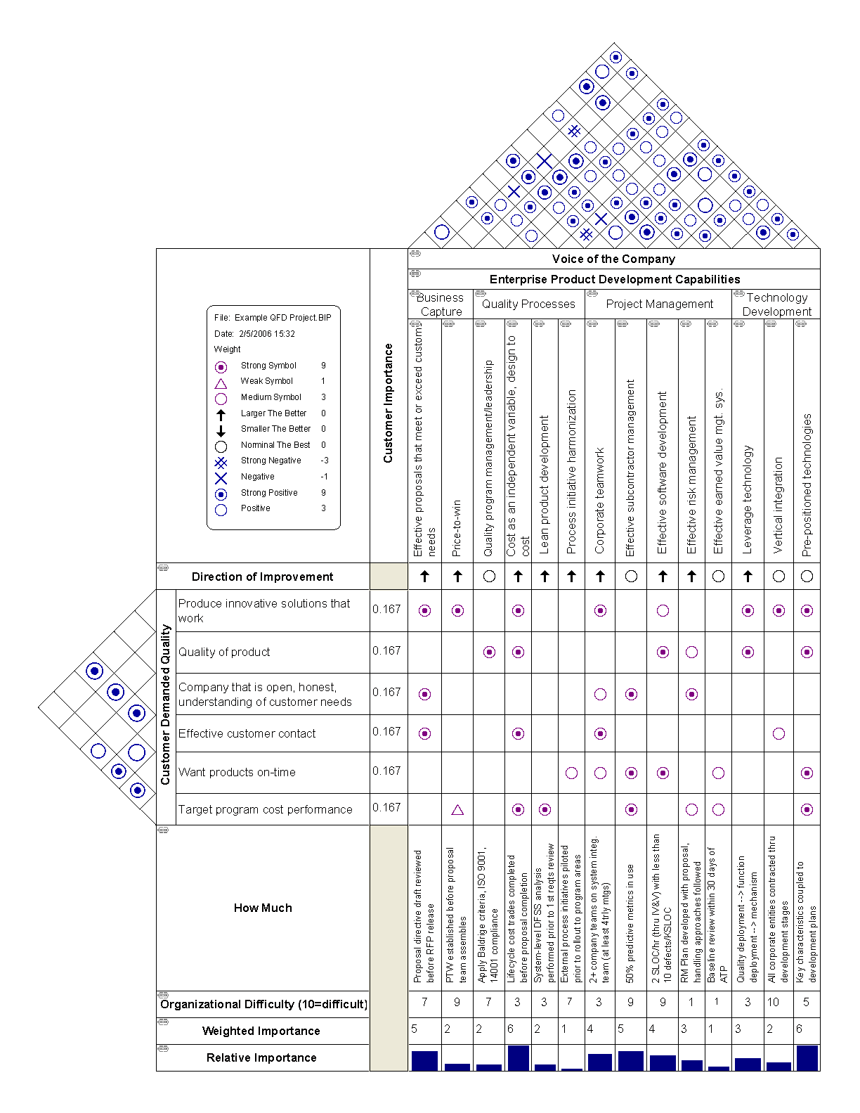
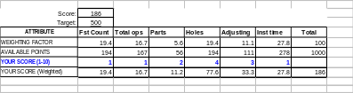
Identify Required Attributes
Goals and Targets
Team Building
Targets & Goals
Thinking Differently
Personal Accountability
Producibility Attributes
Share the Vision
Paradigm Pioneering
Producibility Profile
Installation
Time
Fastener
Count
1000
Program
= average of LCPT scores
900
337
Total
Operations
800
432
365
340
197
351
LCPTs
= average of
commodity
scores
Concept
Development
Phase
Joint
Definition
Phase
Detail
Definition
Phase
500
Adjusting
186
700
Target
600
447
435
295
202
388
Hole
Count
Total
Parts
500
Target
395
387
288
112
440
400
Commodities
300
420
414
331
214
N/A
= average of
scores within
groups
Problems
Solved
Paradigm
Pioneer
200
633
222
449
240
227
100
198
173
225
498
504
186
Time
Time
Notes:
Pit stop picture is to denote, teams should specify the required product attributes products to meet the goals of the project as quickly as possible to find the best product design. The attributes and quick analysis narrow the product candidates and provide the basis for more detailed trade studies. An attribute may be Installation Time and the team would ask how could we reduce the installation time, by reducing the number of holes drilled during manufacture.
LCPT = Life Cycle Product Team as described in http://www.designnews.com/article/CA6441528.html Vertical- Fuselage, Interior,Propulsion, etc. Horizontal-Systems, Services, Prod Ops
Further information on this slide is provided at:
B-19 presentation at https://btec.web.boeing.com/TFBTEC/display.asp?Conf=BTEC12
“Paradigm Pioneering” video is an excellent source to depict the difference between a “Selttler” and a “Pioneering Spirit”. We need a pioneering attitude to develop find solutions to meet targets and goals. Over time the rate of new ideas will rapidly increase in an S-curve type fashion.
QFD transforms customer needs (the voice of the customer [VOC]) into engineering characteristics
QFD image is copied from http://en.wikipedia.org/wiki/Systems_engineering

Slide 11
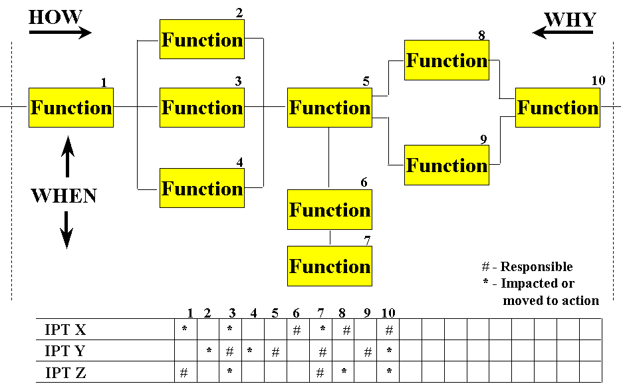
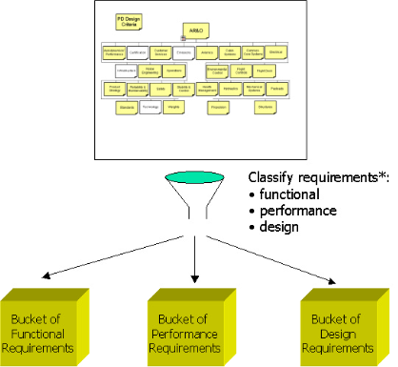
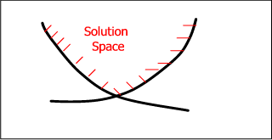
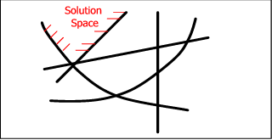
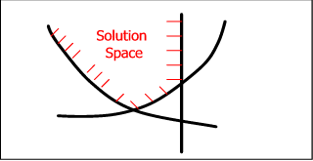
Identify Required Functionality and Requirements
FAST Models
Functional Architecture
(System Requirements Model e.g. SLATE)
Functional Architecture
Data Flow Diagrams
Requirements Analysis
Requirements Loop
Functional Analysis/Allocation
Design Loop
Design Synthesis
Verification
Functional Analysis
Identifying Gaps
Capturing Requirements
Decomposition
Architecture Validation
Building Architectures
Solution Space
Airplane/Vehicle
Airplane function decomposition
Requirements set
for each function:
Performance
Reliability
Safety
Cost
Etc.
Allocation of functions
& rqmts to “systems”
Autopilot System
decomp
Hydraulic System
decomp
Wing Structure
decomp
Requirements set for each function:
Performance
Reliability
Safety
Cost
Etc.
Notes:
Customers don’t want our products…..they want the functionality of the product at a reasonable price.
The team convenes to understand the performance requirements and their boundaries.

Slide 12

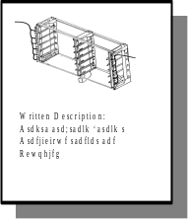
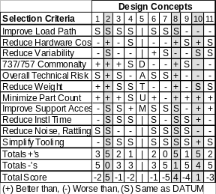
Lean Design
FASTENING
Group 1
Group 2
Group 3
Snap
Together
Clamp
Part
Press
Together
Power
Screw
Manual
Screw
0
3
4
11
2
15
3
4
5
3
3
1
?
X2
X2
2
3
4
7
0
3
8
3
4
5
3
Spread
Glue
Blind
Rivet
Bucked
Rivet
Drill
Hole
Ream
Hole
?
X2
X2
5
5
15
15
8
0
3
8
3
4
5
3
DFMA Training
Attribute Grading
Process Mapping
Down Select
Combine & Select
Generate Ideas
Prototyping

Slide 13
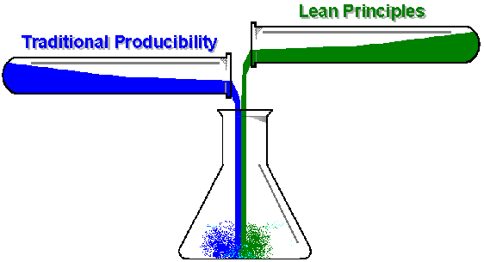
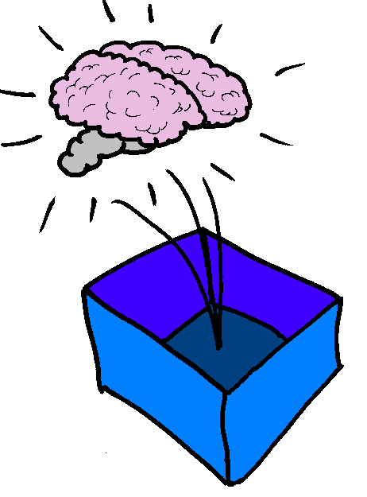
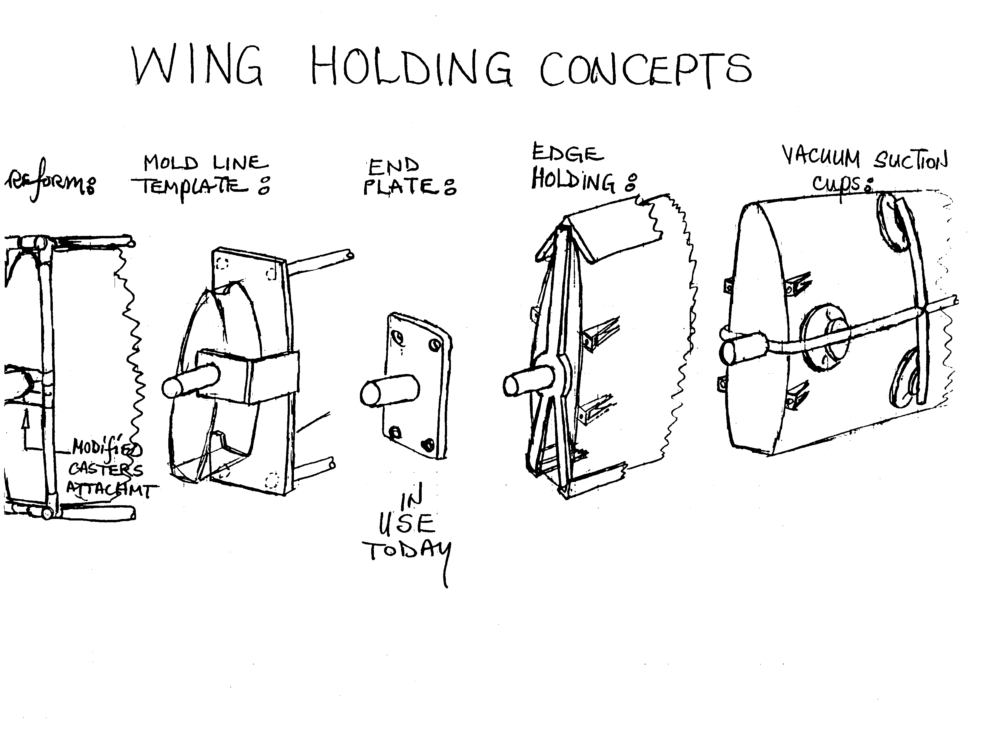
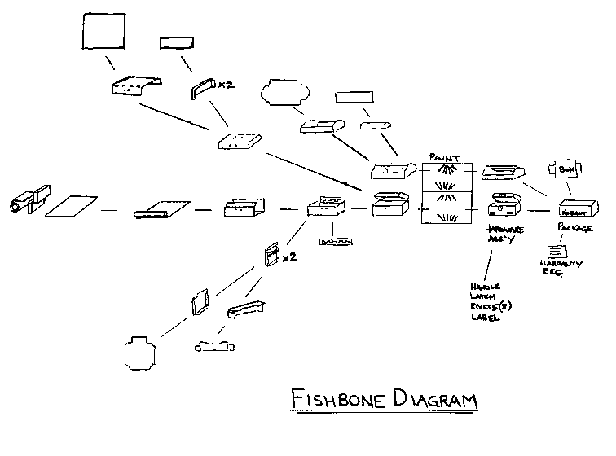
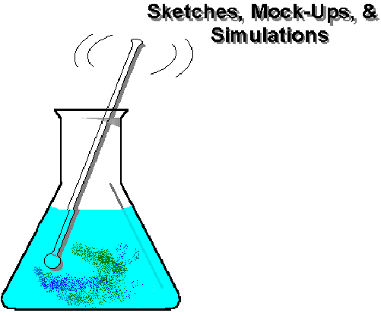
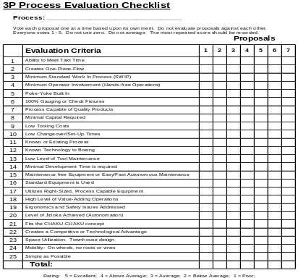
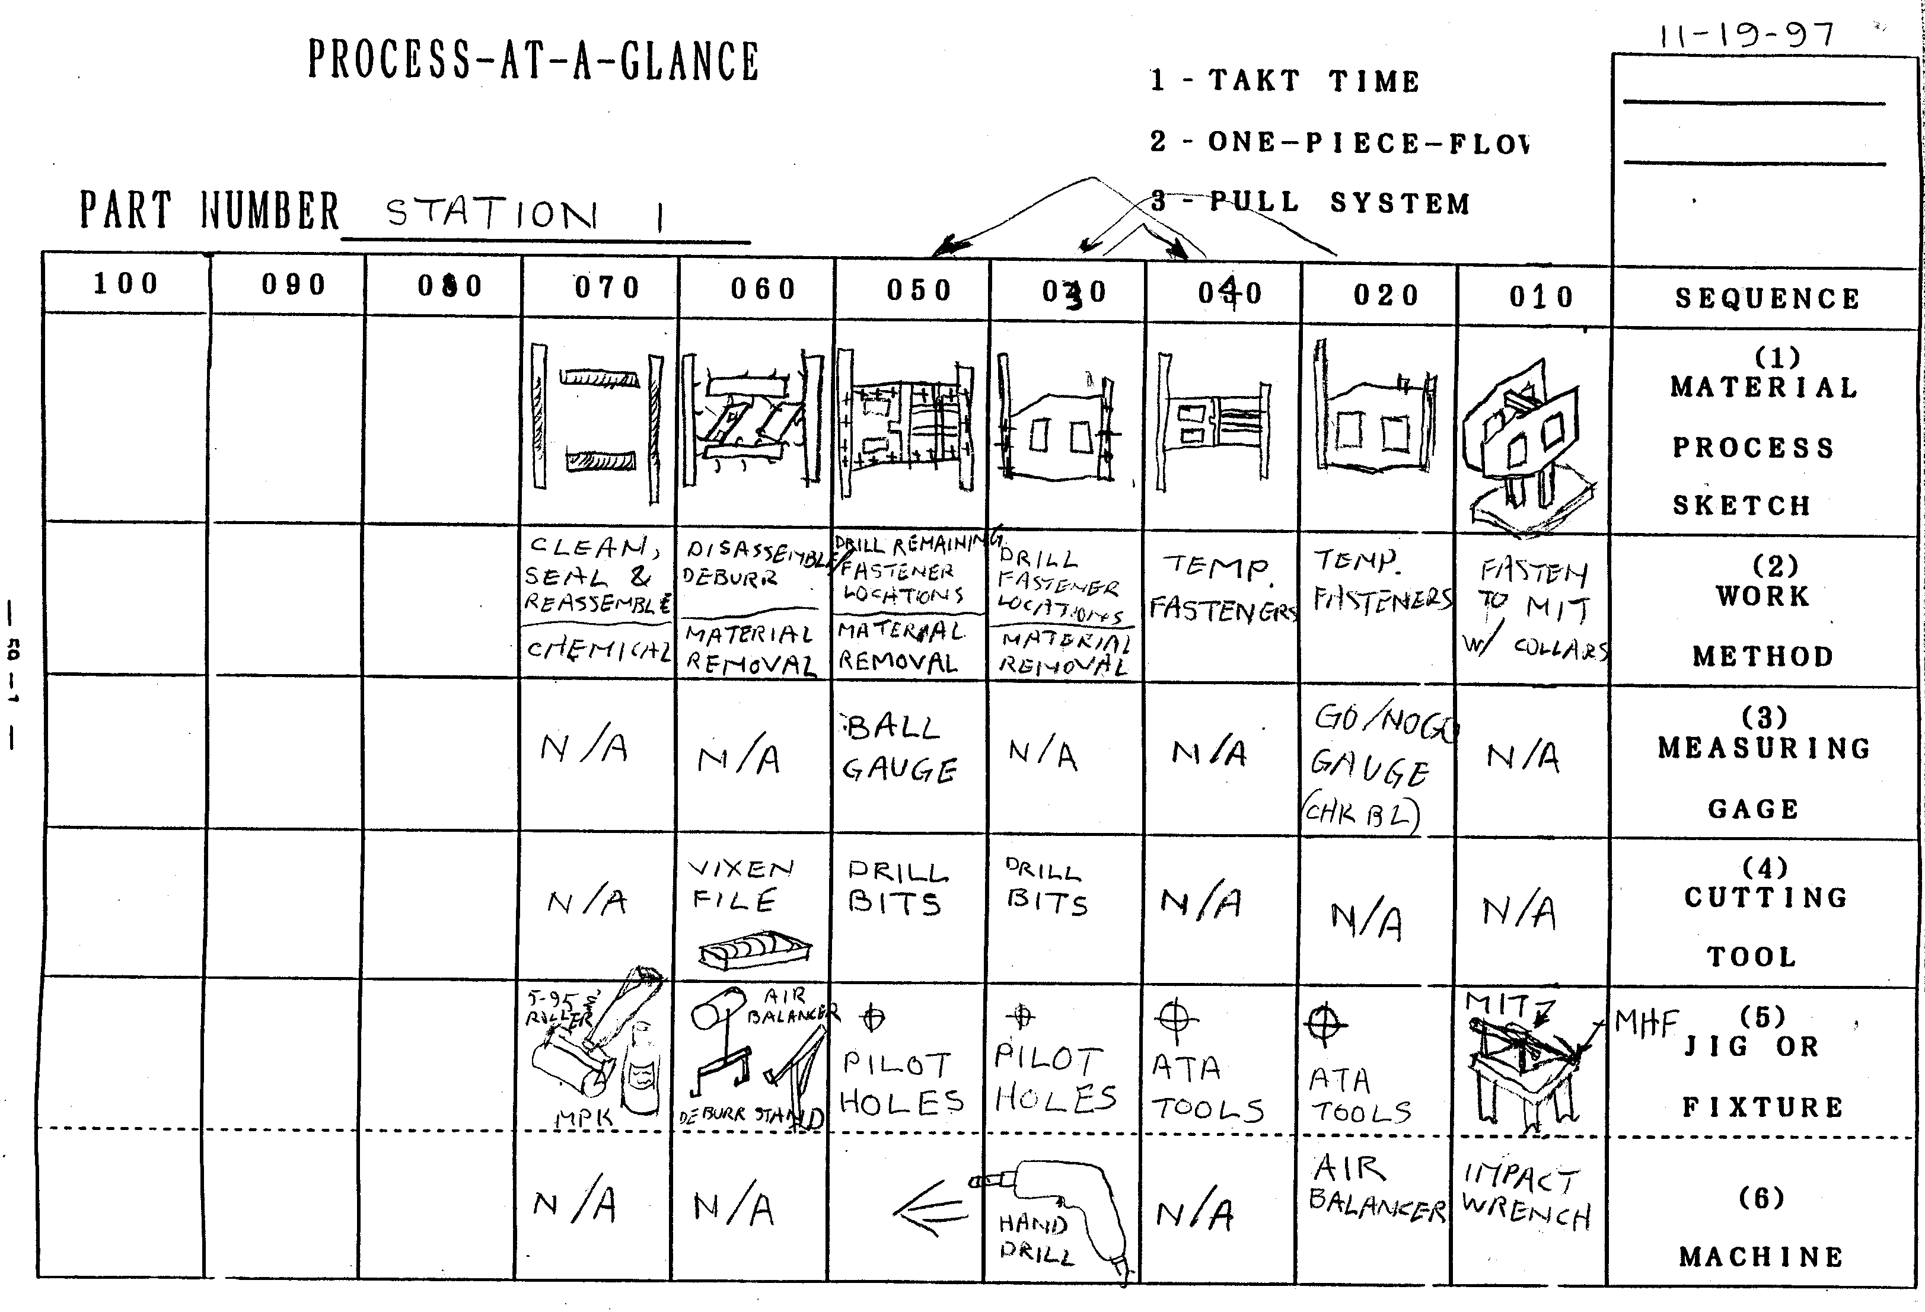
Production Preparation Process
3P Training
Process at a Glance
Fishbone Diagrams
Evaluation
Moonshine
Brainstorming
Simulations

Slide 14
Integration Point: Value and Waste
Doing The Right Thing
is the main focus of
Value Engineering
(Function/Cost balance)
(Customer Perceived Value)
Doing Things Right
is the main focus of
Lean and Six Sigma
(Process Improvement)
(Customer Satisfaction)
VE = Only Value
Lean = No Waste
e.g., Function Analysis
Systems Technique
(FAST)
e.g., Value Stream/
Value Chain
Mapping
Both Are Required
to increase Boeing profit
Source of information is BCA SE website
Notes:
Common technique for “Defining The Right Thing”. VA/VE takes waste out of requirements while Lean takes waste out of the process. Lean+ provides methods for integrating SE activities
The slide is based on a book entitled, “Commit to Quality” by Robert Townsend

Slide 15
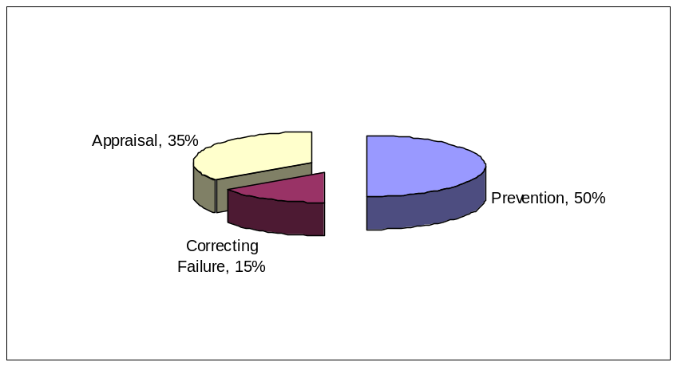
Cost of Quality: Pay Me Now Or Pay Me Later
The Defense Acquisition University (DAU) SYS201A course asks students to, “Choose the best breakdown of costs for achieving quality from the following pie charts.
A B C
Prevention 20% 25% 50%
Correcting Failure 47% 25% 15%
Appraisal 33% 50% 35%
The answer given was, “Ideally prevention should be 50%, appraisal should be 35% and correction of failure should be only 15% of the cost of achieving quality.”
Quantifying the cost of quality for the systems engineering efforts into these three buckets to evaluate the cost of quality for systems engineering. It may be helpful to publicize best practice (Ideals) SE percentages for each bucket for various program types.
Notes:
Pie chart information is from SYS201A course at http://www.dau.mil/schedules/schedule.asp

Slide 16

Lean Design/Build Roadmap
REQUIREMENTS/
OBJECTIVES (VE)
LEAN DESIGN
(DFMA)
PRODUCTION
PREPARATION
(3P)
Divergent
Convergent
CONCEPT
PRODUCT
Divergent
Convergent
VISION
VISION
Divergent
Convergent
Design Process Flow
Convergent
Divergent
Divergent
Convergent
Lean Design meets customer needs by providing the best value solution for the entire value stream
Divergent
Convergent
TRIAL
Function Brainstorming
Attributes Mining
Requirements mining
Configuration Analysis
Customer Surveys
Requirements Brainstorming
Shop / Customer Tours
Functional Mapping
Requirements Mapping
Dimensioning the Model
Paired Comparison
Consensus
Goal Setting
Scope and Boundaries
Constraints Identification
Report Out
Process Mapping
Map Grading
Benchmarking
Lessoned Learned
Nature
Defect Reports
Key Technology Reviews
Brainstorming
Idea Sheets
Shop / Customer Tours
Multi Voting
GFI Voting
Attributes Evaluation
Categorizing
Concept Building
Mapping Evaluation
Concept Prototyping
Report Out
Value Stream Process Walking
Fishbone Mapping
Benchmarking
Seven Ways
Seven Designs
Physical Prototyping
Brainstorming
Shop / Customer Tours
Evaluation
Down Selecting
Process at a Glance
Try Storming
Voting
Physical Prototyping
Moonshine
Validation
Simulation
Report Out
TOOL KIT
Formal Release
Notes:
Divergent Convergent process is repeated in an iterative fashion as the design progresses from Airplane/Vehicle > major systems > Major Subsystems > Subsystems > etc.
e.g. should we use hydraulic or electric brakes > how should we attach the brakes > how should we transport power > etc.

Slide 17
Additional Resources
Boeing Enterprise-Wide Value Methodology Home Page http://vm.web.boeing.com/index.htm
Lawrence D. Miles Value Engineering Reference Center http://wendt.library.wisc.edu/miles/index.html
Value Engineering Handbook http://rtoc.ida.org/ve/documents/IDAPaperP-4114.pdf
SAVE International http://www.value-eng.org/
Defense Acquisition Guidebook http://www.acq.osd.mil/se/publications.htm
DAU Hot Topics Forum, July 12, 2006 https://acc.dau.mil/CommunityBrowser.aspx?id=105657
Defense Acquisition University (DAU) Continuous Education website https://learn.dau.mil/html/clc/Clc.jsp "CLE001 Value Engineering"
DoD Value Engineering Website http://rtoc.ida.org/ve/ve.html
FAST Description - Department of Energy's (DOE) Scientific and Technical Information. http://www.osti.gov/bridge/servlets/purl/8929-OkjsUp/native/8929.PDF
Integrated Defense Acquisition, Technology, & Logistics Life Cycle Management Framework IDAT&LLCMgt Framework

Slide 18
backup

Slide 19
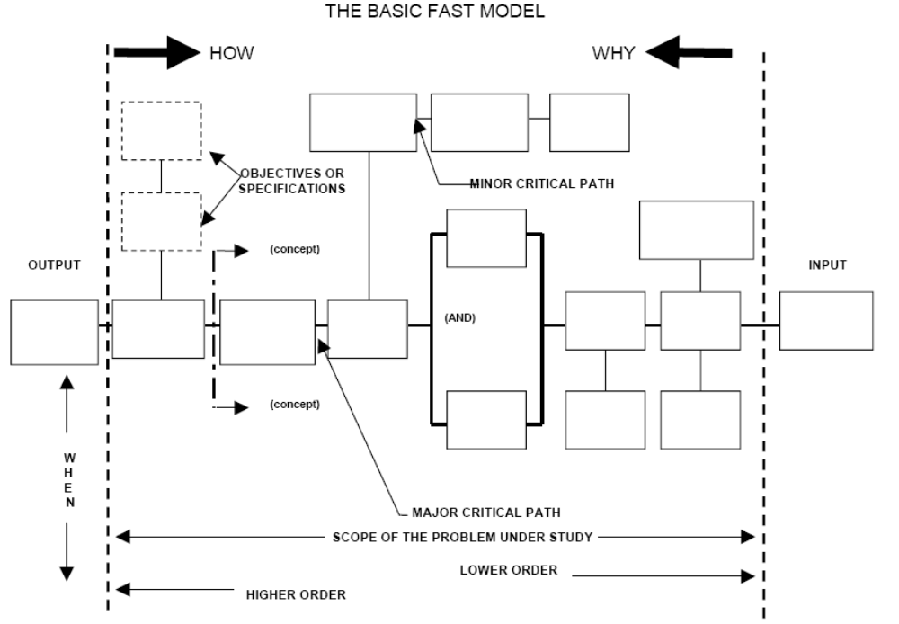
The Basic FAST Model
Notes:
The example comes from:
http://www.osti.gov/bridge/servlets/purl/8929-OkjsUp/native/8929.PDF
Function Analysis and Decomposition Using Function Analysis Systems Technique by J. R. Wixson June 6, 1999 – June 10, 1999, International Council on Systems Engineering Annual Conference (INCOSE ’99)

Slide 20
An Example
FAST Diagram for:
SUPPORT LIFE “MARS HABITAT”
SUPPORTING FUNCTIONS
060000 Assure Convenience
061000 Stores Equipment
062000 Facilitate Service
062100 Facilitate Fabrication
062200 Facilitate Repair
063000 Facilitate Eating
064000 Segregate
065000 Instruct User
070000 Assure Dependability
071000 Isolate Catastrophe
072000 Maintain Task
072100 Resist Deformation
072200 Resist Corrosion
072300 Minimize Breakdowns
073000 Protect Surroundings
080000 Satisfy User
081000 Minimize Disorder
081100 Maintain Health
081200 Allow Recreation
081300 Furnish Solitude
082000 Optimize Payload
082100 Minimize Space
082200 Minimize Weight
082300 Minimize Materials
083000 Cooks Food
084000 Refrigerate food
090000 Attract User
091000 Add Color
092000 Project Substance
093000 Decorate interior
BASIC FUNCTIONS
010000 Receive Utilities
011000 Receive Power
012000 Receive Water
020000 Enclose Space
021000 Allow Access/Ext
022000 Establish Boundaries
030000 Contain Atmosphere
031000 Maintain Pressure
032000 Furnish Oxygen
033000 Furnish Buffer
040000 Contain Environment
041000 Remove Contaminants
041100 Collect Waste
041200 Remove Waste
042000 Shield Radiation
043000 Resist Contaminants
044000 Heat/Cool Space
050000 Control Environment
051000 Aid Rest
052000 Supply Water
053000 Supply Food
Notes:
Functions identified at http://wendt.library.wisc.edu/miles/ve_studies/marsfast.pdf

Slide 21
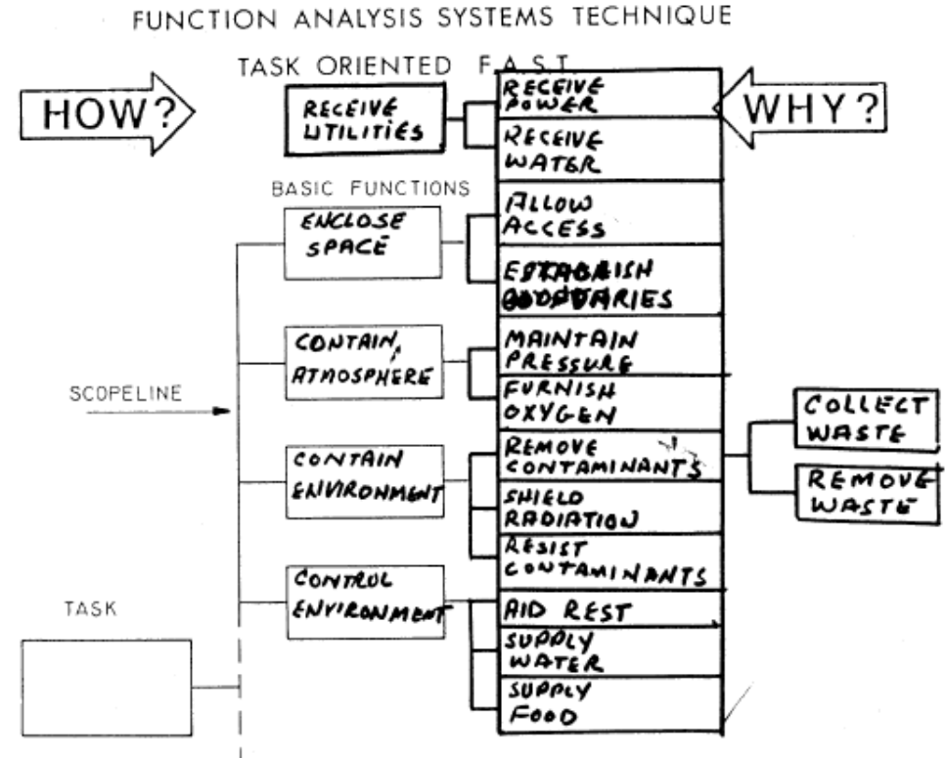
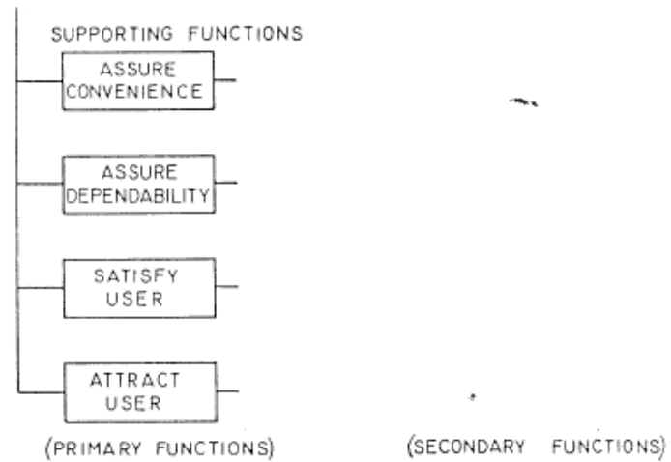
An Example continued
FAST Diagram for:
SUPPORT LIFE “MARS HABITAT”
Support Life
Notes:
Functions identified at http://wendt.library.wisc.edu/miles/ve_studies/marsfast.pdf

