Slide 1
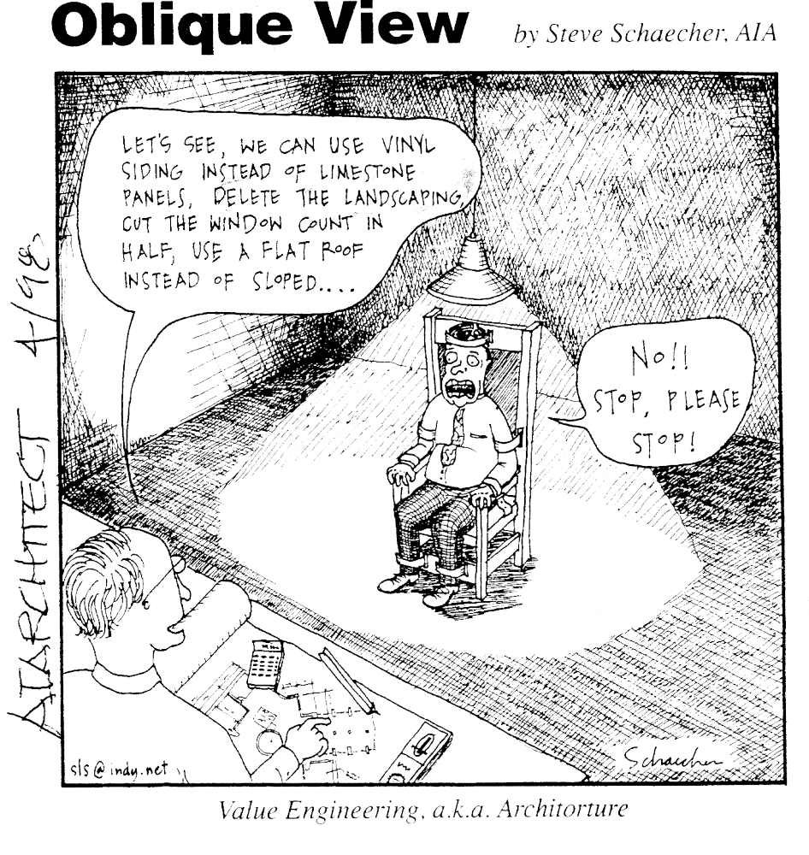
What is Value Analysis?
Value Engineering a.k.a. Architorture”

Slide 2
Value Analysis is….
“an organized team study of functions to creatively generate alternatives which will satisfy the users needs at the lowest initial and/or life-cycle cost”

Slide 3
Value Analysis is NOT…..
A COST CUTTING PROGRAM!!!!
  Cost cutting programs cut costs regardless of how they affect the product.
  Any product can be cut in costs!
JUST A HURDLE TO JUMP THROUGH

Slide 4
Value Analysis IS about…..
Sound, Defensible, Value-based Decision Making
Providing essential functions for an appropriate cost
Benefit to Cost Relationships and working both sides of the equation.
Managing the Decision Points
Making better decisions!!!

Slide 5
Why do Value Analysis…..?
To improve benefit or reduce cost….
Notes:
66

Slide 6
Value Analysis Job Plan
Information Phase (Investigation)
Functional Analysis Phase (Analysis)
Creativity Phase (Speculation)
Evaluation Phase
Development Phase
Recommendation Phase (Presentation)
Implementation Phase
Notes:
68

Slide 7
INFORMATION PHASE

Slide 8
Information Phase
Understand the function and purpose of the project by gathering relevant information.
Review base data
  Stakeholders
  Building Program
  Current Alternatives

Slide 9
FUNCTIONAL ANALYSIS PHASE

Slide 10
Functional Analysis
Park Purpose and Significance -- ? Exist for Monument Open Space/Monument Fire Center?
Program
What does a facility need to do?
How do you do it?
Why do you do it?

Slide 11
Functional Analysis
Fast Diagram
Functional
Analysis
System
Technique
Notes:
OVERHEAD PROJECTOR FOR FAST WORK

Slide 12
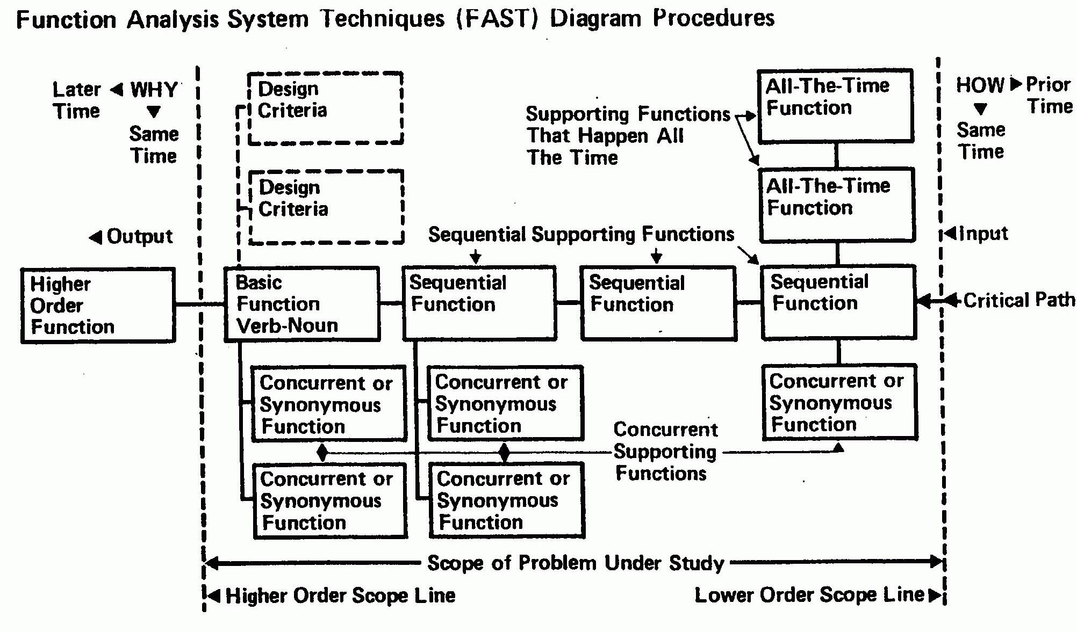
FAST Diagramming

Slide 13
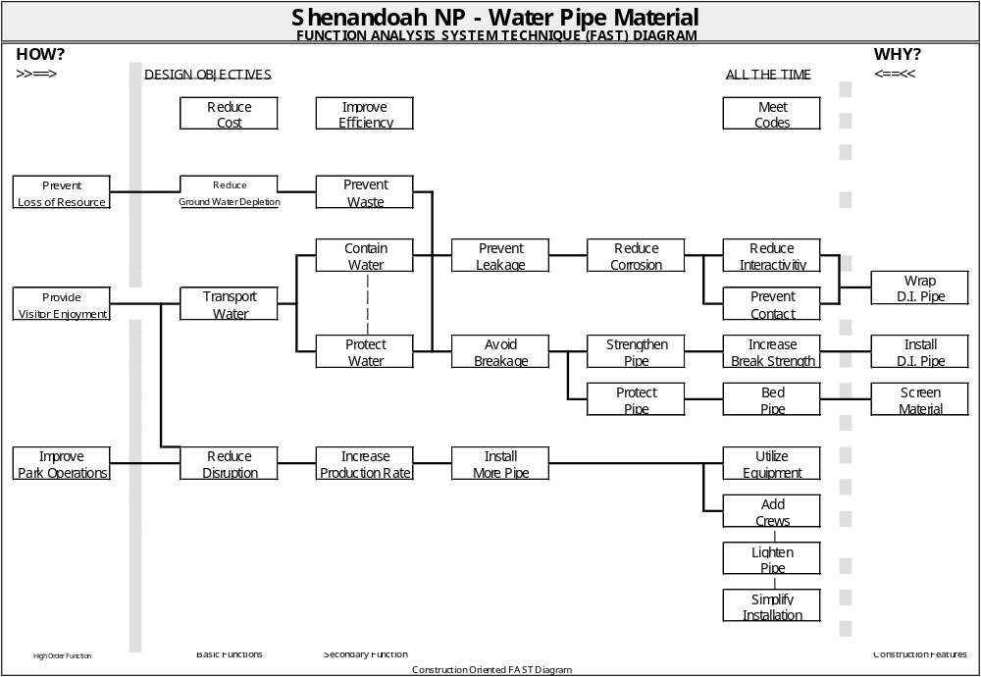
Functional Analysis
Notes:
a functional portrait of the project

Slide 14
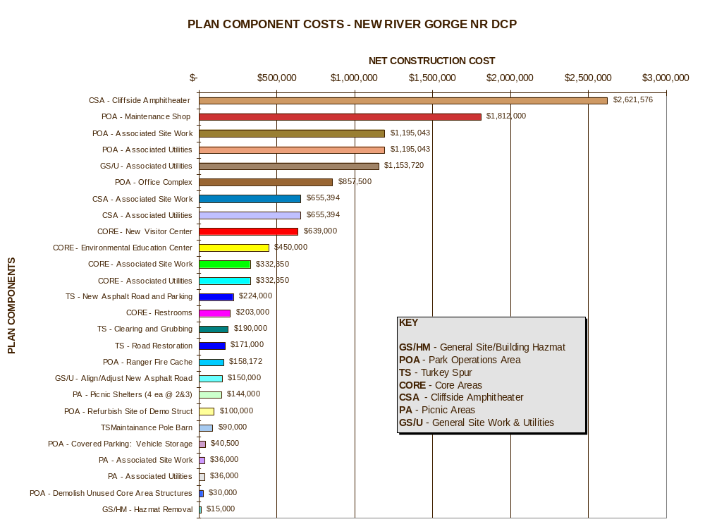
Cost Model

Slide 15
What areas should we focus on?

Slide 16
CREATIVITY PHASE

Slide 17
Creativity Phase
"Brain-storm" alternative methods of achieving the required functions of a project.
Ideas are not evaluated, since criticism of an idea could discourage participation, decrease the flow of alternatives, and inhibit the creative endeavor.
Promote and encourage sustainable concepts and other policy objectives
Keywords: Brainstorming, Deferred Judgment, Options, Alternatives

Slide 18
Roadblocks to new ideas….
It needs higher approval
Its too ambitious for us
We did it this way the last time
We have no problems now…why change
If you want a quick answer it is…NO!!
It does not agree with the guide specs
It’s against our policy
That’s not the way it’s done around here

Slide 19
Roadblocks to new ideas….(cont)
It won’t work
It’s too much trouble to phase in
We tried that 10 years ago, and it didn’t…
Let maintenance take care of that
Let operations handle it
Notes:
1797 the farmers union reponce to the cast iron plow was ti would poison the soil and casuse weed to grow
German experts proved in 1820’s that trains traveling over 15MPH would cause blood to spurt from travelers noses, and they would suffocate in tunnels
Iron ships will not float
in 1888 Architectural News said steel skyscrapers will expand and contract and all the outside plaser will fall off, leaving nothing but steel skeletons in just a few years.
Psychiatrists in the US stated that the introduction of railroas would reuire aslums, because of the terror of seeing a locomotive
Joshua Coppersmith was arrested in Boston for trying to sell telephone stock. The judge upheld a conviction because “All well infomed people know that it was impossible to transmit human voice by wire”
Creativity, getting out of the rut, changing views are a very important part of Value Analysis. It trys to get people to look at things in new ways, evaluate and identify functions, and seek better ways to accomplish that function at the best possible value

Slide 20
EVALUATION
PHASE

Slide 21
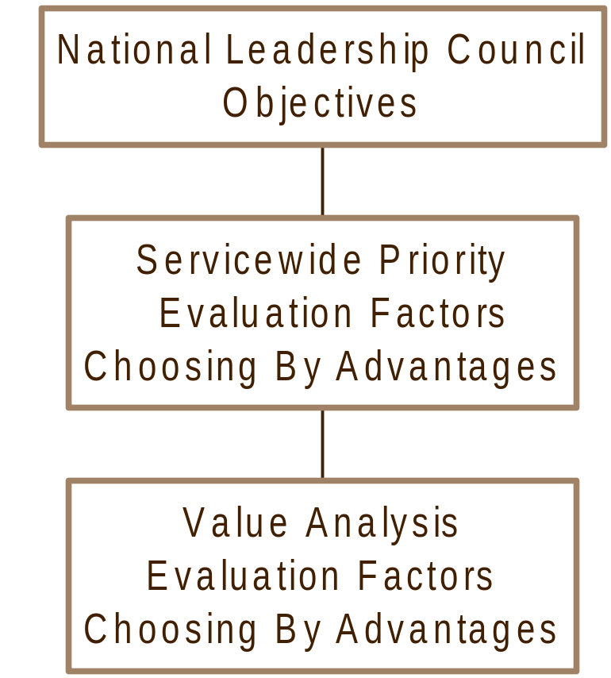
Evaluation Factors
Notes:
69

Slide 22
Objectives
Protect cultural and natural resources
Provide for visitor enjoyment
Improve efficiency of forest operations
Provide cost-effective, environmentally responsible, and otherwise beneficial development for the national forest system
Notes:
26

Slide 23
Evaluation Factors
Prevent loss of resources
Maintain or improve condition of Resources
Provide visitor services and educational and recreational opportunities including accessibility
Protect public health, safety, and welfare
Improve operational efficiency and sustainability
Protect employee health, safety, and welfare
Provide other advantages to the national forest system
Notes:
27

Slide 24
CHOOSING BY ADVANTAGES
A DECISION MAKING PROCESS

Slide 25
CBA Purpose.......
To simplify, clarify and unify decisionmaking
To quantify non-monetary benefits or advantages

Slide 26
Effective Decisionmaking
Doing the Right Things Right - the First Time, Every Time, and On Time - in a manner that is acceptable to various stakeholders who may have conflicting values and preferences

Slide 27
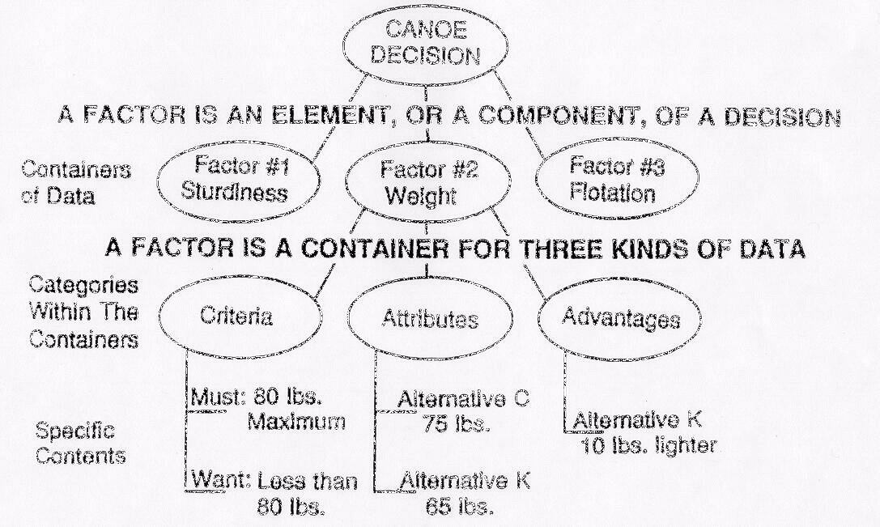
Definitions

Slide 28
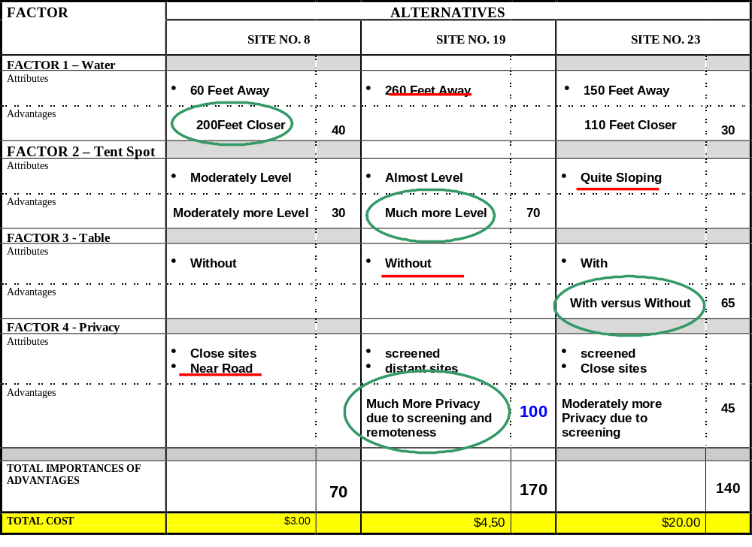
CBA Matrix...

Slide 29
DEVELOPMENT PHASE

Slide 30
Development Phase
Best alternatives are developed into proposals for final evaluation and presentation.
Initial Cost Estimates
Life Cycle Cost Estimates

Slide 31
Money Decisions Require Special Methods
The Principle of Interdependency: A dollar spent for one purchase is not available for another
Wellington’s Rule: “No increase of expenditure over the unavoidable minimum is expedient or justifiable, however great the probable profits and value of the enterprise as a whole, unless the INCREASE can with reasonable certainty be counted on to be, in itself, a profitable investment.”

Slide 32
Money Decisions Require Special Methods
An increment is increase in cost, coupled with an increase, a decrease, or no change in total importance of advantages, or benefits.

Slide 33
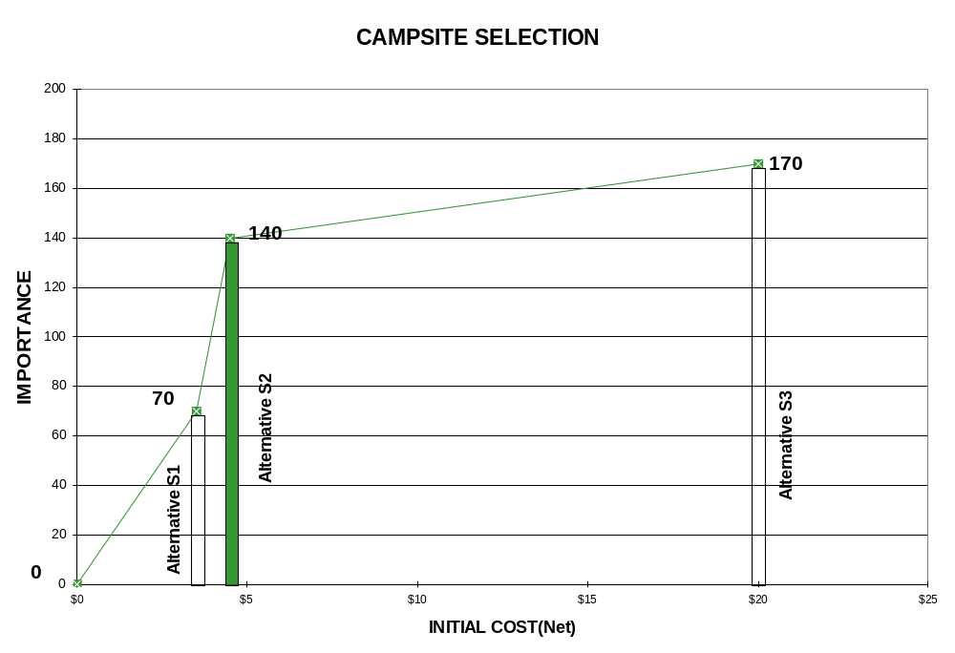
Importance to Cost Graph

Slide 34
Life Cycle Cost is….
“Life cycle costing is the development of all significant cost of ownership of an item, system, or facility, over a specified length of time”

Slide 35
Life Cycle Cost
Development Phase
Initial Cost
  Cost associated with initial development of a facility, including project costs as well as construction costs.
Recurring/Cyclic Costs
  Costs that recur on a periodic basis throughout the life of a project.
Annual Cost
  Operations
  Maintenance
  Staffing
  Energy

Slide 36
RECOMMENDATION and
PRESENTATION
PHASE

Slide 37
Recommendation and
Presentation Phase
Review Decisions
Make Recommendations
Conduct Presentation
Summarize
Wrap-up

Slide 38
IMPLEMENTATION
PHASE

Slide 39
Implementation Phase
Occurs outside the workshop and provides for implementation of accepted VA proposals.
Follow Through
Documentation
Monitoring

