Slide 1

1. value
portfolio

Slide 2
1.1 index

Slide 3

3. resources
Aula 1 - Lexicon/Process

Slide 4
2. summary
V
1. ENGINES
1. project
what

Slide 5
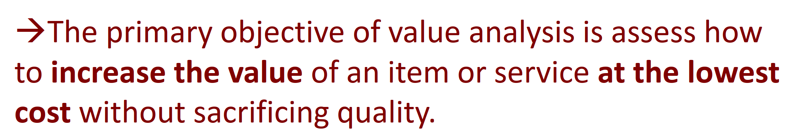
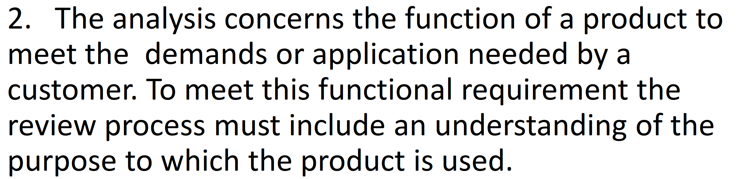
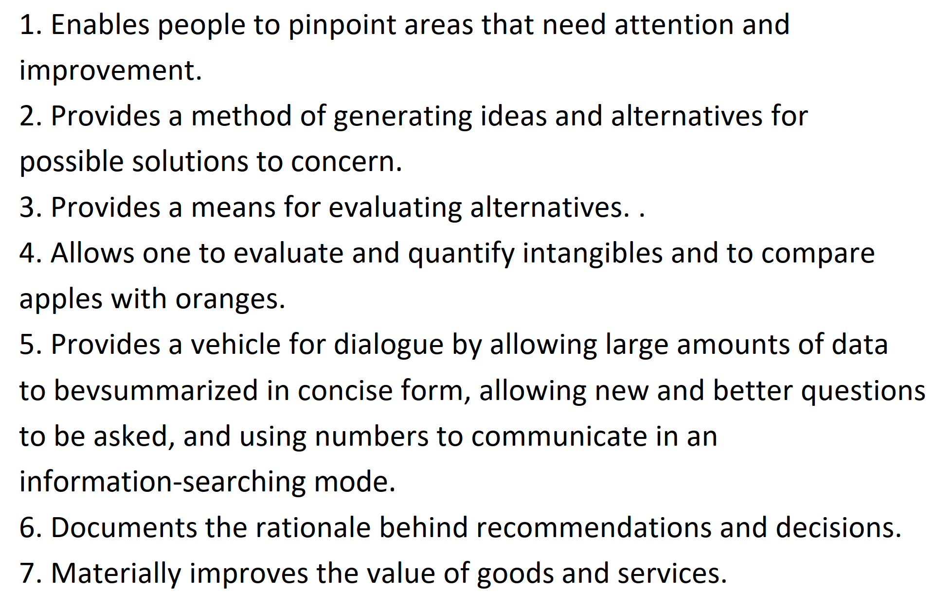
3. lexicon
value analysis
Aula 1 - Lexicon

Slide 6
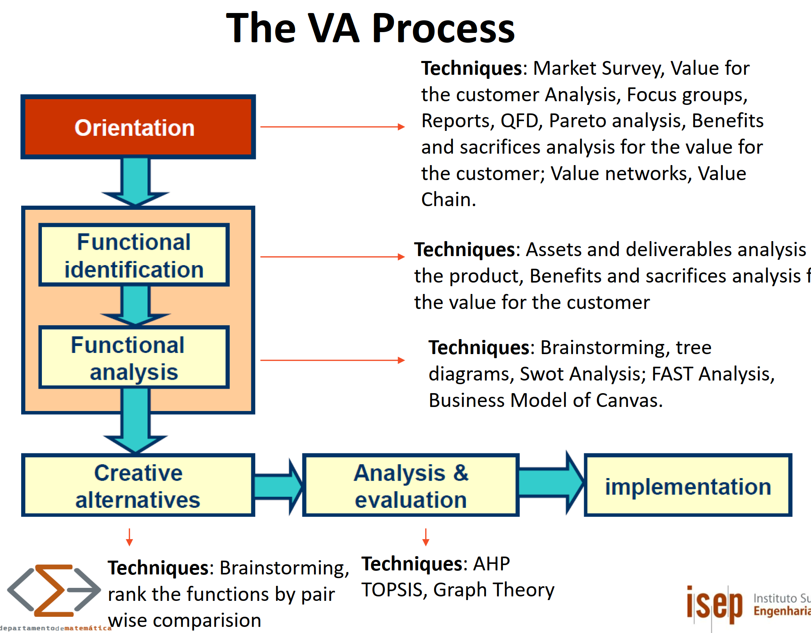
4. process
Aula 1 - Lexicon/Process

Slide 7





Z. template
new project
ExecuteAsync
square post-it
download
  exe
download
  exe
why
A slash
  followed
by
  two consecutive asterisks
D:\A1_research\C2_c0dice\B1_jmeter\A1_install
functionalities
introduction
build-exe
entity framework plus
zig help
⊂
4
every key-frame
defines the operation
success

