Slide 1
1. functional
class vs function
https://iamshadmirza.com/class-vs-function-based-programming-simplified
oop vs functional
https://medium.com/@shaistha24/functional-programming-vs-object-oriented-programming-oop-which-is-better-82172e53a526

Slide 2
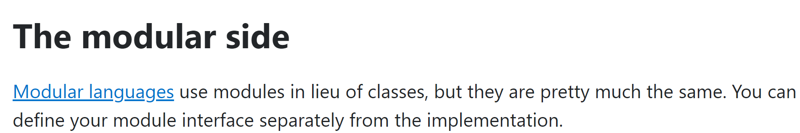
2. encapsulation
what
functional-programming-oop-and-data-hiding

Slide 3
3. state
what
classes imply state
only in the definition of object
see oop.pptx
functional denies state
what is state?
advantages vs disadvantages
see chrome bookmarks

Slide 4
4. paradigms
what
functional programing
helps me
understand oop
because I need something to compare with
so I have to study other paradigms
see their advantages and desevantages

Slide 5

5. books
Composing Software
Complexity and Reuse Design

Slide 6
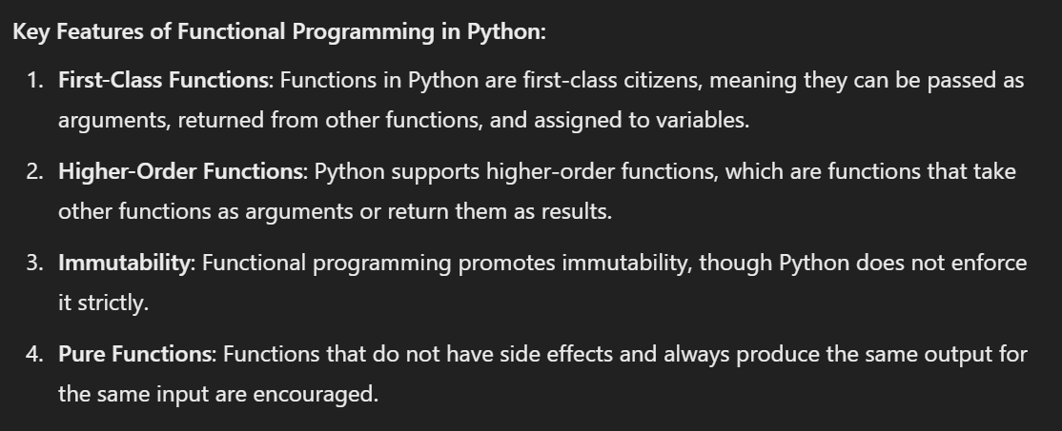
6. what
to be done

Slide 7
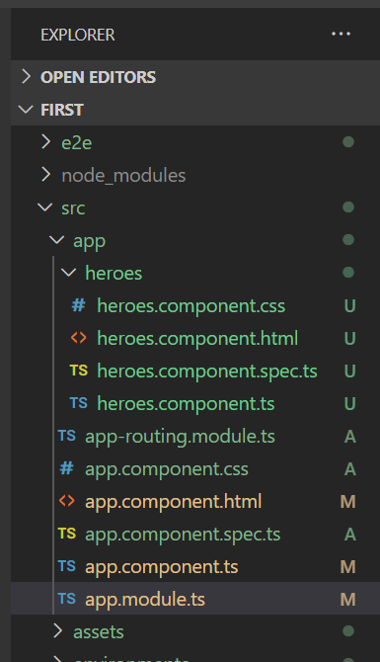
Z. template
new project
⊂
ExecuteAsync
square post-it
A slash
followed
by
two consecutive asterisks
then
a slash
matches
zero
or
more
directories
express
every key-frame
defines the operation
being executed
d:\research\A2_se\A2_architecthure
success
4

