Slide 1

1. ➔ OOP
what
wikipedia/object oriented programming
pillars
four-pillars-of-object-oriented-programming
Abstraction
Encapsulation
Inheritance
Polymorphism
why-favor-composition-over-inheritance-java-oops-design
objectives
reusability
modularity
execution context
this
variable range
where the code lives
encapsulation
interface
namespaces
scope
lifetime
transient
scoped
singleton
static
why
wikipedia/scope
closure

Slide 2
1.1 types
prototype
wikipedia/Prototype-based_programming
classes

Slide 3

1. ➔OOP
pillars
https://javarevisited.blogspot.com/2013/06/why-favor-composition-over-inheritance-java-oops-design.html
Abstraction
Encapsulation
Inheritance
Polymorphism
objectives
reusability
modularity
book
D:\bibliography\A1_calibre\OO\Grady Booch\A1 Object Oriented Analysis and Desi (5)\A1 Object Oriented Analysis and - Grady Booch.pdf

Slide 4
1.1 objects
D:\bibliography\A1_calibre\OO\Unknown\A3A3 oop (4)\A3A3 oop - Unknown.pdf
Objects are collections of operations that share a state.
The operations determine the messages (calls) to which the object can respond,
while the shared state is hidden from the outside world
and is accessible only to the object's operations.
Variables representing the internal state of an object are called instance
Variables and its operations are called methods.
Its collection of methods determines its interface and its behavior.
description
Programs in procedure-oriented languages are action sequences.
In contrast, object-oriented programs are collections of
interdependent components,
each providing a service specified by its interface.
Object-oriented program structure directly models interaction among objects of an application domain
goals
Splitting a large task into components is a time-honored method of managing complexity,
variously referred to as "divide and conquer" and "separation of concerns".
Computers have hardware components while data structures have array and record components.
Software components arise in decomposing computational problems into subproblems
that cooperatively determine the solution to the complete problem.
Software components include
functions, procedures, and objects
as well as concurrently executable components such as processes, actors, and agents.
components

Slide 5
1.2 abstraction

Slide 6
1.3 encapsulation
what
oop-concept-for-beginners-what-is-encapsulation
an information hiding mechanism
encapsulation is not information hiding

Slide 7
1.4 inheritance

Slide 8
1.4.1 composition over extension
reasons
https://javarevisited.blogspot.com/2013/06/why-favor-composition-over-inheritance-java-oops-design.html
break encapsulation
access internal state of master class
extension hierarchy
https://www.youtube.com/watch?v=wfMtDGfHWpA
references need graph not tree
multiply inheritance

Slide 9
1.5 polymorphism

Slide 10

1.6 state
what
stateful-or-stateless-classes
oop classes without properties
google

Slide 11
1.7 types
what

Slide 12
3. ➔GRASP
https://en.wikipedia.org/wiki/GRASP_(object-oriented_design)
General Responsibility Assignment Software Patterns (or Principles), abbreviated GRASP, consist of
guidelines for assigning responsibility to classes and objects in object-oriented design.
It is not related to the SOLID design principle.
controller
creator
Indirection
Information expert
cohesion
coupling
protect variations
fabrication

Slide 13
3.1 controller

Slide 14
3.2 creator

Slide 15
3.3 indirection

Slide 16
3.4 information expert

Slide 17
3.5 cohesion

Slide 18
3.6 coupling

Slide 19
3.7 protect variations

Slide 20
3.8 fabrication

Slide 21
4. ➔LIMITATIONS
https://blog.mgechev.com/2015/07/29/aspect-oriented-programming-javascript-aop-js/
The object-oriented programming paradigm is powerful.
We design an OO system by:
decomposition of the problem domain,
following guiding principles concerning the decomposition and the communication between the different modules.
The process is structured;
It involves logical thinking,
understanding of the domain
and eventual predictions for the future evolution of the system.
Often we’re trying to keep our code
DRY (not always),
highly coherent and loosely coupled.
However, in some cases this is just impossible.
There are some code snippets we’re just blindly copying and pasting all around our code base.
Cross-cutting Concerns

Slide 22

5. books
new project
Object Oriented Analysis and Design

Slide 23
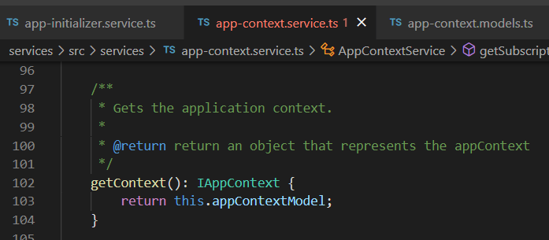
Z. template
new project
⊂
ExecuteAsync
square post-it
A slash
followed
by
two consecutive asterisks
then
a slash
matches
zero
or
more
directories
every key-frame
defines the operation
being executed
d:\research\A2_se\A2_architecthure
success
4
small talk versions and ide

