Slide 1

1. procedural
paradigms

Slide 2
1.1 index
to be done

Slide 3
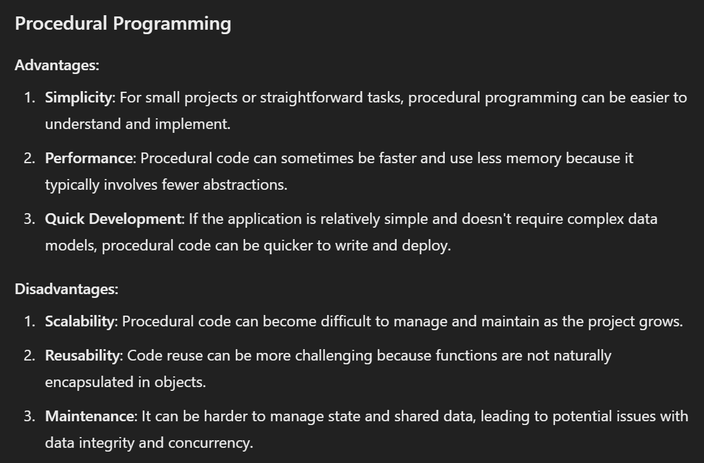
2. advantages
to be done

Slide 4
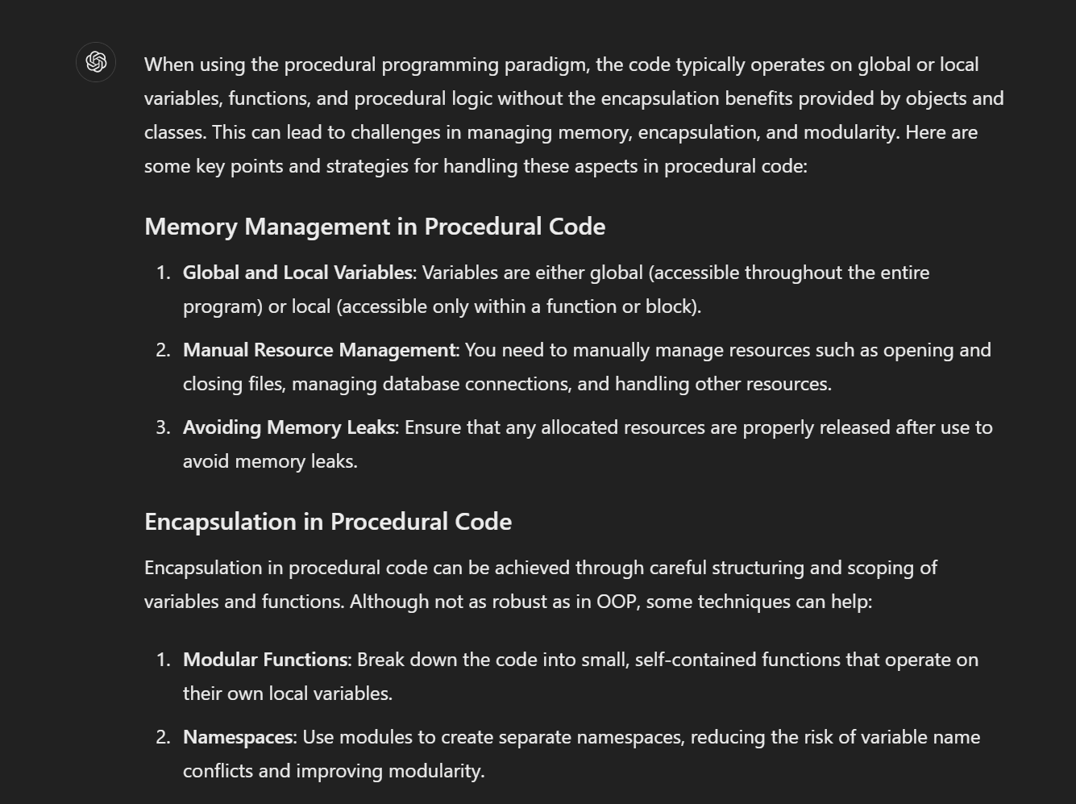
3. encapsulation
to be done

Slide 5
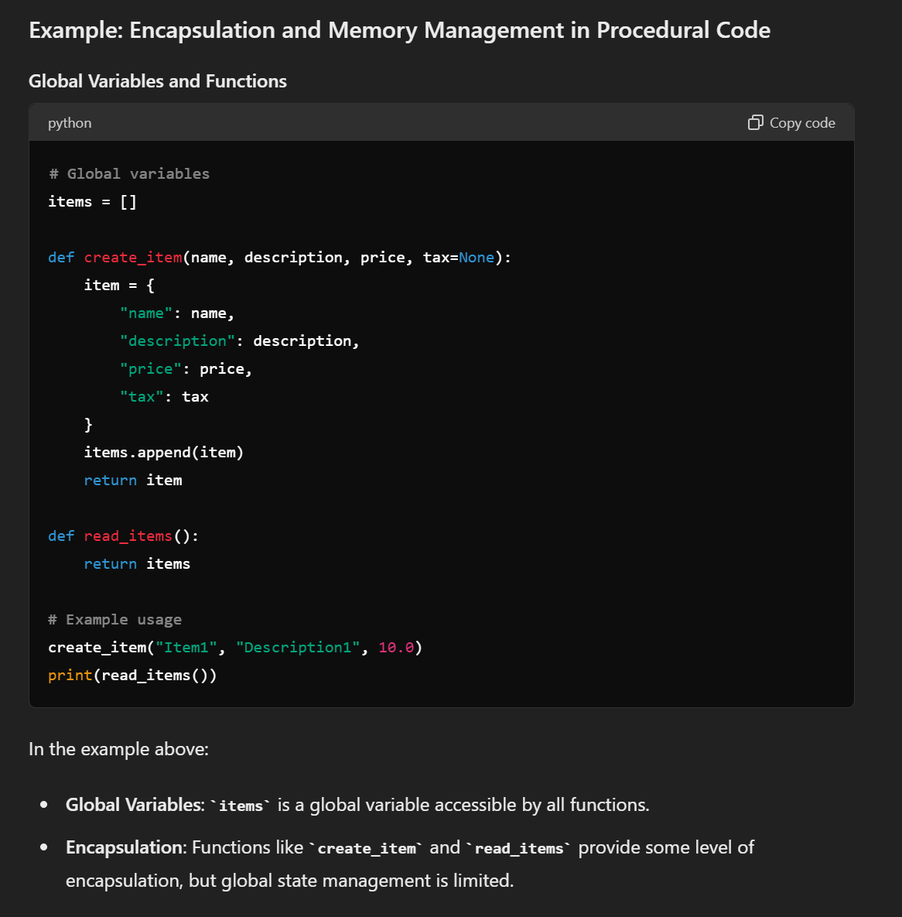
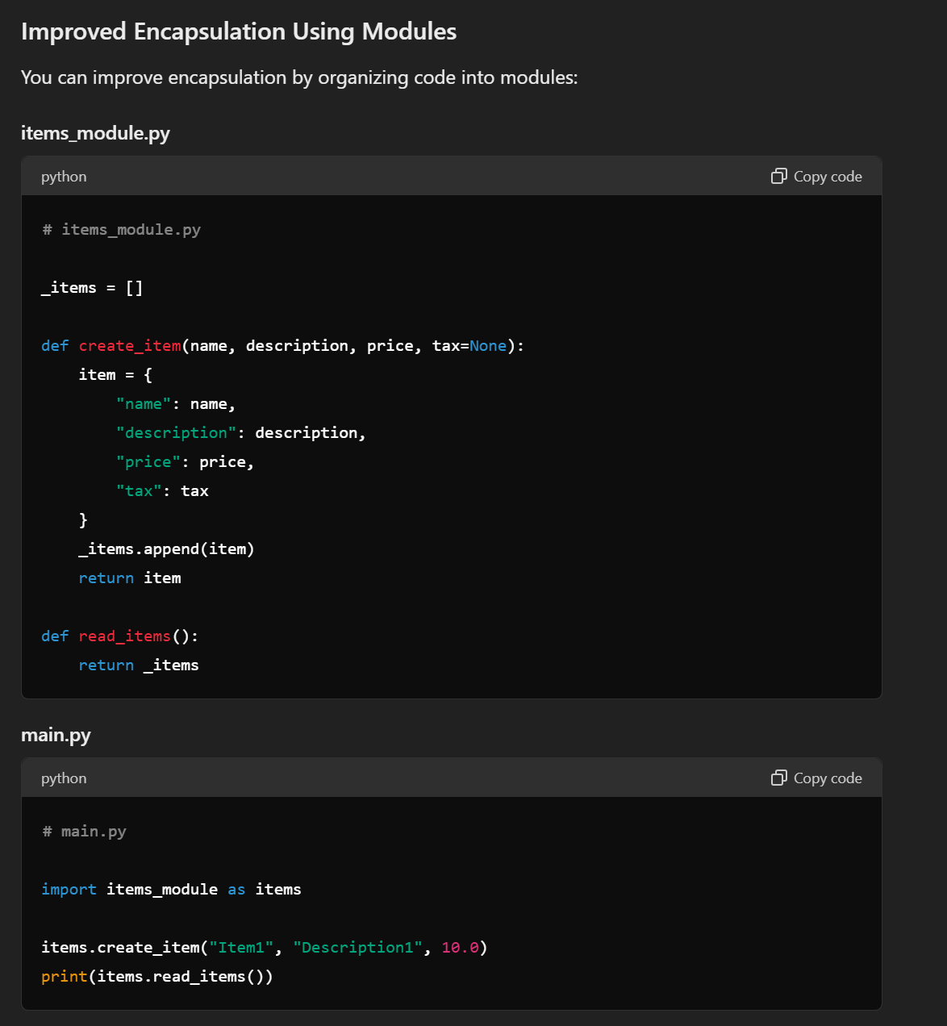

3.1 how
to be done

Slide 6
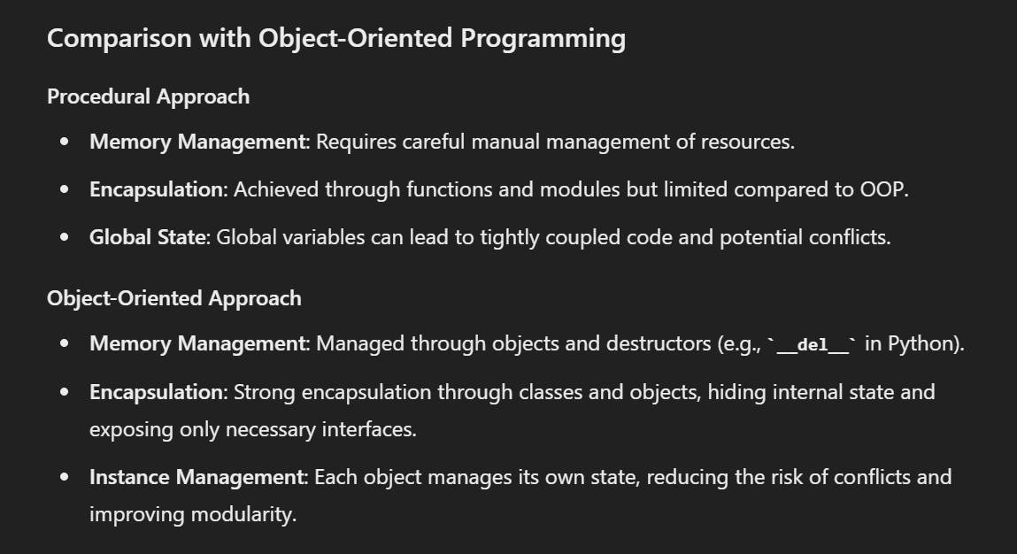
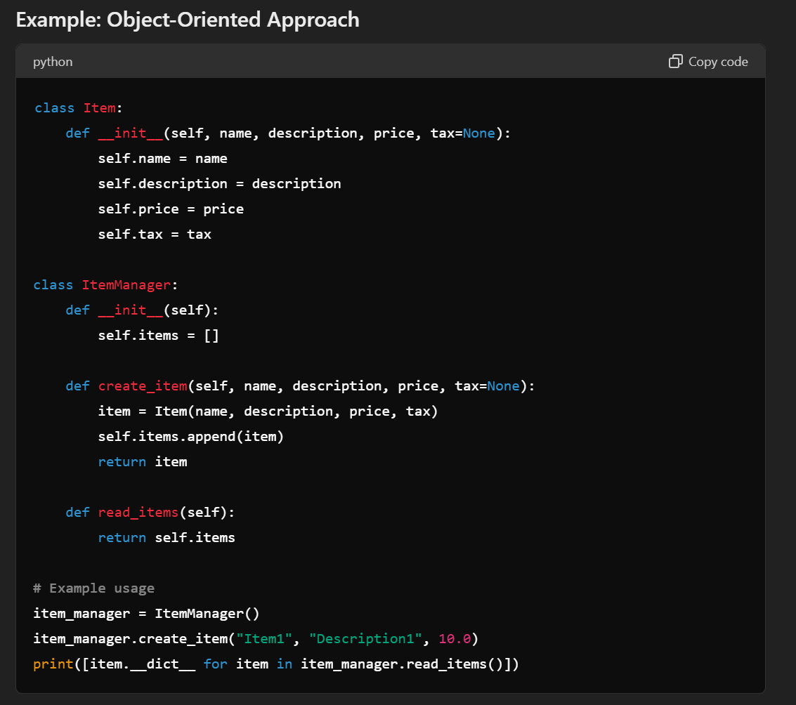
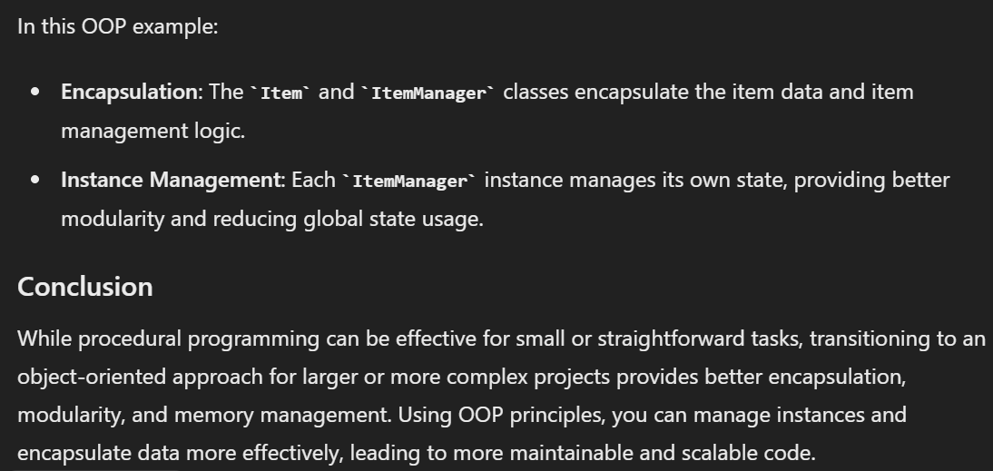
3.2 oop
to be done

Slide 7
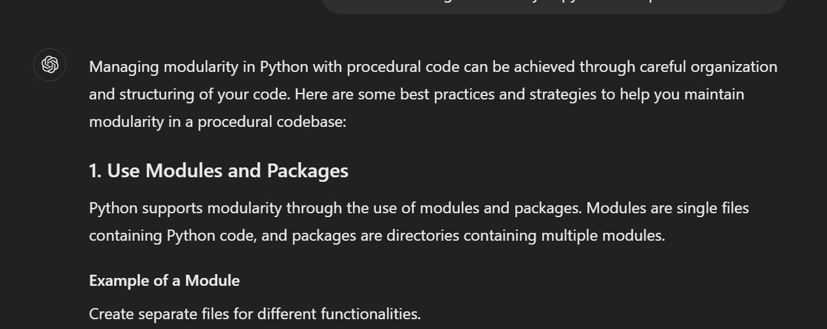
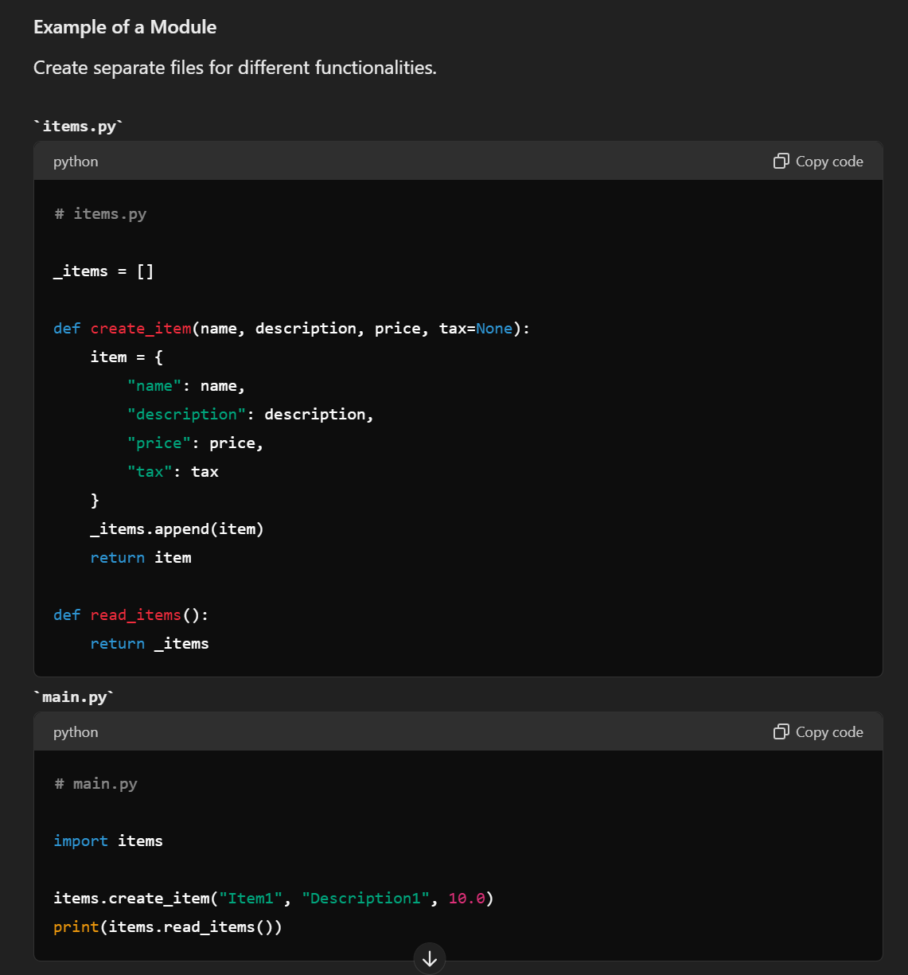
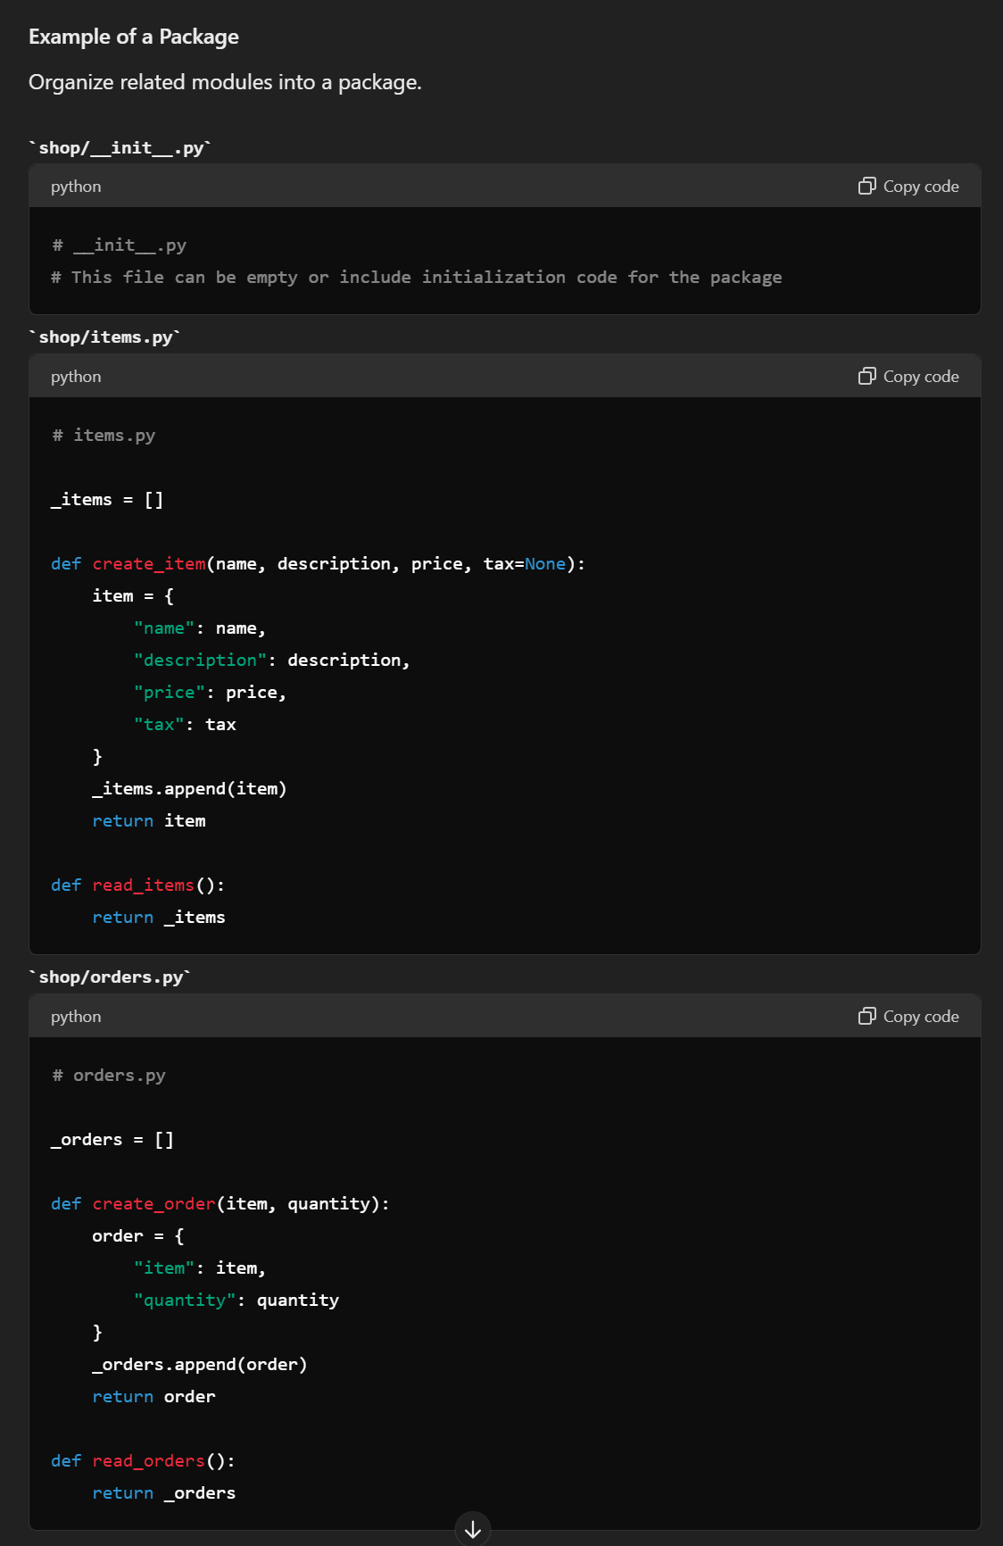

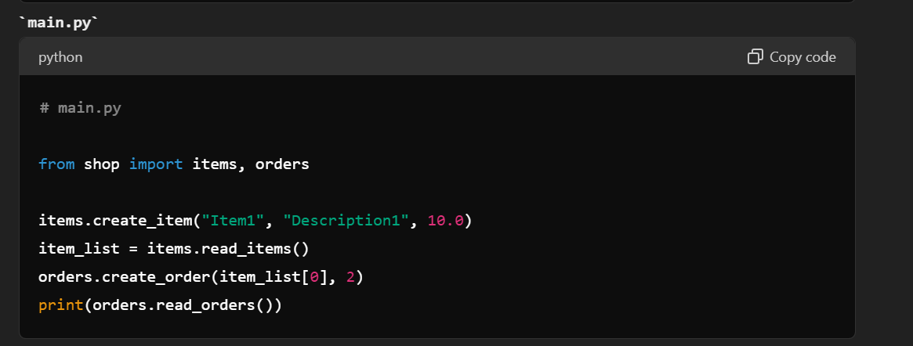
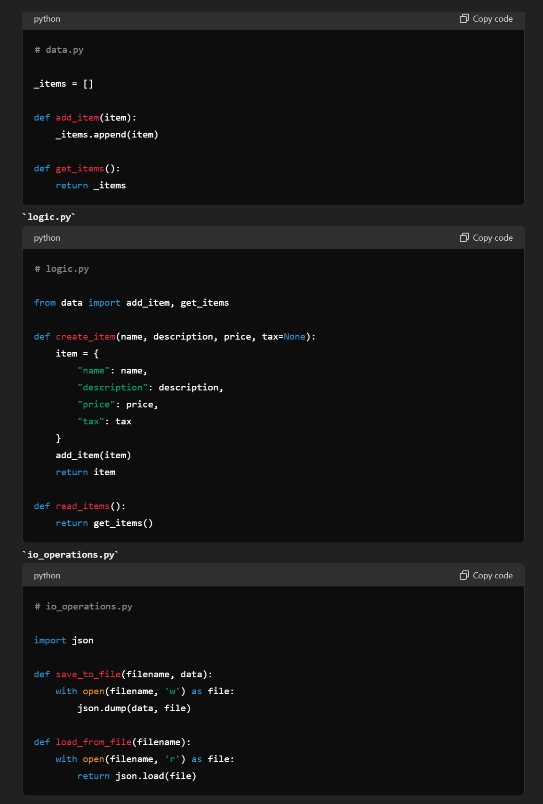
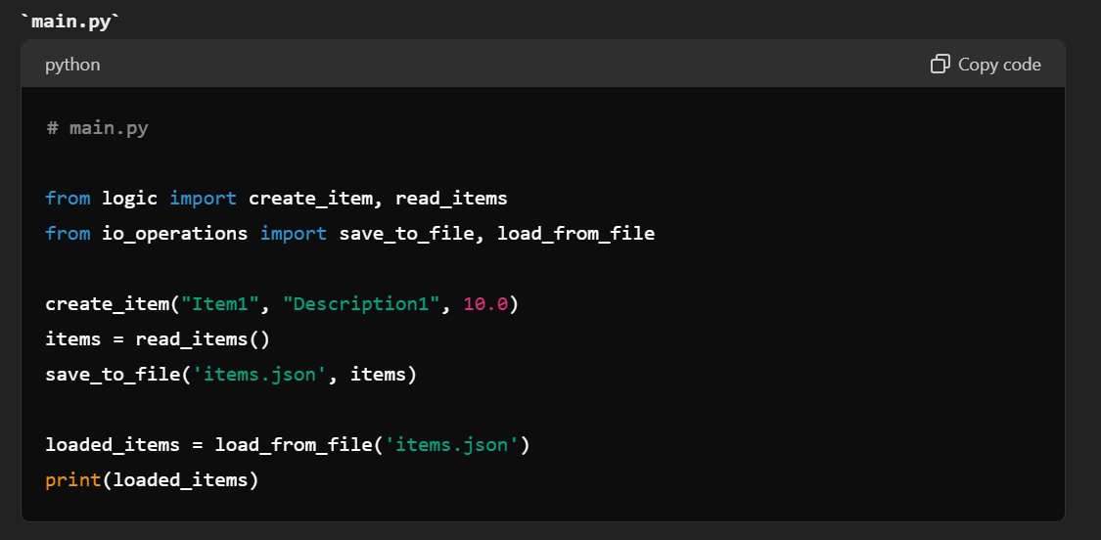

4. modularity
to be done

Slide 8
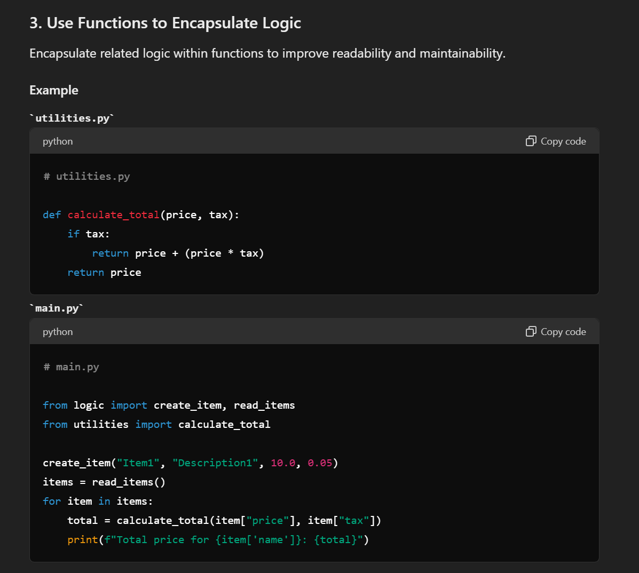
4.1 functions
to be done

Slide 9
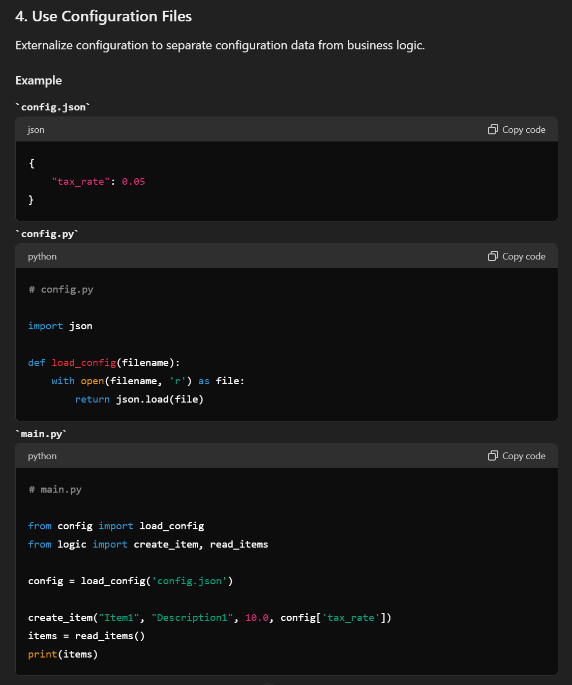
4.2 configuration
to be done

Slide 10
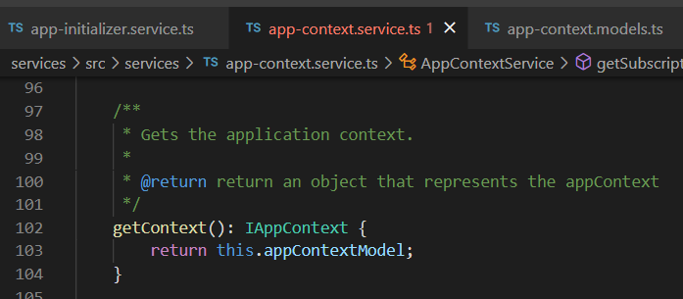





Z. template
new project
ExecuteAsync
square post-it
download
exe
download
exe
why
A slash
followed
by
two consecutive asterisks
D:\A1_research\C2_c0dice\B1_jmeter\A1_install
functionalities
introduction
build-exe
entity framework plus
zig help
⊂
4
every key-frame
defines the operation
success

