Slide 1

1. dependency inversion
python
clean

Slide 2


1.1 index
solid-principles-python/#dependency-inversion-principle-dip
_resources\dependency_inversion_python.pdf

Slide 3
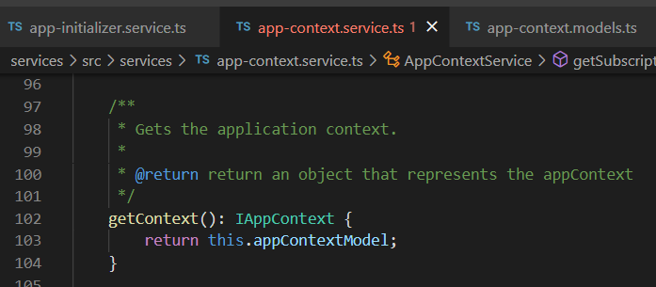

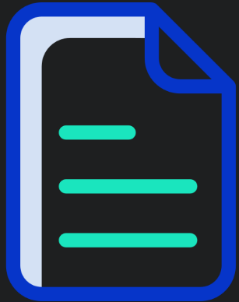

Z. template
new project
ExecuteAsync
square post-it
download
exe
download
exe
why
A slash
followed
by
two consecutive asterisks
D:\A1_research\C2_c0dice\B1_jmeter\A1_install
functionalities
introduction
build-exe
entity framework plus
zig help
⊂
4
every key-frame
defines the operation
success

