Slide 1

1. environment
python

Slide 2

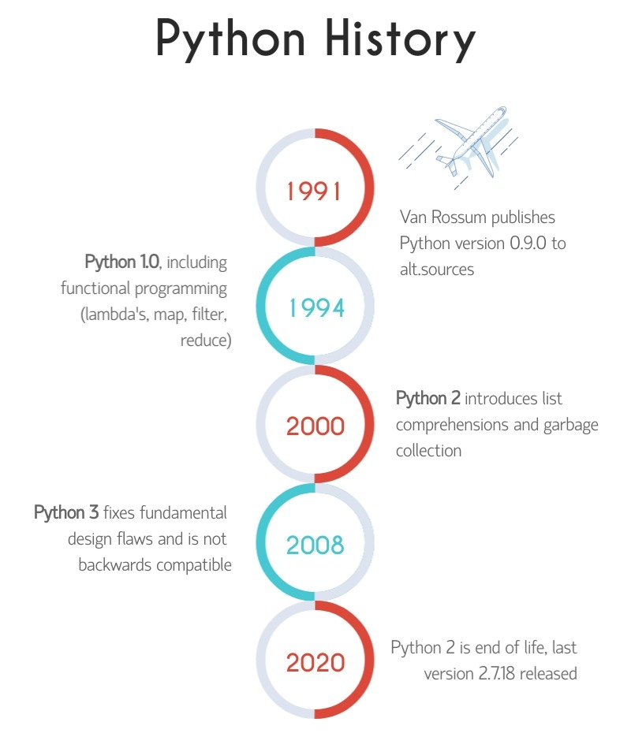

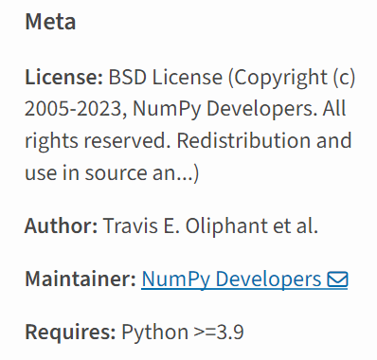

2. python
version
3.12
2
python package index
search
C:\Python312
numpy
1
2.x and 3.x: language syntax
2
packages compatibility
python tutorial/Why learn Python

Slide 3
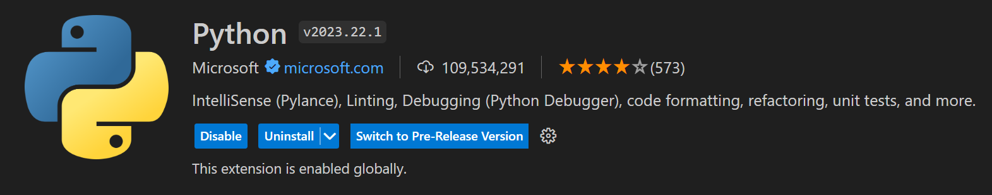
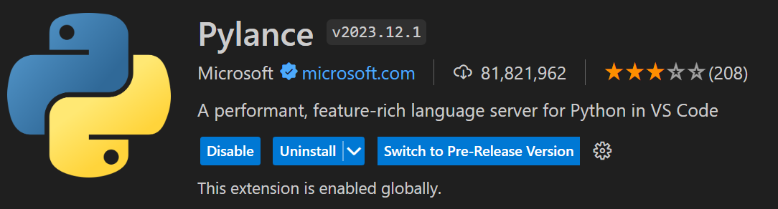
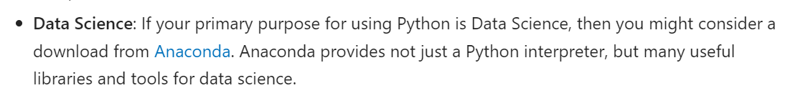
3. vsCode
tutorial
Getting Started with Python in VS Code
python-in-vsCode
extension
marketplace
data science

Slide 4
3.1 extensions
what
The Best VSCode Python Extensions
Python
You at least want to install the official Python extension for Python programming. It offers many features you’ll need, like IntelliSense, linting, debugging, code navigation, code formatting, refactoring, variable explorer, test explorer, snippets, and more. You’ll automatically get the Pylance plugin when you install this plugin.
Sonarlint
The Sonarlint plugin detects common mistakes and bugs. It detects many security and code quality issues and has saved me more than once. I highly recommend it. It’s not just for Python but also supports common languages like Java, JavaScript, TypeScript, PHP, and more.
MagicPython
MagicPython is a cutting-edge version of the default Python syntax highlighter in VSCode. You don’t need it unless you use cutting-edge Python versions, but I always install it just to be sure.
Python Indent
The Python Indent plugin helps you indent your code, especially when creating complex data structures between bracket pairs. E.g., when you create large nested lists, big dictionaries, etcetera.
autoDocstring
The autoDocstring extension helps you quickly generate docstring snippets.
Visual Studio IntelliCode
The Intellicode extension is a smart, AI-assisted code completion extension built by Microsoft. It supports Python, Java, JavaScript, and TypeScript. Changes are you already have this installed, though!
Python Extension Pack
If you want to get a nice selection quickly, you can also install the Python Extension Pack. I personally prefer to pick my own selection since packs like these may change their selection of extensions at any moment and perhaps add things I don’t want.
vscode-python-extensions

Slide 5
4. management
what
packages
pip
environments
python -m venv .venv
virtualenv
`venv` and `virtualenv` are both
tools used to create
environments
 | venv | virtualenv
Built-in vs. External | is a module comes with Python 3.3 built into Python | separate package need to install
Python version | System python | specify python version
System Site Packages | no access | can be configured
Legacy | > Python 3.3 | better

Slide 6
4.1 tools
what
 | pipenv | poetry
environments | automatically
dependency | Pipfile
locking | Pipfile.lock
dev/prod | yes
folder | <user folder>
commands | install: pip install --user pipenv packages: pipenv install <package name> activate: pipenv shell deactivate: exit

Slide 7
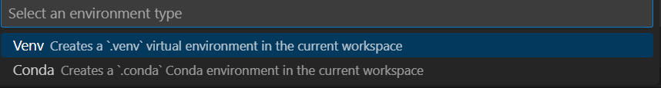
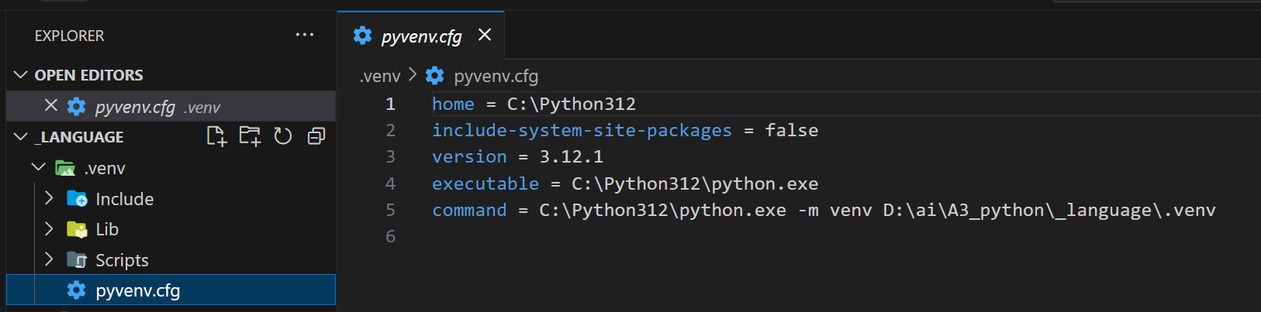
4. env
tutorial
Create virtual environment
what
once you activate an environment,
any packages
you then install
are isolated
from
other environments,
including
the global interpreter environment,
reducing many complications
that can arise
from
conflicting
package versions
error
CREATE VENV.UPGRADE PIP FAILED
run command in folder:
python -m venv .venv
success

Slide 8
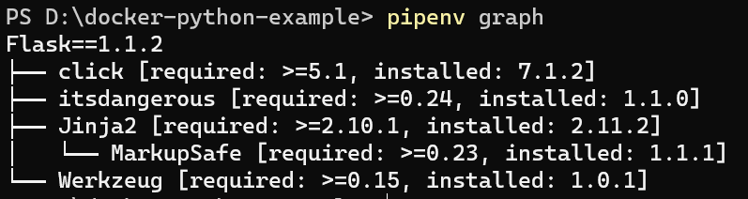
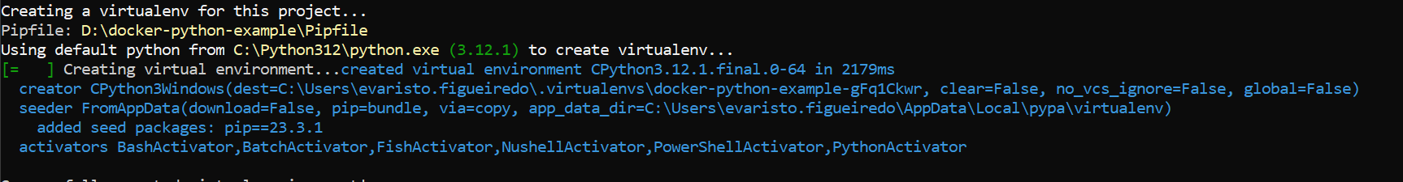
4.1 pipenv
tutorial
virtual-environments/pipenv
install
pip install --user pipenv
graph
install
without
any
packages
create
new virtual environment
based on
the information
in
your Pipfile
--env

Slide 9
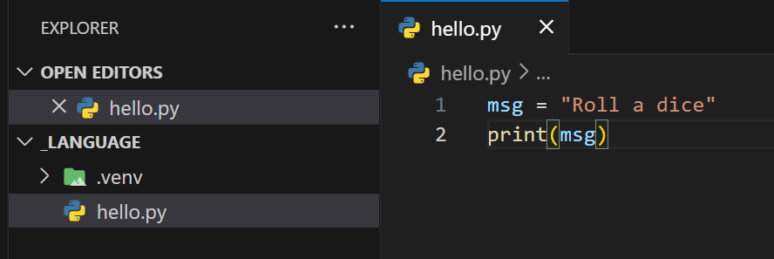
5. program
tutorial
create-a-python-source-code-file
what
msg = "Roll a dice"
print(msg)

Slide 10
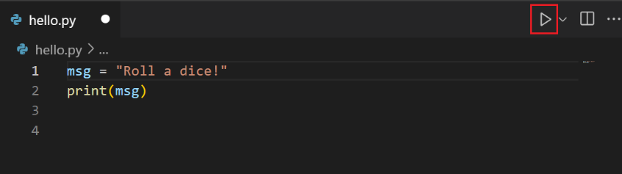
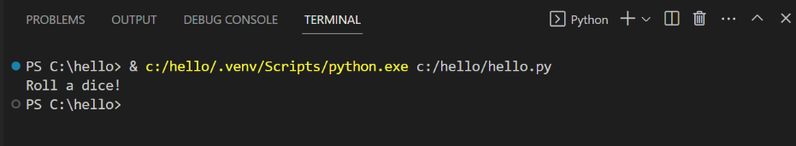
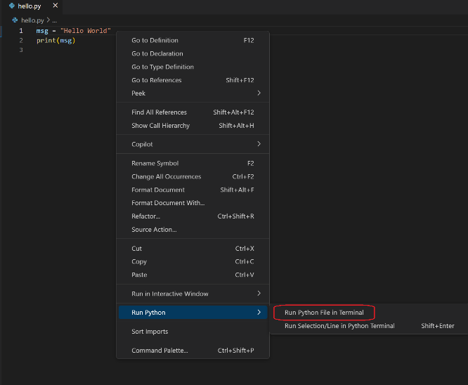
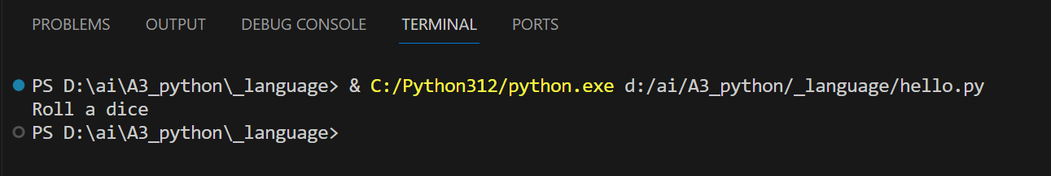
6. run
tutorial
run-python-code
what

Slide 11
7. debug
tutorial
configure-and-run-the-debugger
to be done

Slide 12
8. packages
tutorial
install-and-use-packages
to be done

Slide 13
9. next
tutorial
_install-and-use-packages
Next steps
To learn how to build web apps with popular Python web frameworks, see the following tutorials:
Use Django in Visual Studio Code
Use Flask in Visual Studio Code
Use FastAPI in Visual Studio Code
There is then much more to explore with Python in Visual Studio Code:
Python profile template - Create a new profile with a curated set of extensions, settings, and snippets
Editing code - Learn about autocomplete, IntelliSense, formatting, and refactoring for Python.
Linting - Enable, configure, and apply a variety of Python linters.
Debugging - Learn to debug Python both locally and remotely.
Testing - Configure test environments and discover, run, and debug tests.
Settings reference - Explore the full range of Python-related settings in VS Code.
Deploy Python to Azure App Service
Deploy Python to Container Apps
to be done

Slide 14
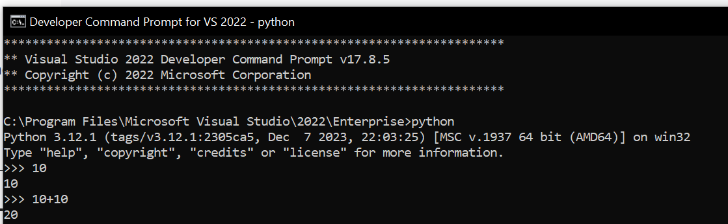
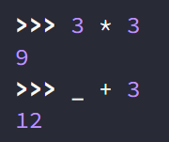
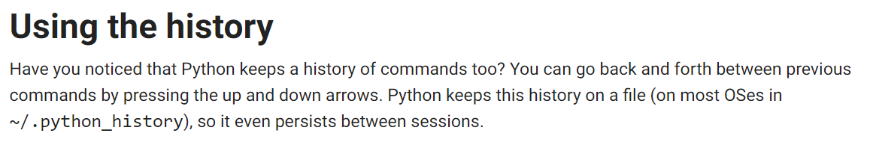
A. repl
what
underscore
history
exit
exit()
Ctrl-Z plus Return

Slide 15
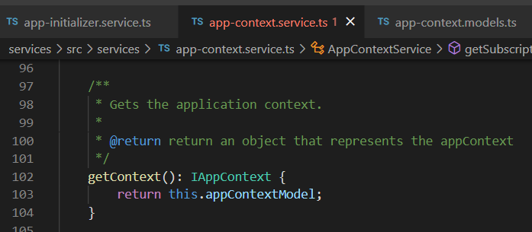

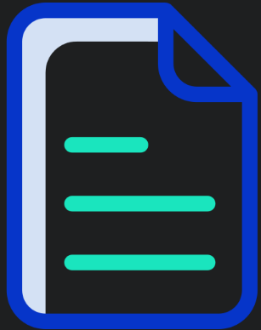

Z. template
new project
ExecuteAsync
square post-it
download
exe
download
exe
why
A slash
followed
by
two consecutive asterisks
D:\A1_research\C2_c0dice\B1_jmeter\A1_install
functionalities
introduction
build-exe
entity framework plus
zig help
⊂
4
every key-frame
defines the operation
success

