Slide 1

1. interfaces
language
python

Slide 2

1.1 sources
interfaces
Python Interface Overview
Informal Interfaces
Using Meta classes
Using Virtual Base Classes
Formal Interfaces
Using abc.ABCMeta
Using .__subclasshook__()
Using abc to Register a Virtual Subclass
Using Subclass Detection With Registration
Using Abstract Method Declaration
Interfaces in Other Languages
Java
C++
Go
Conclusion

Slide 3
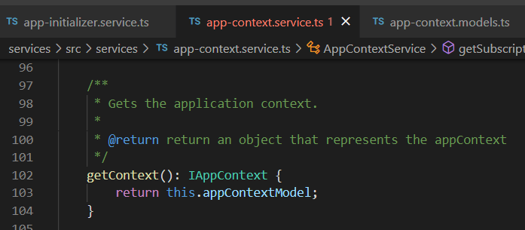


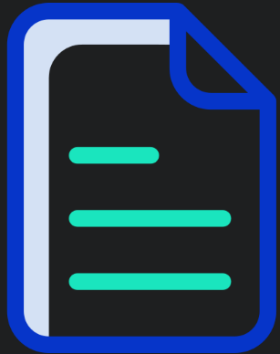

Z. template
new project
ExecuteAsync
square post-it
download
exe
download
exe
why
A slash
followed
by
two consecutive asterisks
D:\A1_research\C2_c0dice\B1_jmeter\A1_install
functionalities
introduction
build-exe
entity framework plus
zig help
⊂
4
every key-frame
defines the operation
success

