Slide 1
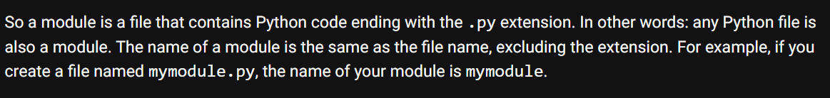

1. modules
what
python-modules

Slide 2
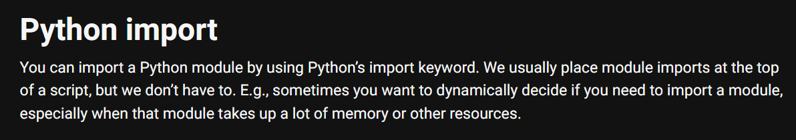
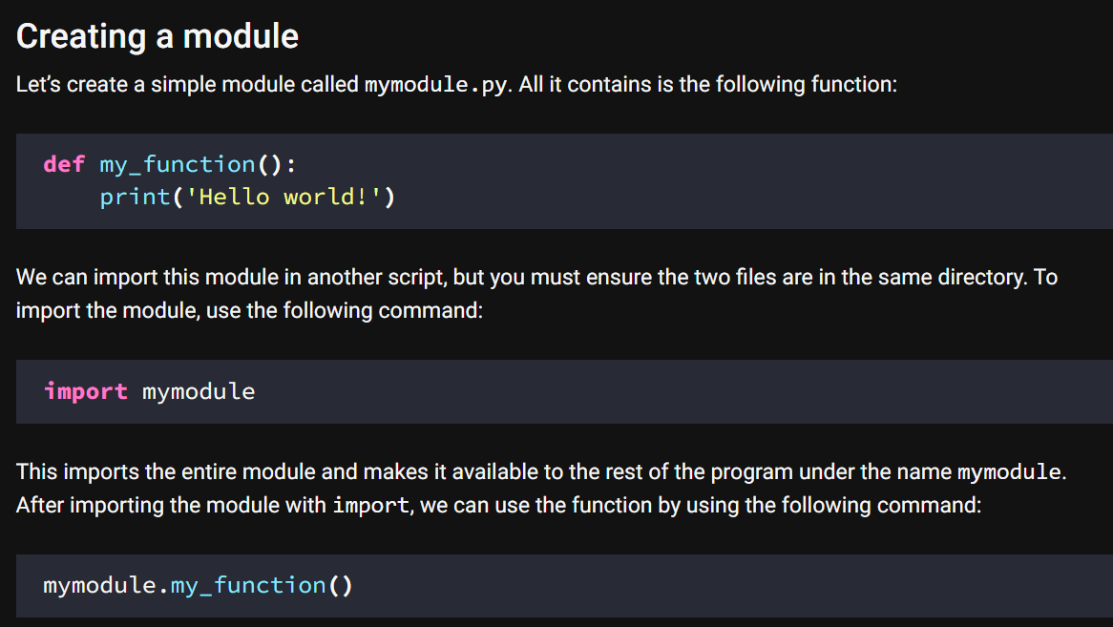
2. import
what

Slide 3
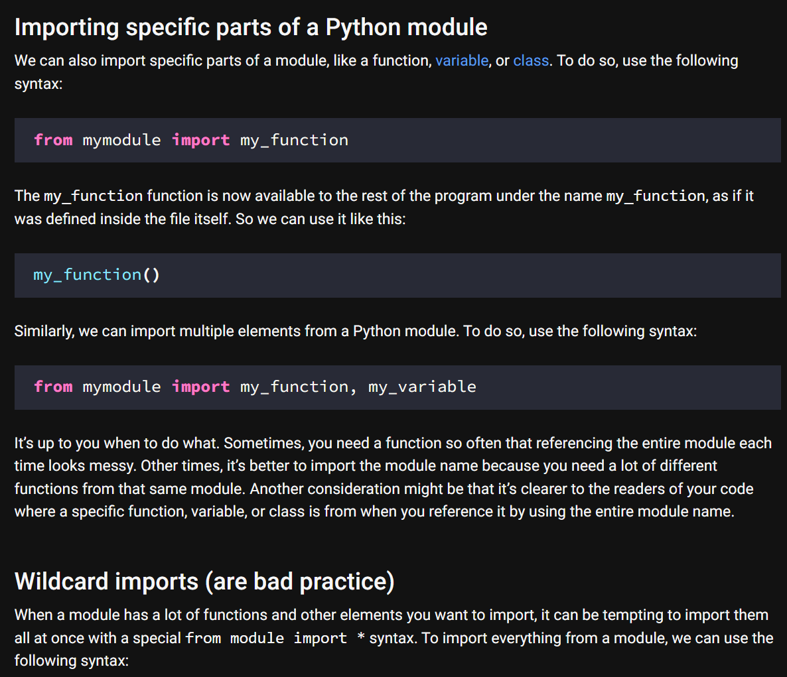
2.1 parts
what
import

Slide 4
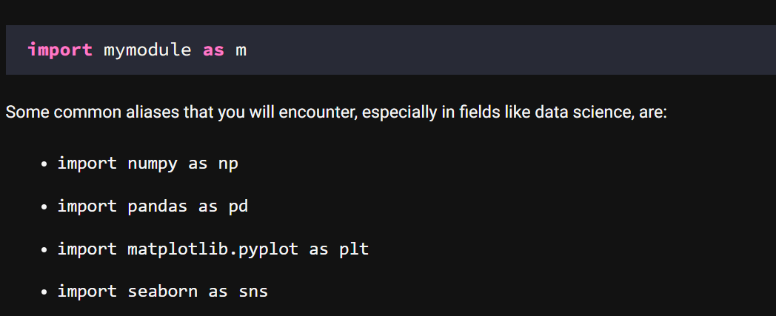
3. aliases
what
Import aliases

Slide 5
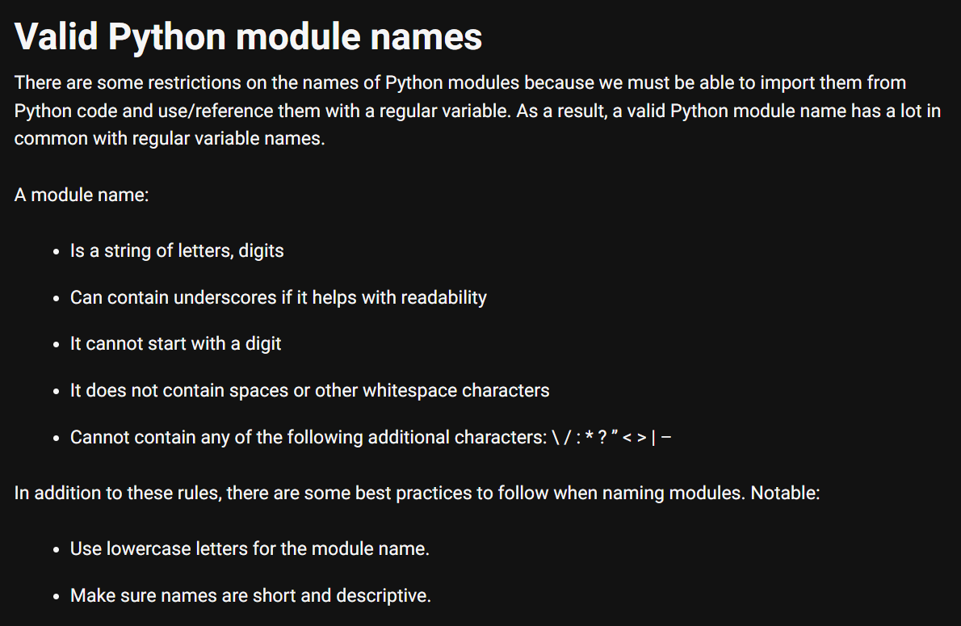
4. names
what
names

Slide 6
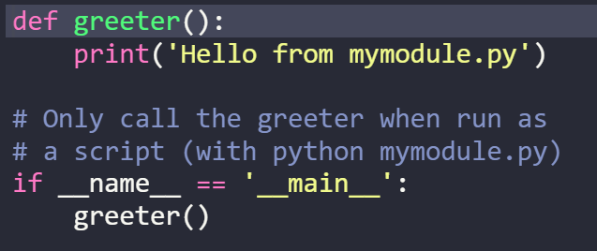
5. main
what
The If __name__ == '__main__' check

Slide 7
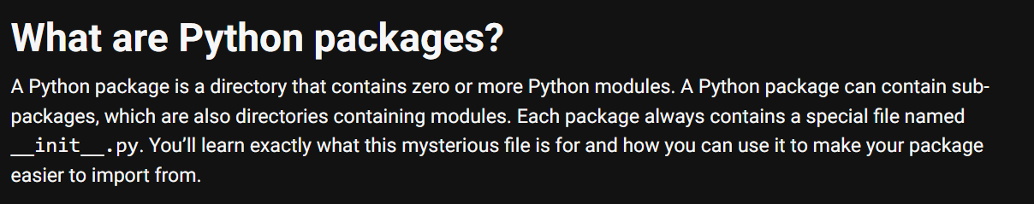
6. packages
what
python-packages

Slide 8
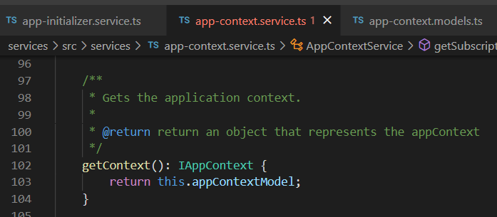






Z. template
new project
ExecuteAsync
square post-it
download
exe
download
exe
why
A slash
followed
by
two consecutive asterisks
D:\A1_research\C2_c0dice\B1_jmeter\A1_install
functionalities
introduction
build-exe
entity framework plus
zig help
⊂
4
every key-frame
defines the operation
success

