Slide 1
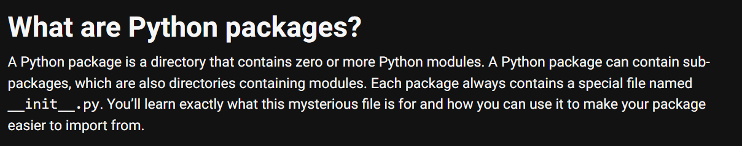

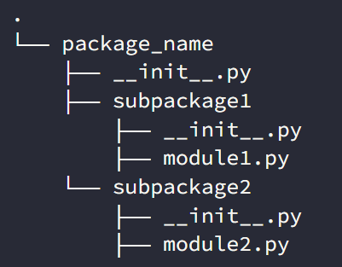

1. packages
what
python-packages
resources\main_vs_init.pdf

Slide 2
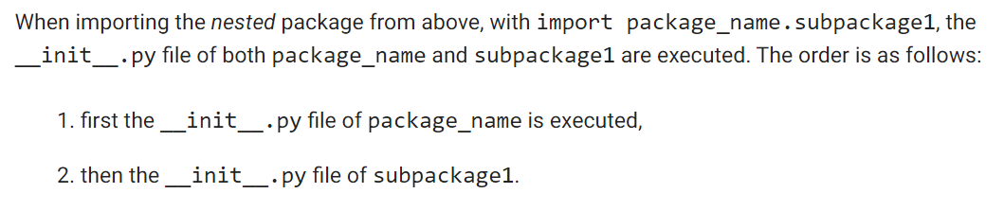
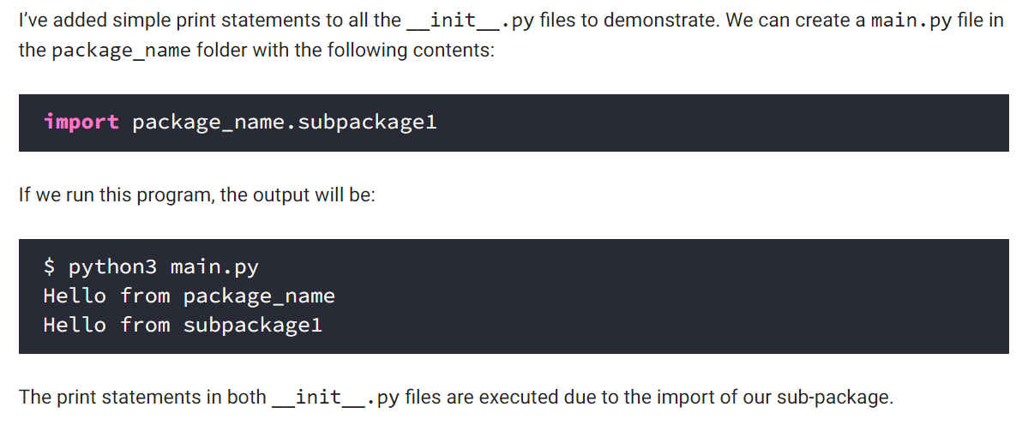
2. __init__
what
used when
import
init
example

Slide 3
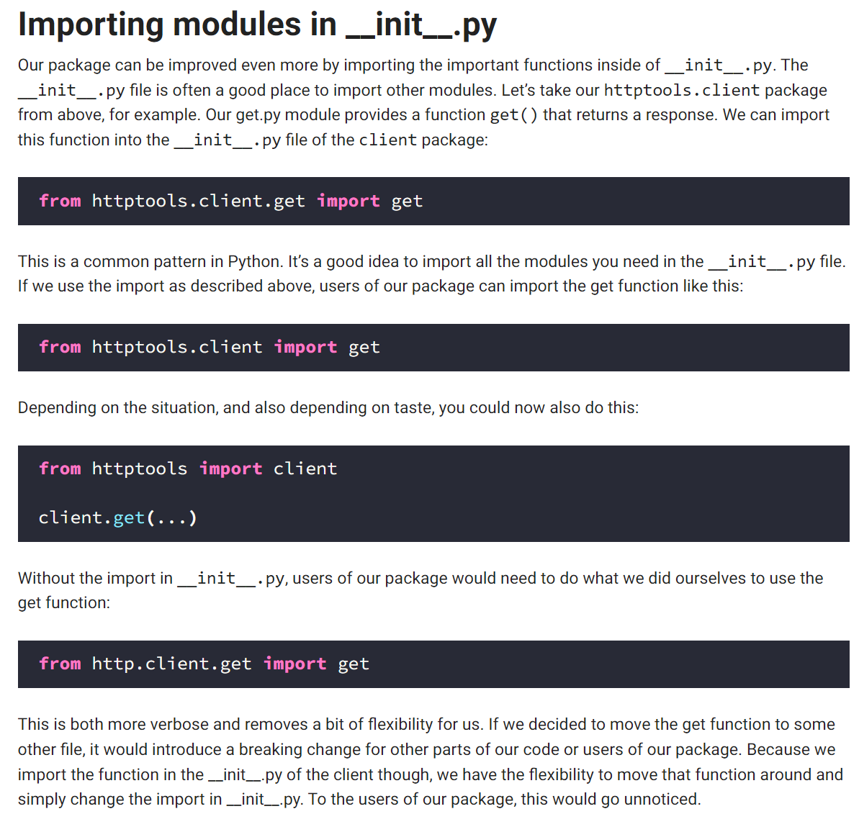
2.1 importing
what
Importing modules in __init__.py

Slide 4
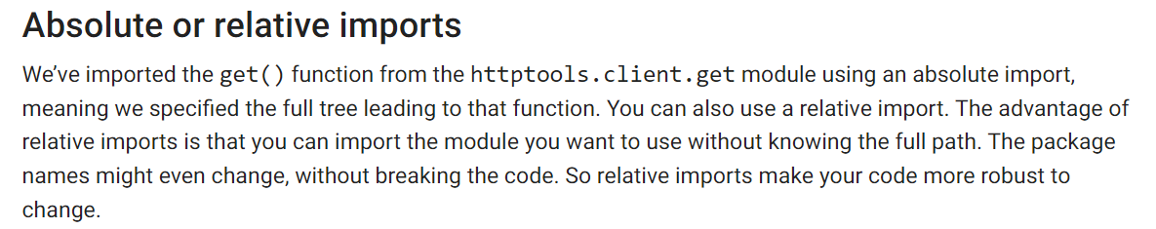
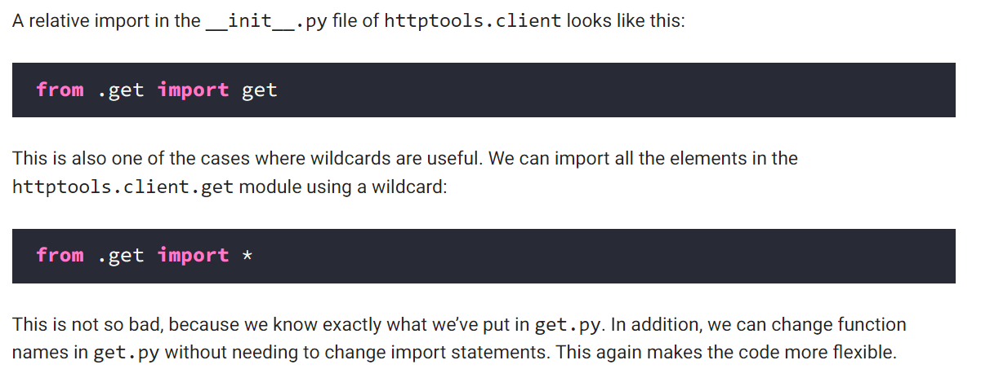
2.2 path
what
absolute and relative paths
relative

Slide 5
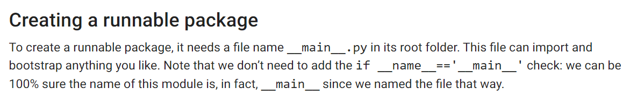
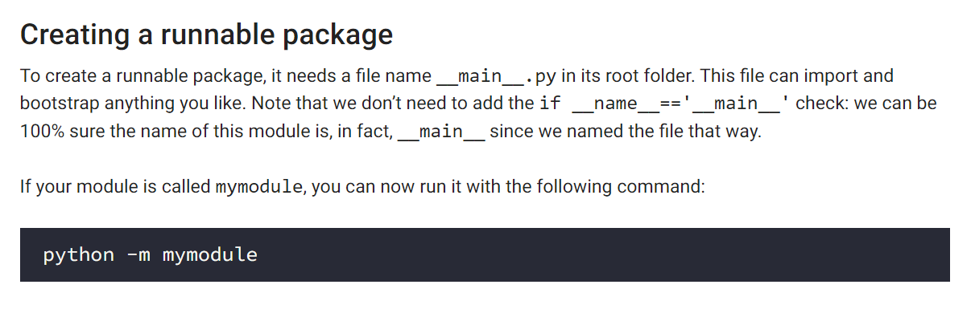
3. __main__
what
main
used when
execute
relative

Slide 6
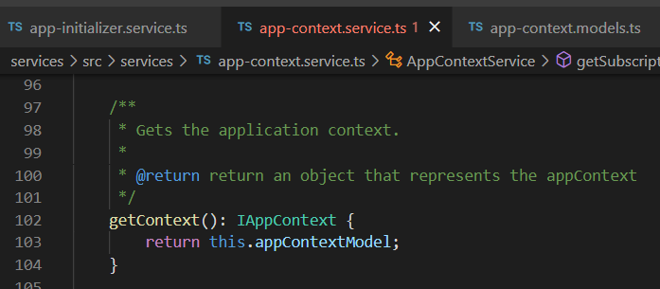





Z. template
new project
ExecuteAsync
square post-it
download
exe
download
exe
why
A slash
followed
by
two consecutive asterisks
D:\A1_research\C2_c0dice\B1_jmeter\A1_install
functionalities
introduction
build-exe
entity framework plus
zig help
⊂
4
every key-frame
defines the operation
success

