Slide 1

1. pip
python

Slide 2

2. list
global
pip list
pip freeze
local
pip list --user
pip freeze --user
list-python-packages

Slide 3
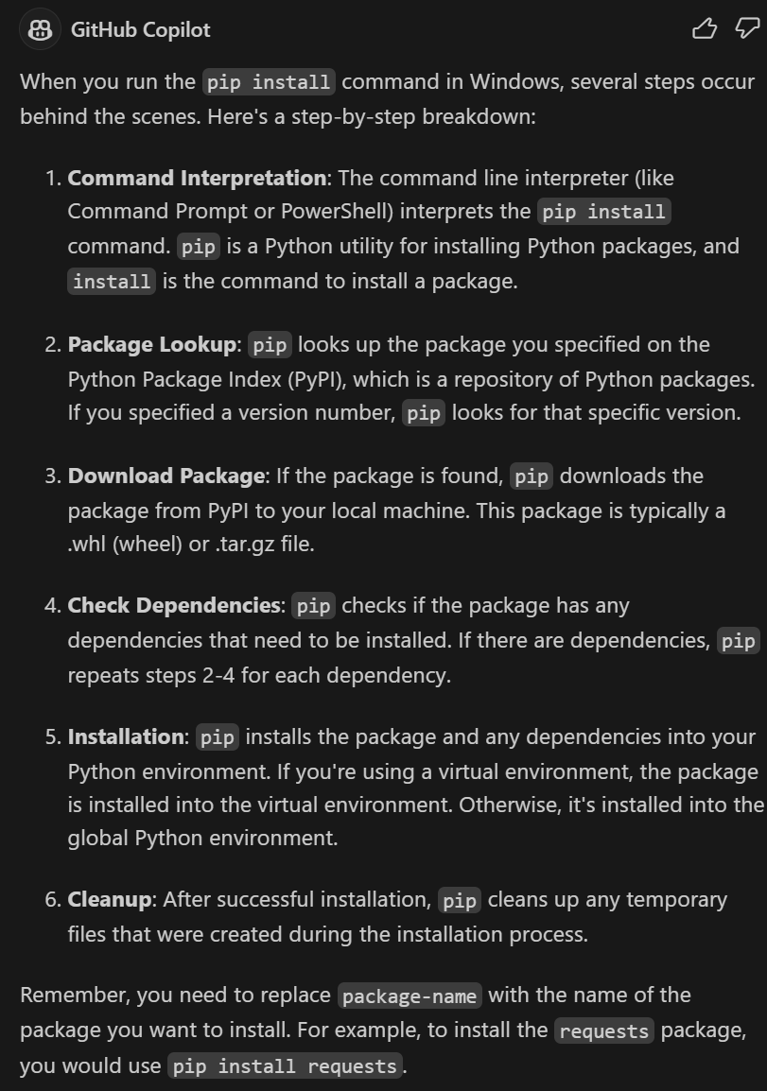
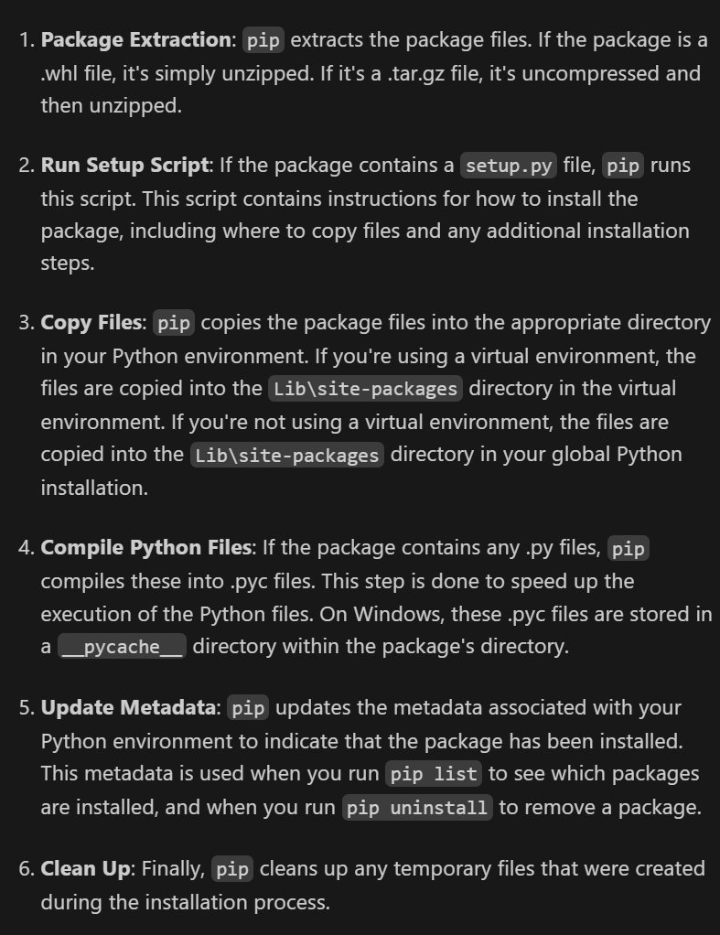
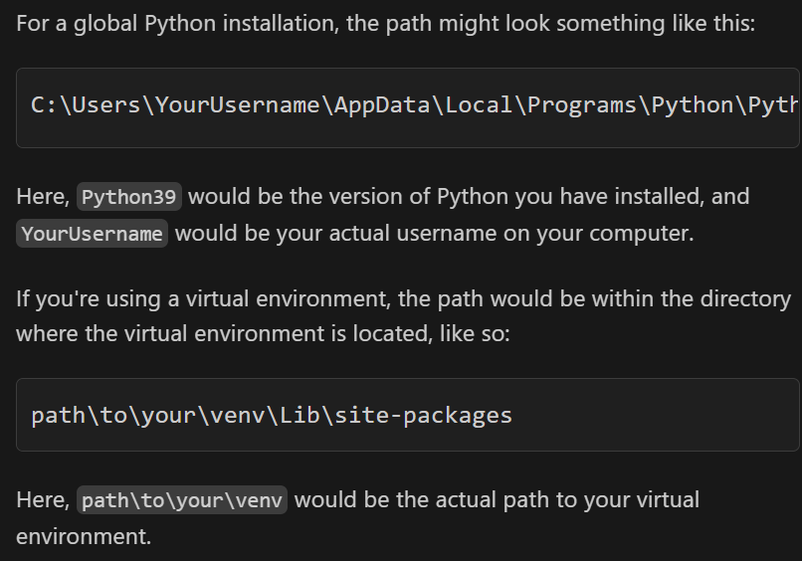
3. install
what
C:\Users\YourUsername\AppData\Local\Programs\Python\Python39\Lib\site-packages

Slide 4
3.1 editable
The command `pip install -e .`
is used
to install a package
in
editable
or
"develop"
mode
from the
current directory (`.`).
in editable mode,
changes to the
source code
immediately affect
the installed package
without needing
to reinstall it
what
pip install -e .
pip install
The `.`
refers to
the current directory
the setup script
(`setup.py`)
for the package
code
is expected to be found
in
the current directory
uninstall
pip uninstall package-name
list
pip list -e

Slide 5
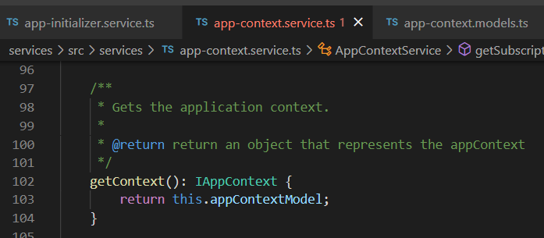


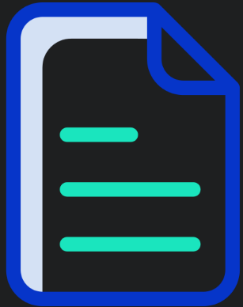


Z. template
new project
ExecuteAsync
square post-it
download
exe
download
exe
why
A slash
followed
by
two consecutive asterisks
D:\A1_research\C2_c0dice\B1_jmeter\A1_install
functionalities
introduction
build-exe
entity framework plus
zig help
⊂
4
every key-frame
defines the operation
success

