Slide 1

1. python
skunk
portfolio

Slide 2
1.1 index
environment
command
language
ai
pip
code generation
clean architecture
blocking

Slide 3

1.2 resources
_resources\PythonCheatSheet.pdf
_resources\PythonCheatSheetComplexDataTypes.pdf
_resources\PythonCheatSheetFunctionsAndTricks.pdf
_resources\PythonOpenAI.pdf

Slide 4
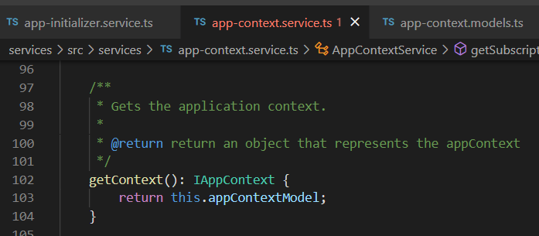




Z. template
new project
ExecuteAsync
square post-it
download
exe
download
exe
why
A slash
followed
by
two consecutive asterisks
D:\A1_research\C2_c0dice\B1_jmeter\A1_install
functionalities
introduction
build-exe
entity framework plus
zig help
⊂
4
every key-frame
defines the operation
success

