Slide 1

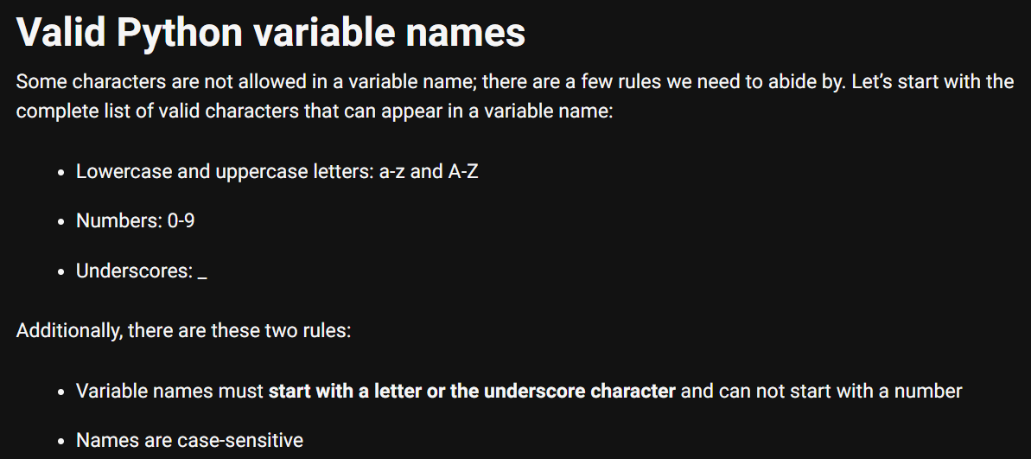

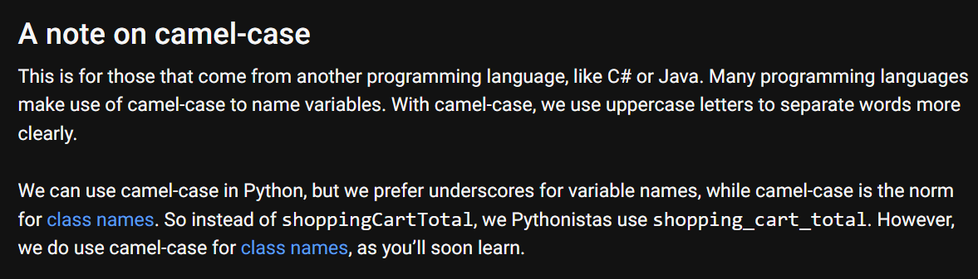

1. variables
language
python
what
variables
..\..\_language\A2_variables.py

Slide 2
2. types
simple
Integers
Floating point numbers
Complex numbers
Booleans
Strings
python-data-types

Slide 3
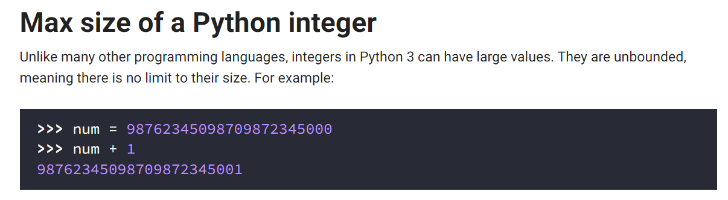
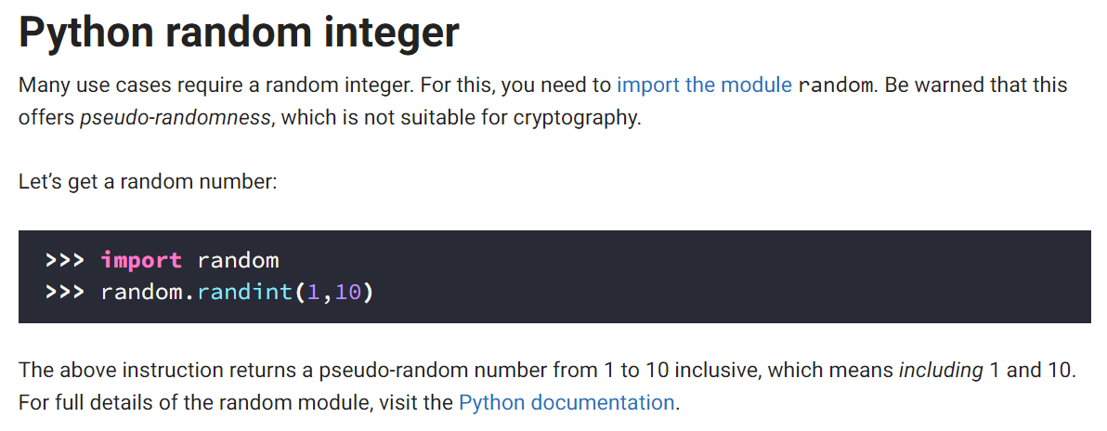
2.1 integers
simple
python-integer
random

Slide 4
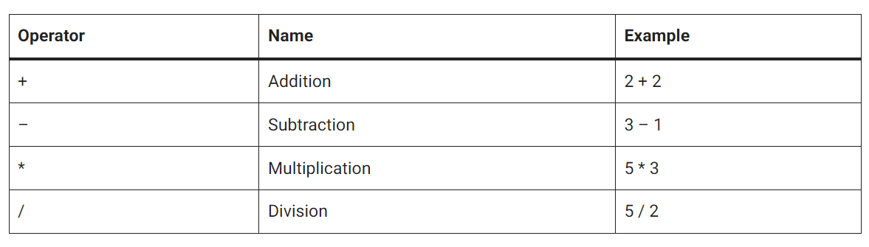
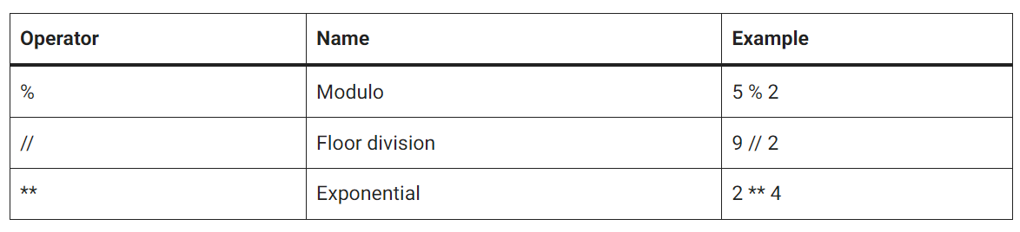
2.1.1 operators
what
operators

Slide 5
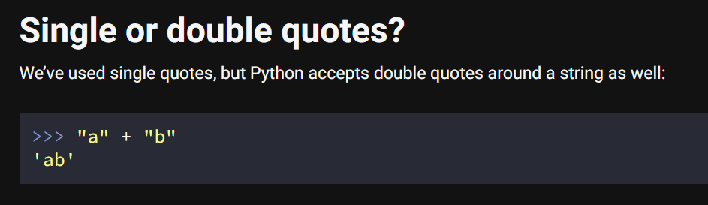
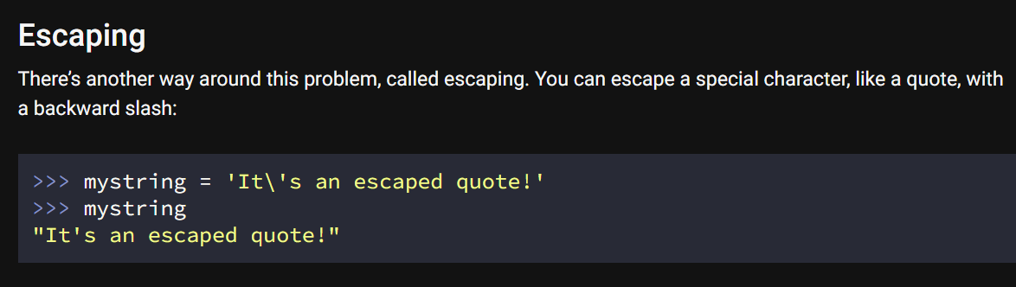
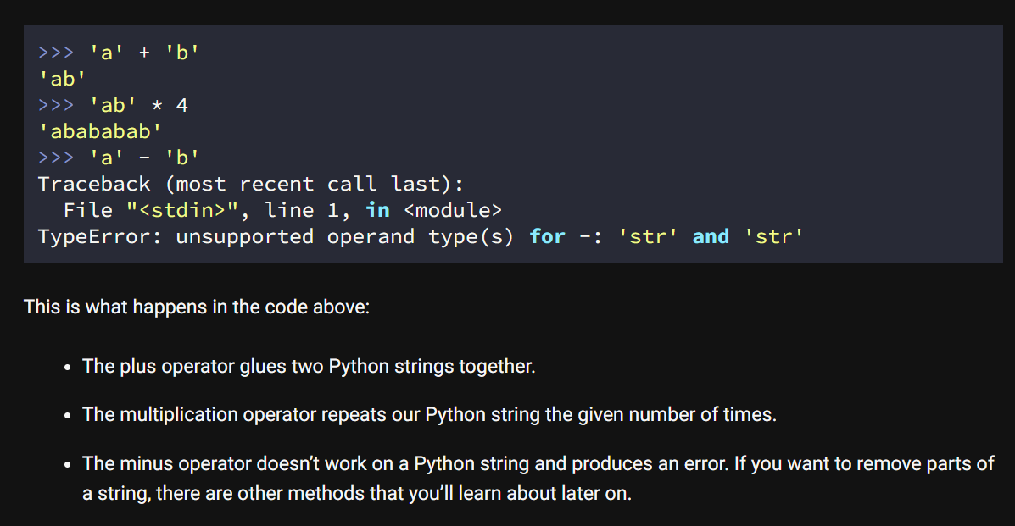
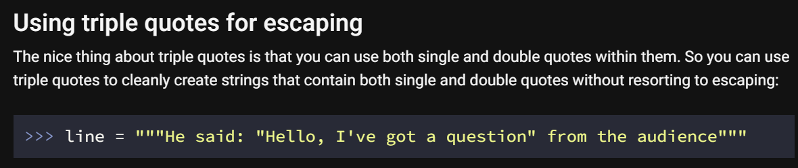
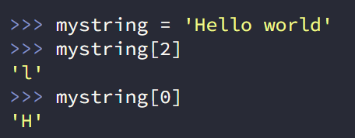
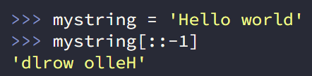
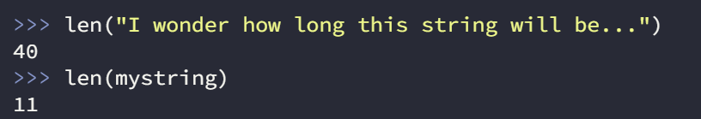
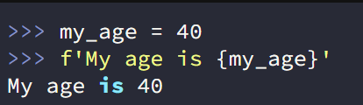
2.2 strings
quotes
escaping
strings
operators
triple
methods
string-methods
lists
f-string

Slide 6
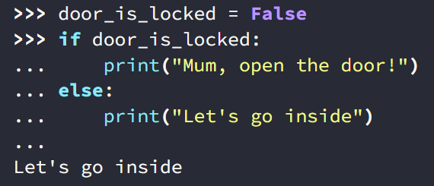
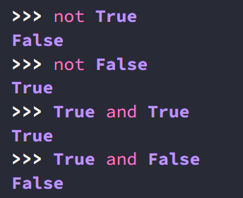
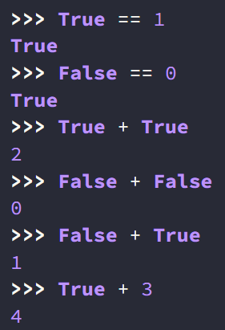
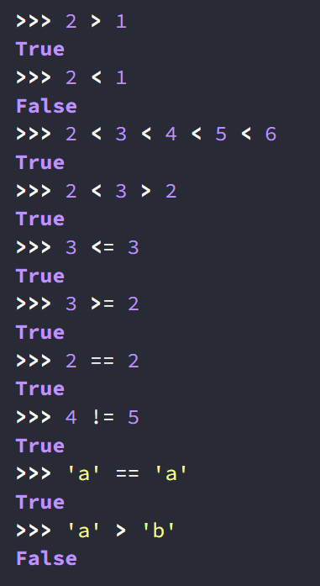
2.3 boolean
what
python-boolean-and-operators
if
operators

Slide 7
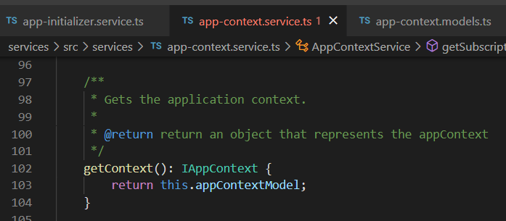




Z. template
new project
ExecuteAsync
square post-it
download
exe
download
exe
why
A slash
followed
by
two consecutive asterisks
D:\A1_research\C2_c0dice\B1_jmeter\A1_install
functionalities
introduction
build-exe
entity framework plus
zig help
⊂
4
every key-frame
defines the operation
success

