Slide 1

1. AI
portfolio

Slide 2


1.1 index
autogen
hackathon
_reference\hugging
short term memory
perplexity
Introducing the Model Context Protocol ***
Model Context Protocol (MCP)

Slide 3

2. tutorial
tutorial
data-science

Slide 4
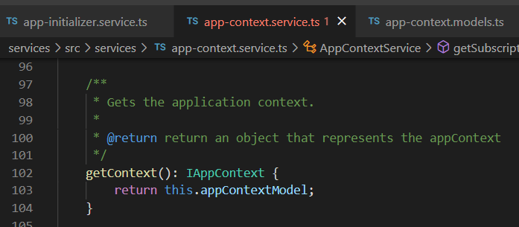



Z. template
new project
ExecuteAsync
square post-it
download
exe
download
exe
why
A slash
followed
by
two consecutive asterisks
D:\A1_research\C2_c0dice\B1_jmeter\A1_install
functionalities
introduction
build-exe
entity framework plus
zig help
⊂
4
every key-frame
defines the operation
success

