Slide 1

1. azure
deployment
environment
python

Slide 2
1.1 index

Slide 3

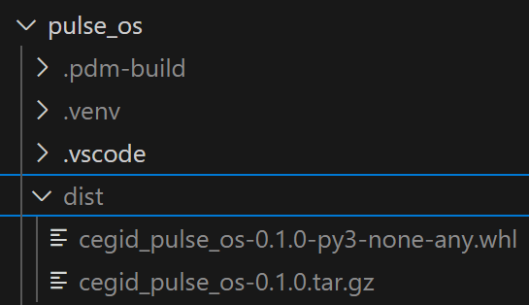
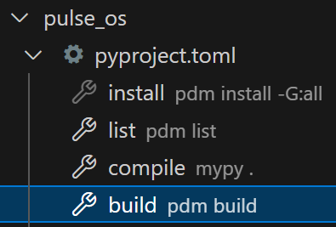


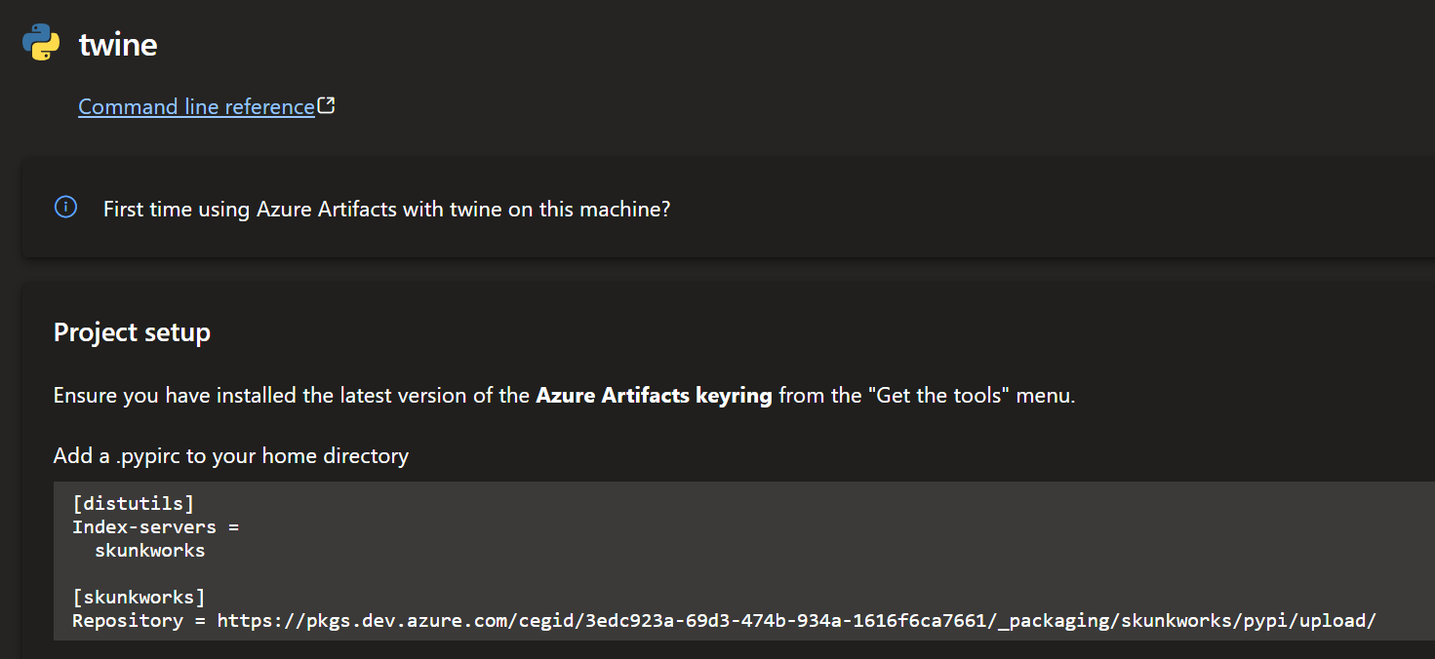
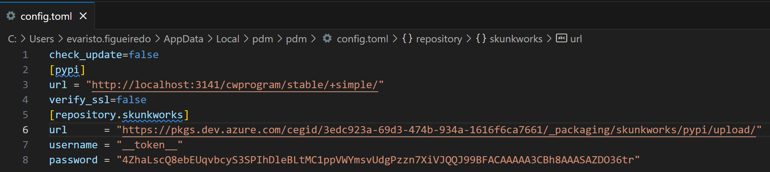
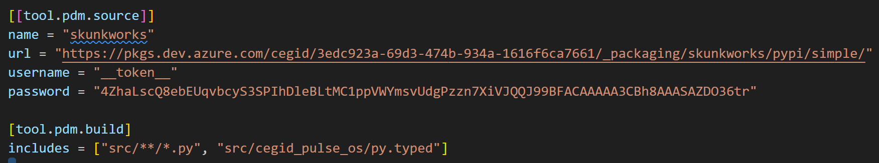
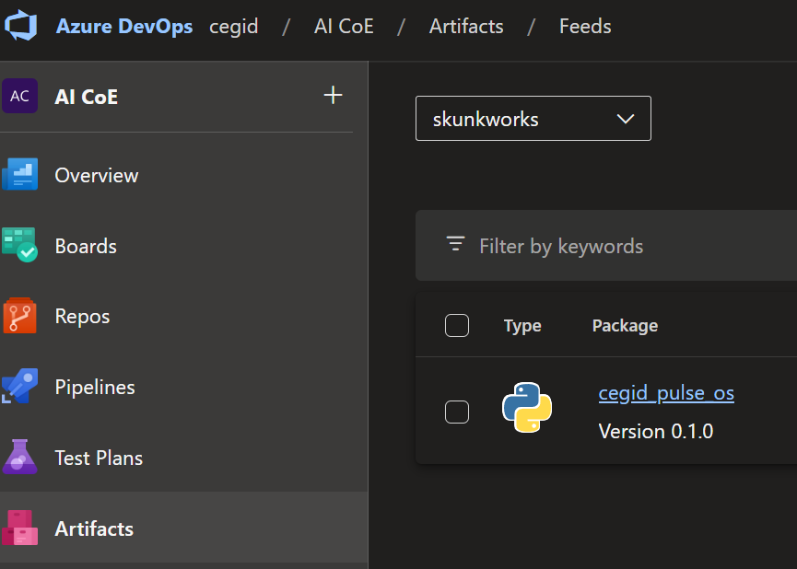
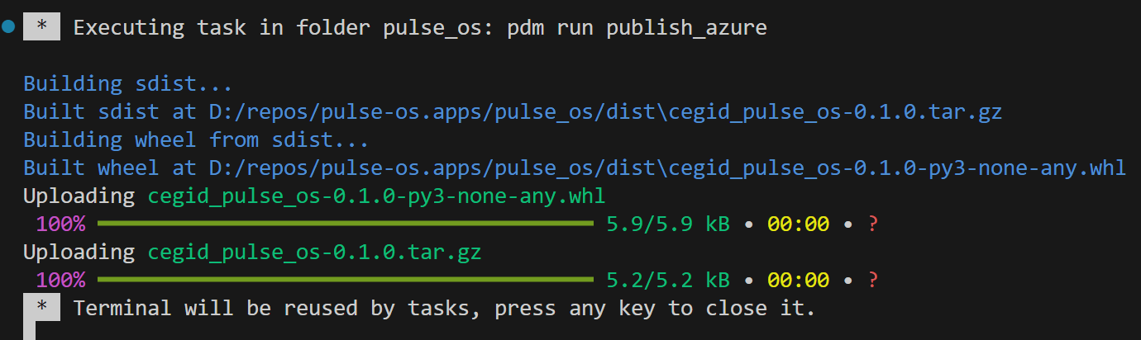
2. how
1
azure feed
skunkworks
2
build
to run
  PDM install
only need
  project setup
3
personal access token (PAT)
pat
C:\Users\evaristo.figueiredo\AppData\Local\pdm\pdm\config.toml
3
PDM setup
find URL
[repository.skunkworks]
url = "https://pkgs.dev.azure.com/cegid/3edc923a-69d3-474b-934a-1616f6ca7661/_packaging/skunkworks/pypi/upload/"
username = "__token__"
password = "4ZhaLscQ8ebEUqvbcyS3SPIhDleBLtMC1ppVWYmsvUdgPzzn7XiVJQQJ99BFACAAAAA3CBh8AAASAZDO36tr"
4
project setup
need to refer to /simple
need user name and password
5
publish
pdm publish --repository skunkworks

Slide 4
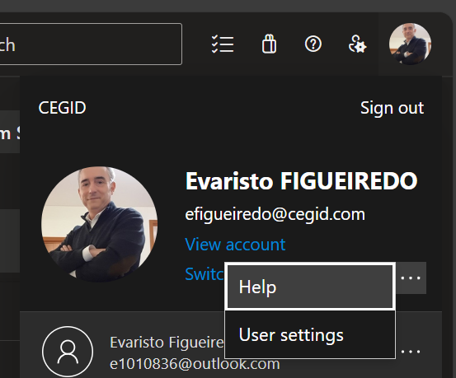
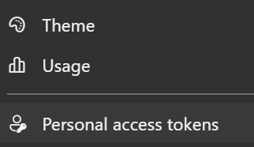
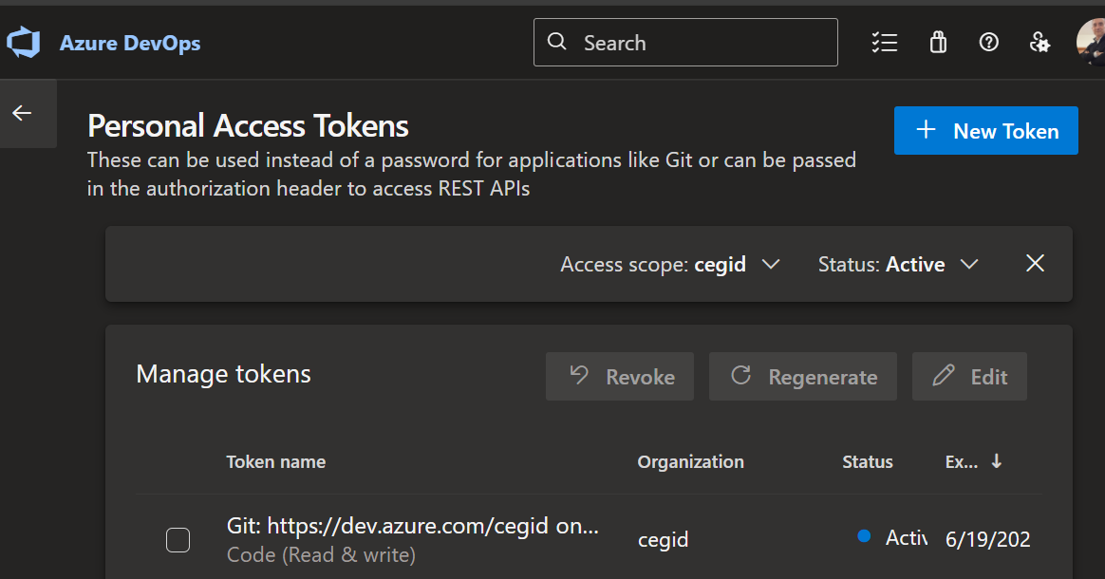
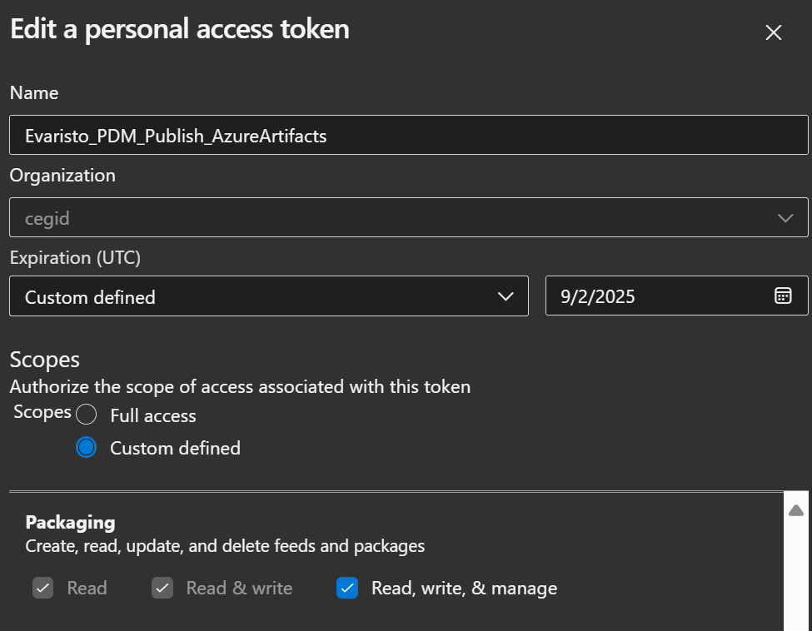
2.1 pat
1
azure feed
skunkworks
2
personal access tokens
3
new
7KBH3ElkH6QiE7kRIjN6sPuBo57FjXY1mOmsNEmwmS8nh8eNmeFGJQQJ99BFACAAAAA3CBh8AAASAZDO2Kf5

Slide 5



Z. template
new project
ExecuteAsync
square post-it
download
  exe
download
  exe
why
A slash
  followed
by
  two consecutive asterisks
D:\A1_research\C2_c0dice\B1_jmeter\A1_install
functionalities
introduction
build-exe
entity framework plus
zig help
⊂
4
every key-frame
defines the operation
success

