Slide 1

1. oop
language
python

Slide 2
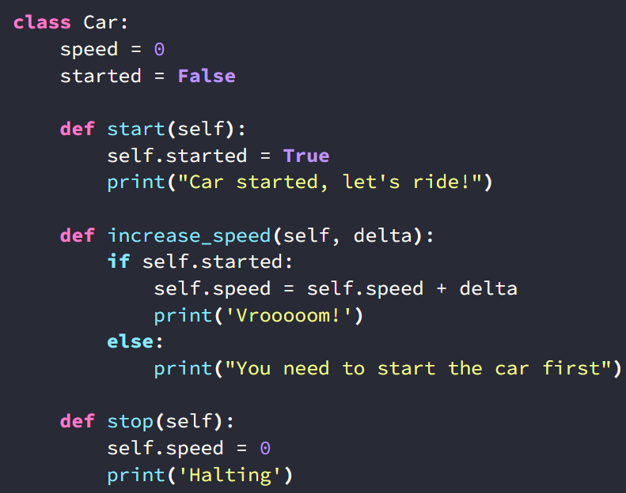

2. class
what
class

Slide 3
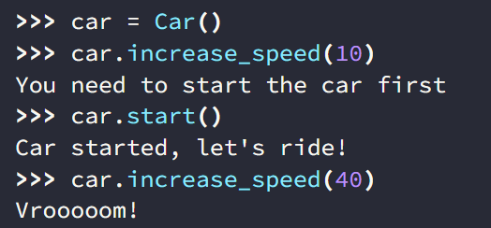
3. objects
what
objects

Slide 4
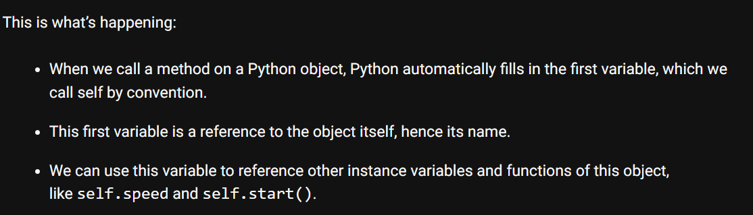
4. self
what
self

Slide 5
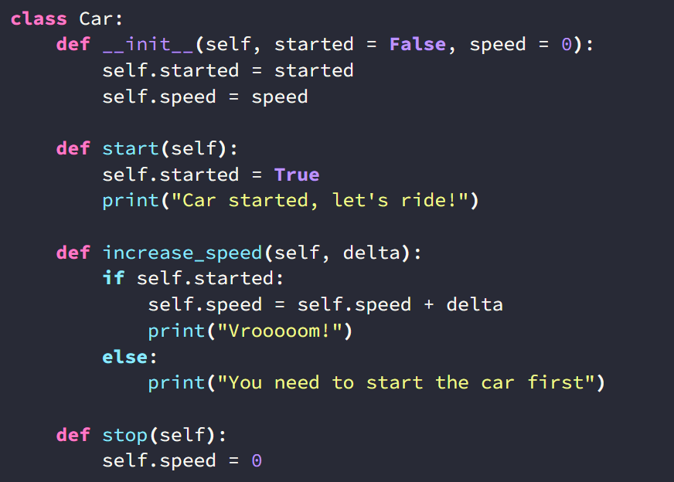
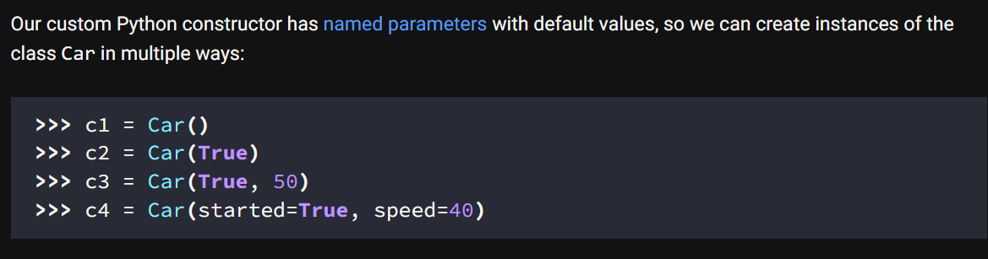
5. constructor
what
python-constructors

Slide 6
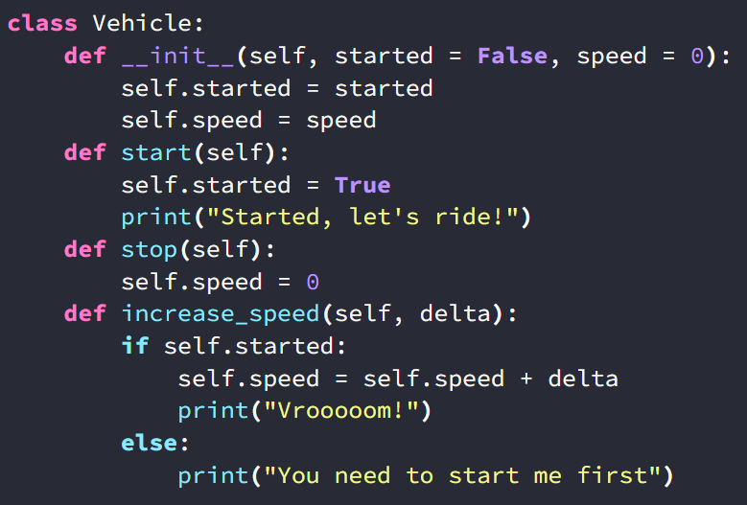
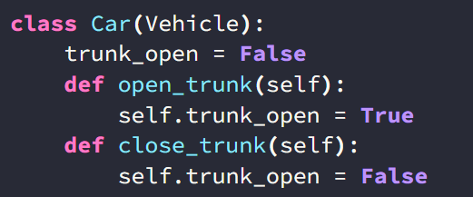
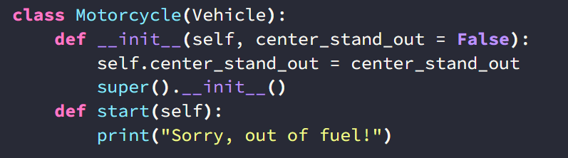
6. inheritance
what
python-inheritance
overriding

Slide 7
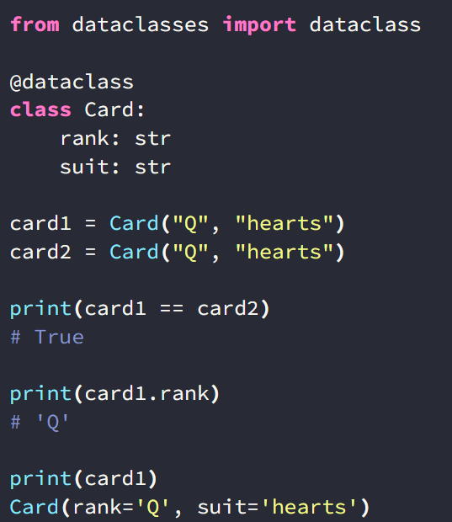
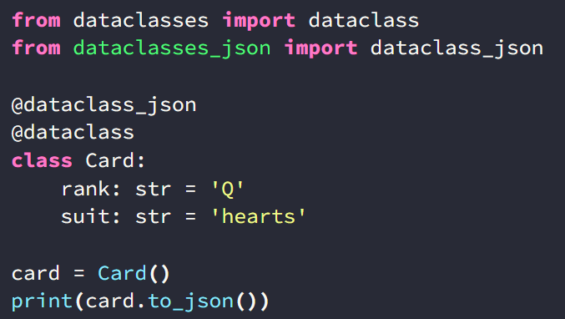

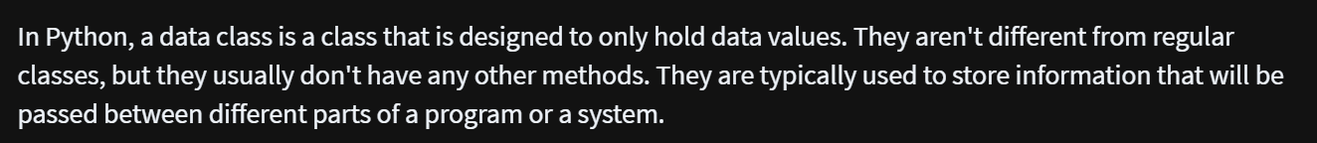
7. data class
what
json
python-data-classes
how-to-use-python-data-classes

Slide 8
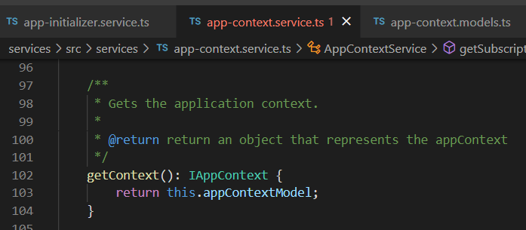





Z. template
new project
ExecuteAsync
square post-it
download
exe
download
exe
why
A slash
followed
by
two consecutive asterisks
D:\A1_research\C2_c0dice\B1_jmeter\A1_install
functionalities
introduction
build-exe
entity framework plus
zig help
⊂
4
every key-frame
defines the operation
success

