Slide 1
1. aws

Slide 2

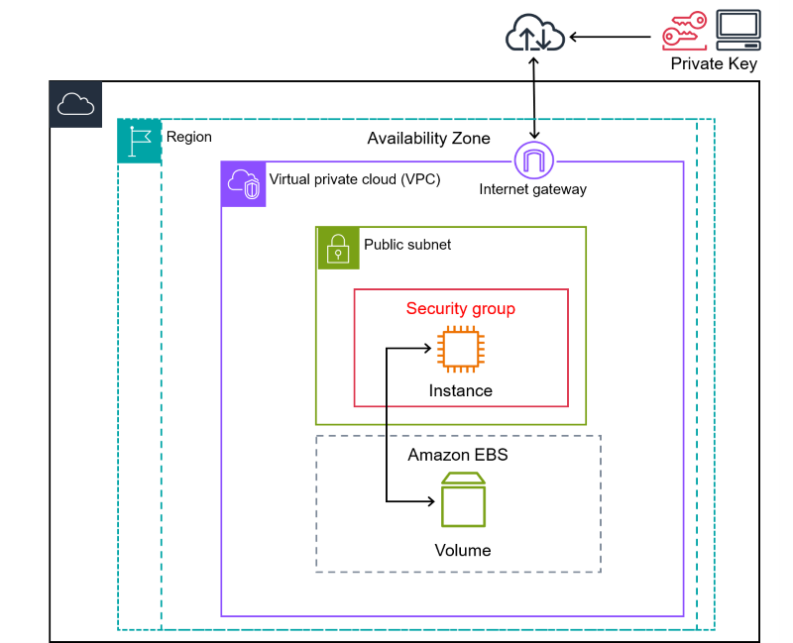
2. EC2
what
Amazon Elastic Compute Cloud (Amazon EC2)
provides
on-demand,
scalable
computing capacity
in
the Amazon Web Services (AWS) Cloud.
EC2

Slide 3
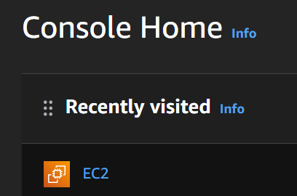
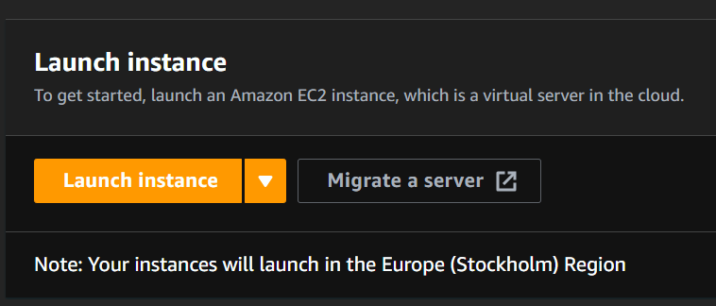
2.1 launch
run
launch

Slide 4
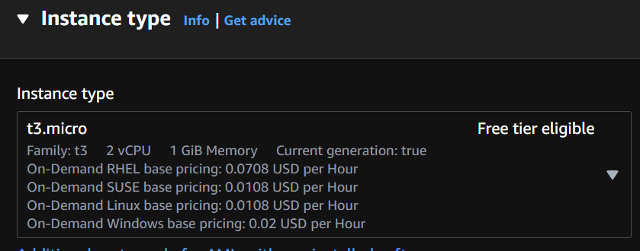
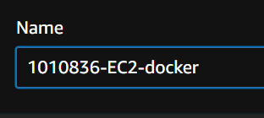
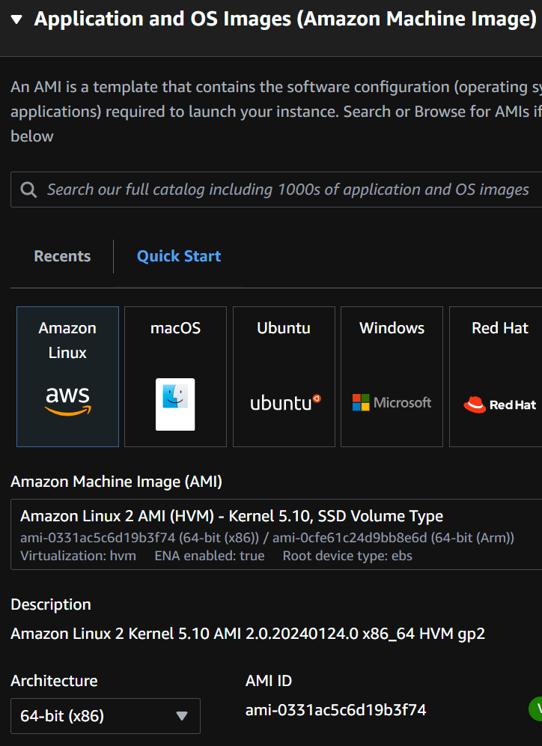
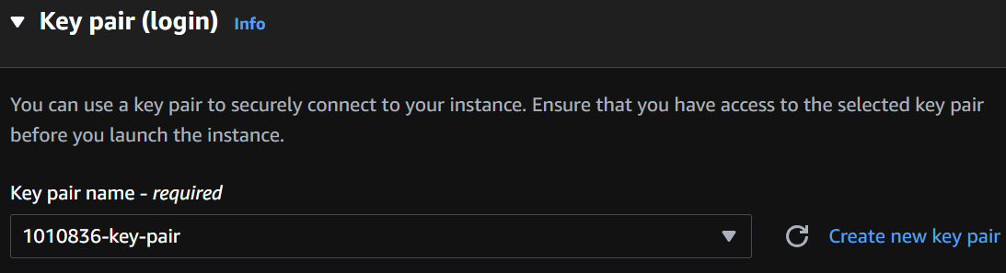

2.2 setup
name
type
images
access
..\_projects\docker-python-example\1010836-key-pair.pem
required
amazon-linux-extra

Slide 5
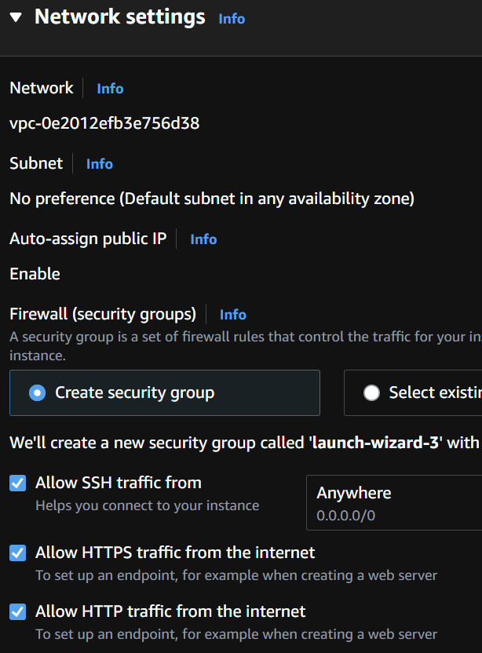
2.2.1 network
what
review
not secure

Slide 6
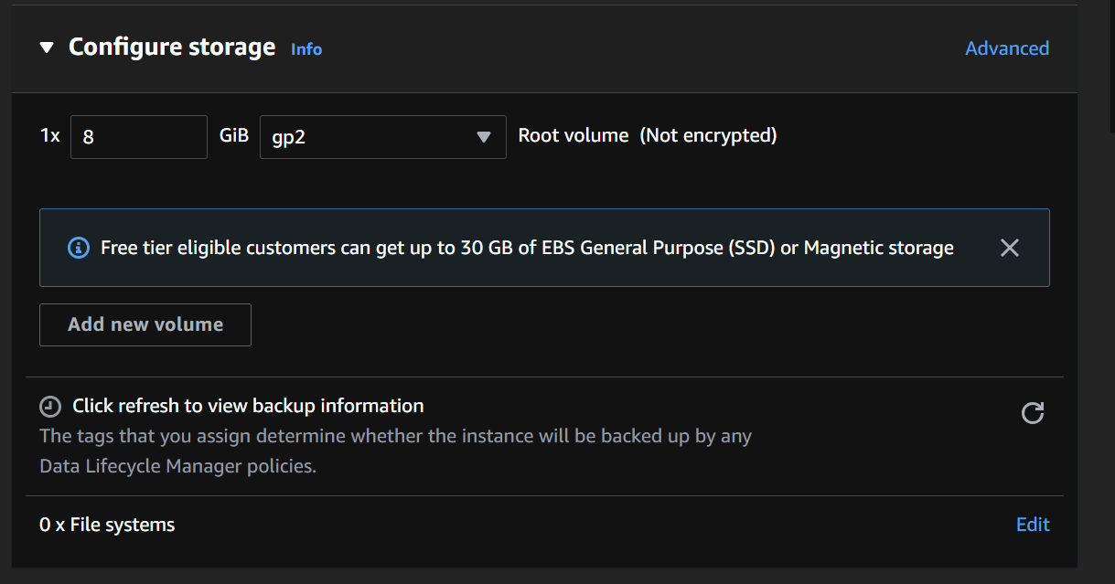
2.2.2 storage
what

Slide 7
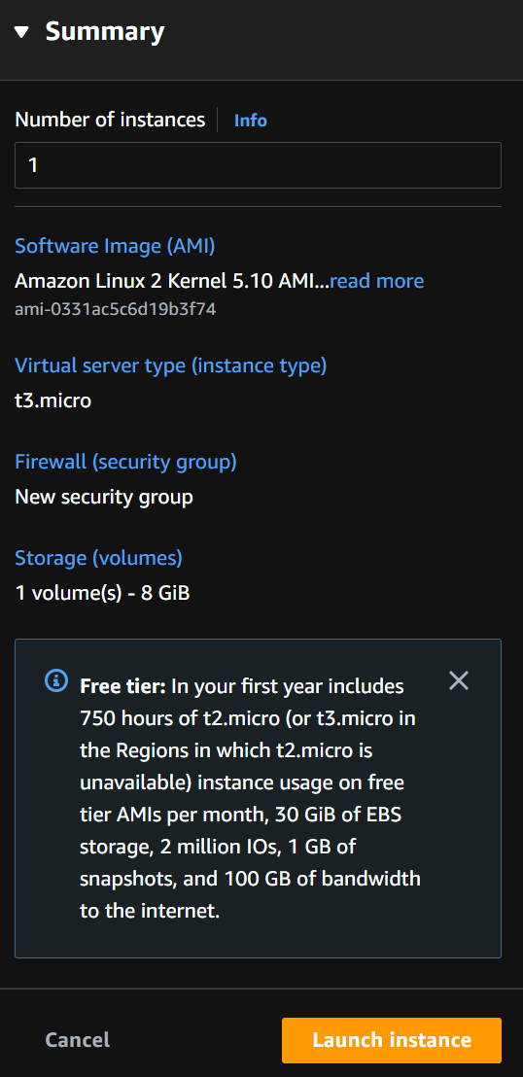
2.3 start
what

Slide 8
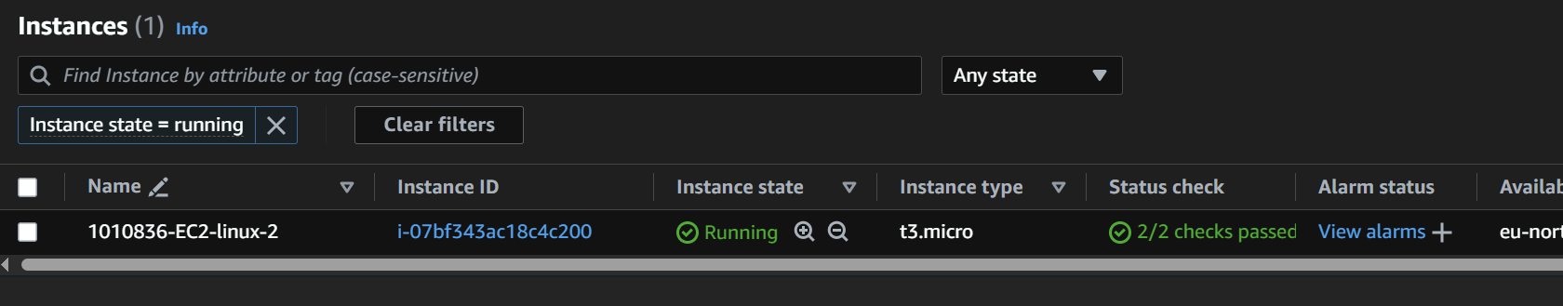
2.4 connect
instances
connect

Slide 9
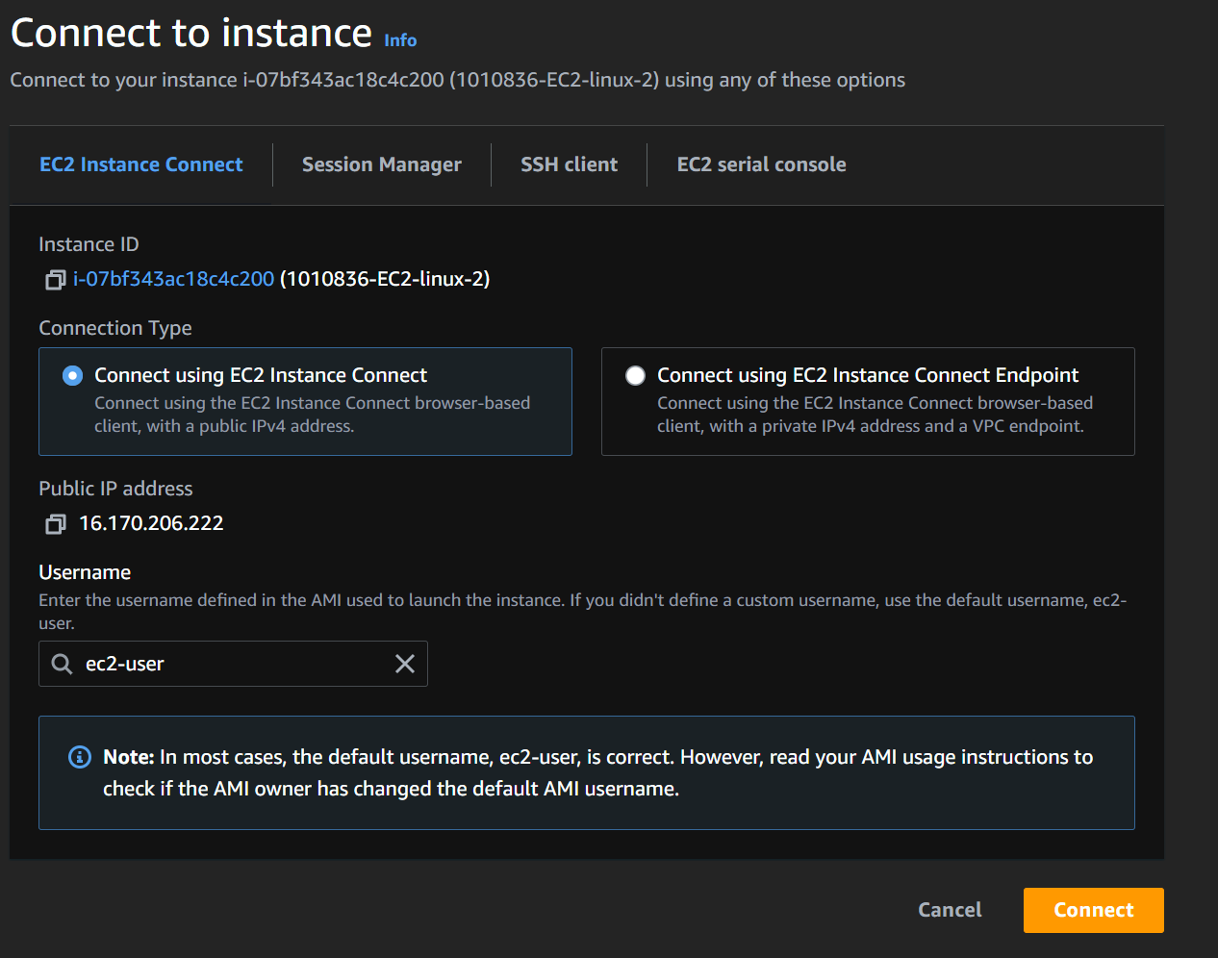
2.4.1 login
what

Slide 10
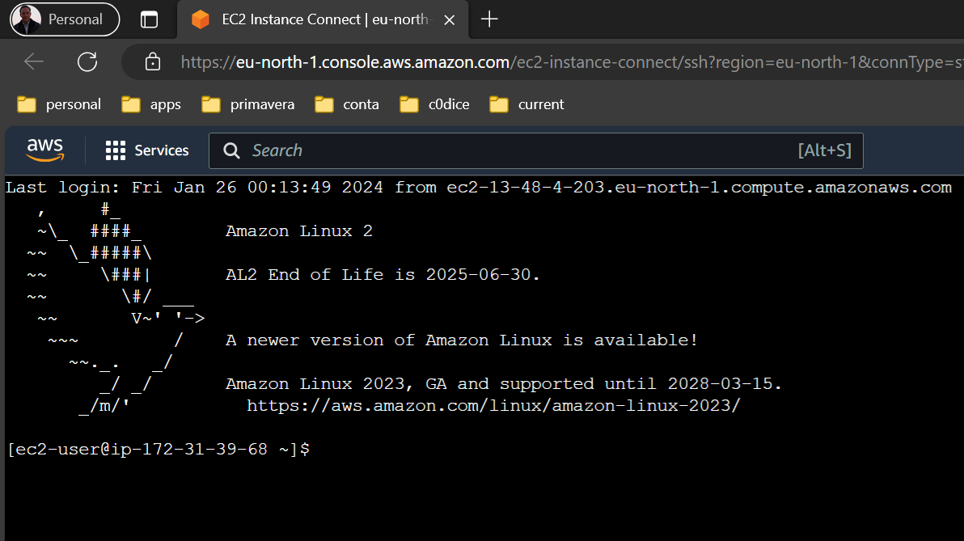
2.5 console
what

Slide 11
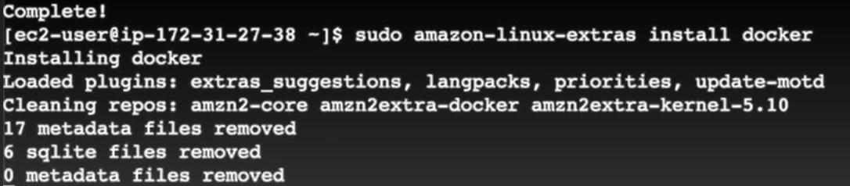
3. docker
how
tutorial
install
sudo amazon-linux-extras install docker
start
sudo service docker start
I have to write the command (can´t copy/past)
privileges
sudo usermod –a –G docker ec2-user
run docker commands without sudo

Slide 12
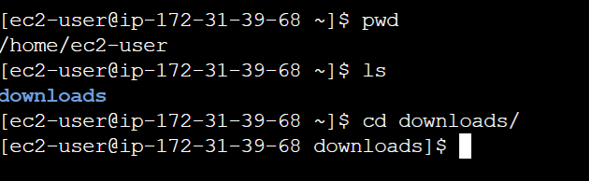
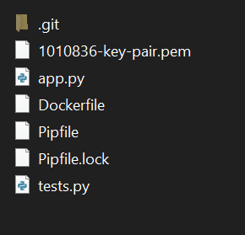
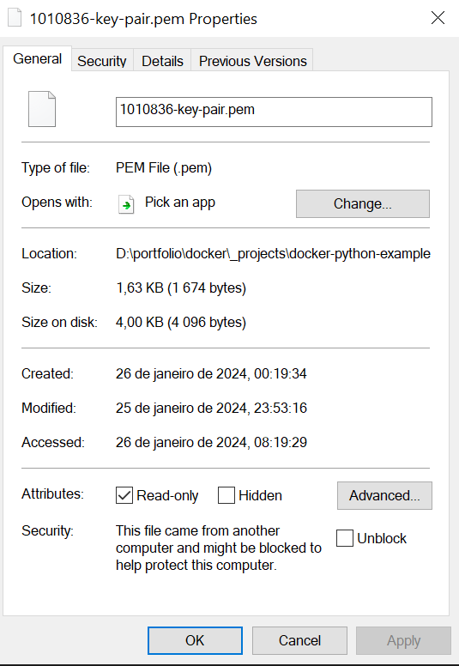
3.1 upload
create downloads folder
add security key
upload
scp –i 1010836-key-pair.pem Dockerfile app.py Pipfile Pipfile.lock ec2-user@16.170.206.222:/home/ec2-user/downloads
error
use FileZilla
connect-to-amazon-ec2-file-directory-using-filezilla-and-sftp

Slide 13
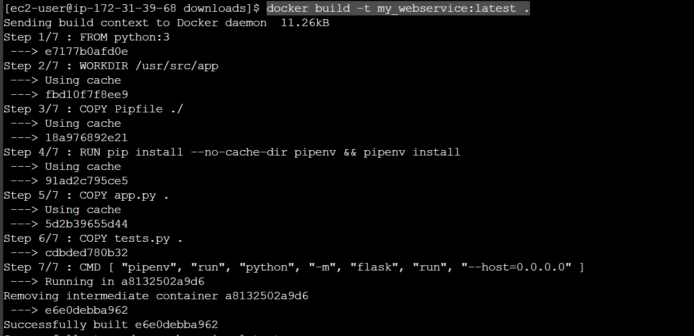
3.2 build
command
sudo docker build -t key_value_pair:latest .

Slide 14
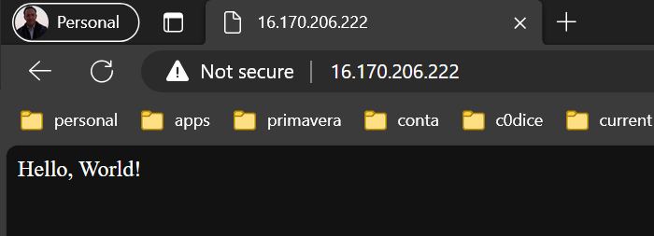
3.3 run
command
sudo docker run -d -p 80:5000 key_value_pair

Slide 15
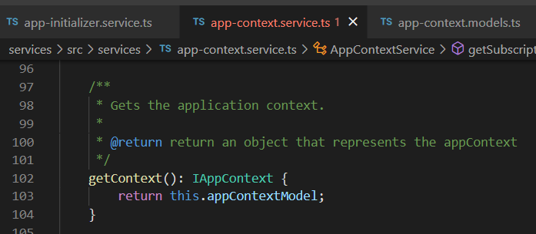




Z. template
new project
ExecuteAsync
square post-it
download
exe
download
exe
why
A slash
followed
by
two consecutive asterisks
D:\A1_research\C2_c0dice\B1_jmeter\A1_install
functionalities
introduction
build-exe
entity framework plus
zig help
⊂
4
every key-frame
defines the operation
success

