Slide 1


1. language
python
tutorial
python-tutorial
areas
video 1 hour
data science
web
django
flask
automation

Slide 2
2. index
variables
loops
arrays
functions
oop
structure

Slide 3
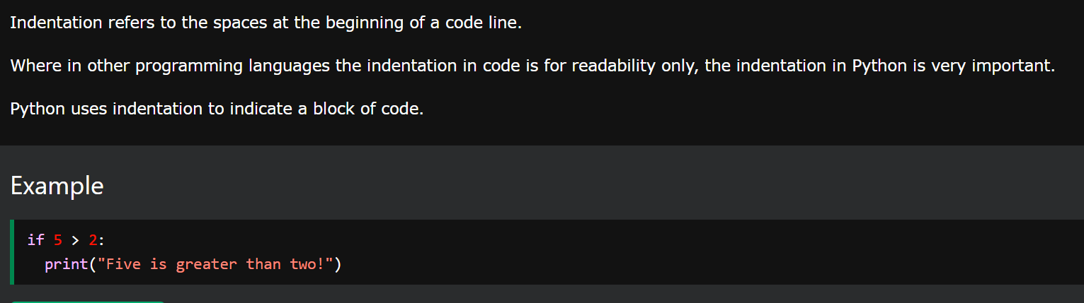
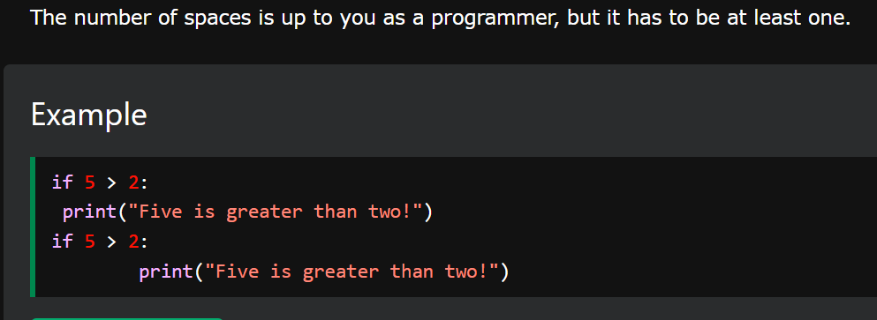
3. indentation
what
indentation

Slide 4
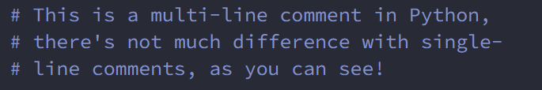
4. comments
what
python-comment

Slide 5
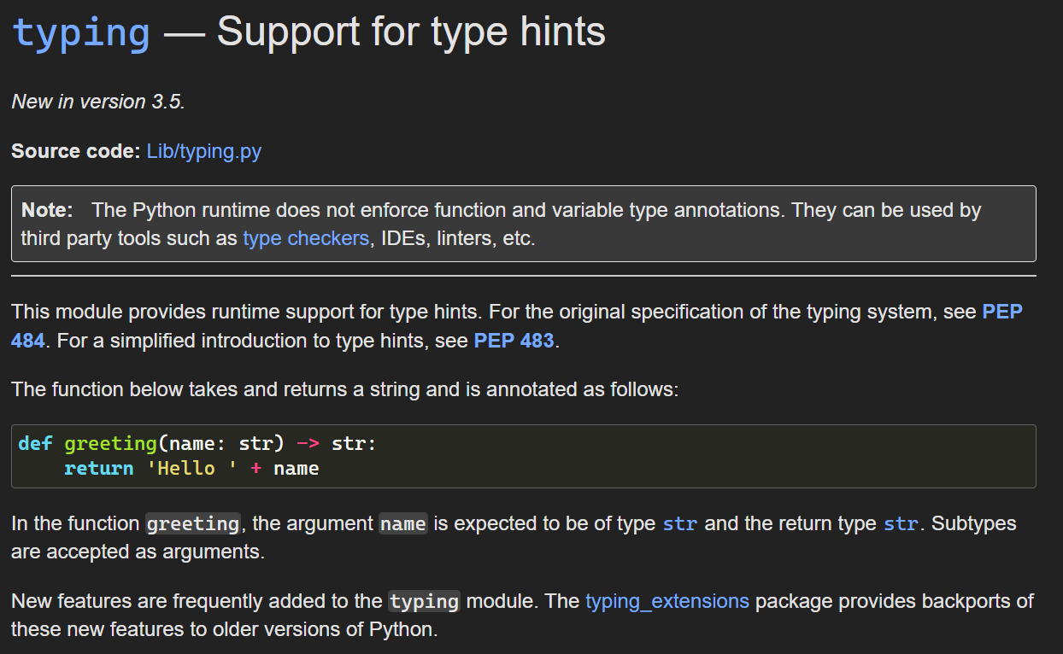
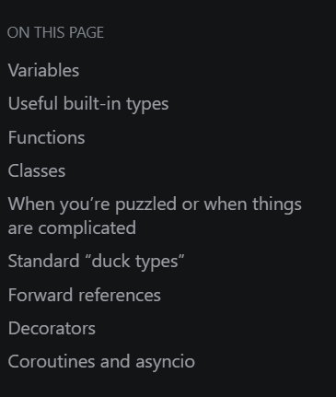
5. types
what
hints list
Python 3.5
typing

Slide 6
6. build in
what
A abs() aiter() all() anext() any() ascii() B bin() bool() breakpoint() bytearray() bytes() C callable() chr() classmethod() compile() complex() D delattr() dict() dir() divmod() | E enumerate() eval() exec() F filter() float() format() frozenset() G getattr() globals() H hasattr() hash() help() hex() I id() input() int() isinstance() issubclass() iter() | L len() list() locals() M map() max() memoryview() min() N next() O object() oct() open() ord() P pow() print() property() | R range() repr() reversed() round() S set() setattr() slice() sorted() staticmethod() str() sum() super() T tuple() type() V vars() Z zip() _ __import__()
functions

Slide 7
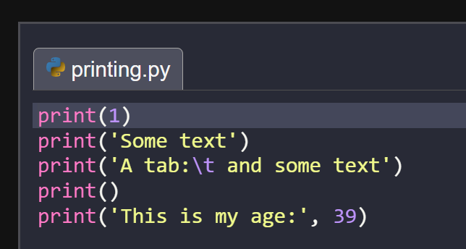
6.1 print
what
python-print

Slide 8
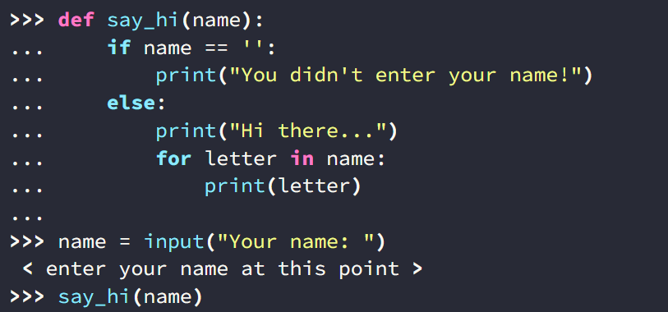

6.2 input
what
input
D:\ai\A3_python\_language\A3_input.py

Slide 9
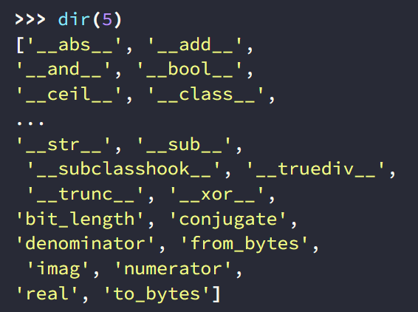
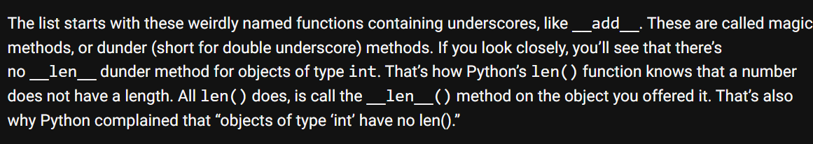
6.3 dir
what
dunder
dir

Slide 10
7. reserved
what
False | def | if | raise
None | del | import | return
True | elif | in | try
and | else | is | while
as | except | lambda | with
assert | finally | nonlocal | yield
break | for | not
class | from | or
continue | global | pass
reserved

Slide 11
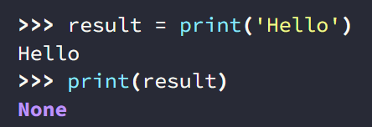
7.1 none
what
none

Slide 12
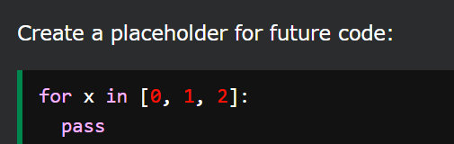
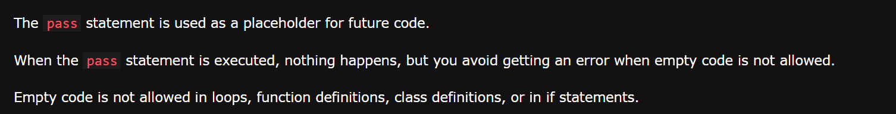
7.2 pass
what
keyword pass

Slide 13
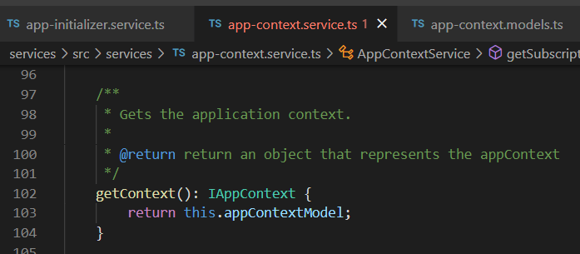

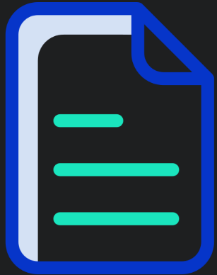


Z. template
new project
ExecuteAsync
square post-it
download
exe
download
exe
why
A slash
followed
by
two consecutive asterisks
D:\A1_research\C2_c0dice\B1_jmeter\A1_install
functionalities
introduction
build-exe
entity framework plus
zig help
⊂
4
every key-frame
defines the operation
success

