Slide 1

1. k8s
portfolio

Slide 2
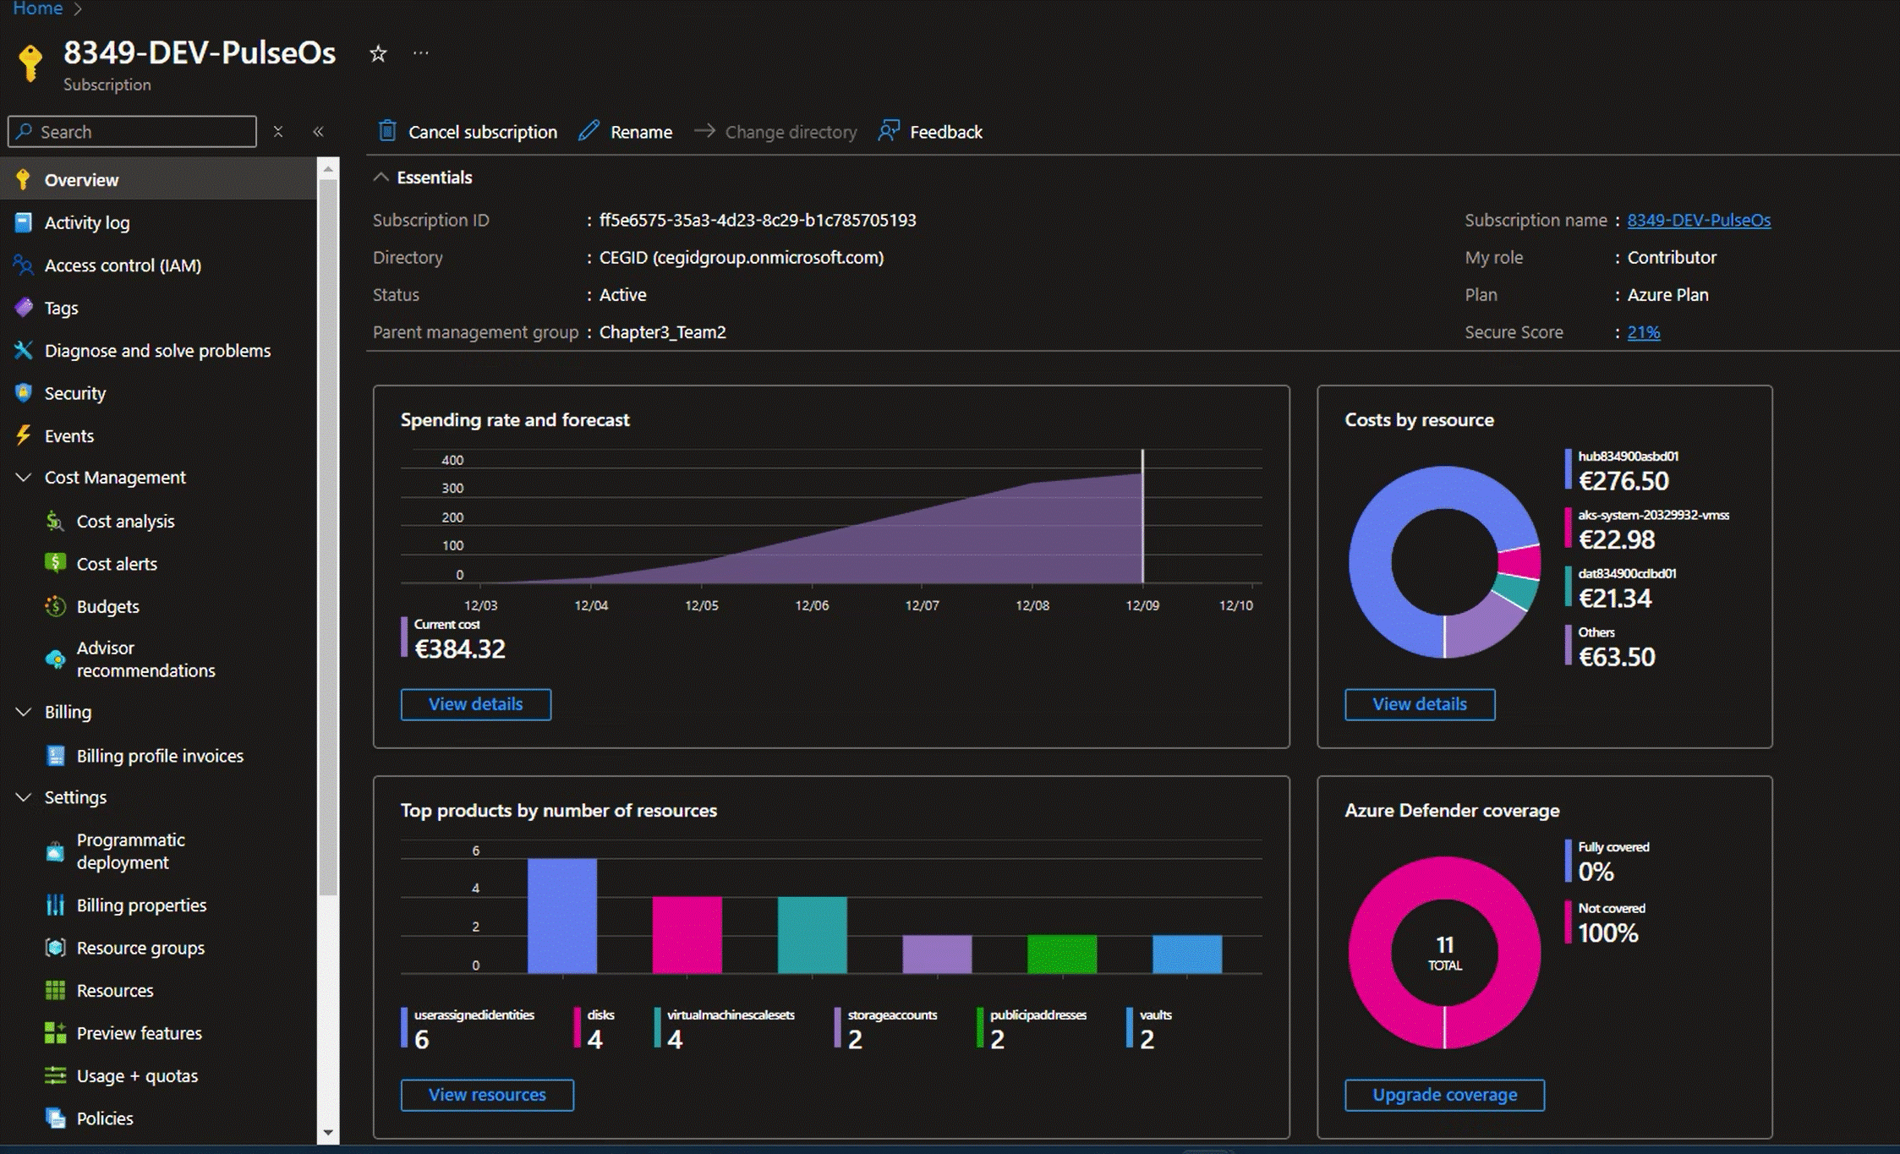

2. subscription
k8s subscription

Slide 3
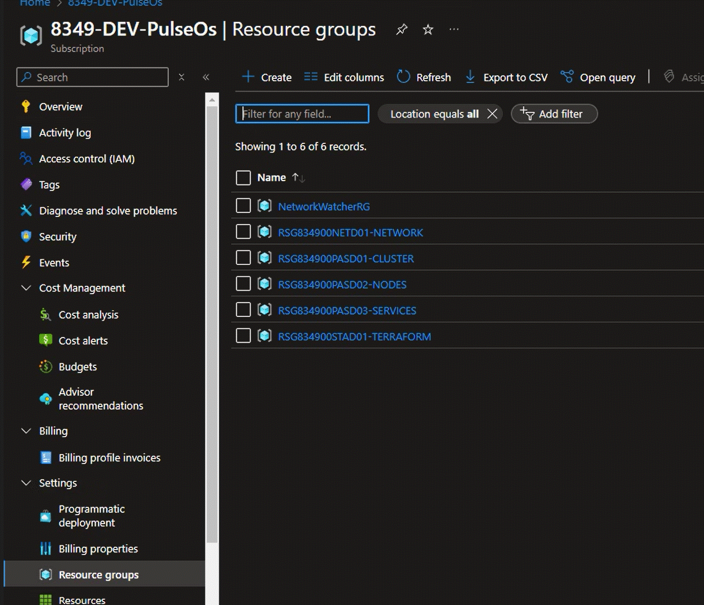
3. resource groups
resource groups

Slide 4
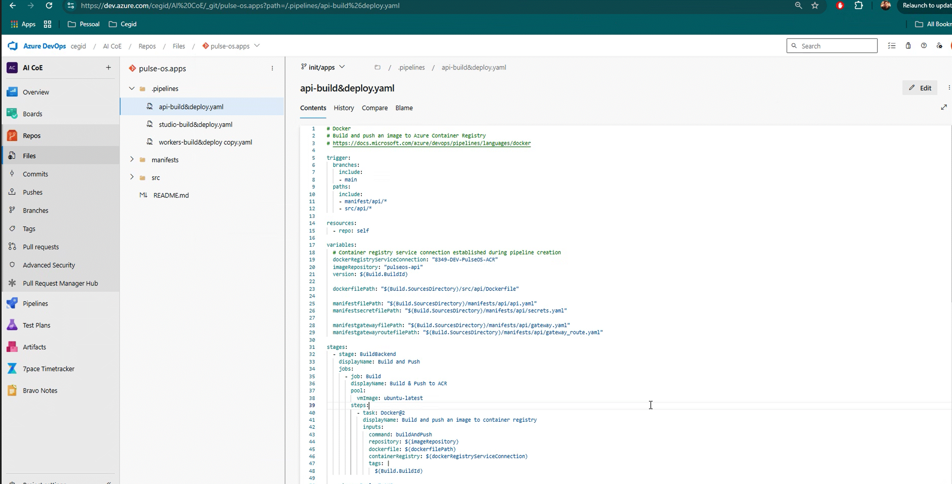
4. pipeline
resource groups

Slide 5
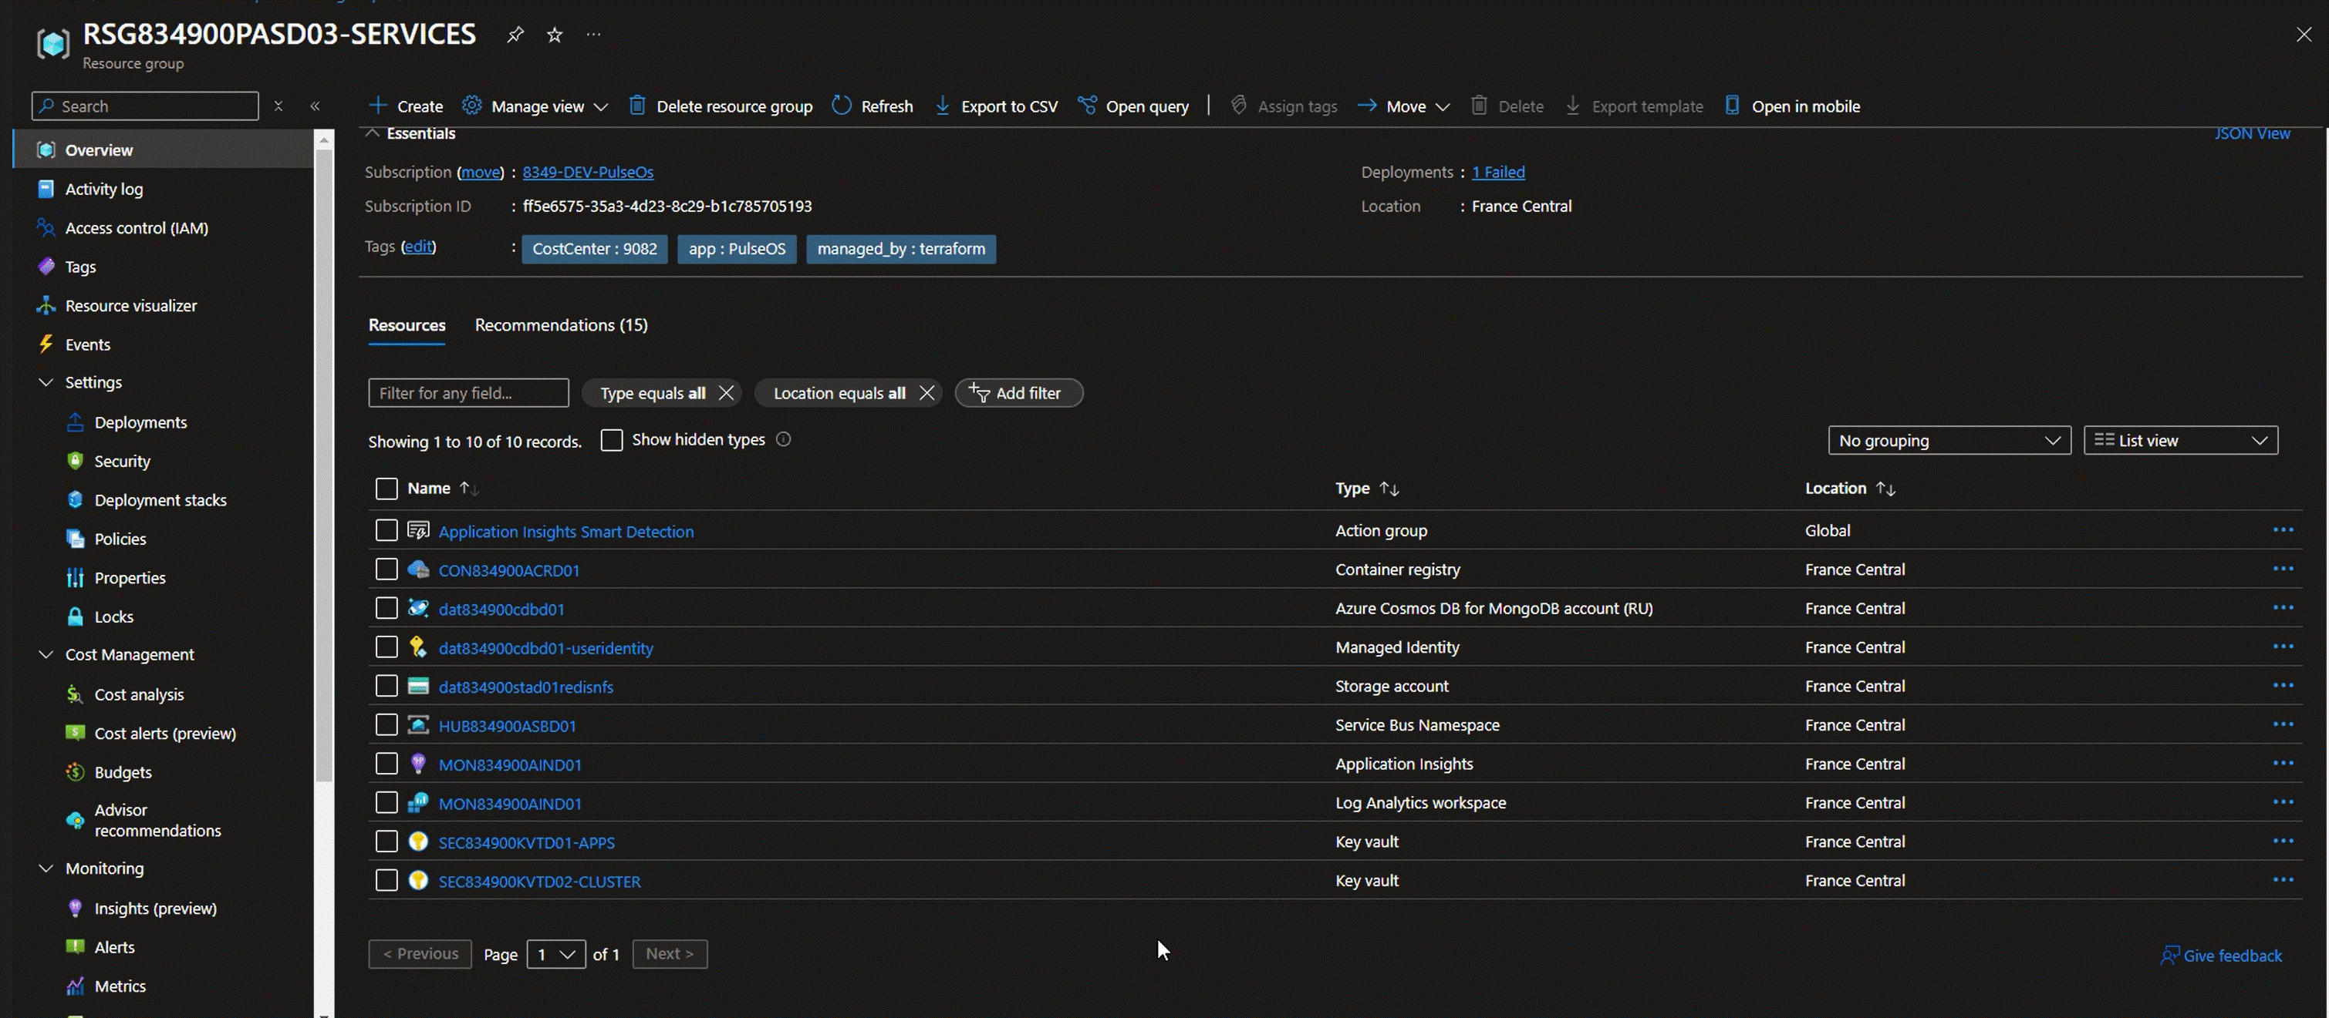
5. services
resource group/service

Slide 6






Z. template
new project
ExecuteAsync
square post-it
download
  exe
download
  exe
why
A slash
  followed
by
  two consecutive asterisks
D:\A1_research\C2_c0dice\B1_jmeter\A1_install
functionalities
introduction
build-exe
entity framework plus
zig help
⊂
⊂
4
every key-frame
defines the operation
deploy

