Slide 1

1. azure logs
portfolio

Slide 2

1.1 sources
video: comprehensive use of logs

Slide 3

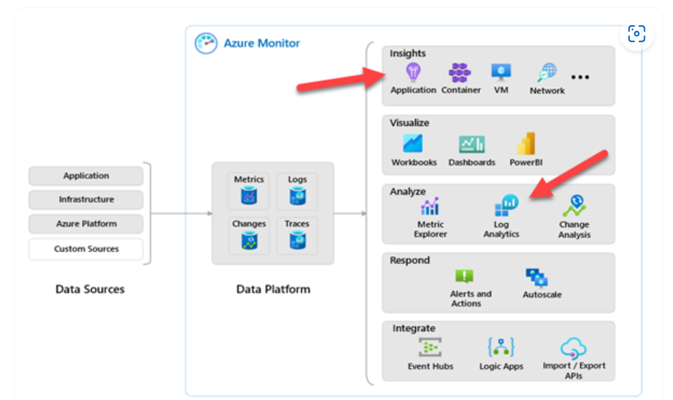
2. concepts
tenant
subscriptions
resource groups
code
app insights
log analytics
workspace
workspaces

Slide 4
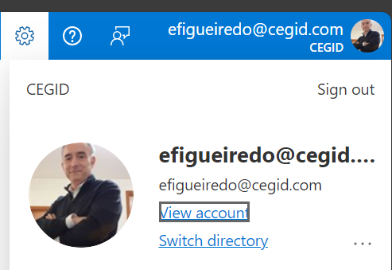
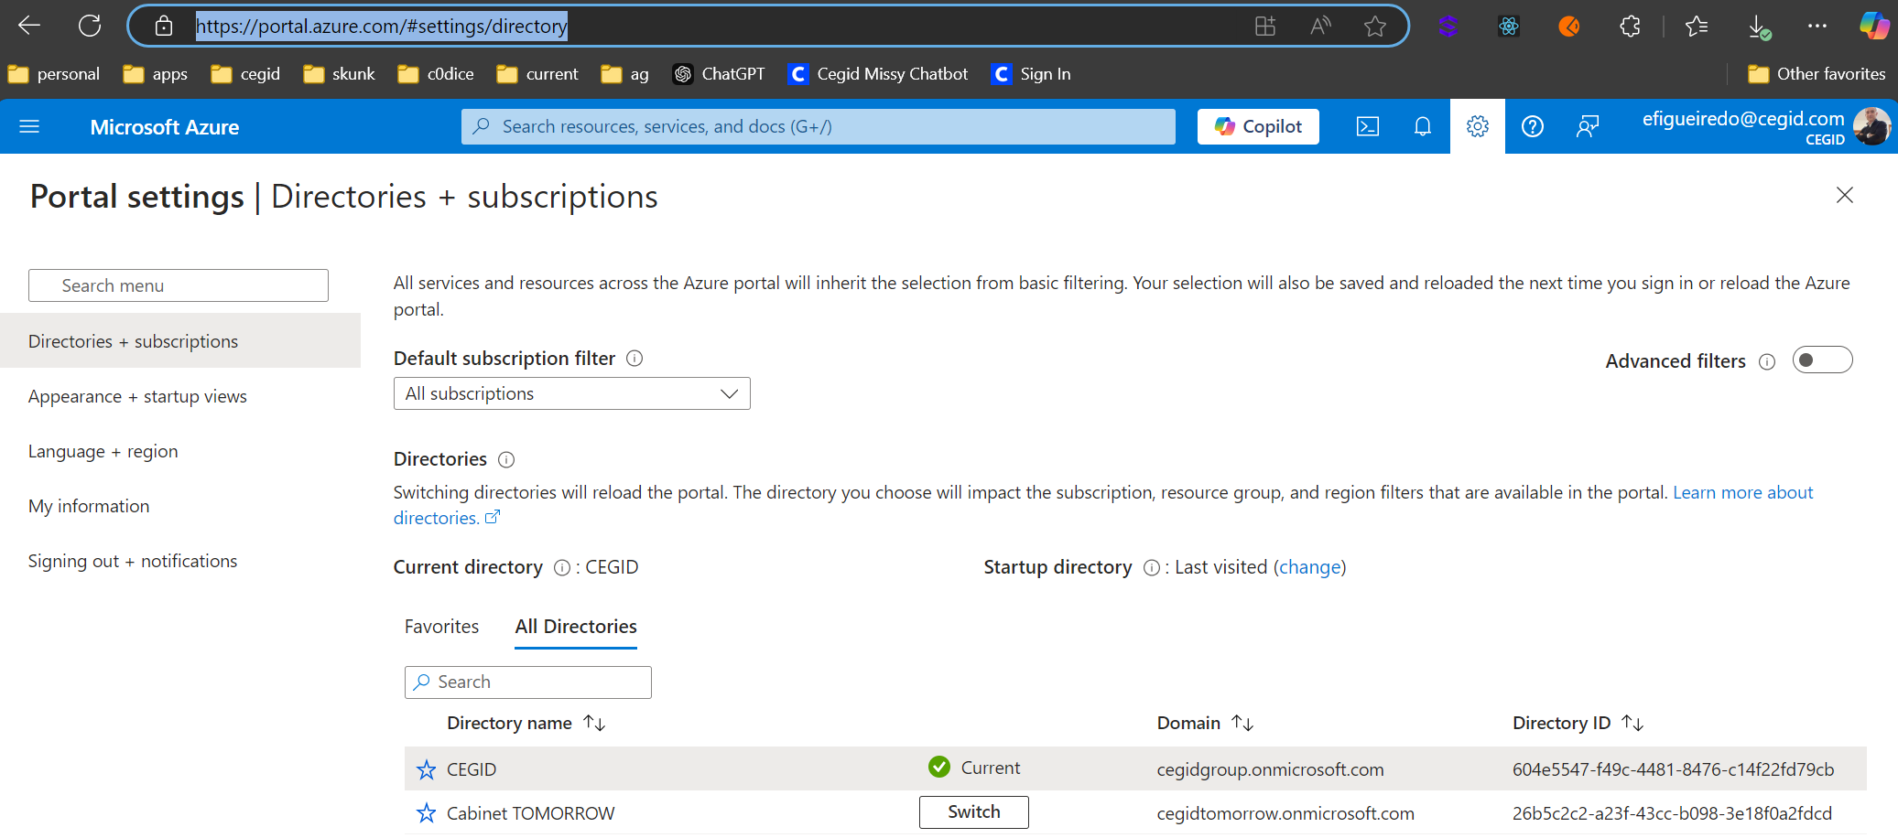
2.1 tenant
what
tenants

Slide 5
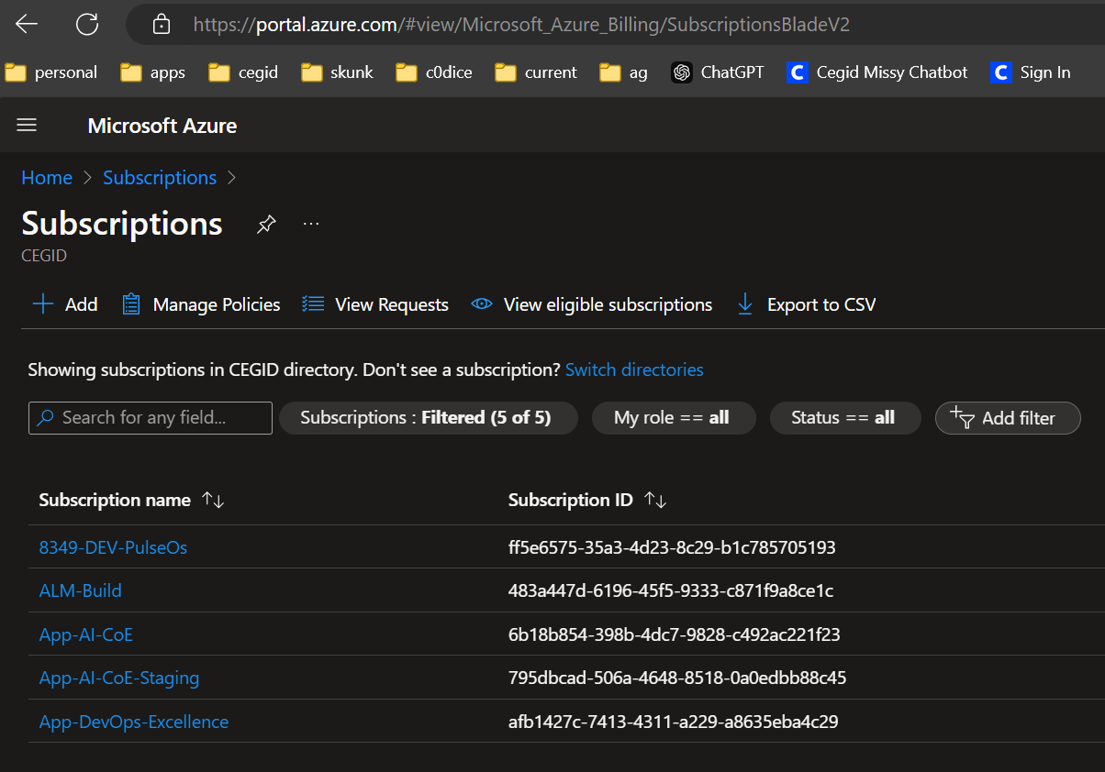
2.2 subscriptions
what
DEV
STG
subscriptions

Slide 6
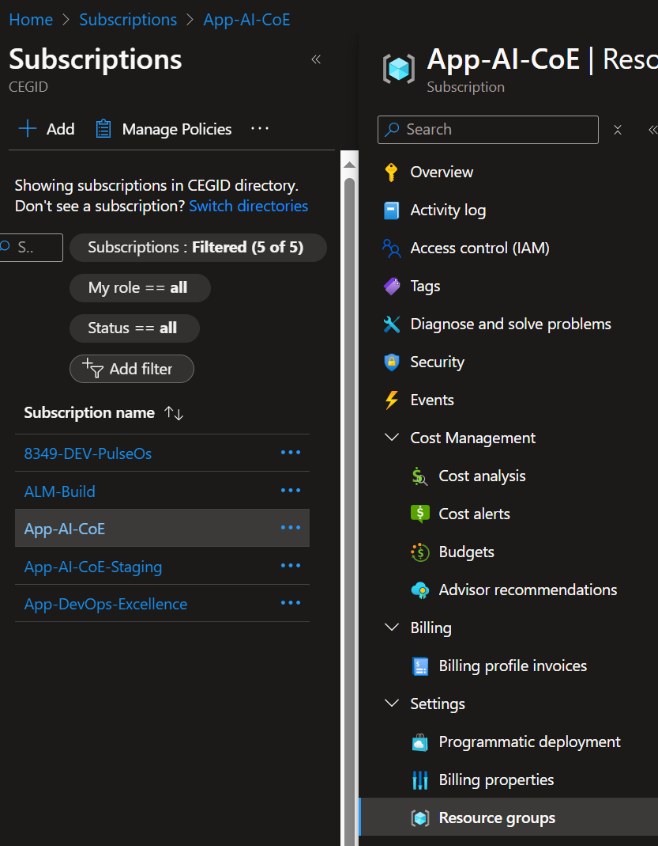
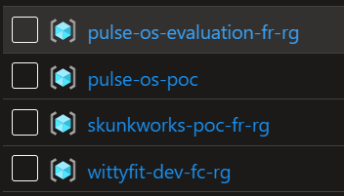
2.3 resource groups
what
resource groups

Slide 7
2.4. code
what
configure_azure_monitor
  is a function
from
  the `azure.monitor.opentelemetry` package
it is used to
  set up Azure Monitor
for
  an application
enabling the application
  to collect and send
telemetry data
  (such as logs, traces, and metrics)
to Azure Monitor
open telemetry
Azure Monitor
observability framework
  providing
APIs and tools
  to
instrument, generate, collect, and export
  telemetry data
monitoring service
  in Azure
that
  collects, analyzes, and acts
on
  telemetry data
integration
by using
  configure_azure_monitor,
we integrate
  Open Telemetry
    with
  Azure Monitor,
Open Telemetry
  collects
telemetry data
  to send
to
  Azure Monitor
for:
  further analysis;
  monitoring

Slide 8
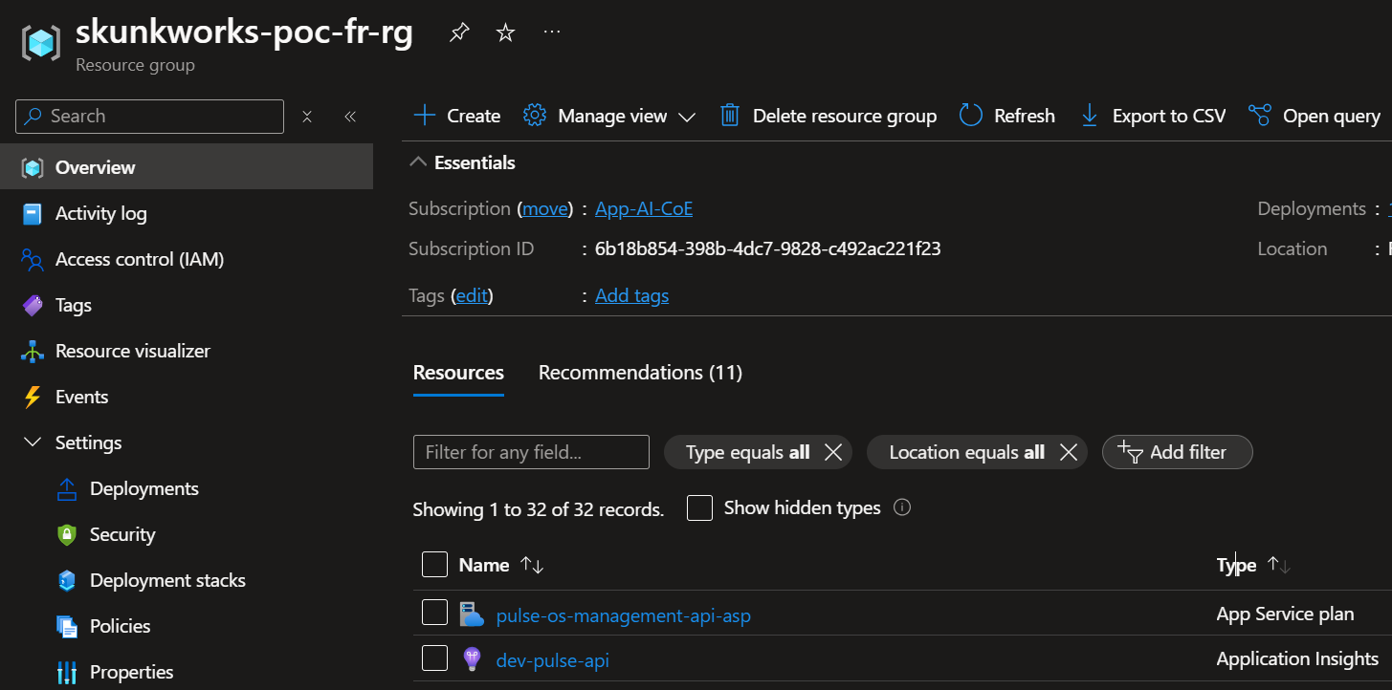
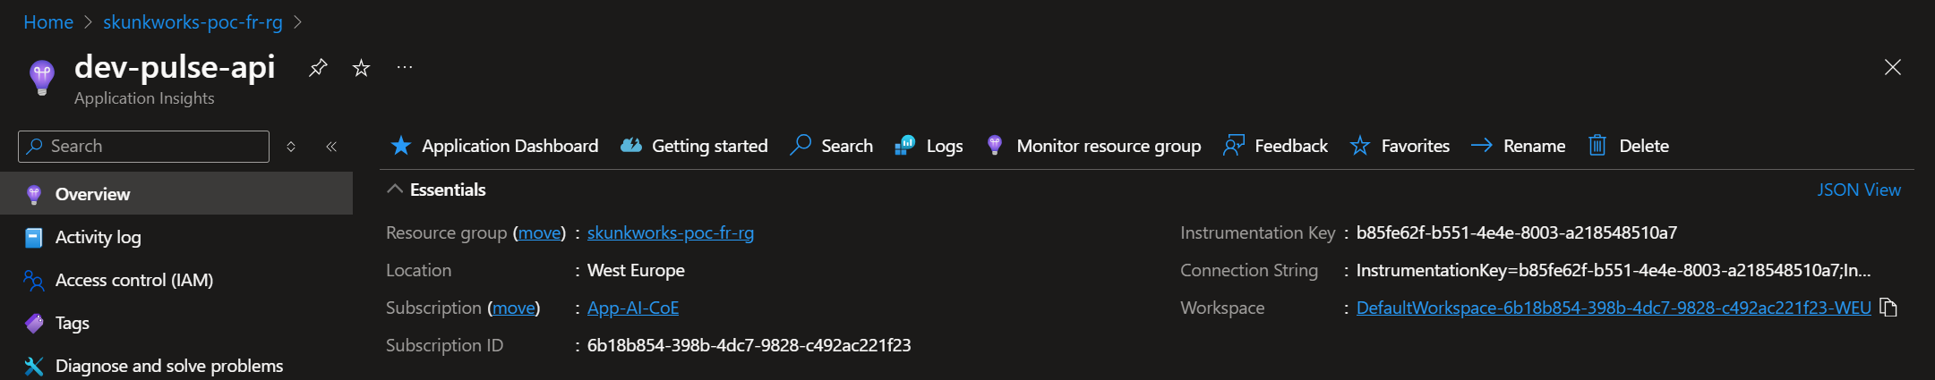
2.5 app insights
what
open app insights
app insights dev

Slide 9
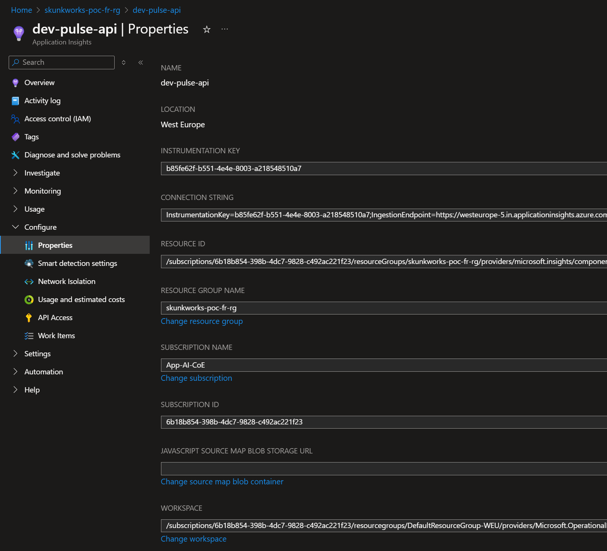
2.6 log analytics
what
app insights
direct link
connection string
app insights dev
tutorial
video
application-insights-vs-log-analytics
log-analytics command line

Slide 10
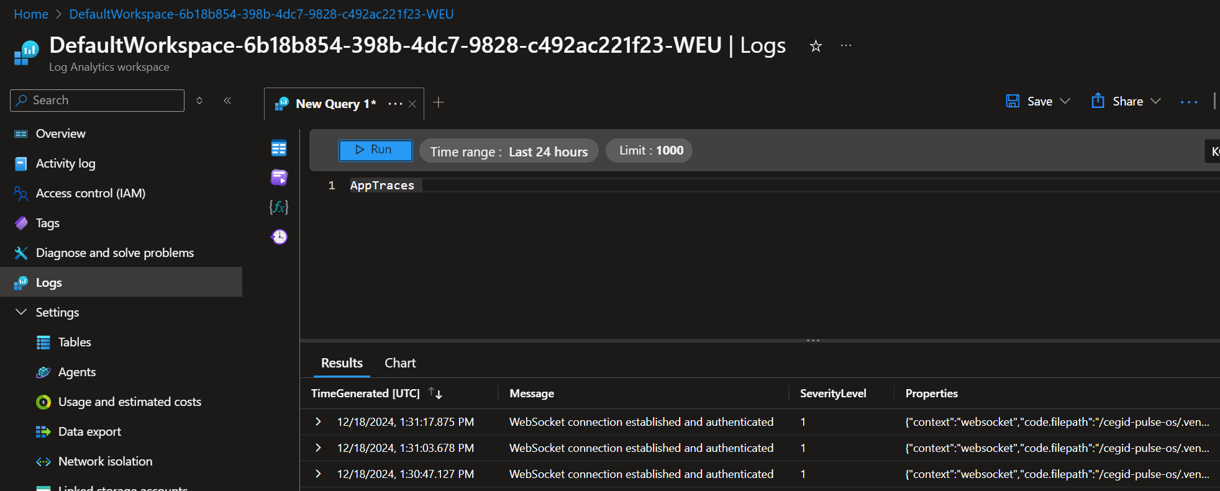
2.6.1 workspace
what
tables
workspace

Slide 11
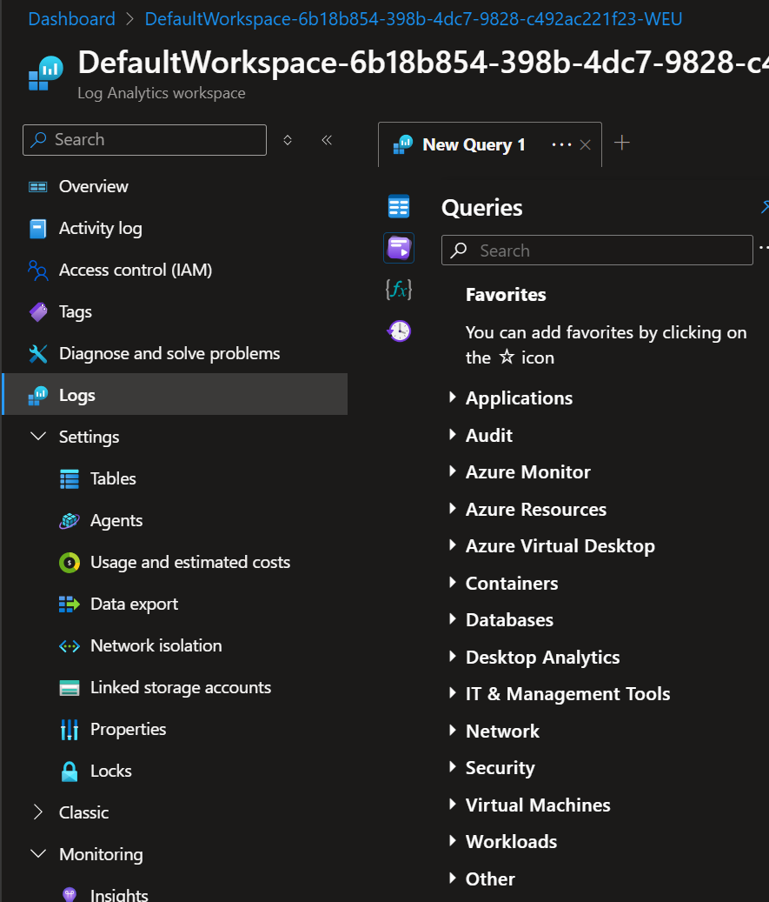
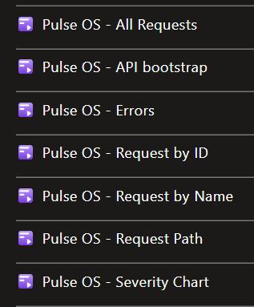
2.6.1.1 queries
what
queries
logs

Slide 12
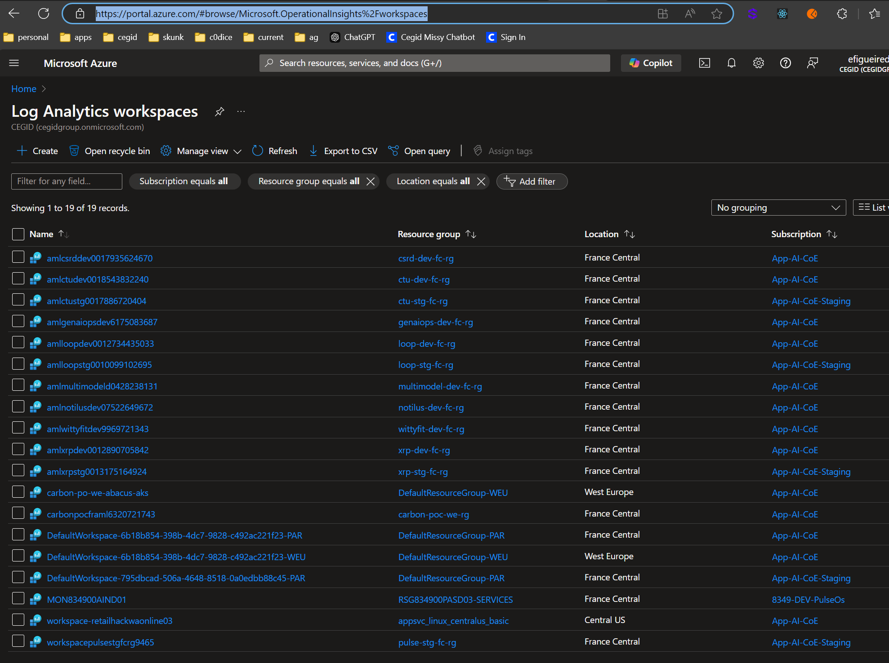
2.6.2 workspaces
what
log analytics workspaces

Slide 13
3. kusto
az kusto cli
guide
plural sight
python sdk
WIP

Slide 14
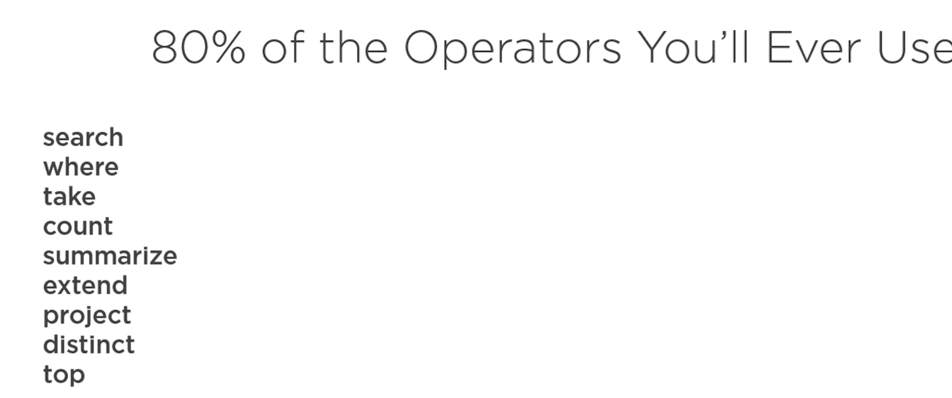
3.1 operators
WIP
plural sight

Slide 15
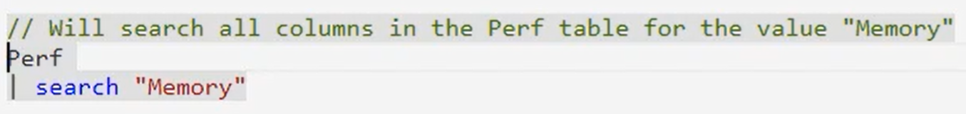
3.2 search
WIP

Slide 16
=> 6. command line

Slide 17
6.1 install
install azure client
extension
az extension add --name kusto
not in use
extension
az extension add --name log-analytics

Slide 18
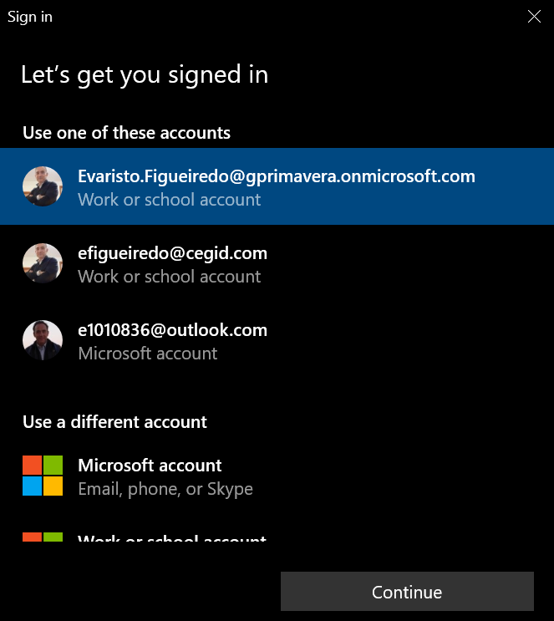
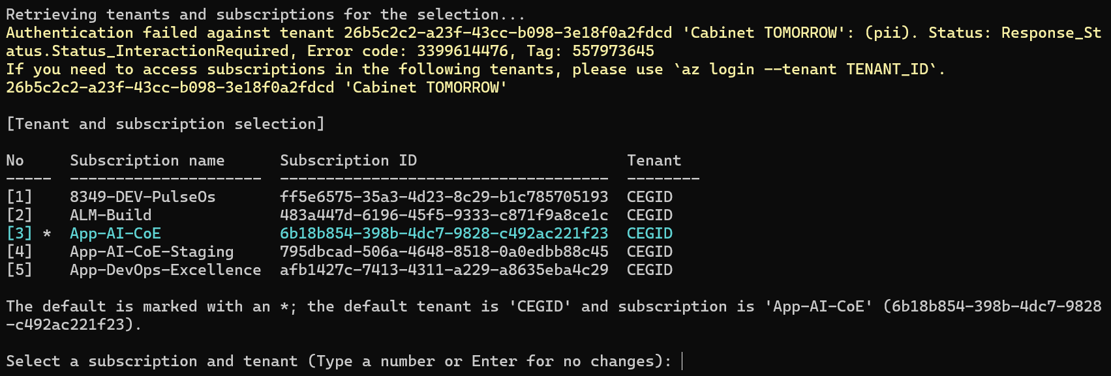
6.2 login
login
az login
sign-in-with-web-account-manager-wam-on-windows

Slide 19
6.2.1 error
not allowed
  login
with
  password

Slide 20
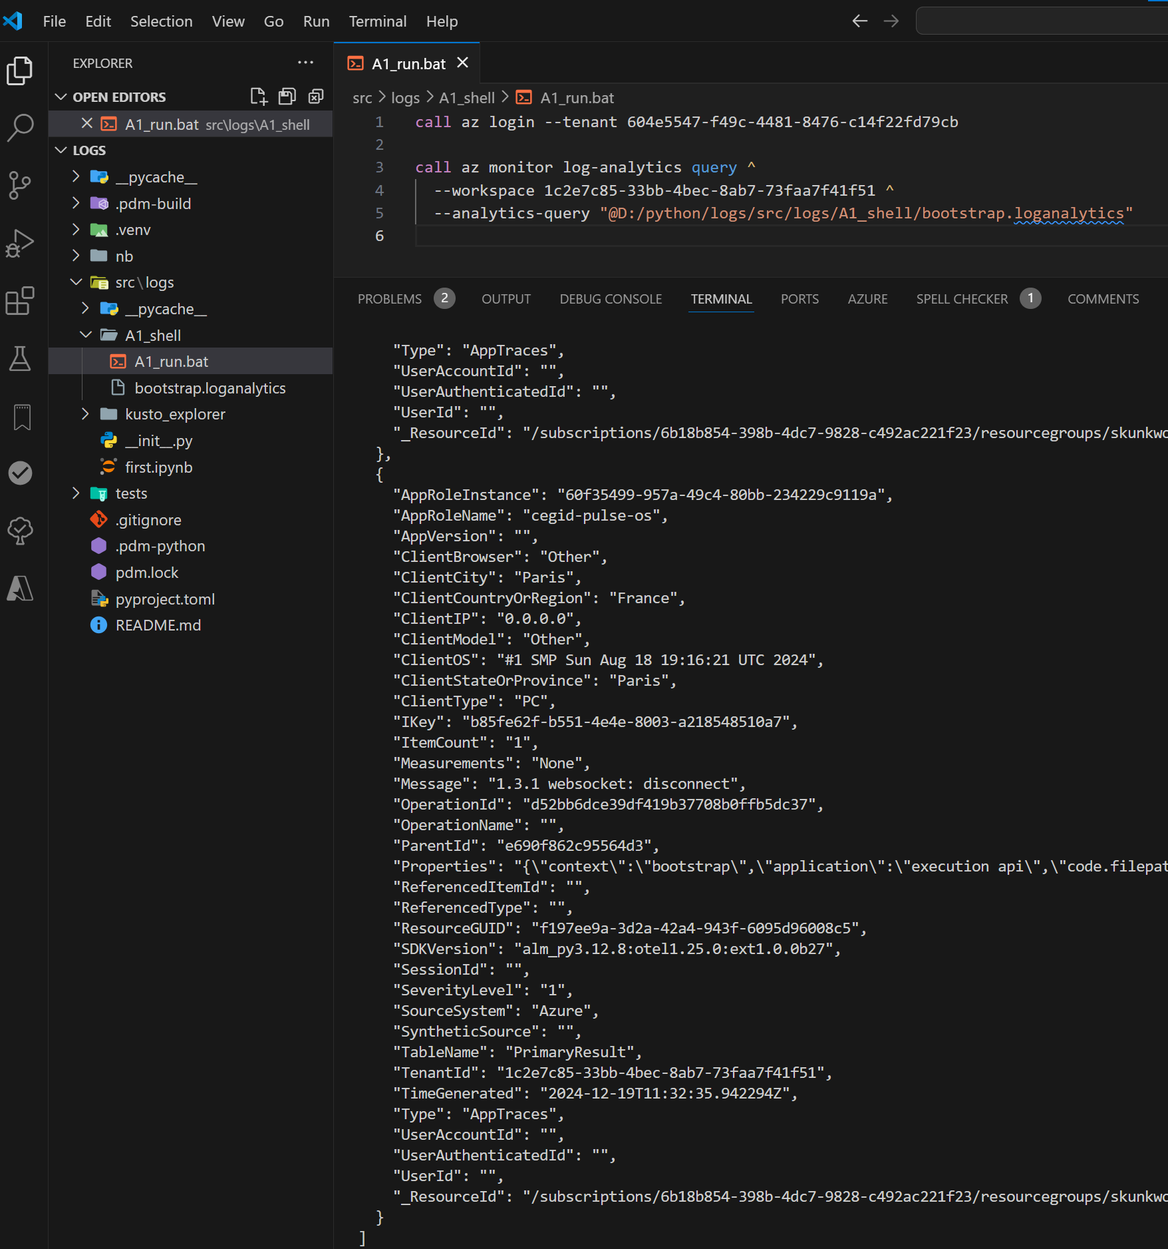
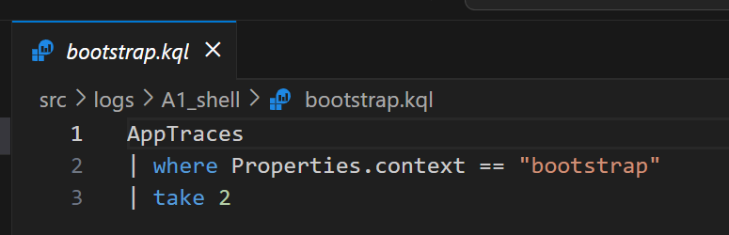

6.3 run
what
call az login --tenant 604e5547-f49c-4481-8476-c14f22fd79cb
call az monitor log-analytics query ^
--workspace 1c2e7c85-33bb-4bec-8ab7-73faa7f41f51 ^
--analytics-query "@d:/repos/business-os/.commands/A4_insights/bootstrap.kql"
..\..\python\logs\src\logs\A1_shell

Slide 21
7. problems
1
it is working
problems
1
the output is in Json not table
2
I need to login every time
3
It access
  the log analytics
not
  app insights
the tables have different names
  in:
    App insights;
    Log Analytics Workspace
different table names

Slide 22
7.1 different table names
what
this discrepancy
  arises because
each service:
  structures;
  names
is
  data tables based
    on
  its specific schema
and
  data collection methods
application Insights
  is tailored for:
    monitoring live applications;
    collecting telemetry data such as:
      traces;
      requests;
      exceptions
  its schema
    is optimized
      for
    application
      performance management,
      with
    tables
      named accordingly
    like
      traces for trace logs
Log Analytics
  is designed for:
    broader log and performance data analysis
      across
    various Azure resources
When Application Insights data
  is ingested
into a
  Log Analytics workspace,
it's mapped into
  the workspace's schema,
which may have
  different naming conventions
For instance,
  Application Insights' traces
    might be mapped to
  AppTraces
    in Log Analytics
  to integrate seamlessly
    with other
      data sources
    and maintain
      a consistent schema

Slide 23
7.2 solutions
1
try different tools
  azure data studio
  kusto explorer
  vsCode extensions

Slide 24
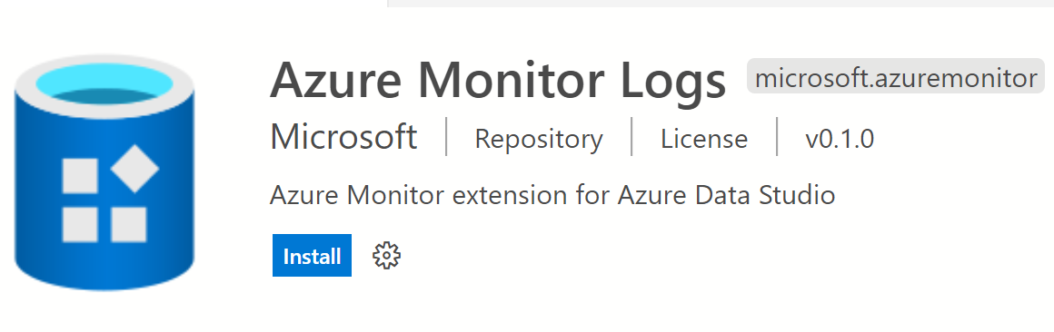
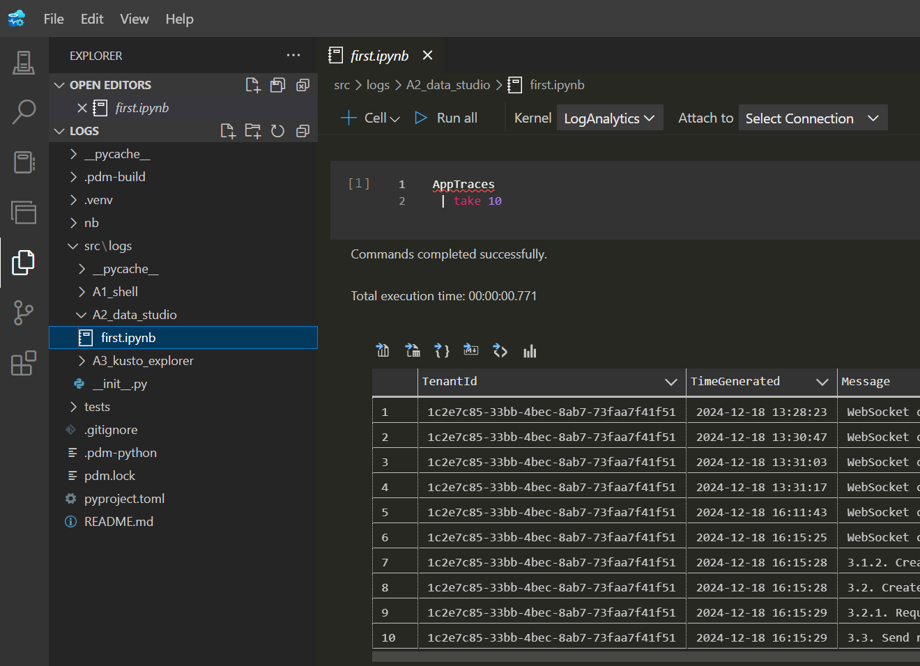
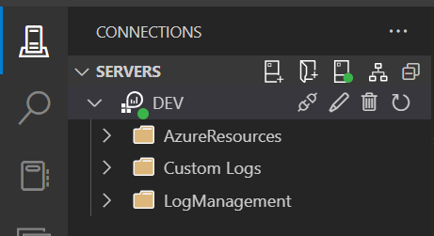
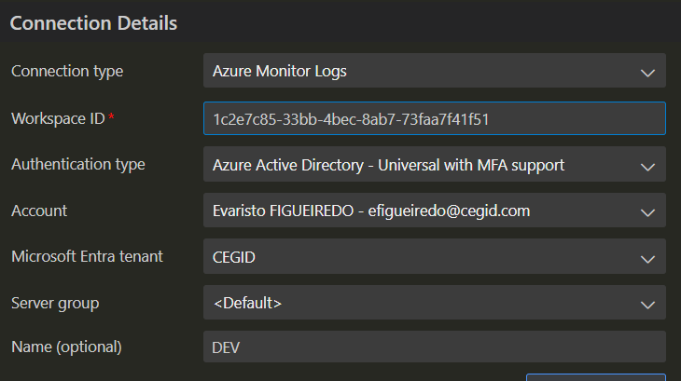
7.2.1 azure data studio
what-is-azure-data-studio
download
extension log-analytics-workspace-in-azure-data-studio
only log analytics
D:\python\logs\src\logs\A2_data_studio

Slide 25
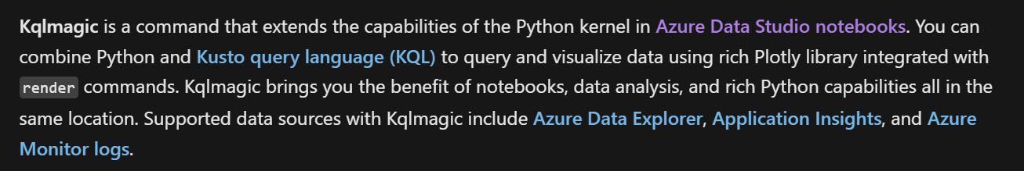
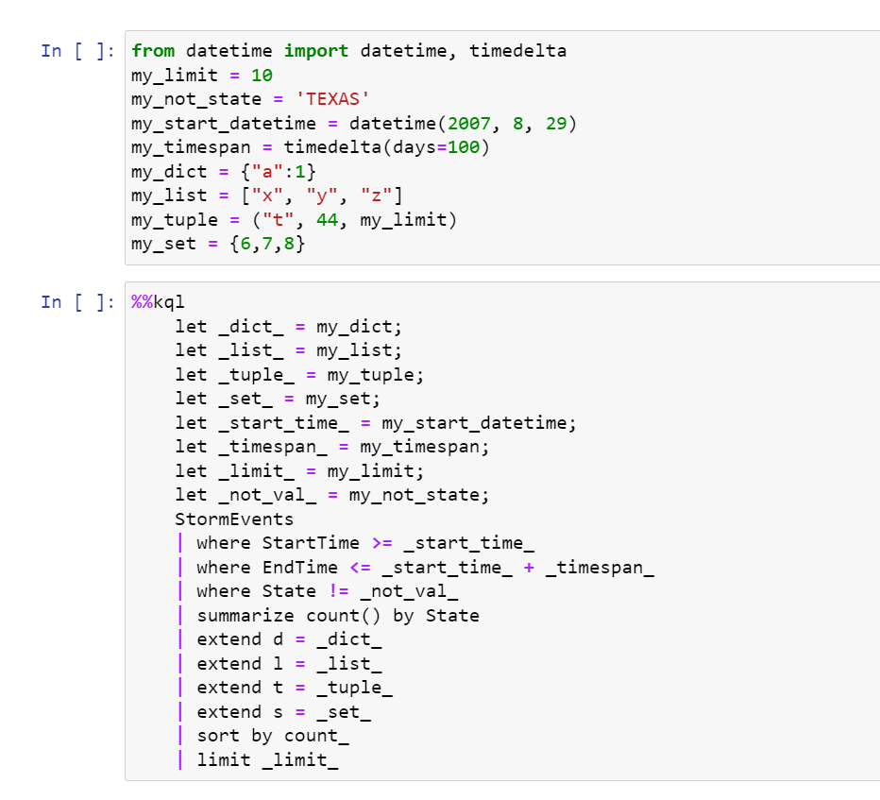
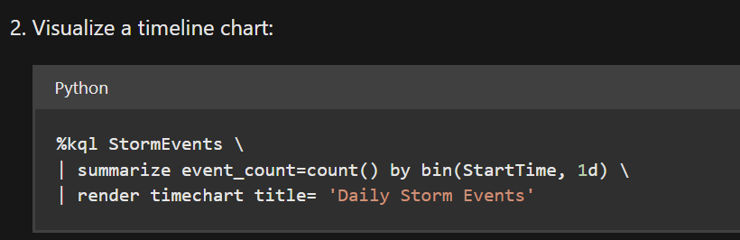
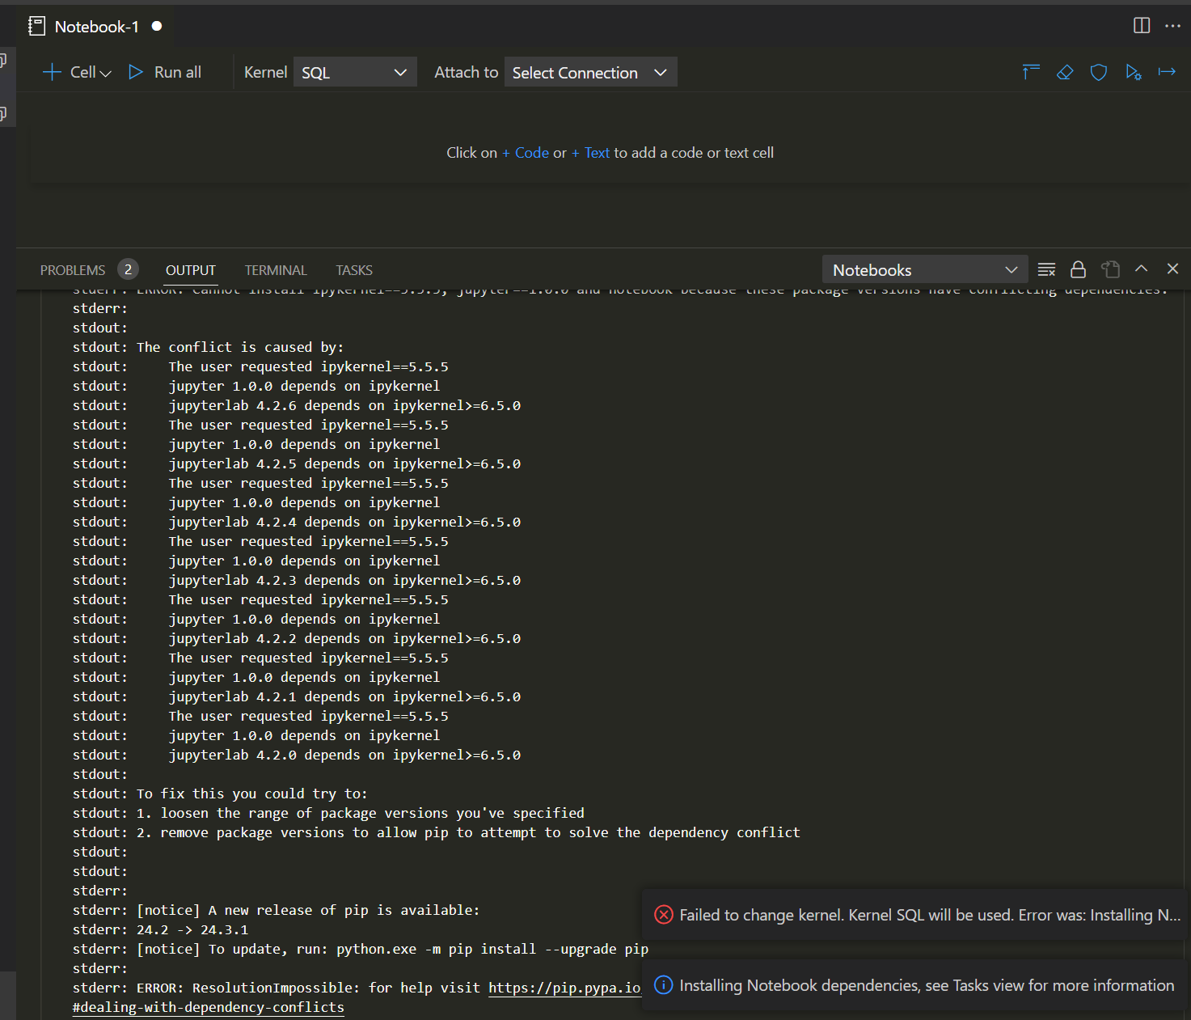
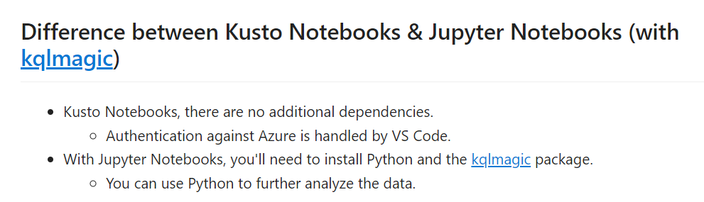
7.2.1.1 KQL Magic
github
Get Started Notebooks
Get Started with Kqlmagic for Kusto
Get Started with Kqlmagic for Application Insights
Get Started with Kqlmagic for Log Analytics
Parametrize your Kqlmagic query with Python
Choose colors palette for your Kqlmagic query chart result
notebooks-kqlmagic
only render
error with notebooks
when change notebook kernel to Python
mix python with kusto
good option to use in vsCode
more research

Slide 26
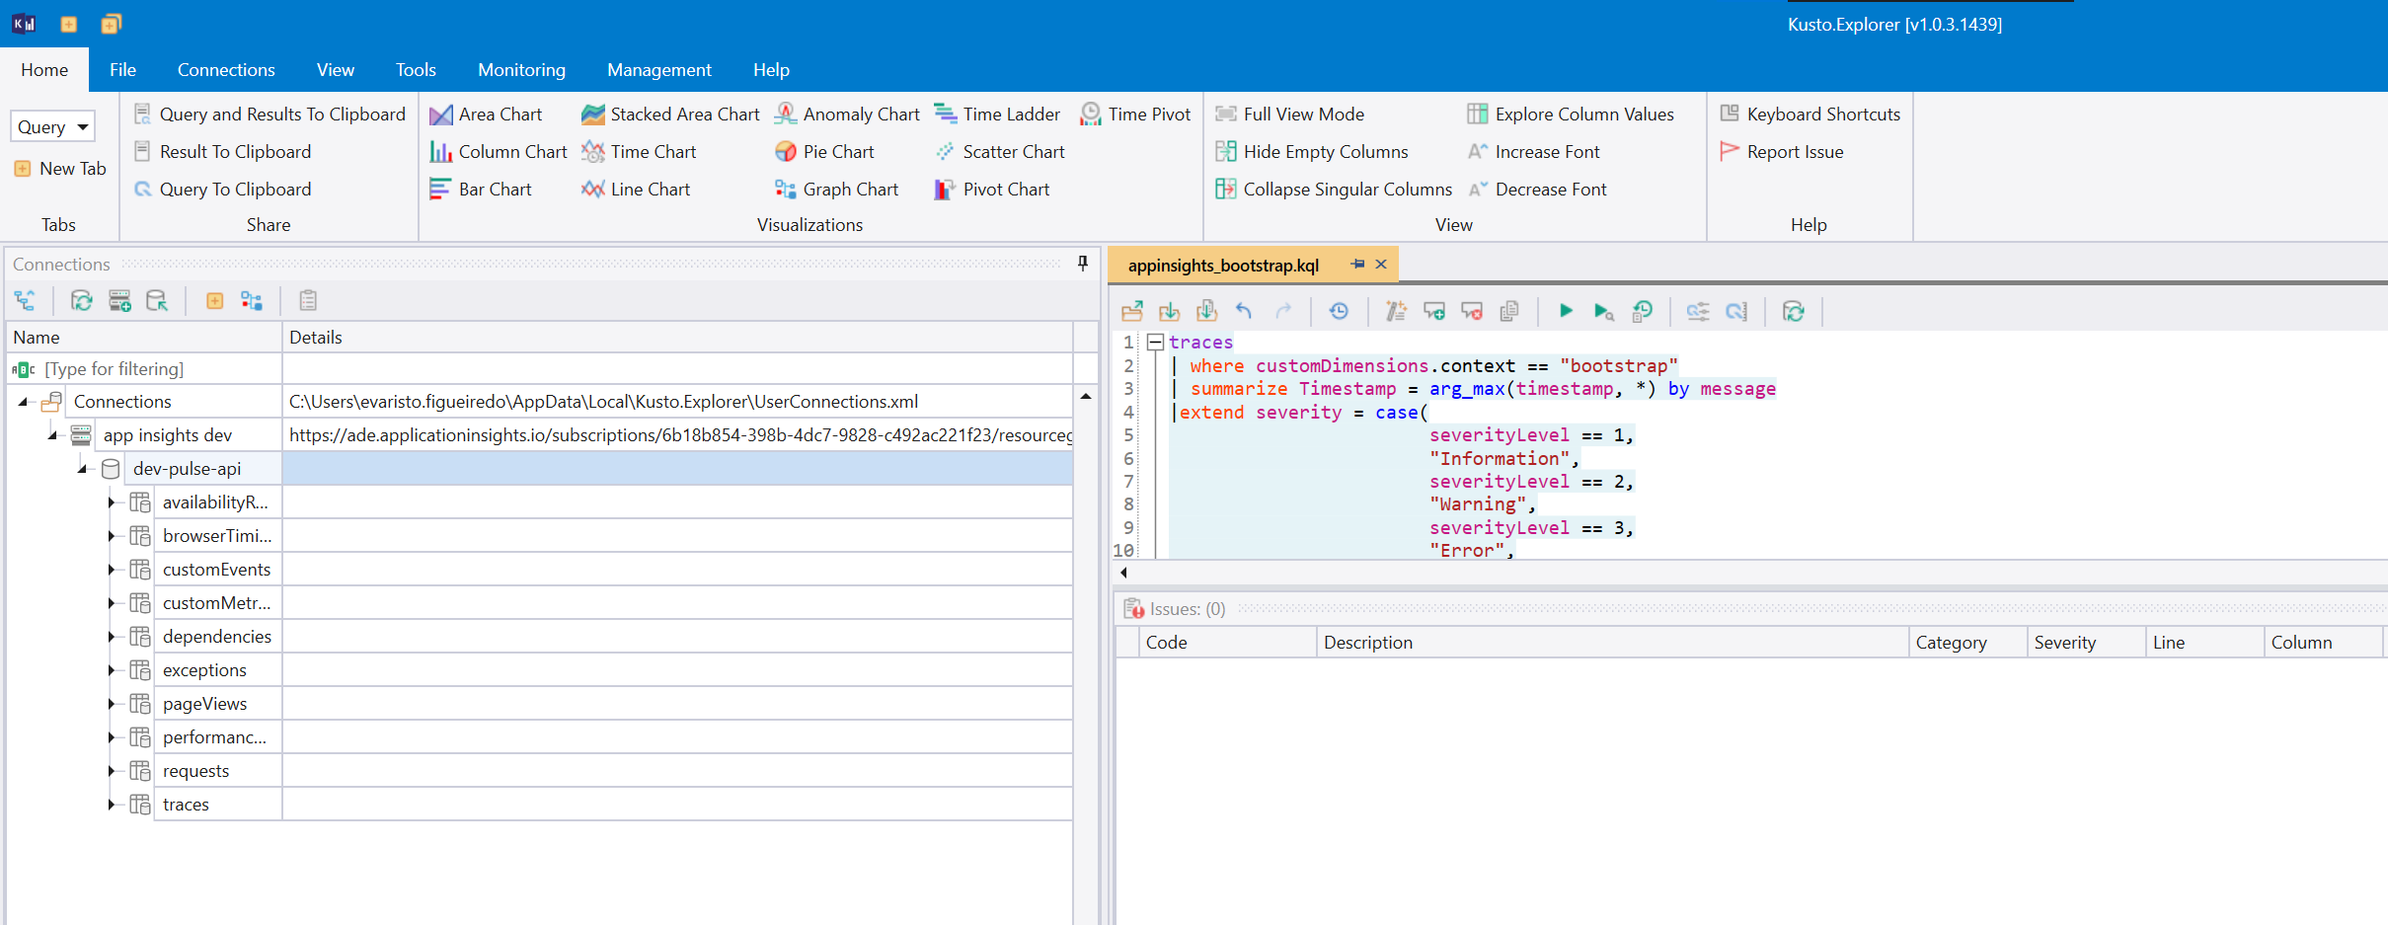
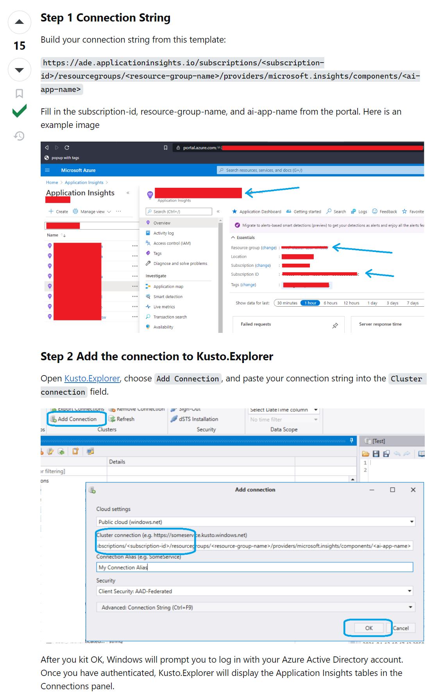
7.2.2 kusto explorer
kusto-explorer: install and tutorial
it works
D:\python\logs\src\logs\A3_kusto_explorer
no project???
connection string
need more research
https://ade.applicationinsights.io/subscriptions/6b18b854-398b-4dc7-9828-c492ac221f23/resourcegroups/skunkworks-poc-fr-rg/providers/microsoft.insights/components/dev-pulse-api
query-my-application-insights-logs-analytics-from-kusto-explorer

Slide 27
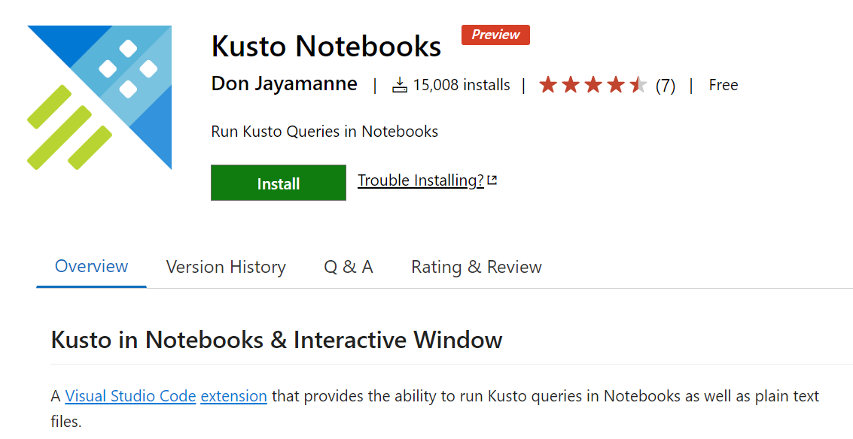
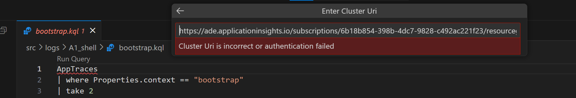
7.2.3 vsCode
vsCode extension for Kusto
I don´t know how to connect
connection-strings/kusto

Slide 28
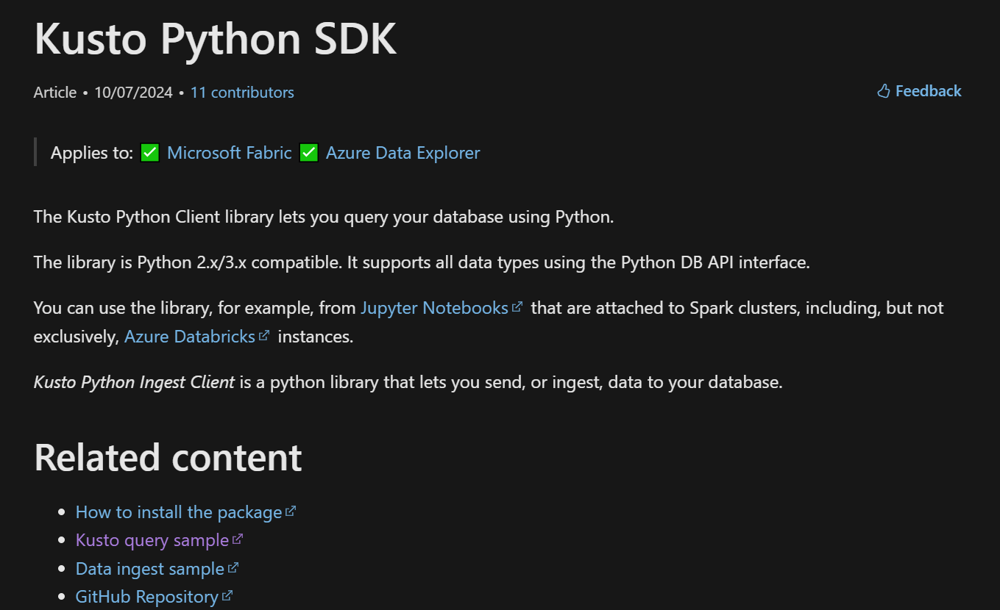
7.2.4 python
not explored
/kusto-python-client-library
github

Slide 29




Z. template
new project
ExecuteAsync
square post-it
download
  exe
download
  exe
why
A slash
  followed
by
  two consecutive asterisks
D:\A1_research\C2_c0dice\B1_jmeter\A1_install
functionalities
introduction
build-exe
entity framework plus
zig help
⊂
⊂
4
every key-frame
defines the operation
deploy

