Slide 1

1. requirements
NEXUS

Slide 2
1.1 index

Slide 3

1.2 resources
wiki

Slide 4
2. summary

Slide 5
3. perspective

Slide 6
3.1 customer
3
the flow is simple and product-oriented
with this token in hand,
  the team
moves on
  to
the development phase
From the customer’s point of view
2
an internal team
  that wants to build an AI solution
the UI communicates
    with
  a platform API,
which
  validates the request
  and persists all the information
    in a central database
as a result of this process,
  a unique token/key is generated,
  which identifies that team
  and that solution within the platform.
this token represents the technical identity
  of the solution
The customer starts by accessing a UI application
  (portal) of the platform
In this portal,
  they register a request to create a new AI solution,
    providing information such as
      the responsible team,
      use case description,
      type of desired solution,
      and other relevant metadata.
the platform provides
  an official library
that can be used
  in
different languages
  (depending on existing support),
1
for example,
  simple agents,
  multi-agent workflows,
  decision graphs (LangGraph),
  AG2,
  or other approaches
    supported by the platform
allowing the team
  to build their
AI solution
  using
the framework they prefer
4
the team develops
    their AI solution
  locally
  using this library,
without worrying about
  runtime details,
    authentication,
    scalability,
    or observability,
  because these responsibilities
      are abstracted by
    the platform
5
when the solution is ready,
  the customer
    uses
  an official platform CLI
to start
  the deployment process.
5.1
the solution is
  registered
    in
  the platform
    as
  an AI agent/service
the deployment metadata
  stored
    in
  the database
the solution is
  packaged
  and executed
as
  a pod
in
  EKS
AI solution
  becomes
active in
  the platform runtime.
this deploy command
  uses
the previously generated token
  to
authenticate the operation
here

Slide 7
3.1.1 result
this endpoint
  represents
the public interface
  of
the AI solution
  created by
the team
6
the customer
  can create
    one or more assistants
  that consume
    this solution
each assistant
  gets
a dedicated endpoint
    which
  can be called by
    the customer’s applications
      (UI, backend, automations, etc.)
7
the customer focuses only on:
  designing the AI logic
  deploying via the CLI
  consuming the solution’s endpoint
all infrastructure, security, scalability, and governance
    are handled
  by the platform

Slide 8
3.2 developer
the official CLI,
which is responsible for:
  authenticating the user with the platform
  packaging the AI solution
  registering the agent via the API
  triggering the deployment
    of the solution
    in the runtime (EKS)
3
Platform developers’ perspective
includes
  standard agents
    routing,
    orchestration,
    fallback
  common utility functions
  integration with RAG, tools,
    and supported providers
  authentication and identity
    mechanisms
      based on
    the platform token
the team that builds the product
provide a
  stable,
  extensible,
  and governed
ecosystem
    that enables
      client teams
    to create
      AI solutions
        in
      a consistent way
2
are responsible for
  developing
  maintaining
the platform’s
  official library
infrastructure
design and maintain
      the execution runtime,
    where
      each AI solution runs
        as
      an isolated workload (pod)
        in
      Kubernetes
resource control
isolation between solutions
observability
scalability
security policies
1
4
defines
  the technical contract
      between
    the clients’ AI solutions
    the platform runtime
5
provides
    common abstractions,
    helpers,
    patterns
that allow teams
    to build
  agents,
  workflows,
  AI integration’s
      without direct coupling
    to the infrastructure
platform
maintains
  a central API database
    that act as
  a system of record
    control panel,
customers and teams
tokens/keys
registered solutions
active agents
assistants and endpoints
is distributed
  internally
through JFrog,
  ensuring
    versioning, control,
    reuse
  the different teams
here

Slide 9
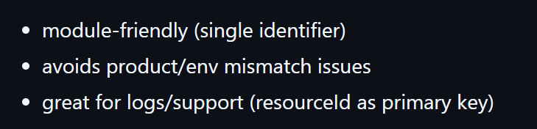
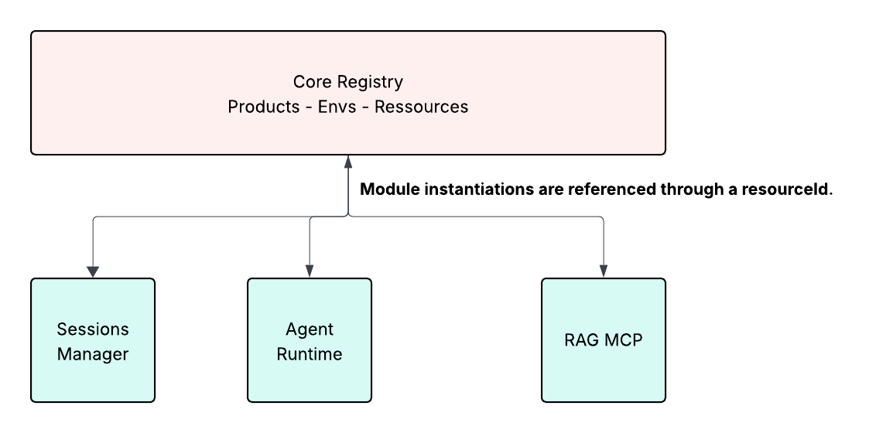
4. core
can we have same module in different products?
1. module 1 – 1 resource
Allow modules to resolve their execution context using a stable identifier: resourceId.
source
Provide a shared and stable definition of ProductEnv (product + environment + region + policies/config).

Slide 10
4. core
1. module 1 – 1 resource 1 – n tenants 1 - env
must be isolated per environment?
needs to be a table
source
module name is just for human readable because:
  resource 1 -- 1 module
same tenant can be repeated in resource = module

Slide 11



Z. template
V
2. FOUNDRY
1. project
download
  exe
foundry
engines
build-exe
foundry
D:\repos\minerva\lumen\lumen\ai\tools.py
4
success

