Slide 1
1. nexus

Slide 2

1.1 index
requirements
infra

Slide 3

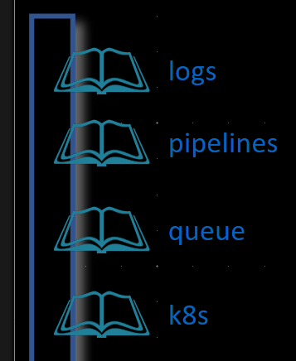
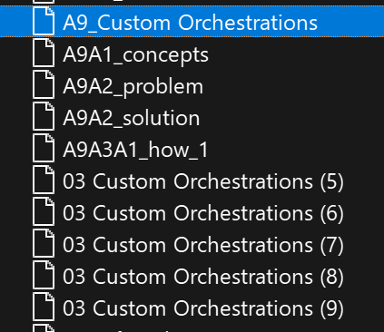
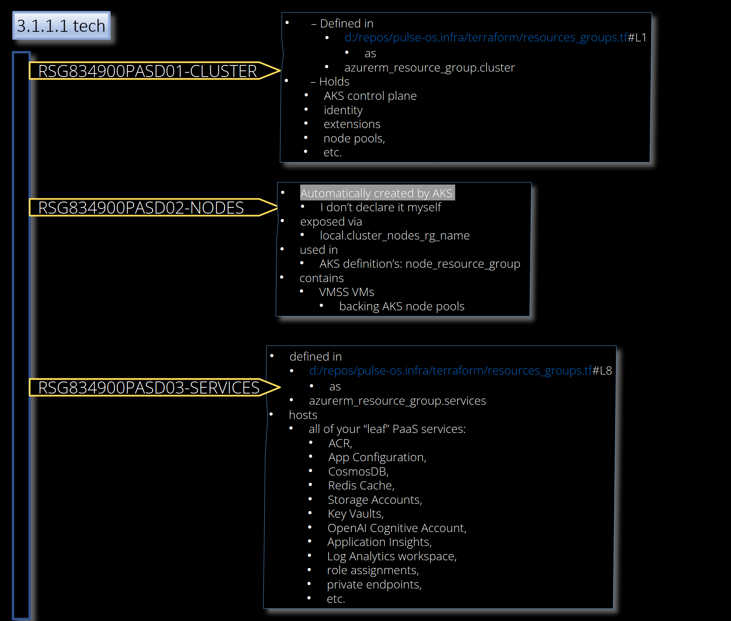
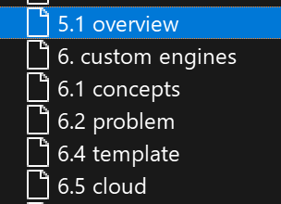
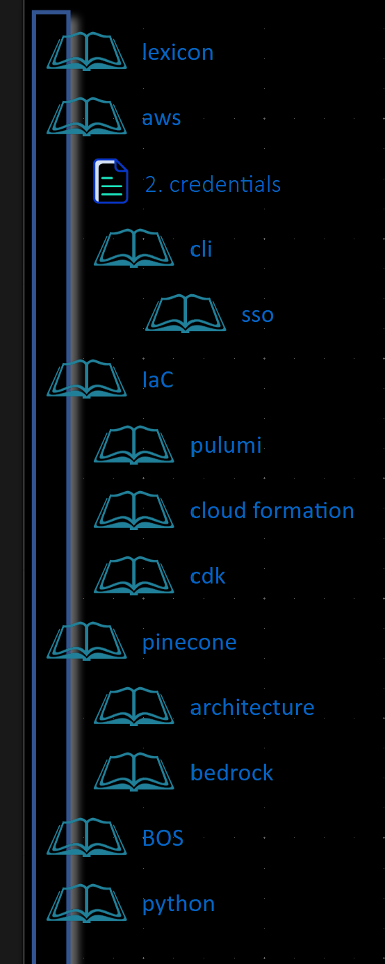
1.2 resources
glossary
platform engineiring
UI
UI
azure
azure
zensical
fern
fern - project
pulse OS
presentation Oct 25
IDP
infra
engines
docker
docker
presentation Ago 25
aws
need
to be
organized
aws
ODP report

Slide 4
2. summary
not using a traditional "Project Management" framework (like PMBOK or RUP)
engineering philosophy called Platform Engineering
"Docs-as-Code" methodology.
(Nexus Platform, Team, Roadmap, Architecture, Engineering, Operations) is a textbook implementation of
  an Internal Developer Portal (IDP).

Slide 5
3. zensical
what
documentation should evolve as rapidly as the software it describes
eliminating the friction between development velocity and documentation quality
coherent systems that let you stay in the flow and align your processes with your pace and way of working
offers you peace of mind by providing an open yet integrated solution, designed as a combination of performance, robustness, and flexibility
teams can
  document knowledge
    with ease
    work across traditional information silos
    to create
      more timely, accurate, and accessible
    documentation
As a technical writer,
  your work seamlessly integrates
    with
    product development
    and
    other business processes
  rather than lagging behind
zensical

Slide 6
4. fern
what
Build beautiful, interactive documentation websites with Fern Docs. Create API references, custom components, and AI-powered features in under 5 minutes.
zensical

Slide 7



Z. template
V
2. FOUNDRY
1. project
download
  exe
foundry
engines
build-exe
foundry
D:\repos\minerva\lumen\lumen\ai\tools.py
4
success

