Slide 1
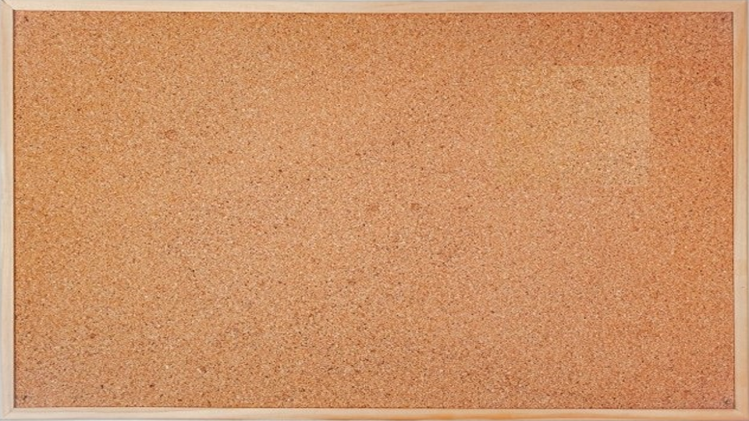


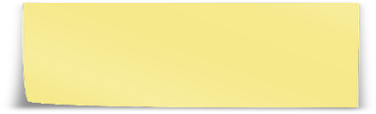
1. user story
TO DO
DOING
DONE
user story
create <feature> branch
merge from feature
feature
develop
commit code
commit unitary tests
main
v1.0.0

Slide 2







Z. template
new project
ExecuteAsync
square post-it
download
  exe
download
  exe
why
A slash
  followed
by
  two consecutive asterisks
D:\A1_research\C2_c0dice\B1_jmeter\A1_install
functionalities
introduction
build-exe
entity framework plus
zig help
⊂
4
every key-frame
defines the operation
success

