Slide 1
1. git flows

Slide 2

1.1 index
access
feature
setup

Slide 3


1.2 resources
_resources
pending
finish report
  review V1
    what: Git lab
  review V2
    what: trunk and considerations
TBD
report_v1
trunk based development
report_v2
https://www.eisquare.co.uk/blogs/how-to-choose-your-branching-strategy
pull requests
https://trunkbaseddevelopment.com/branch-for-release/
chat GPT

Slide 4
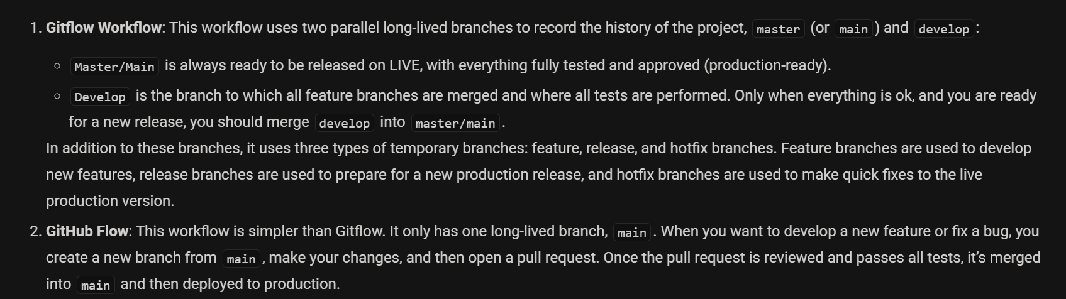
2. what

Slide 5
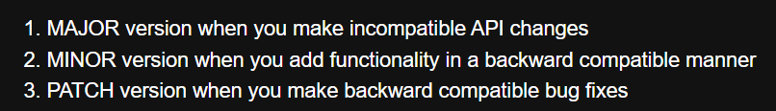
3. versions
what
versions

Slide 6




4. flow
only once
major/minor cycle
bugfix
multiple
feature
develop
development
QA approval
staging
integration
v1.0.0
v1.1.0
acceptance
main
production
v1.0.0
v1.0.1
v1.0.2
v1.1.0
QA approval
multiple
hotfix
old version
for every
old version
QA approval
support
patch cycle
production
branch
branch
merge
cherry pick
commit
commit
deploy
environment

Slide 7
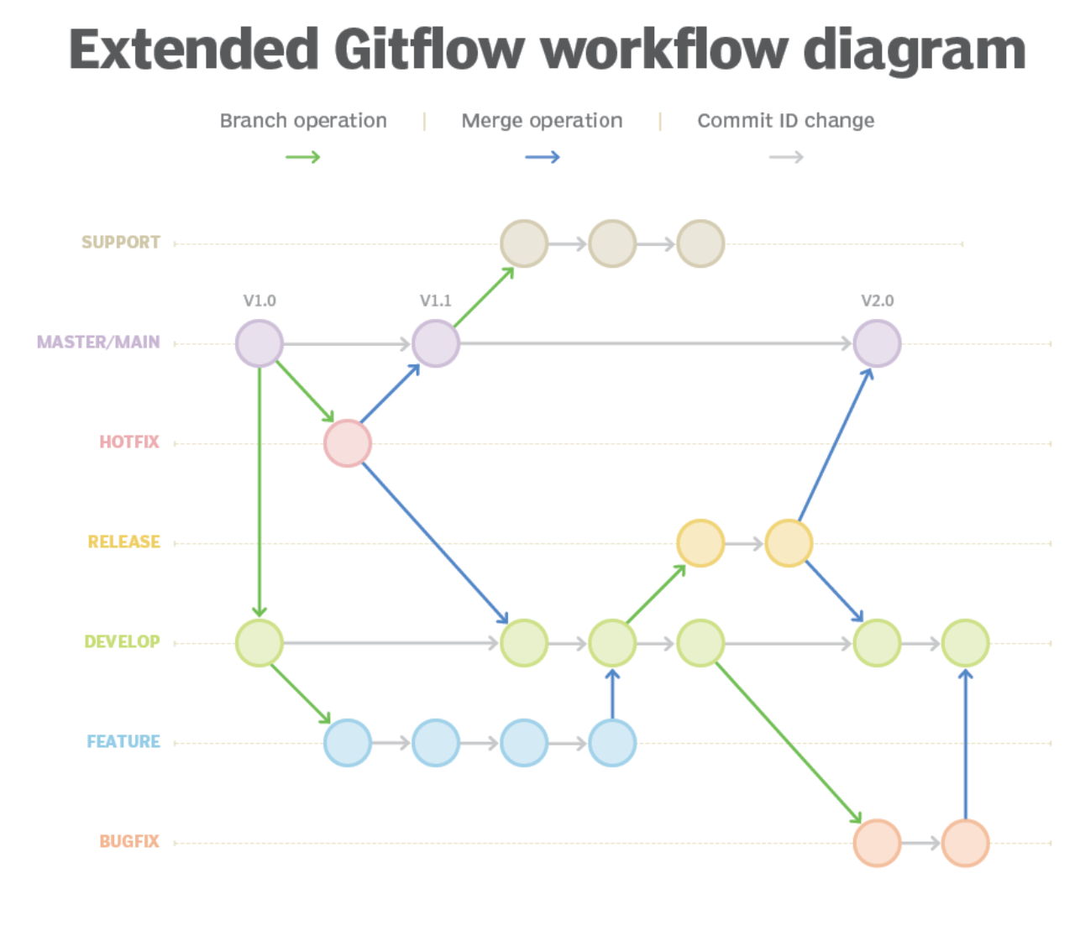
4.1 reference
A better Gitflow diagram with branches, merges and color
GitLab Flow

Slide 8
4.2 promote
1
Create feature (or bug-fix) branches off DEV
2
Promote a range of commits to staging
Do not squash
Azure will
fast-forward
or
create one merge commit
containing all SHA
X is the tip of DEV
QA wants all earlier commit
Open a PR
from DEV to STG
Complete PR
DEV
ahead count
goes to 0
QA decides:
everything up to commit X
on DEV
is good
X is not the tip of DEV
QA wants a subset
git checkout -b promote/X origin/staging
git merge --no-ff <commit-X>
3
Hotfixes

Slide 9
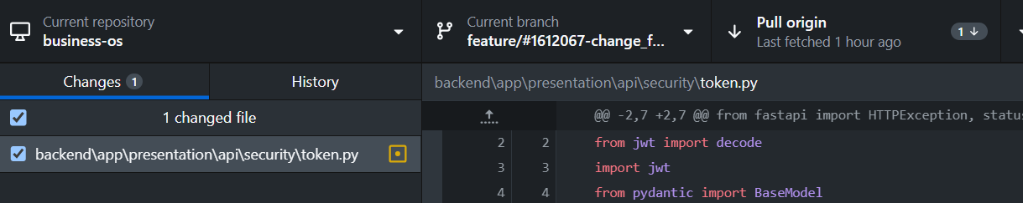
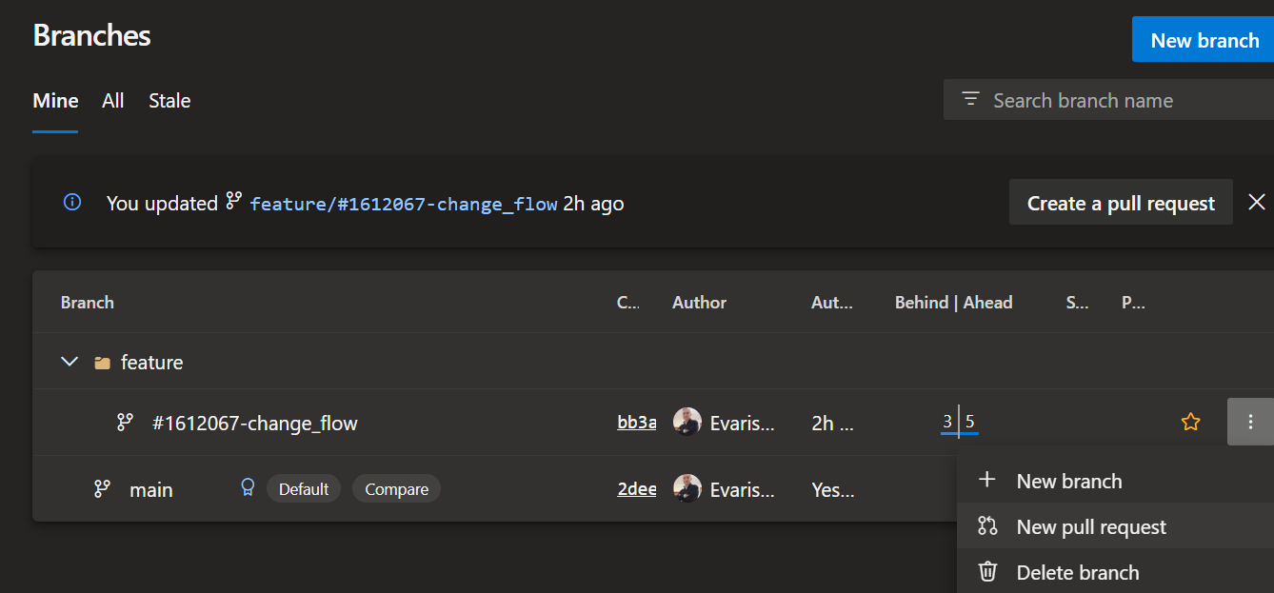
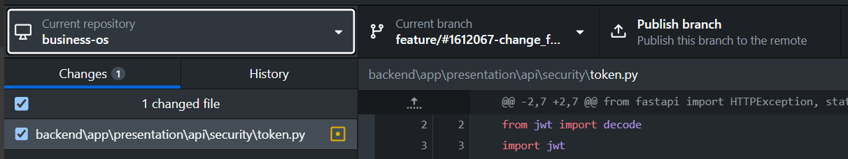
6. revert
1
git reset --soft HEAD~1
if pull origin
  it will
bring the last commit again
  because
I already pushed the commit
reset
reverts
  local
last commit
2
make a copy
  of
altered files
3
change repository;
go back to the last repository
4
delete
  local
branch
5
create
  new
branch
I think that
  if the new branch
has the same name as the last one
I cold have stashed the changes
  and then
get them again
6
copy
  files
back to new branch

Slide 10




Z. template
new project
ExecuteAsync
square post-it
download
  exe
download
  exe
why
A slash
  followed
by
  two consecutive asterisks
D:\A1_research\C2_c0dice\B1_jmeter\A1_install
functionalities
introduction
build-exe
entity framework plus
zig help
⊂
4
every key-frame
defines the operation
deploy

