Slide 1

1. decorators
language
python

Slide 2

2. what
what
provide a flexible and powerful way to extend and modify the behavior of functions or methods
Object-Oriented Programming (OOP) concepts,
  decorators play a crucial role in simplifying and enhancing the readability and maintainability of code
why
Separation of Concerns
  Decorators allow you to separate concerns by isolating specific behaviors (like logging, access control, etc.)
  from the main business logic of methods. This leads to cleaner, more readable, and more maintainable code.
Reusability
  Decorators enable code reusability.
  You can define a behavior once in a decorator and apply it to multiple methods or functions, avoiding code duplication.
DRY Principle
  Decorators help adhere to the DRY (Don't Repeat Yourself) principle by allowing you to encapsulate common functionality
    in a single place and reuse it across different parts of your application.
Enhancing Methods
  Decorators can be used to enhance methods with additional functionality without modifying the original method code.
  This is particularly useful for adding cross-cutting concerns such as logging, performance monitoring, or authorization checks.
Creating Specific Method Types
  Decorators like @classmethod, @staticmethod, and @property are used to create specific types of methods within classes:
    @classmethod: Creates class methods that can access class-level data.
    @staticmethod: Creates static methods that do not access class or instance data.
    @property: Creates properties that can be accessed like attributes but provide the flexibility of methods.
  Abstraction and Interfaces
    Abstract base classes (ABCs) use decorators like @abstractmethod to define methods that must be implemented by subclasses,
    enforcing an interface and providing a way to implement abstraction.
python decorators
Enhance code readability and maintainability.
Provide a clean and concise way to implement and enforce OOP principles like encapsulation, abstraction, and polymorphism.
Aspect-Oriented Programming (AOP) -> cross-cutting concerns (e.g., logging, security)
  Separation of Concerns

Slide 3
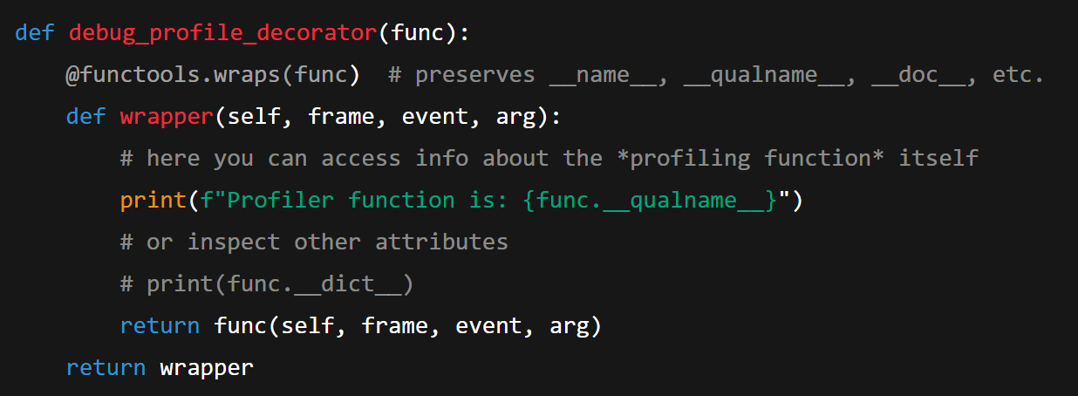
2. what
what
You don’t need @functools.wraps(func) for your code to run, but you almost always want it when writing decorators.
What functools.wraps actually does
Under the hood, @wraps(func):
Copies metadata from func to wrapper, notably:
__name__ (so it stays "profile_function" instead of "wrapper")
__qualname__
__doc__
__module__
__annotations__
Sets wrapper.__wrapped__ = func, which many tools use to get back to the original function (introspection, other decorators, some libs, etc.).
in this decorator
  I can access
the self
to be researched
func tools

Slide 4
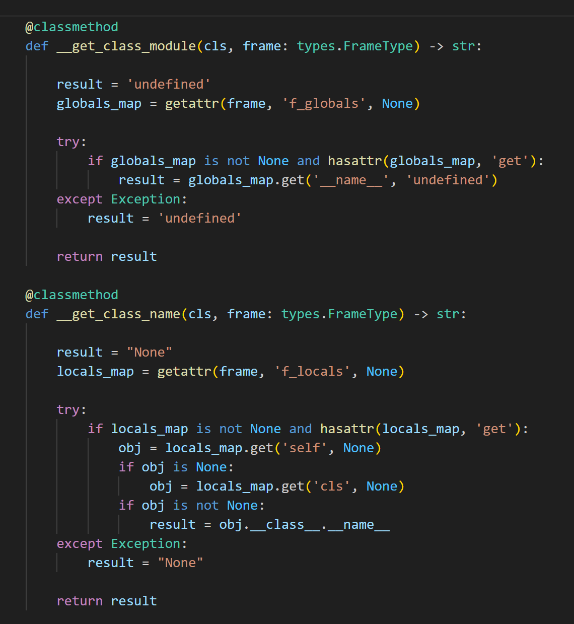

2. what
what
from frame I can get:
  the SELF the class instance
  the module
D:\repos\c0dice\profiler\src\c0dice\profiler\library\state.py

Slide 5




Z. template
new project
ExecuteAsync
square post-it
download
  exe
download
  exe
why
A slash
  followed
by
  two consecutive asterisks
D:\A1_research\C2_c0dice\B1_jmeter\A1_install
functionalities
introduction
build-exe
entity framework plus
zig help
⊂
4
every key-frame
defines the operation
success

