Slide 1

1. pipenv
python
environment

Slide 2
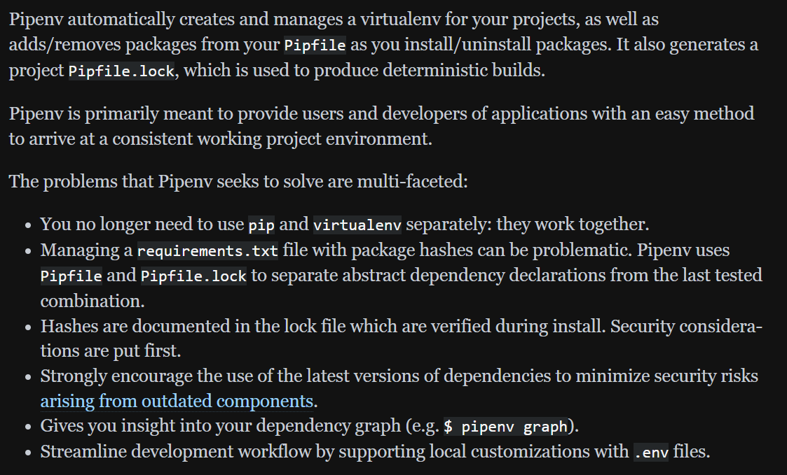

2. what
what
has most of the same basic operations as pip
but thinks about packages a bit differently
tutorial: pipenv
uses pipfile that pipenv creates
  when you install a package,
  pipenv adds that package to Pipfile
  also adds more detailed information
    to a new lock file called
      Pipfile. Lock.
lock files
  act as a snapshot
of
  the precise set of packages installed
including
  direct dependencies
    as well
  as their sub-dependencies.
pipenv
virtual environments

Slide 3





Z. template
new project
ExecuteAsync
square post-it
download
  exe
download
  exe
why
A slash
  followed
by
  two consecutive asterisks
D:\A1_research\C2_c0dice\B1_jmeter\A1_install
functionalities
introduction
build-exe
entity framework plus
zig help
⊂
4
every key-frame
defines the operation
success

