Slide 1

1. client
foundry

Slide 2
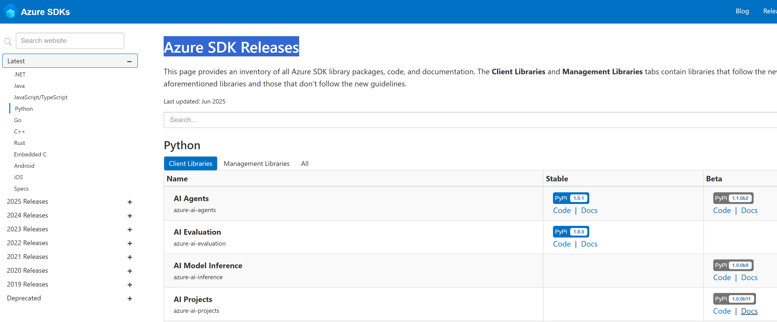

2. client
what
the SDK is yet not stable
need to use the reference in this page
releases
use this links
  to access
the documentation
Azure SDK Releases

Slide 3
3. hub

Slide 4

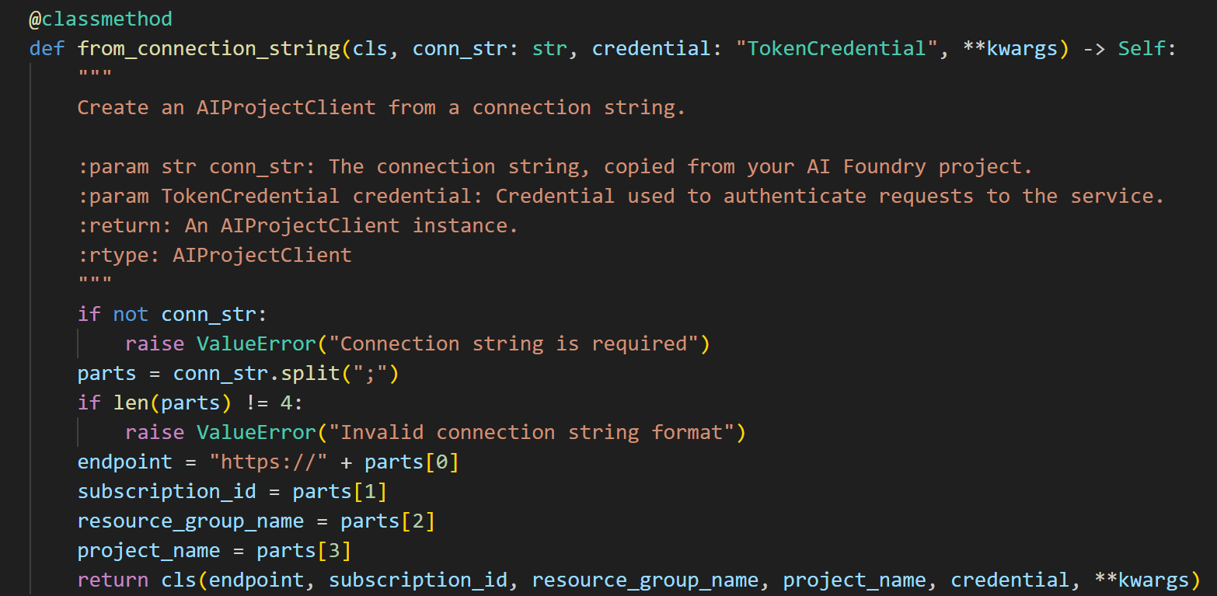
3.1 limitations
what
requires old version: b5
current: b11
it is just a wrapper
we can get
  the normal connection parameters
from the connection string
workshop/quick_start/creating-the-ai-project-client
microsoft/learn/ai_projects/overviewlear/microsoft/ai_projects/overview

Slide 5
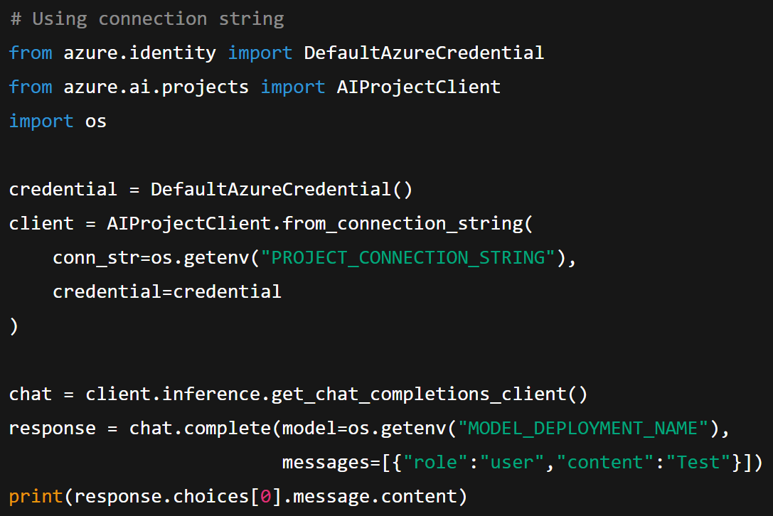
3.1 limitations
what
# Using connection string
from azure.identity import DefaultAzureCredential
from azure.ai.projects import AIProjectClient
import os
credential = DefaultAzureCredential()
client = AIProjectClient.from_connection_string(
conn_str=os.getenv("PROJECT_CONNECTION_STRING"),
credential=credential
)
chat = client.inference.get_chat_completions_client()
response = chat.complete(model=os.getenv("MODEL_DEPLOYMENT_NAME"),
messages=[{"role":"user","content":"Test"}])
print(response.choices[0].message.content)
workshop/quick_start/creating-the-ai-project-client
microsoft/learn/ai_projects/overviewlear/microsoft/ai_projects/overview

Slide 6
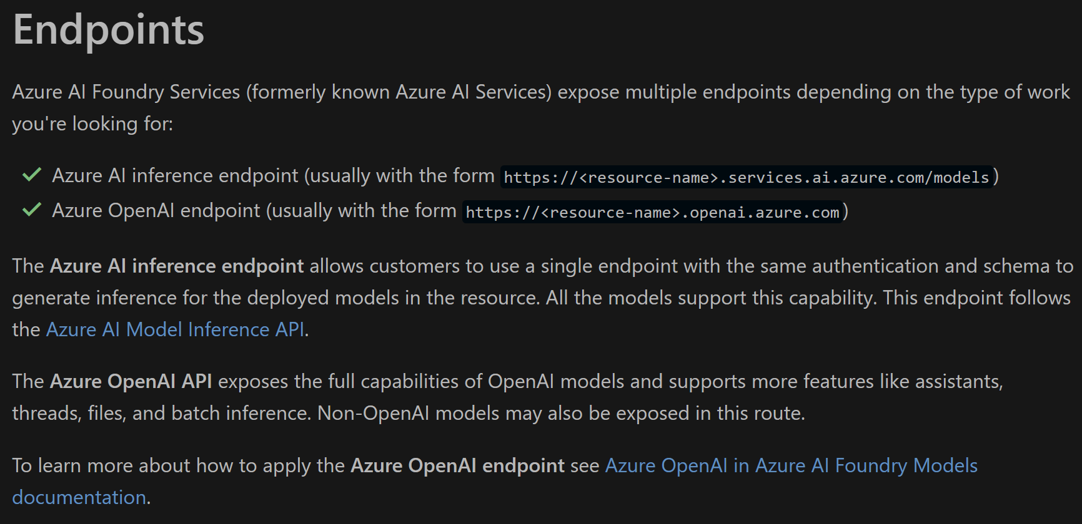
4. endpoints
what
alternative to client
REST endpoints
microsoft/learn/azure foundry endpoints

Slide 7





Z. template
new project
ExecuteAsync
square post-it
download
  exe
download
  exe
why
A slash
  followed
by
  two consecutive asterisks
D:\A1_research\C2_c0dice\B1_jmeter\A1_install
functionalities
introduction
build-exe
entity framework plus
zig help
⊂
4
every key-frame
defines the operation
success

