Slide 1

1. autogen
portfolio

Slide 2

1.1 index
autogen\_projects

Slide 3
2. patterns

Slide 4

2.1 two
what
two-agent chat
is
the simplest form
of
conversation pattern
two-agent-chat-and-chat-result

Slide 5
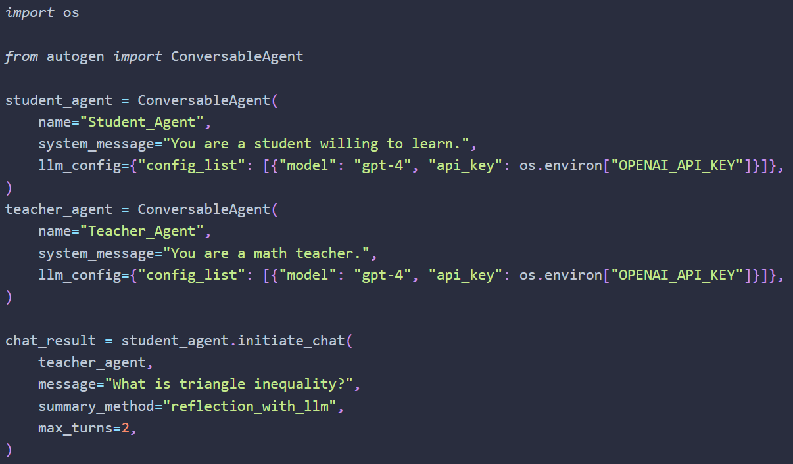
2.1.1 initiate
what
we start
using the
initiate_chat
method
of every
ConversableAgent

Slide 6
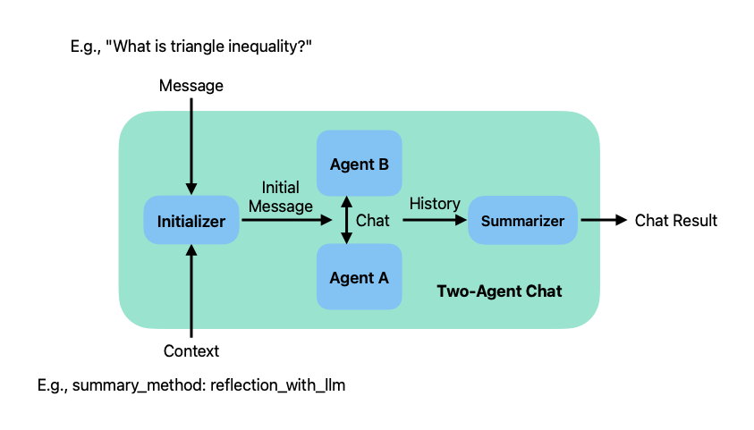
2.1.2 inputs
what
two inputs
a message: which is a string provided by the caller;
a context: which specifies various parameters of the chat.
1

Slide 7
2.1.3 start
what
the sender agent
uses its
chat initializer method
to generate
an initial message
from
the inputs
and sends it
to
the recipient agent
to
start
the chat
i.e.
generate_init_message()
of
ConversableAgent
the recipient agent
is
the other agent
the sender agent
is the agent
whose
initiate_chat
method
is called

Slide 8
2.1.4 end
what
once
the chat
terminates
the history of the chat
is processed
by
a chat summarizer
summarizes
the chat
history
calculates
the token
usage
You can configure
the type of summary
using
the summary_method
parameter

Slide 9
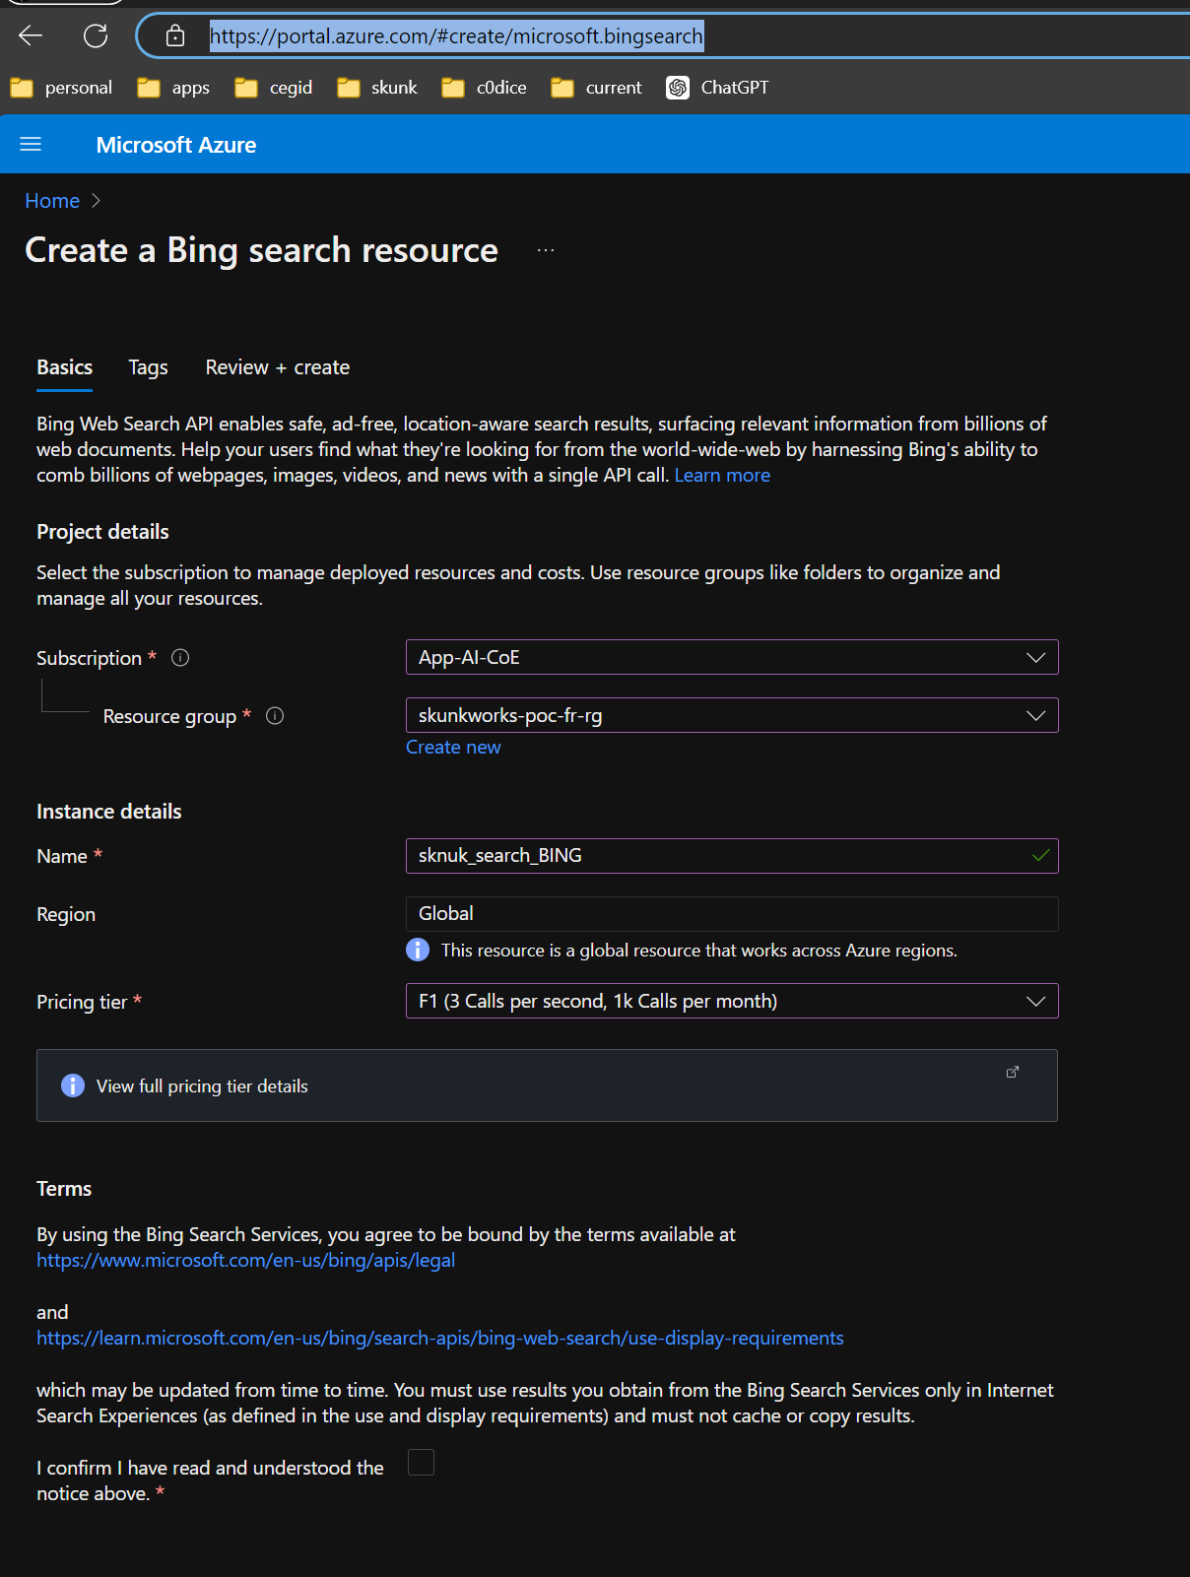
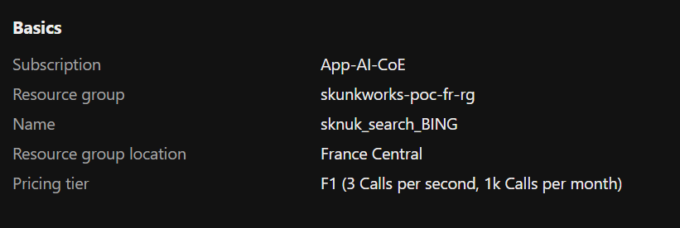
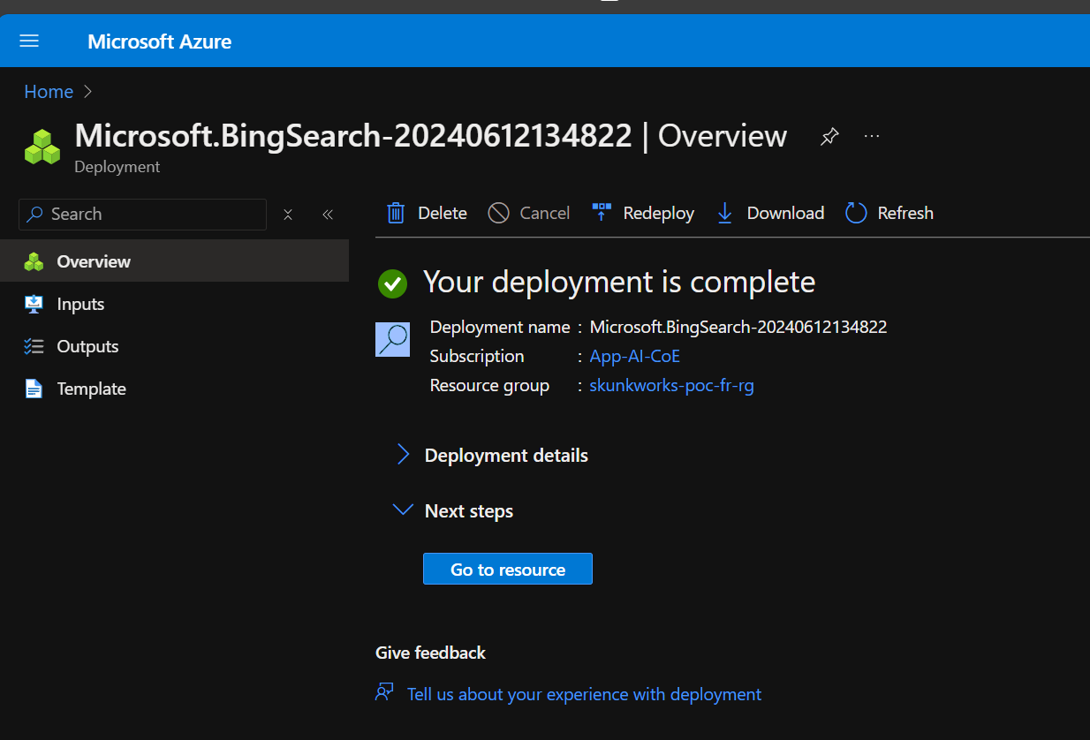
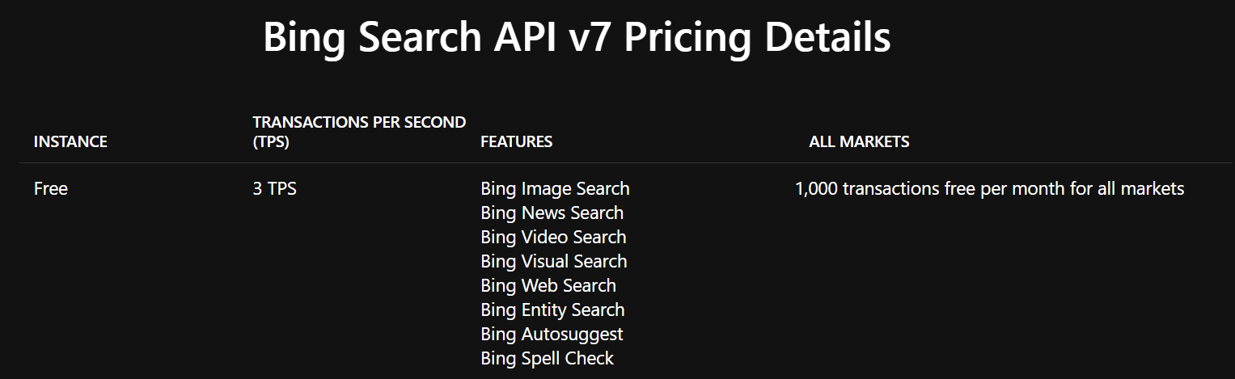
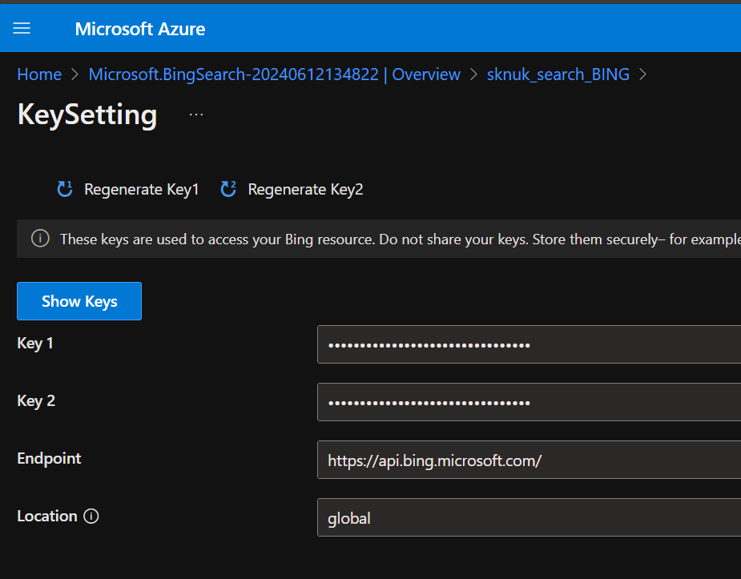
3. web search
create a bing search - Microsoft Azure
Microsoft.BingSearch-20240612134822 - Microsoft Azure
Bing Search API Pricing | Microsoft Bing
KeySetting - Microsoft Azure
fb2b0f8b77fc430da7e58e7aa4ef9207
5de4d354691c42a3b2510cd8fe72f133

Slide 10
3.1 tutorials
AutoGen Tutorial | How to Surf the Web with a WebSurferAgent - YouTube
autogen/notebook/agentchat_surfer.ipynb at main · microsoft/autogen (github.com)
autogen/autogen/agentchat/contrib/web_surfer.py at main · microsoft/autogen (github.com)

Slide 11
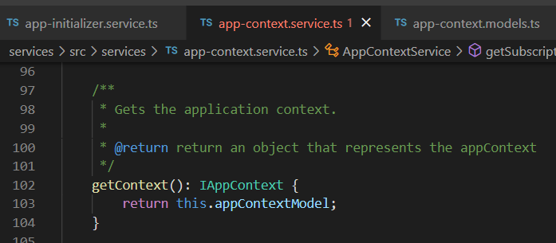



Z. template
new project
ExecuteAsync
square post-it
download
exe
download
exe
why
A slash
followed
by
two consecutive asterisks
D:\A1_research\C2_c0dice\B1_jmeter\A1_install
functionalities
introduction
build-exe
entity framework plus
zig help
⊂
4
every key-frame
defines the operation
success

