Slide 1

1. memory
skunk
portfolio

Slide 2
2. problem
what
Implementing
short-term memory
for
a chat application
description
maintaining
the conversation
context
so that
each
new
user prompt
can be
understood
in
the context
of
the previous
interactions
why
this ensures
the coherence
of
the conversation

Slide 3
3. requirements
chat history
store
the conversation
history
both
prompts
and
responses
contextual understanding
use
the chat history
as
context
for generating
responses
to
new prompts

Slide 4
4. hypothesis 1
session management
track
conversation
sessions
for
each user
how
use
session
tokens
to
uniquely
identify
user sessions
and
respective histories
persistence
use
a database
what
Session token
Timestamp
User prompt
System response
new prompt
is
received
when
to store/manage
chat history
1
retrieve
chat history
for
the session
2
concatenate
history
to form
context
for
new prompt.
history
incorporate
previous
prompts
and
responses
into
the current
prompt
to
maintain
context
how
context window
ensure
the prompt
does not
exceed
the token
limit
of
the API

Slide 5
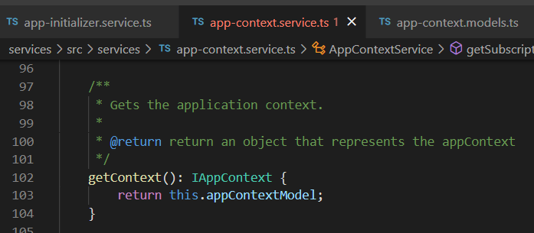





Z. template
new project
ExecuteAsync
square post-it
download
exe
download
exe
why
A slash
followed
by
two consecutive asterisks
D:\A1_research\C2_c0dice\B1_jmeter\A1_install
functionalities
introduction
build-exe
entity framework plus
zig help
⊂
4
every key-frame
defines the operation
success

