Slide 1

1. perplexity
ai
portfolio

Slide 2

1.1 sources
api reference
site

Slide 3
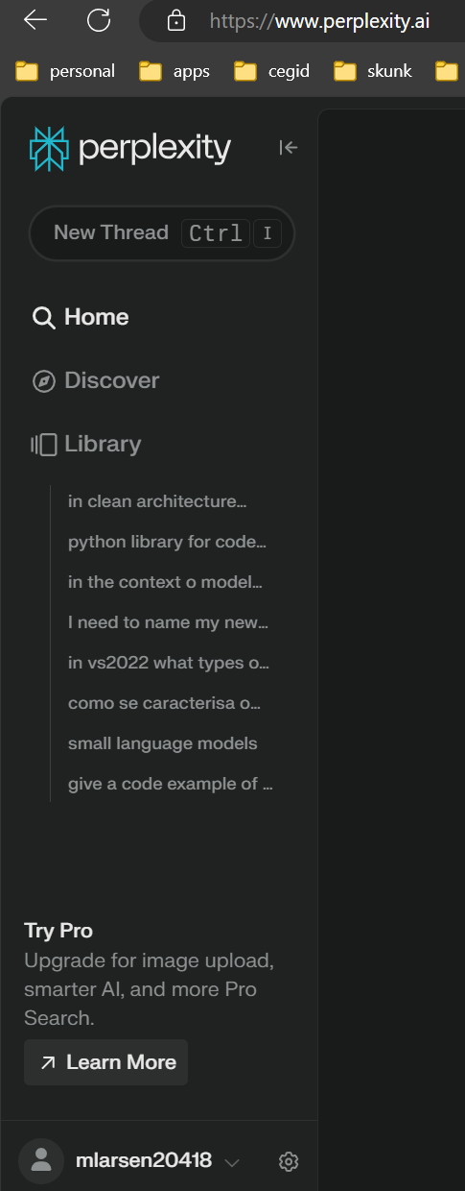
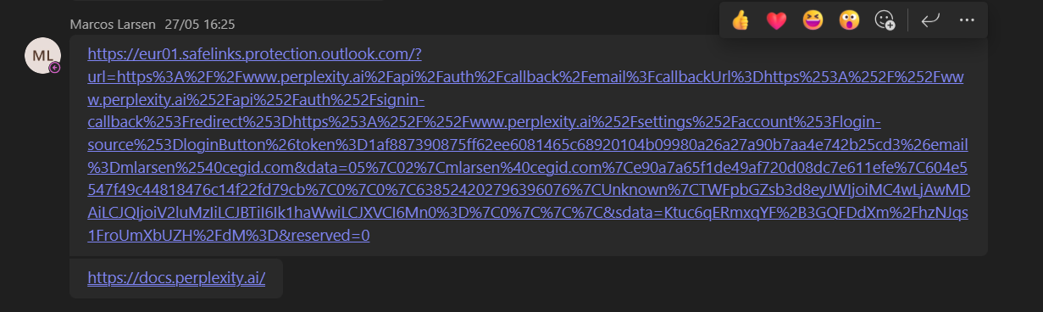
2. credentials
what
marcos has the credentials
use this link
to access
is account
Marcos Larsen: https://eur01.safelinks.protection.outlook.com/?url=https%3A%2F%2Fw...

Slide 4
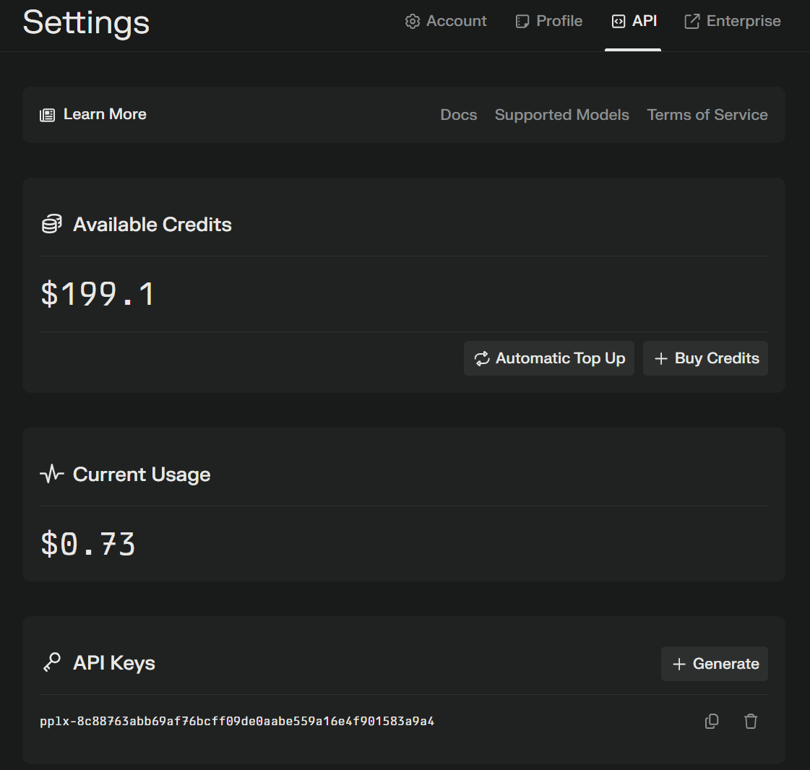
2.1 settings
what
Perplexity api

Slide 5
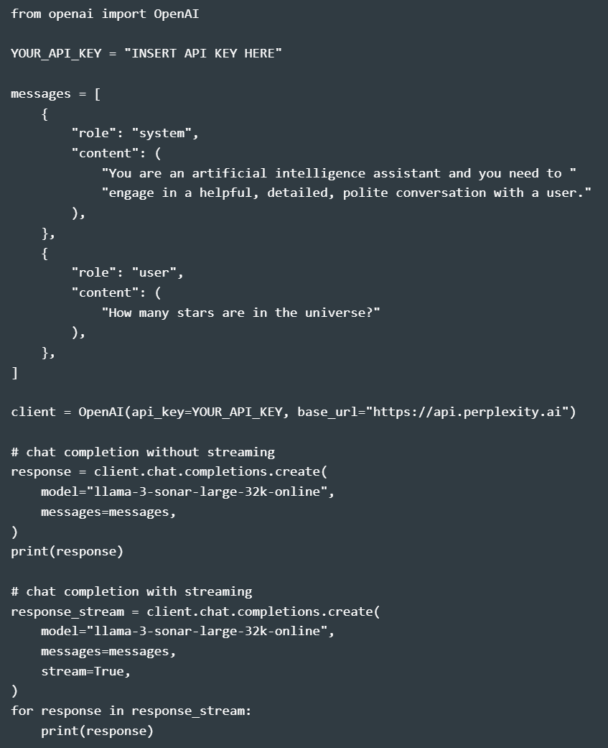
3. what
first
first

Slide 6
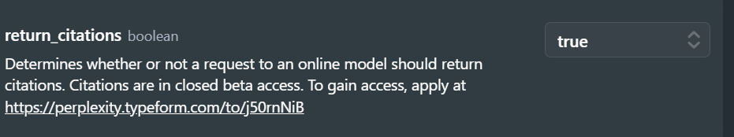
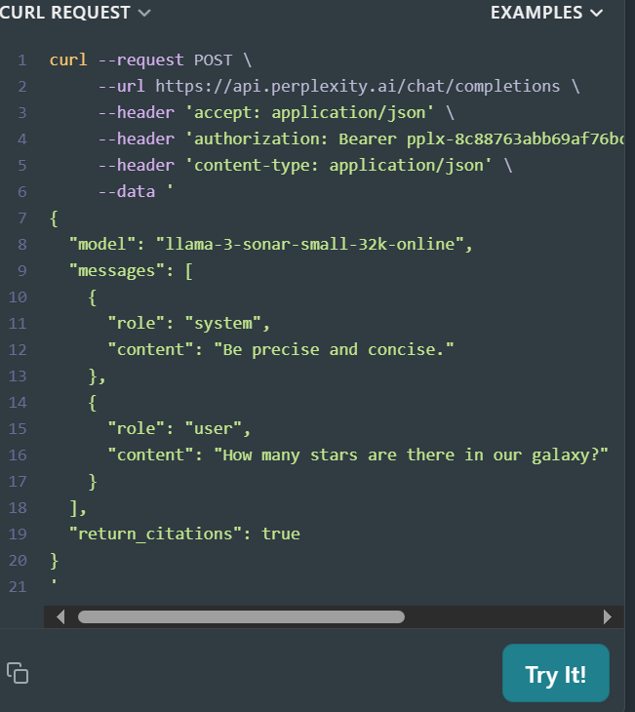
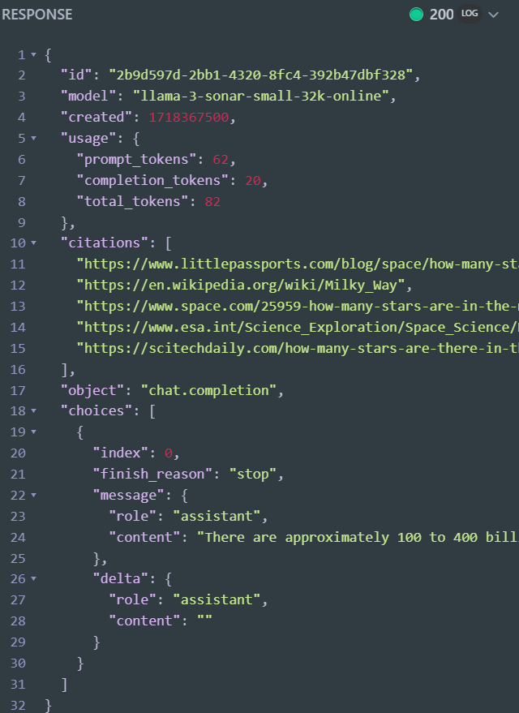
4. citations
what
Chat Completions (perplexity.ai)

Slide 7
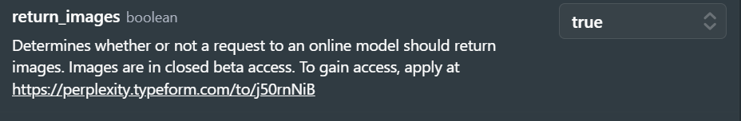
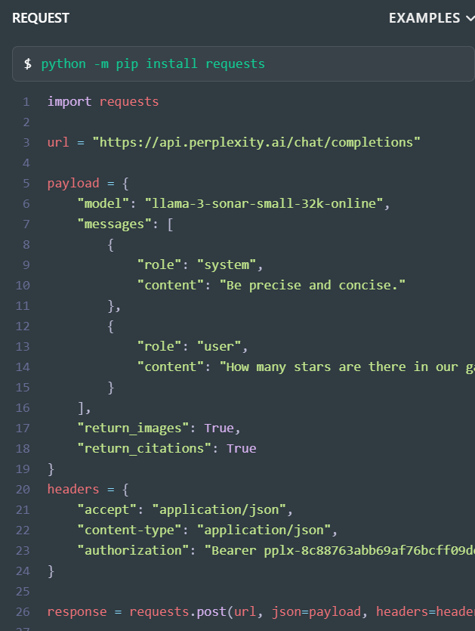
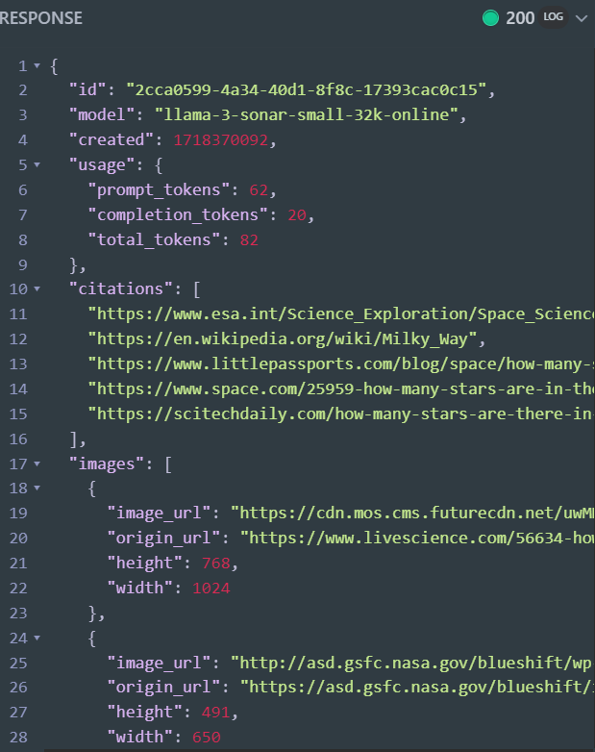
4.1 images
what
Chat Completions (perplexity.ai)

Slide 8
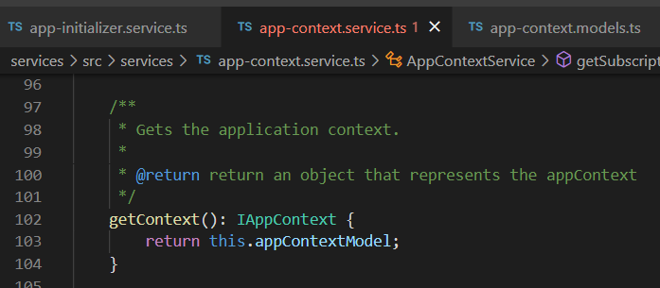




Z. template
new project
ExecuteAsync
square post-it
download
exe
download
exe
why
A slash
followed
by
two consecutive asterisks
D:\A1_research\C2_c0dice\B1_jmeter\A1_install
functionalities
introduction
build-exe
entity framework plus
zig help
⊂
4
every key-frame
defines the operation
success

