Slide 1

1. archi
portfolio
architecture

Slide 2
1.1 index

Slide 3

2. why
BPMN
+
UML
video: why
examples

Slide 4


3. install
download
C:\archi

Slide 5
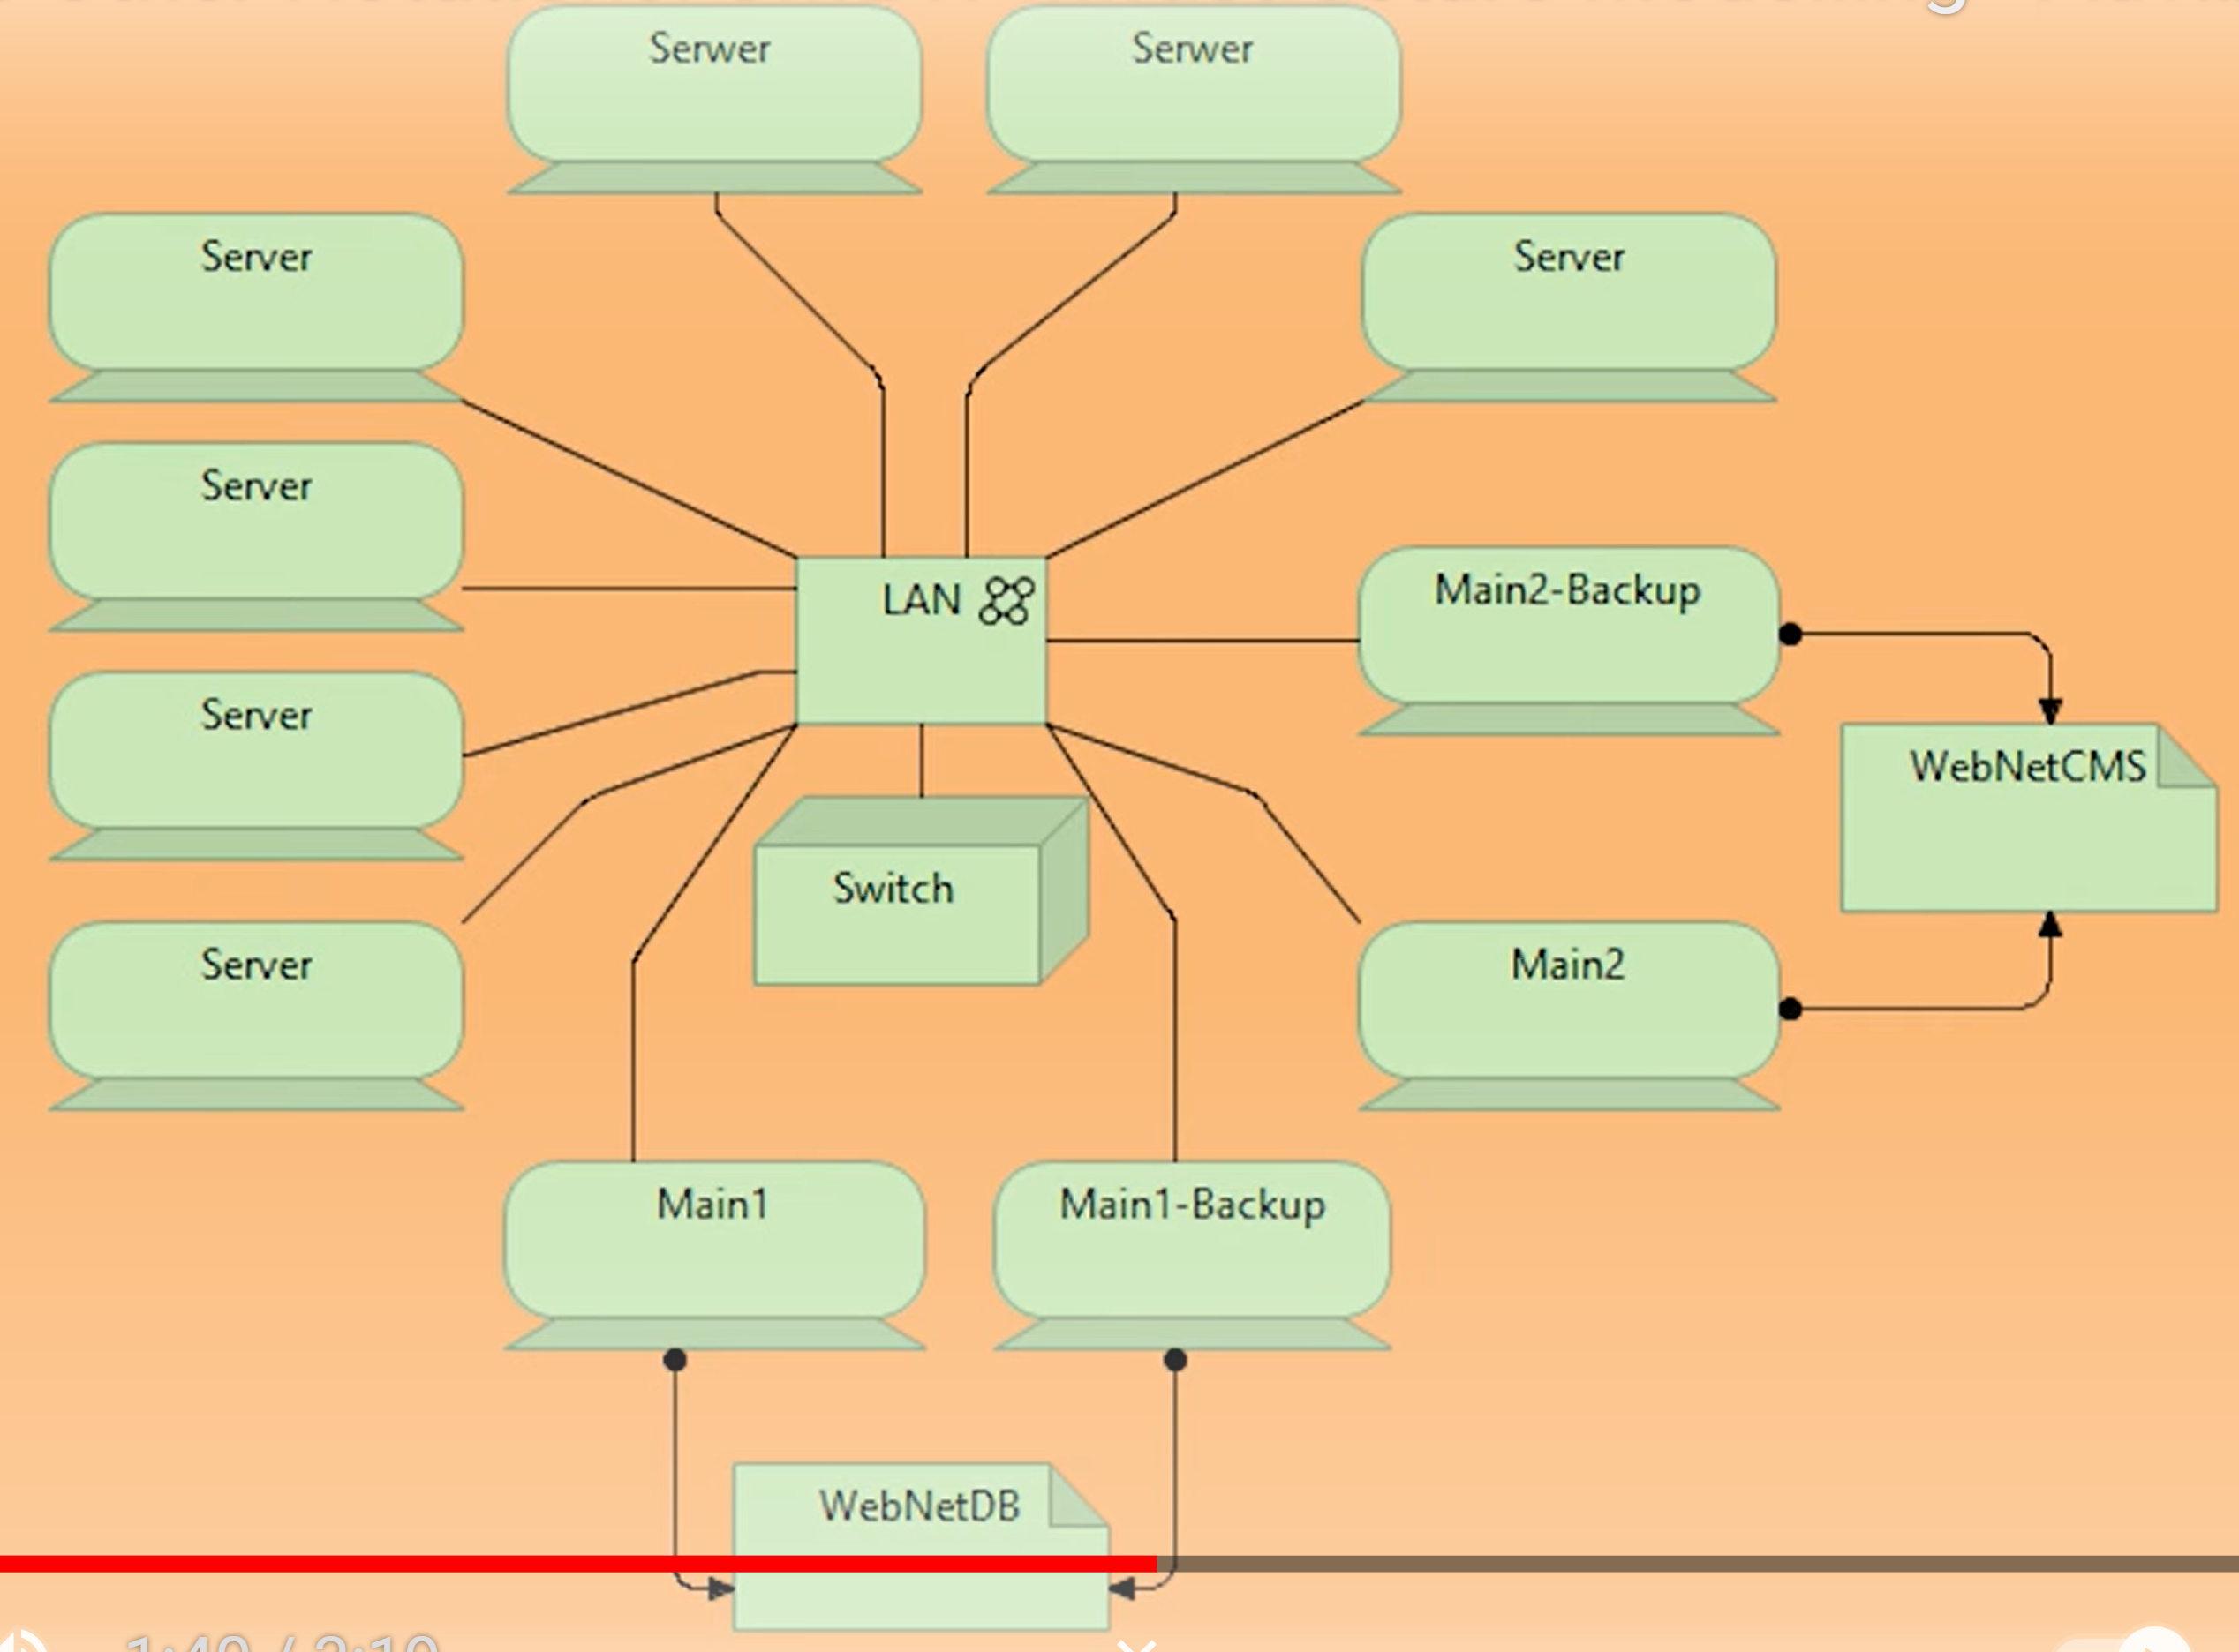
4. technology layer
video: overview
better then
UML deployment
diagram

Slide 6
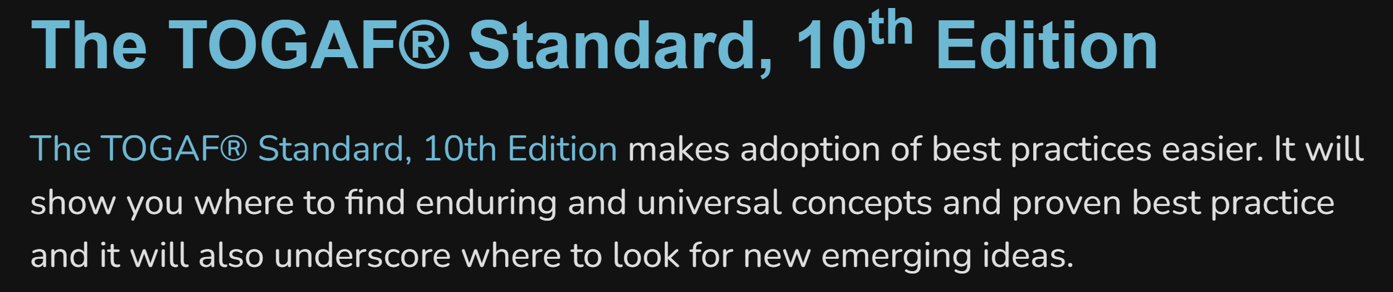
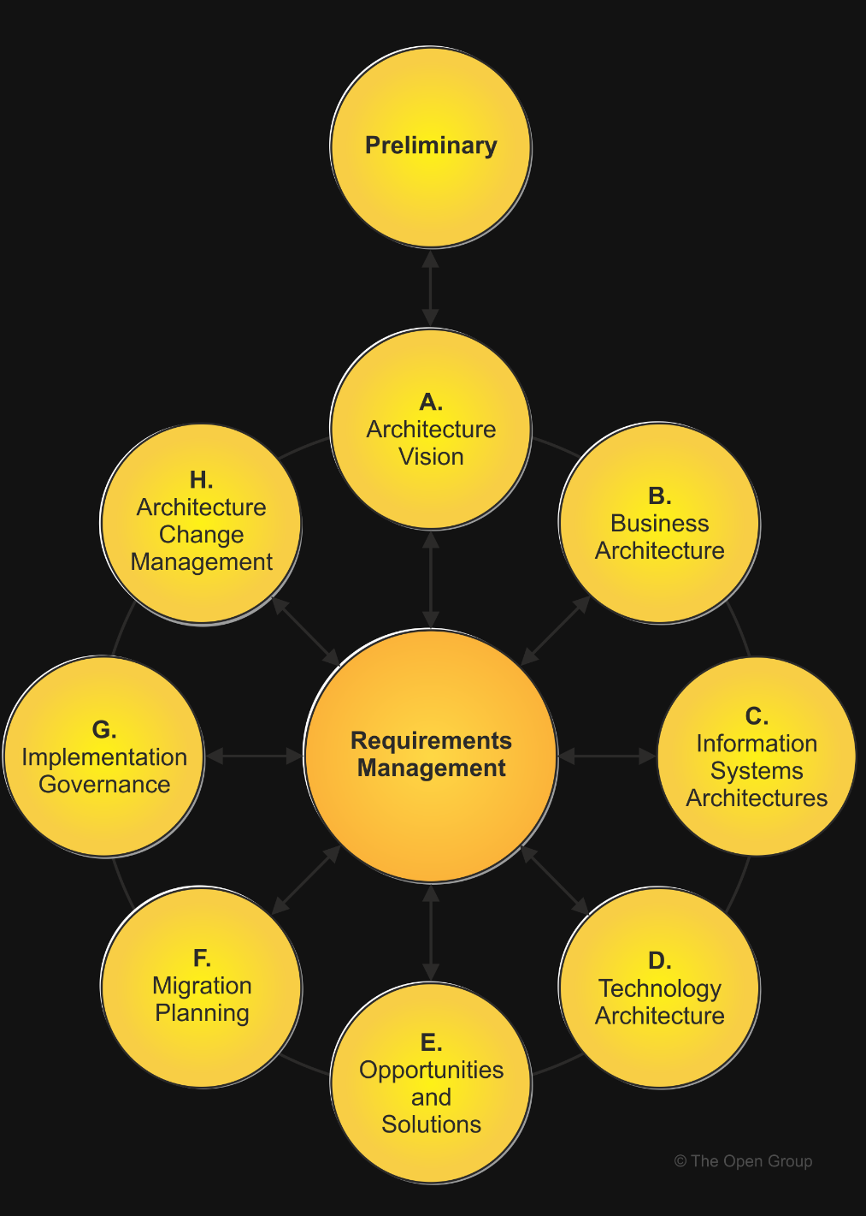
5. language
opengroup.org/togaf

Slide 7
6. wip
video: application layer - overview
manual
video: Visualize, document and explore your software architecture - Simon Brown
video: Visualize, document and explore your software architecture
video: What is Software Architecture Design Document
video: Software Architecture and Design InfoQ Trends Report 2021
video: How to Document and Communicate Software Architectures These Days
video: Solution Architecture Document (S.A.D) Full Example - Design Doc Explanatio

Slide 8
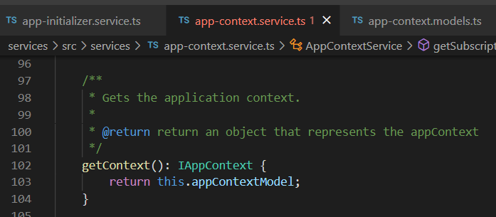



Z. template
new project
ExecuteAsync
square post-it
download
exe
download
exe
why
A slash
followed
by
two consecutive asterisks
D:\A1_research\C2_c0dice\B1_jmeter\A1_install
functionalities
introduction
build-exe
entity framework plus
zig help
⊂
4
every key-frame
defines the operation
success

