Slide 1

1. book
portfolio
architecture

Slide 2
1.1 index

Slide 3

1.2 resources
fundamentals of software architecture 2020

Slide 4
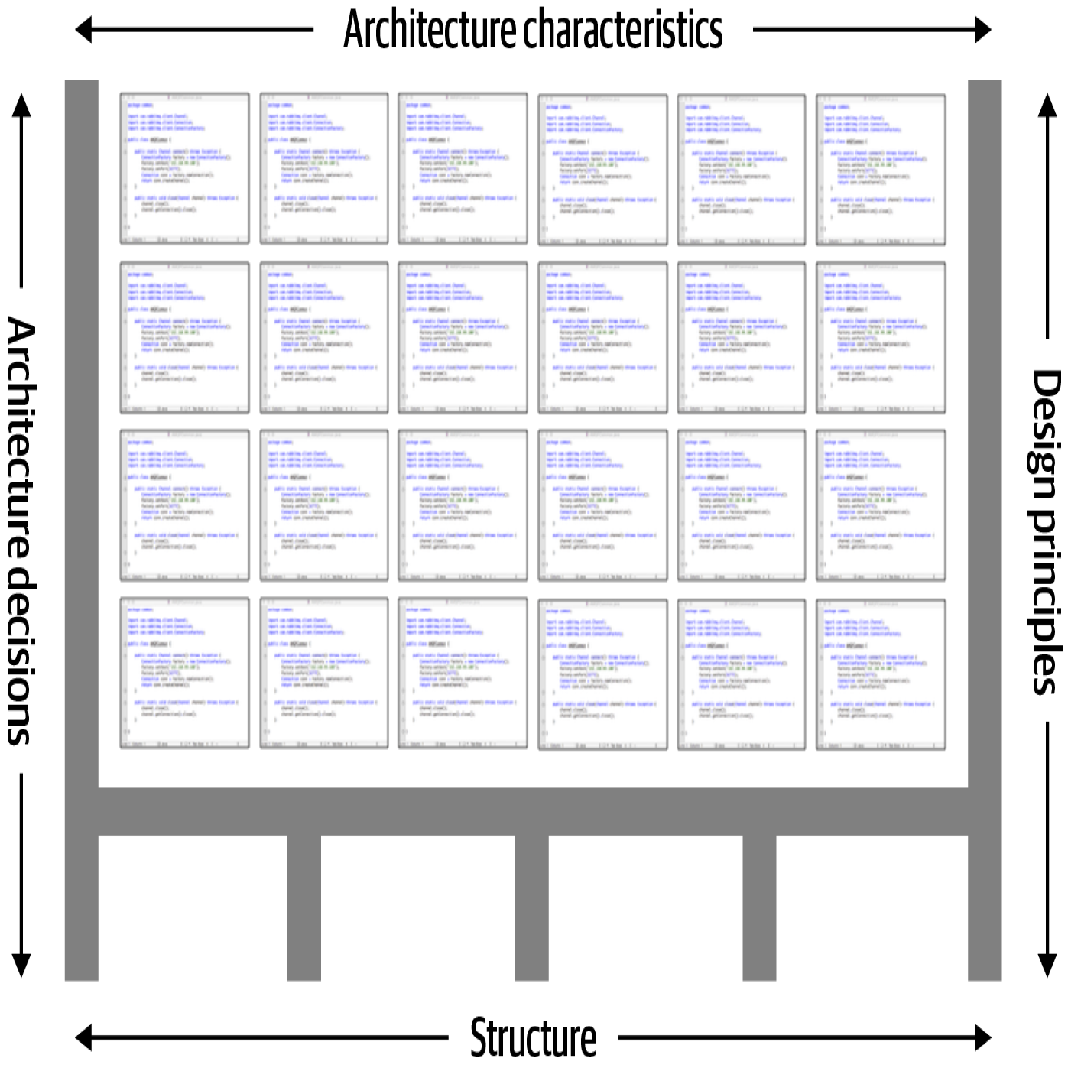
2. what
description
consists of (dimensions)
the structure
architecture characteristics
architecture decisions
design principles

Slide 5
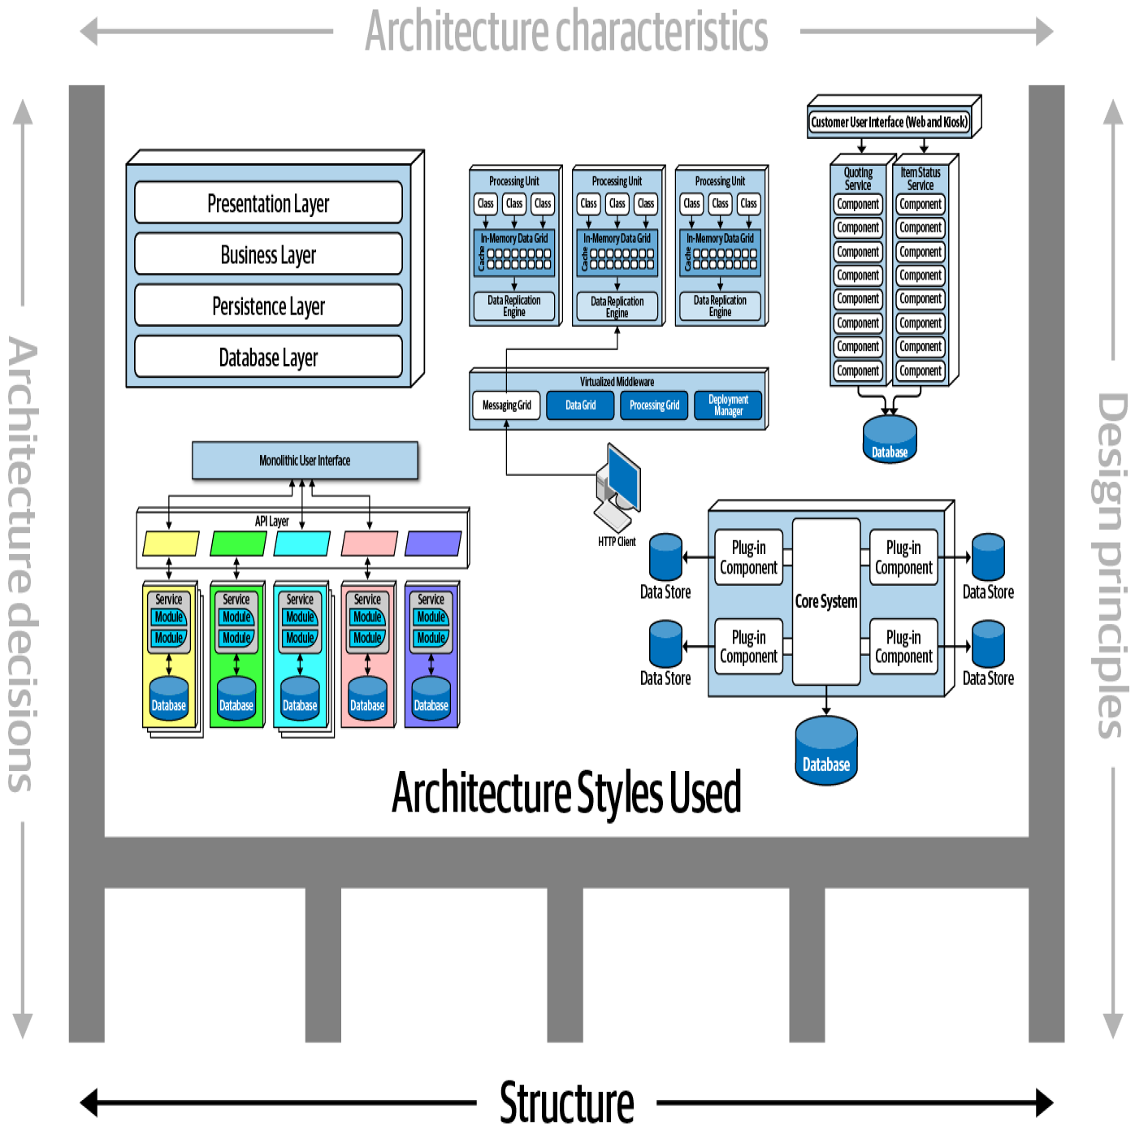
2.1 structure
description
refers to
the type of architecture style (or styles)
the system is implemented in
such as
microservices,
layered
microkernel

Slide 6
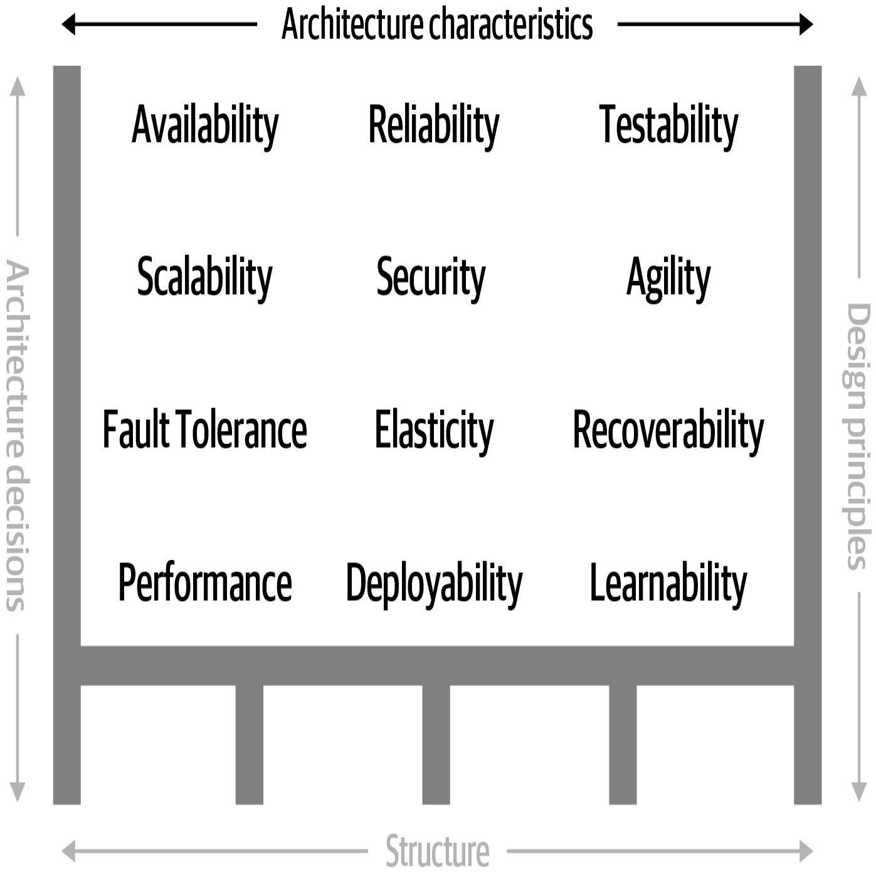
2.2 characteristics
define
the success criteria
of a system,
which is orthogonal
to
the functionality
of
the system
Notice that all of the characteristics listed
do not require knowledge
of
the functionality of the system,
yet they are required
in order for
the system
to function properly
In the mathematical context, "orthogonal" means
"perpendicular"
or
"independent"
When two things are orthogonal,
they have
direct relationship
with each other
description

Slide 7
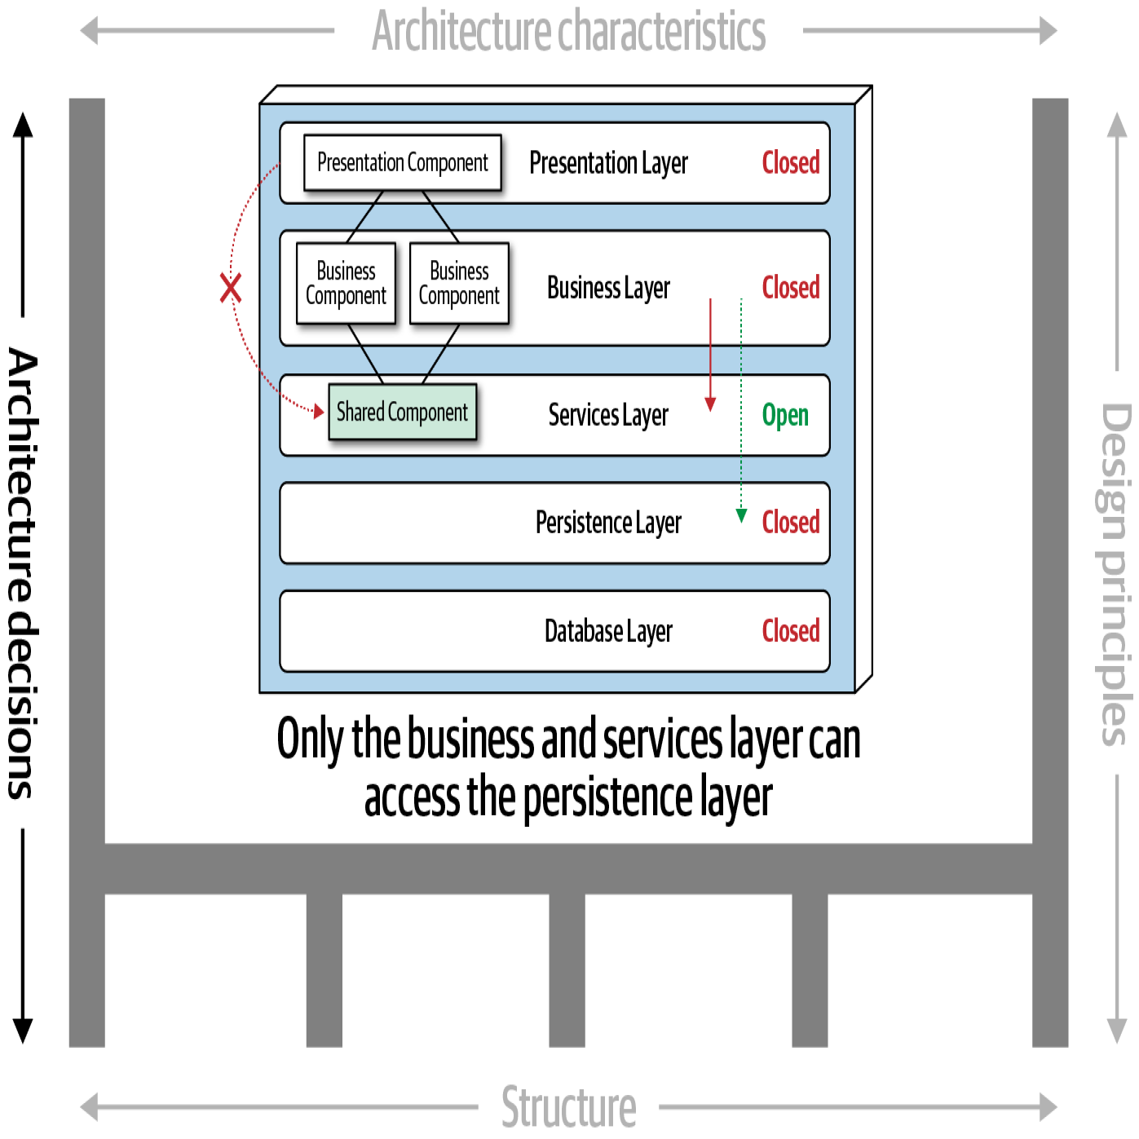
2.3 decisions
define
the rules
for how
a system
should be
constructed
architecture decisions
form the constraints
of
the system
direct
the development teams
on
what is
and
what isn’t
allowed
example:
an architect
might make an architecture decision
that only
the business
and
services
layers
can access
the database
description
restricting
the presentation layer
from
making
direct database calls
most organizations
have variance models
that are used by
an architecture
review board (ARB)
or
chief architect
variance
a decision (or rule) can be broken
through something called
a variance
those models
formalize the process
for
seeking a variance
to
a particular standard
or
architecture decision

Slide 8
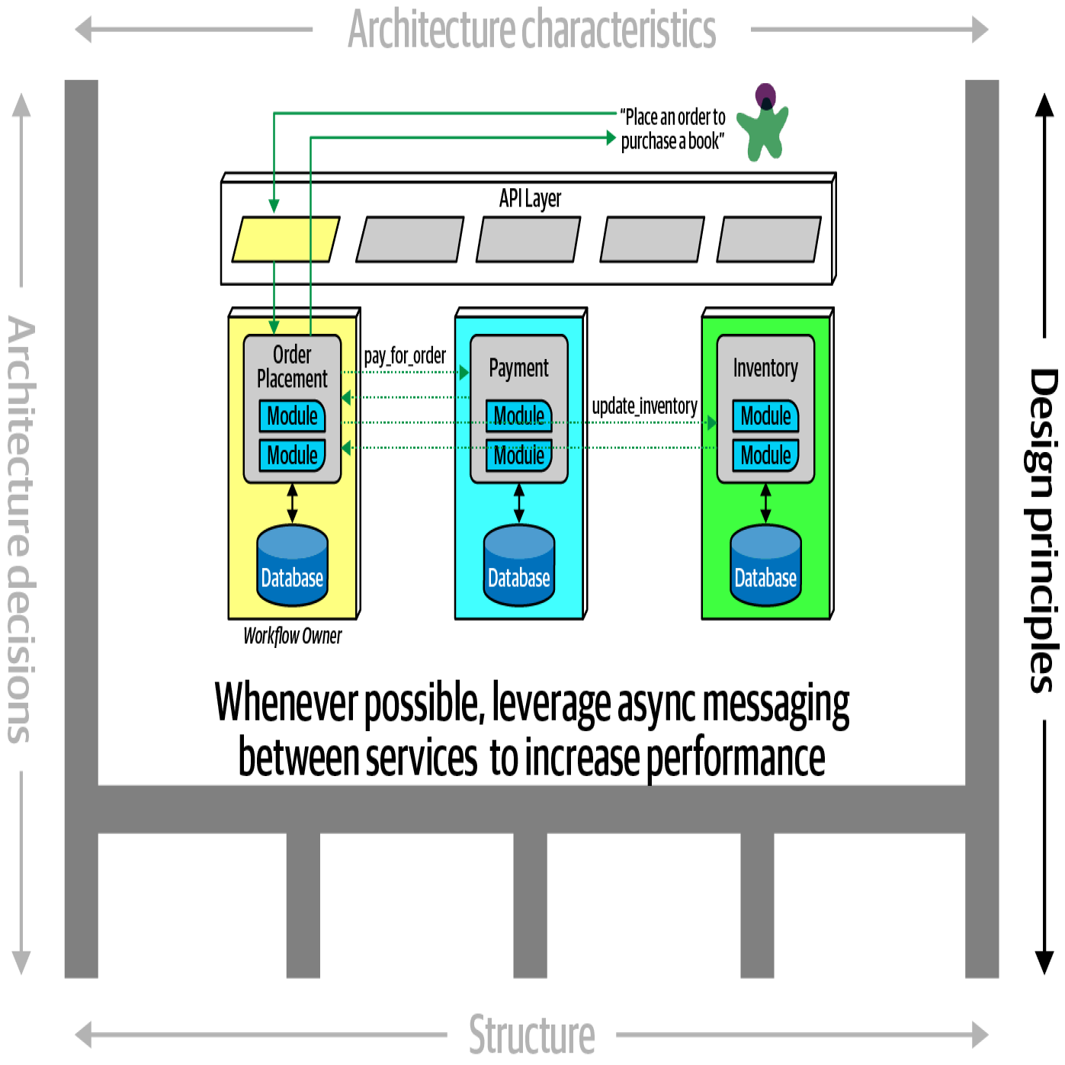
2.4 design principles
differs from an architecture decision
in that
a design principle
is a guideline
rather
than a hard-and-fast rule
example,
the design principle
states that
the development teams
should leverage
asynchronous messaging
between services
an architecture decision (rule)
could never cover
every condition
and
option
for communication
between services,
description
within
a microservices architecture
to increase
performance
so a design principle
can be used
to provide
guidance
for the preferred method
to allow
the developer
to choose
a more appropriate
communication protocol
(such as REST or gRPC)
given
a specific circumstance

Slide 9
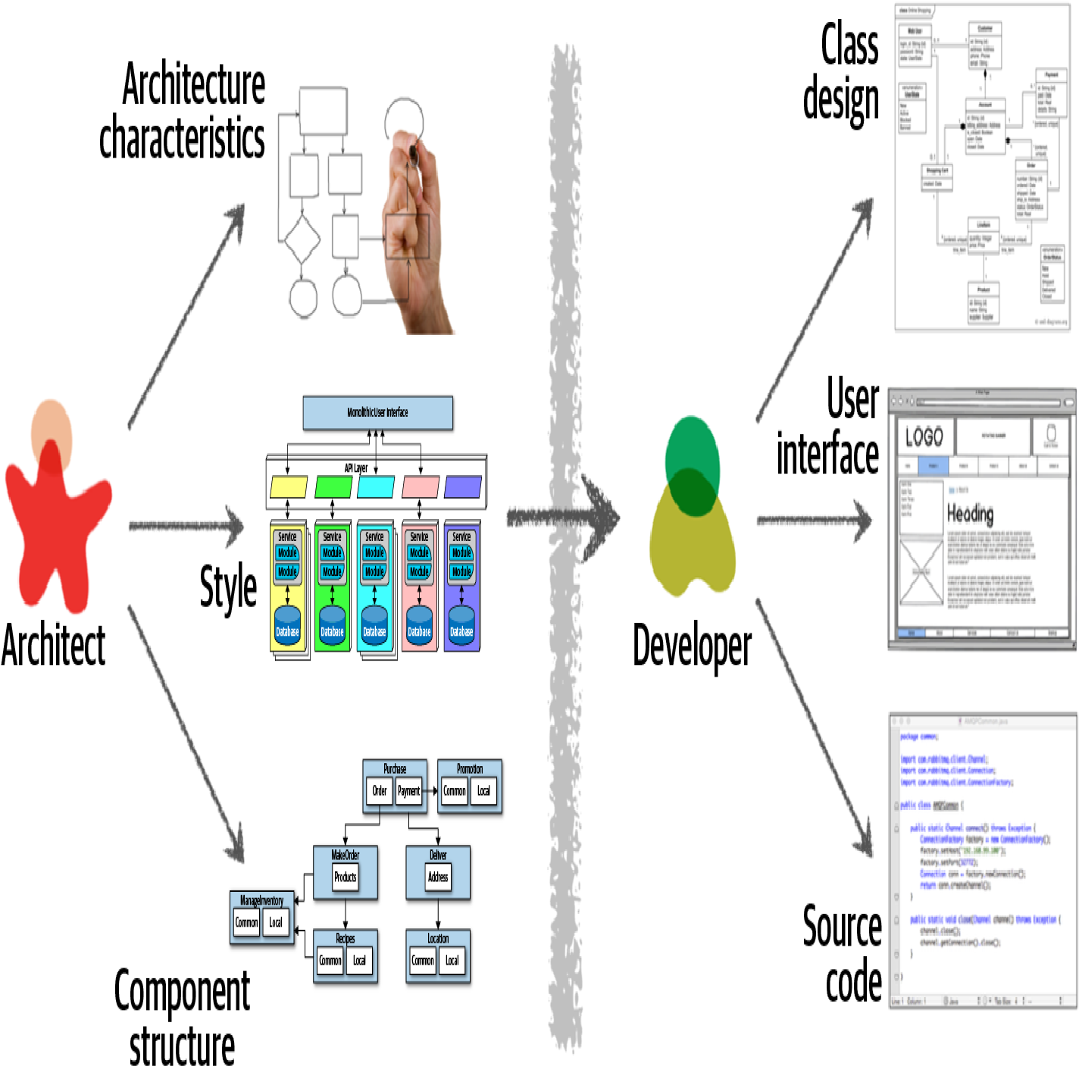
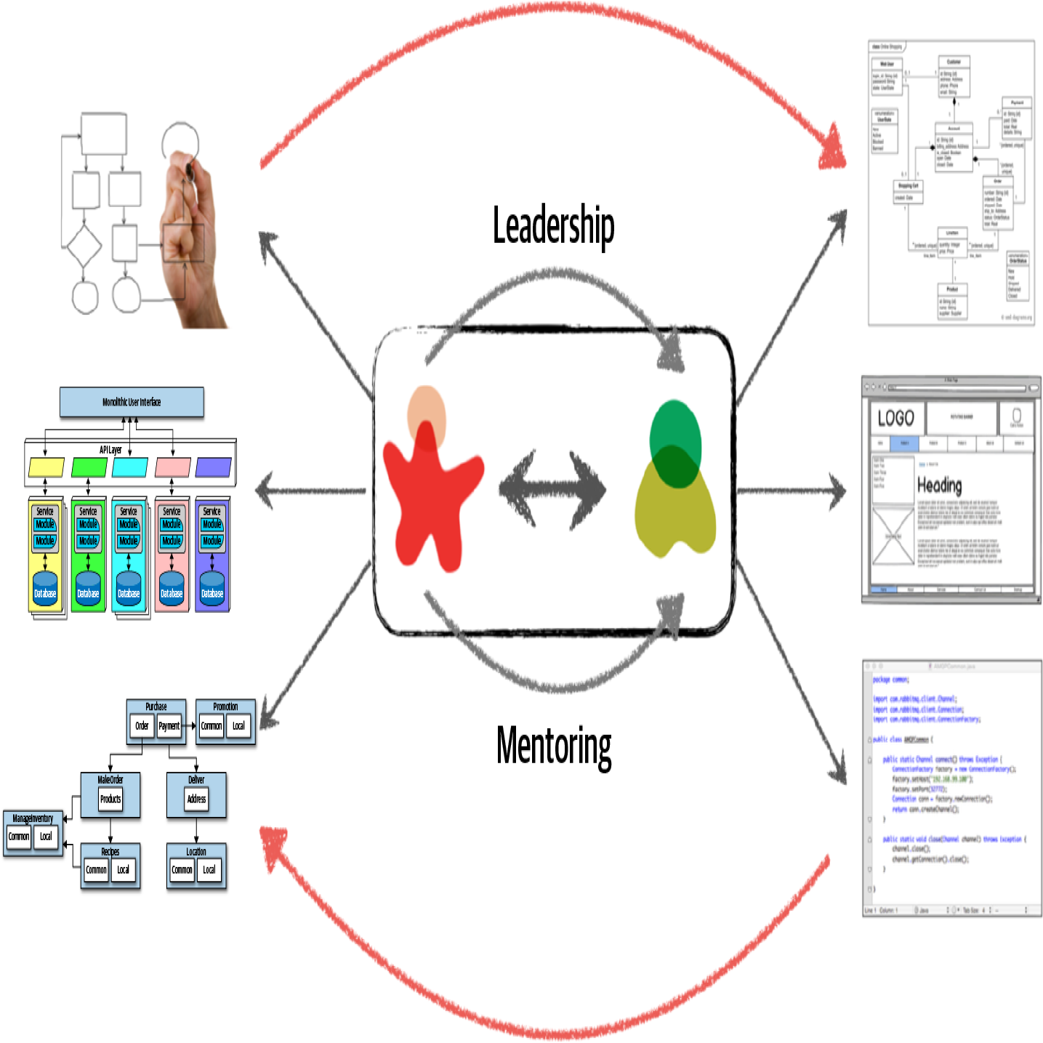
3. design
classic
current
analyzing business requirements
to extract
and
define the architectural
characteristics
(“-ilities”),
selecting which architecture
patterns and styles
would fit
the problem domain
creating components
the building blocks
of the system
creating class diagrams
for each component
creating user interface screens
developing and testing
source code
to make architecture work,
physical
and
virtual
barriers
that exist between
architects
and
developers
must be broken down,
thus forming
a strong bidirectional
relationship
between
architects and
development teams

Slide 10
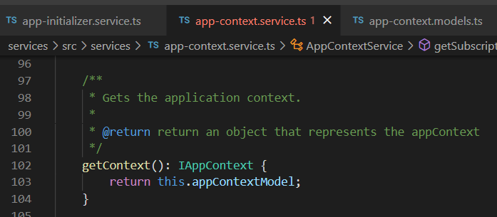




Z. template
new project
ExecuteAsync
square post-it
download
exe
download
exe
why
A slash
followed
by
two consecutive asterisks
D:\A1_research\C2_c0dice\B1_jmeter\A1_install
functionalities
introduction
build-exe
entity framework plus
zig help
⊂
4
every key-frame
defines the operation
success

