Slide 1

1. clean
portfolio
python
python

Slide 2
1.1 index
dependency inversion

Slide 3
1.2 sources

Slide 4
2. what

Slide 5
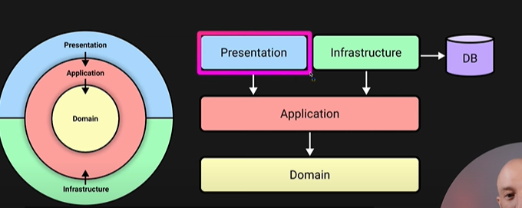

2.1 use case
source
video: use case

Slide 6
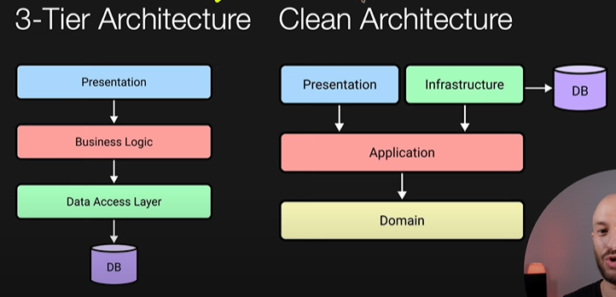
2.2 three tier
what
video: 3 laired vs clean

Slide 7
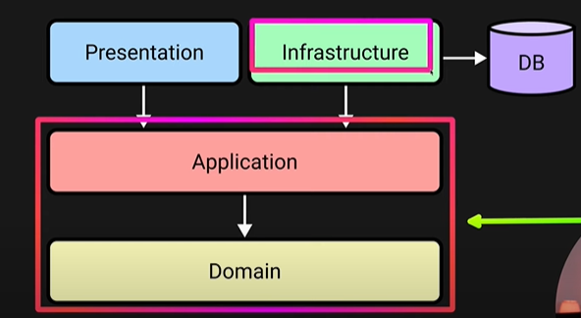
2.3 no DB dependency
diagram
video: no DB dependency

Slide 8
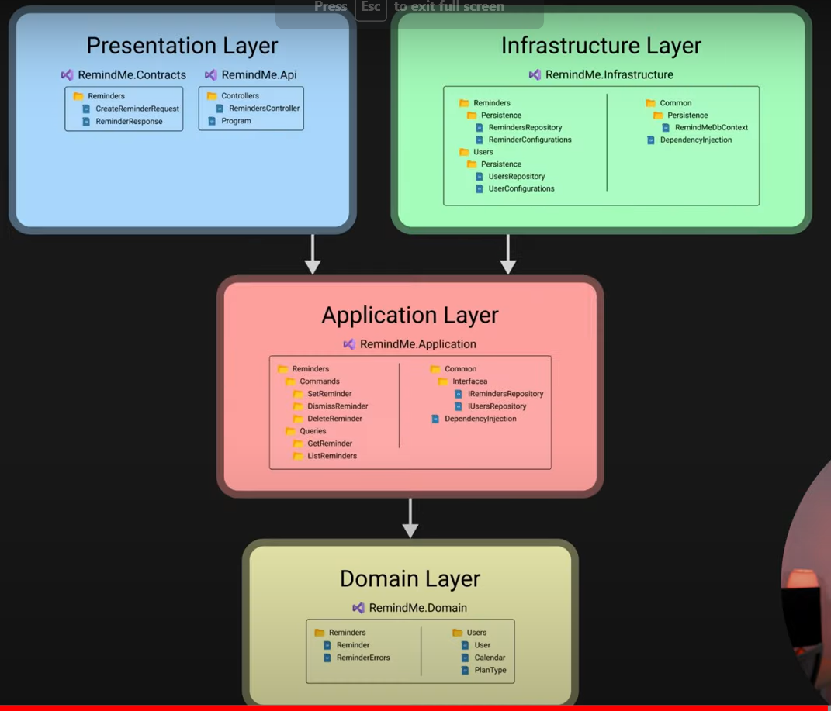
2.4 example
what
video: example

Slide 9
3. how
video: implementing

Slide 10
3.1 c#
tutorial
video: play list with multiple steps
blog 1: How to implement clean architecture
blog 2: overview
missing
more blog
entries

Slide 11

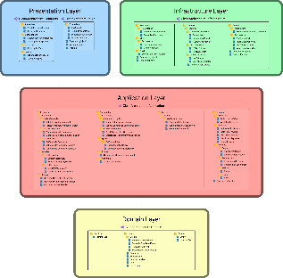
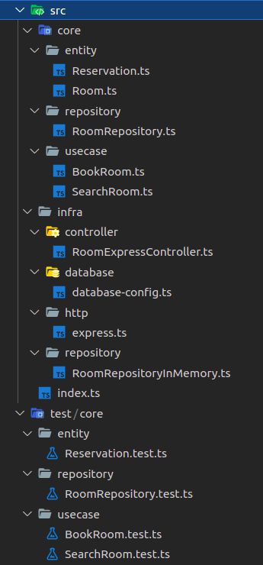
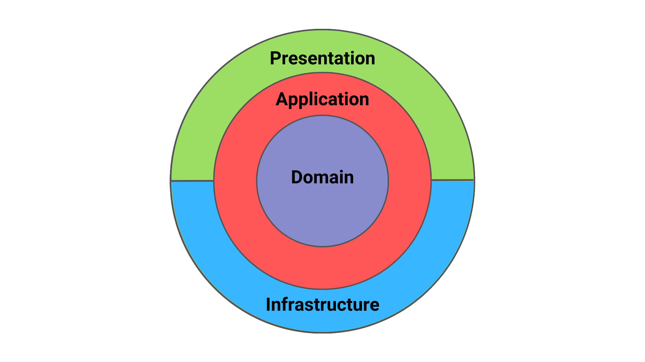
3.2 python
book
/pyca book-introduction/
video: step by step
video
video: lista brazileiro (com muitos detalhes)
ppt
https://ep2020.europython.eu/media/conference/slides/9kugWub-clean-architectures-in-python.pdf
ppt
github: c#, good names
medium: example, typescript, no good names
folders
github: CleanArchitecture-Example 1
code
github: CleanArchitecture-Example 2
linkedIn: what, advantages, python (not good folder names)
linkedIn: erro handling
blog: nocode , good names

Slide 12
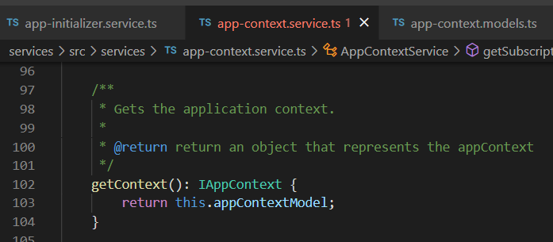

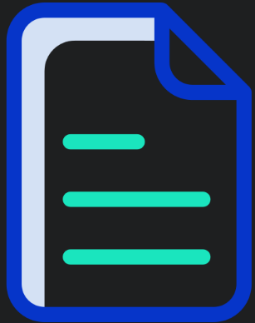

Z. template
new project
ExecuteAsync
square post-it
download
exe
download
exe
why
A slash
followed
by
two consecutive asterisks
D:\A1_research\C2_c0dice\B1_jmeter\A1_install
functionalities
introduction
build-exe
entity framework plus
zig help
⊂
4
every key-frame
defines the operation
success

