Slide 1
1. clean

Slide 2
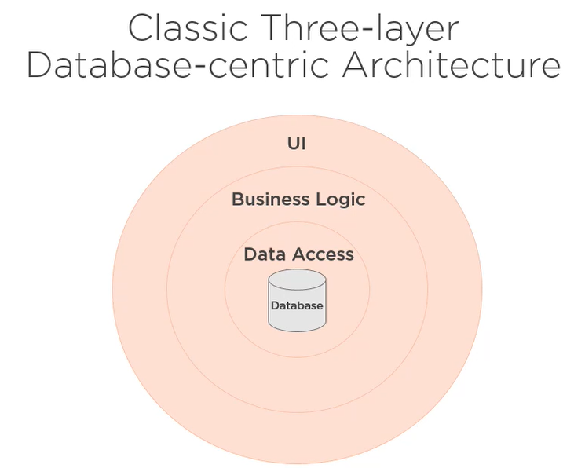
2. 3-layers
Here
we have
the classic
three-layer
database-centric
architecture.
what
Its key feature is
that
the user interface,
business logic,
and data access layer
revolve around the database.
The database
is
essential,
and thus,
it's at
the center
of
this architecture.
pluralsight.com/course

Slide 3
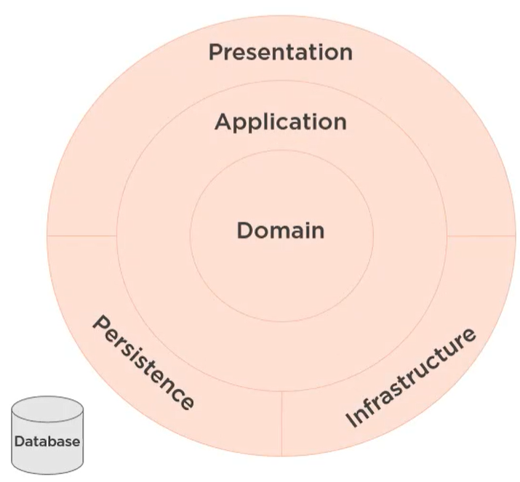
3. clean
some of us
are putting
the domain
at
the center,
rather than
having
the database
at
the center
of
our architecture,
a new perspective
has changed
the way
many of us
look at
our architecture.
what
and
making
the database
just
an
implementation
detail
outside
of
the architecture.
pluralsight.com/course
"the first
concern
of
the architect
is to make sure
that
the house is usable,
by
a change in
perspective
about
what is essential
in
an architecture
it is not
to ensure
that
the house
is made
of
brick. "
This change
in
architectural
perspective
is being
caused
versus
what is just
an implementation
detail.
why

Slide 4
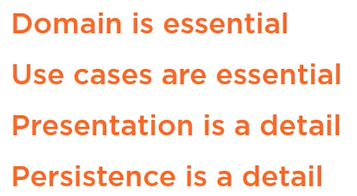
3.1 perspective
Z. template
what
new project
The domain model is essential.
Without it
the system
would not represent
the mental models
of
the users.
The use cases are essential.
Without them
the system
would not solve
the user's problems.
A slash
followed
by
two consecutive asterisks
then
a slash
matches
zero
or
more
directories
pluralsight.com/course
the presentation is just a detail.
We can deliver
the UI
in web forms,
ASP. NET MVC
or as a single page
JavaScript
application,
the persistence is just a detail.
We can store
the data
in
a relational database,
no SQL database,
or as plain old JSON files.

Slide 5
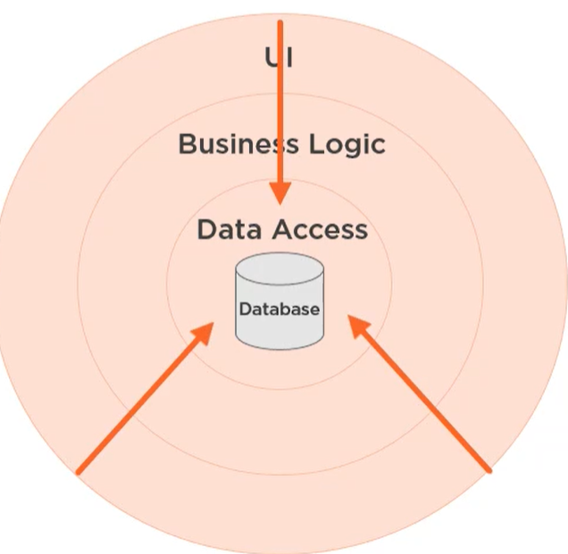
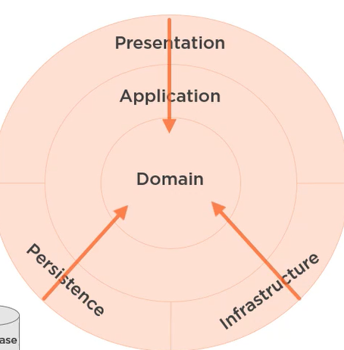
3.1.1 dependences

Slide 6
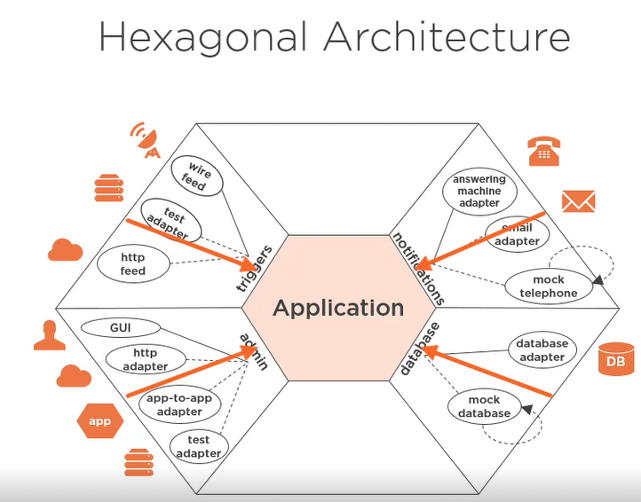
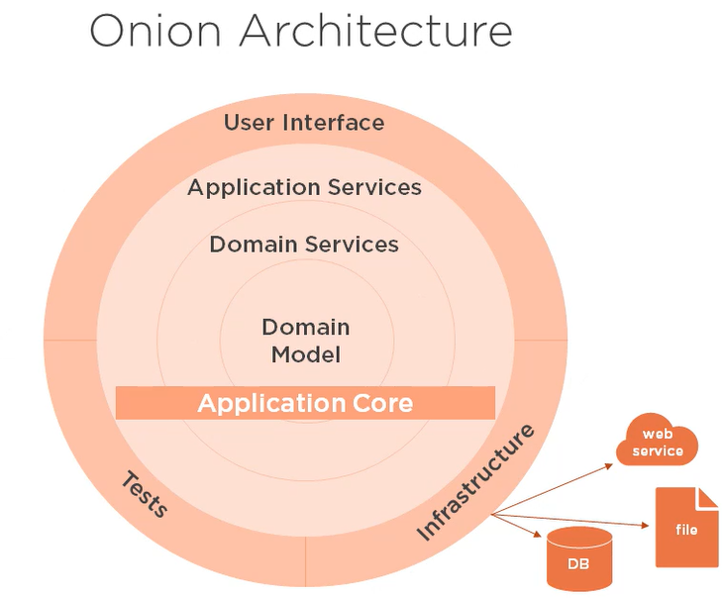
3.2 types

Slide 7
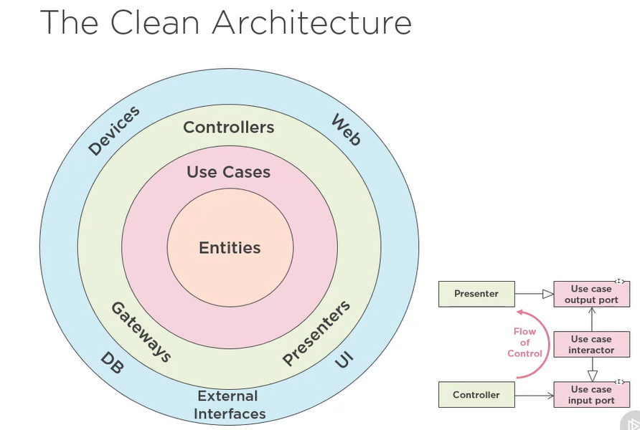
3.2.1 clean

Slide 8
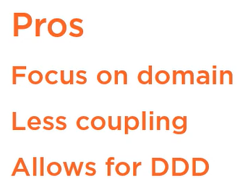
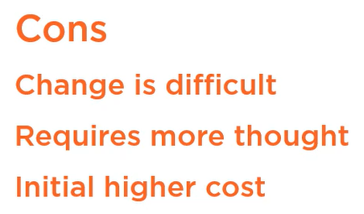
3.3 evaluation
new
unknown
domain and application
vs
business logic

Slide 9
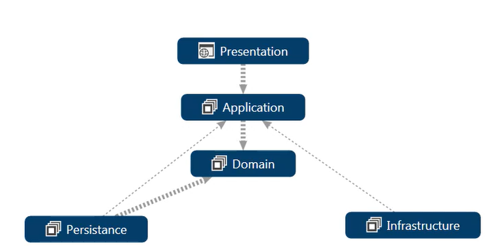
3.4 implementation
only
because
ORM EF
not in general

Slide 10
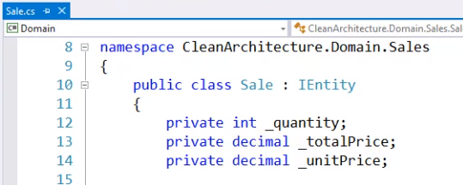
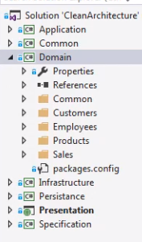

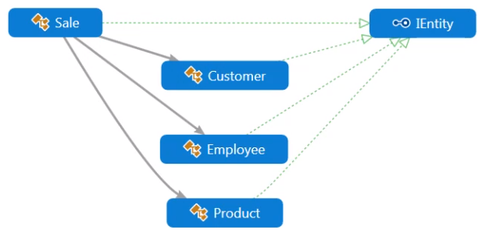
4. domain
functional cohesion
aggregate root entities
DDD
the topmost entities
with
persistent identity
in
a graph
of
dependent entities
and
value objects
POCO
and
methods
named in
the domain language
Common
classes
and
interfaces
for
the entities
shared by
the aggregate roots
IEntity
all entities
with
persistent identity
no
persistence
infrastructure
presentation
classes
with
ID

Slide 11
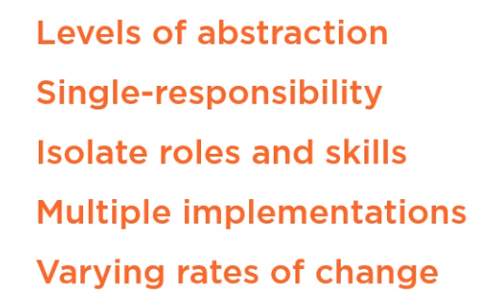
5. layers
designed to
represent
different levels
of
abstraction,
maintain
the single responsibility principle,
isolate
developer roles and skills,
help support
multiple implementations,
assist with
varying rates of change.
Layers
are
boundaries
or
vertical partitions
of
an application
Essentially,
layers
are
the way
that
we slice
an application
into
manageable units
of
complexity

Slide 12
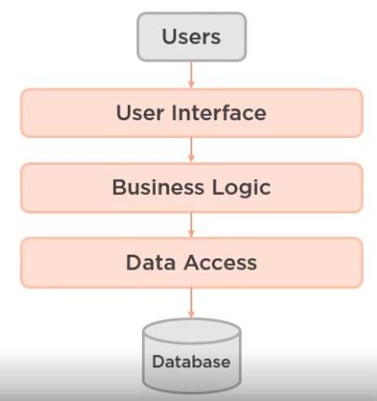
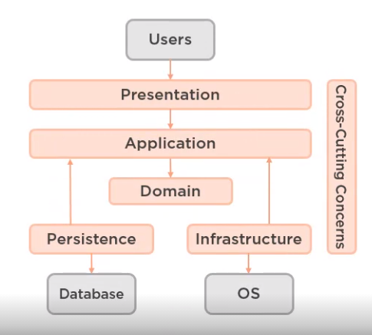
5.1 types
modern
ok for CRUD

Slide 13
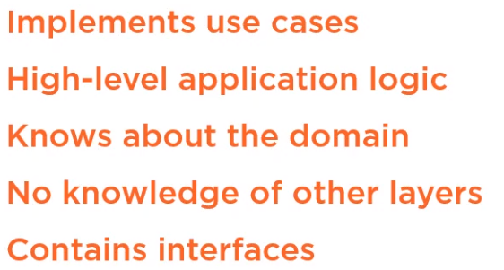
6. application
We
structure
this executable
use case code
as
high-level representations
of
application logic.
The application layer
knows about
the domain layer,
that is,
it has
a dependency
on
the domain,
but it
does not know
about
the presentation,
persistence
or infrastructure
layers.
That is,
there are no
dependencies
on
the outer layers
of
the application.
For example,
we
might have
a query
that
searches for
our product
for
our customer
OR
a command
that
adds
a product
to their
shopping cart.
The application layer,
however,
does contain
interfaces
for
its dependencies
that
these respective
outer layers
then implement.
implements
use cases
as
executable code,
for example,
a customer
searches
for
a product,
adds it
to
their cart,
pays
with
a credit card.
Then we use an IoC framework,
that is
an Inversion of Control framework,
and
dependency injection
to
wire up all the interfaces
and
their implementations at run time

Slide 14

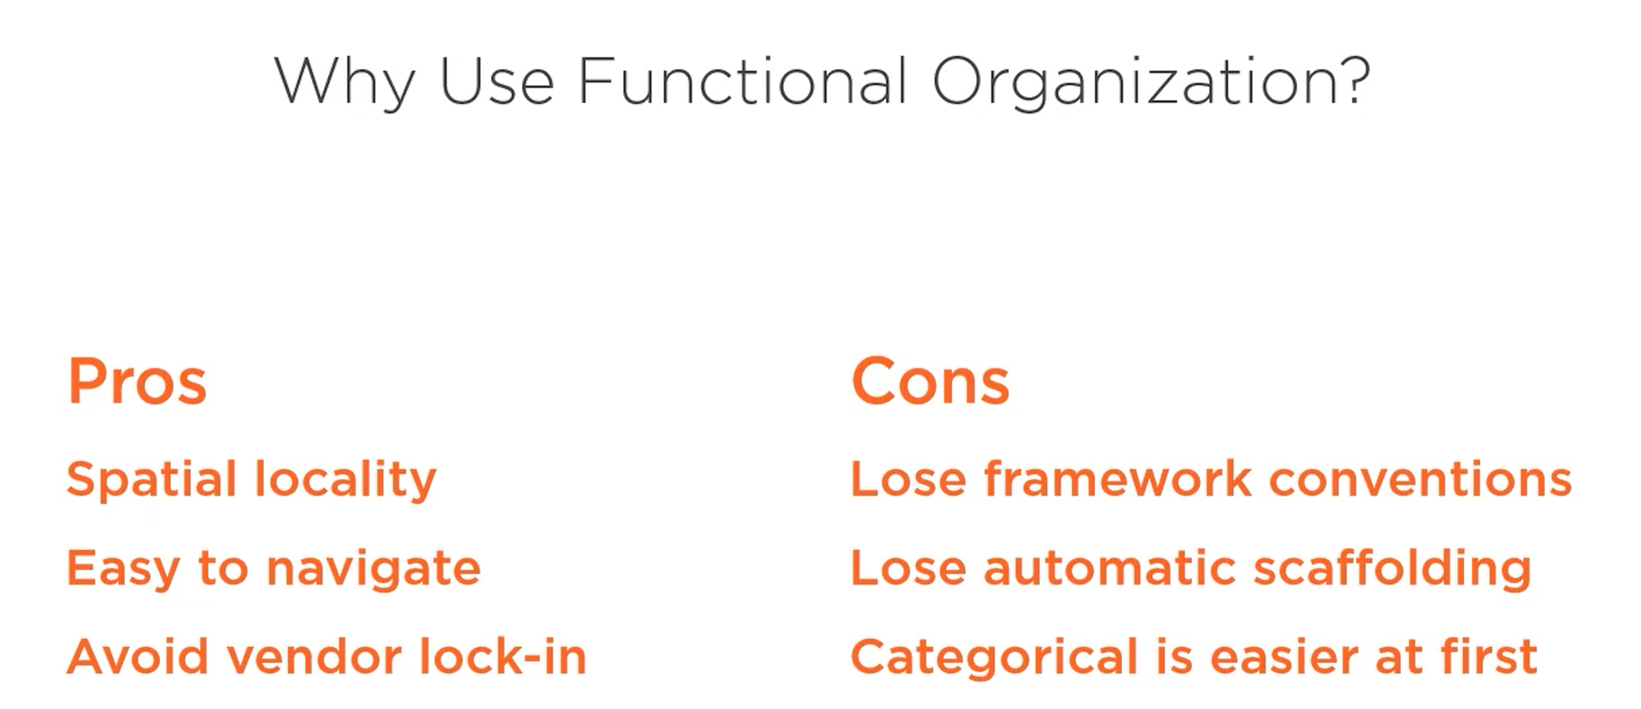
7. functional
functional organization

Slide 15
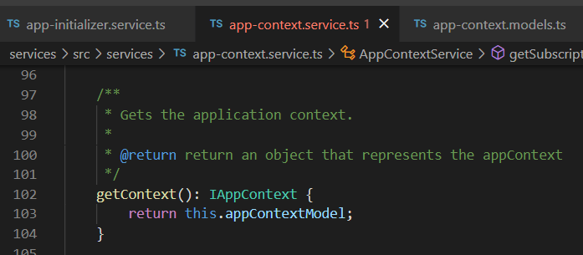


Z. template
new project
⊂
ExecuteAsync
square post-it
A slash
followed
by
two consecutive asterisks
then
a slash
matches
zero
or
more
directories
every key-frame
defines the operation
being executed
d:\research\A2_se\A2_architecthure
success
4
small talk versions and ide

