Slide 1
1. clean code

Slide 2

1.1 index
async
empty lines
one operation
comments
variables

Slide 3

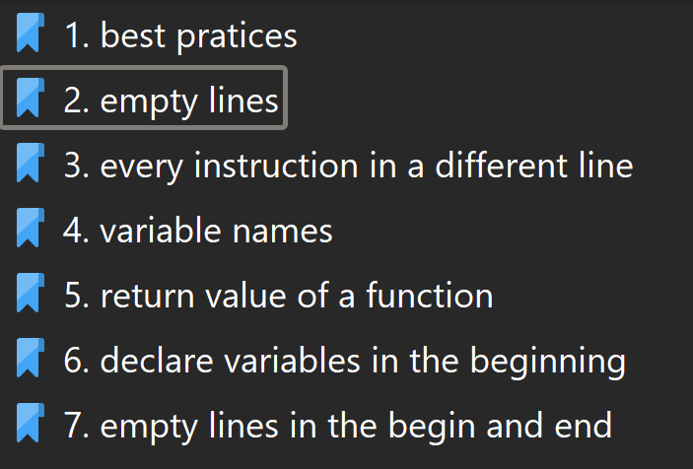
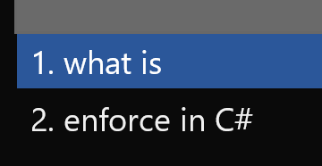

1.2 sources
where
book
code best practices
portuguese
english
Composing Software
complexity/reuse
Complexity and Reuse Design
conta simple
code style guide
clean code and JS callbacks

Slide 4
2. why
languages
are
too permissive
required rules
to
create
good code

Slide 5
3.1 functional cohesion
what

Slide 6
3.1.1 hierarchical
problem:
data grid
can have
two parents
elevation
mock
solution 1:
exists in first parent
is referenced in other parents
solution 2:
start in center
grid
invert hierarchy
grid
parents
mock
elevation
children
uri
row-actions
problem:
finding components is harder
because
we may not know the parents
solution:
exists in first parent
is referenced in other parents
what
need to think about this
dependency relations
is
a graph
not
a tree
hierarchy
is
a tree

Slide 7
3.1.2 flat
easy
to find
components
see
folders
as
an alphabetic
index
problem:
dependencies
are not shown
solution:
requires
a class diagram
what

Slide 8
3.2 models
interfaces without classes
undefined variables
POCO classes
that initialize
attributes
problem:
no default value
solution:
poco
with constructor
problem:
what appends when undefined value
undefined behavior
what
services extends
models
model
sustains
data
state
services
sustains
operations
state

Slide 9
3.3 name spaces
what
simplify
class names

Slide 10
3.4 operations
what
don´t execute operations inside ()
use const and variable in line before
variable name should designate the operation
advantages
variable name documents operation
easy to debug
easy to read: every operation in one line

Slide 11
3.5 indentation
what
why first curly brace in the same line
parameters and curly braces
({
})
two spaces tab
TO DO
indentation

Slide 12

4. indirection
what
wikipedia
augments
complexity

Slide 13
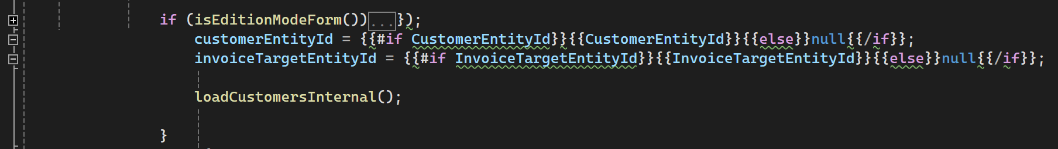
5. collapse
what
VS2022: problem with JS code with handlebars templates
no collapse/expande code
C:\Projectes\v2m\Contasimple\develop\cs\Contasimple.Web\Content\Templates\Banks\BankReceiptForm.html
need
research
code navigation
collapse/expand code blocks
the only way to move through the code
hypothesis

Slide 14
6. symmetry
what
symmetry between code components
example
component 1
menu: Bancos & Caja/Recibos bancarios/Procesar devoluciones
url: http://contasimple.local:10002/Modulos/Bancos/Remesas/Devoluciones.aspx
component 2
menu: Bancos & Caja/Recibos bancarios/Nuevo recibo
url: http://contasimple.local:10002/Modulos/Bancos/Remesas/Nuevo-recibo.aspx
send mail uses the same code in the two components
use symmetry to relate the code of the two components
ANALYSE this example to study how code generation templates should be used (not generic code?)
the two components do the same?
they should reuse the same component?
ANALYSE this example
to study
how code generation templates
should be used
(not generic code?)

Slide 15
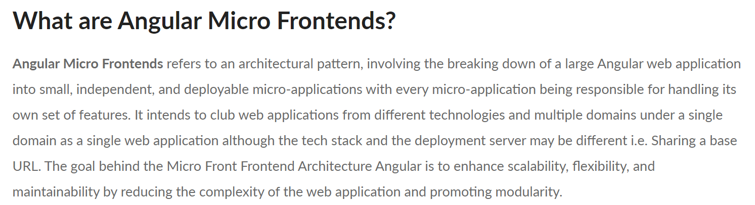
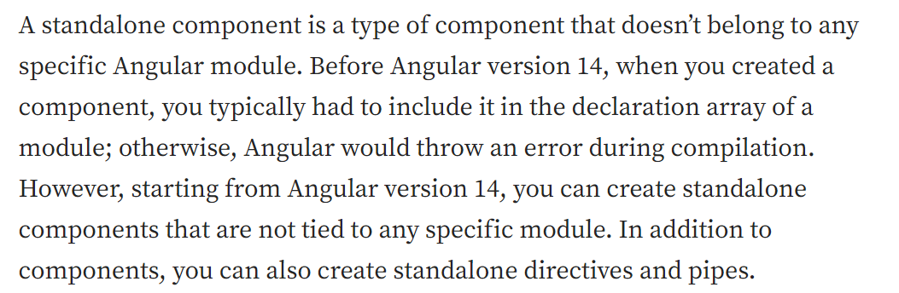
7. micro front ends
what
in c0dice
my concept of
.exe microservices ?
is the same as
the angular micro front ends
stand alone components
need
research
angular micro frontends architecture
standalone components

Slide 16
8. line return
what
returning early pattern
not ifs
https://medium.com/swlh/return-early-pattern-3d18a41bba8
research
new line
before
)
angular micro frontends architecture
standalone components

Slide 17
9. returning early
what
returning early pattern
not ifs
https://medium.com/swlh/return-early-pattern-3d18a41bba8
research
new line
before
)
angular micro frontends architecture
return early

Slide 18
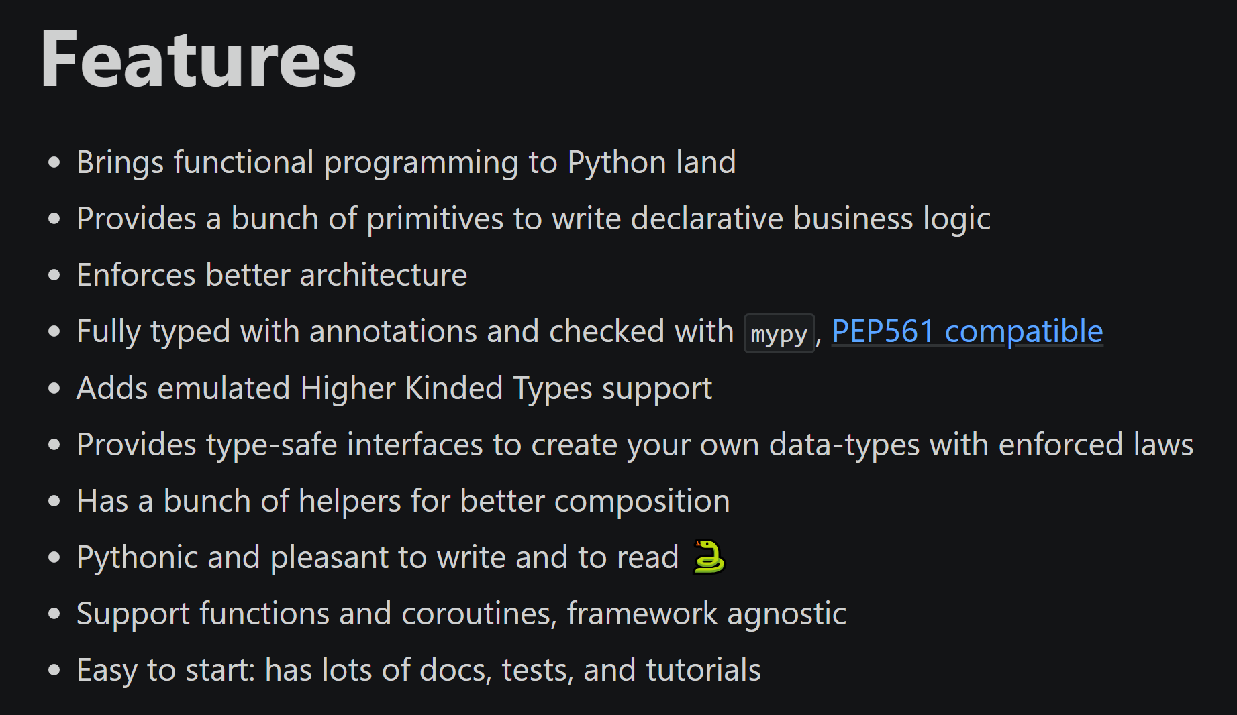
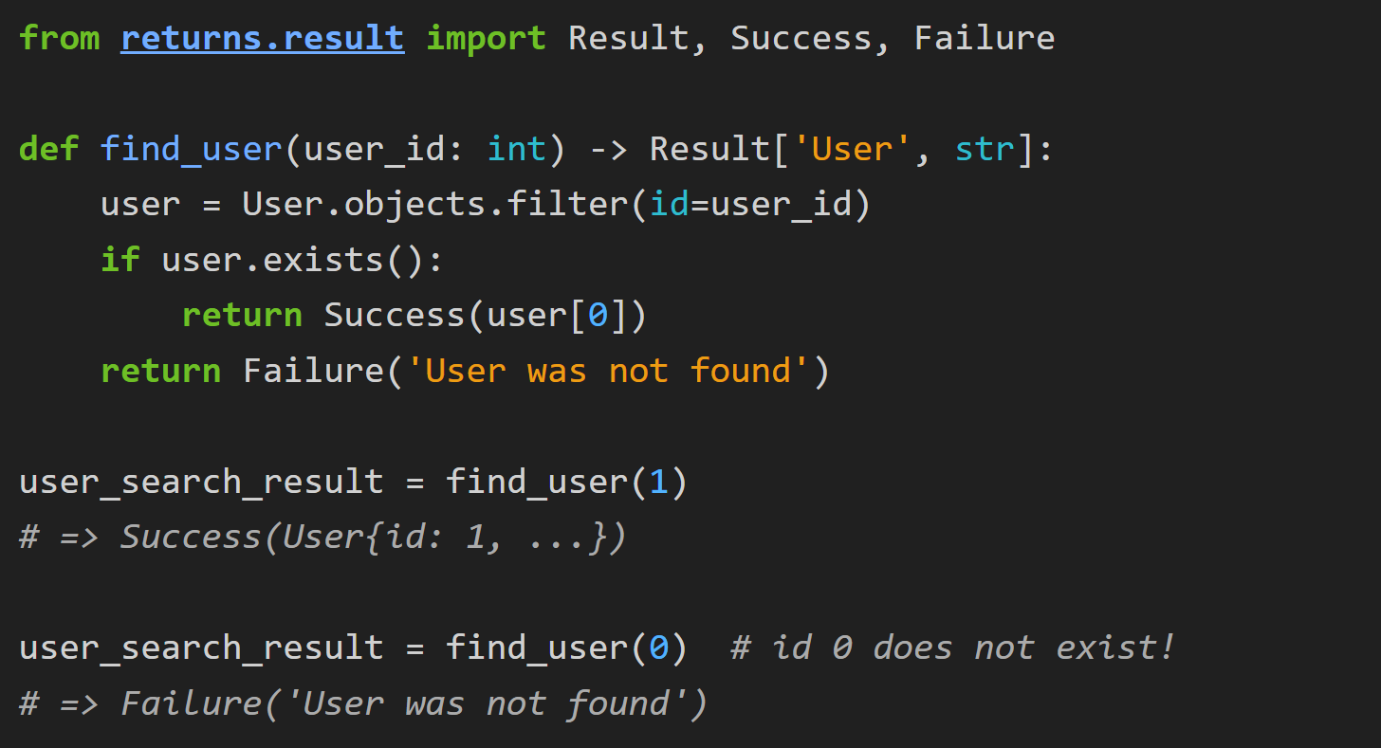
10. return result
what
python returns library
primavera/frameworks/hydrogen/rest

Slide 19
10.1 install
what
pip install returns
python returns library

Slide 20
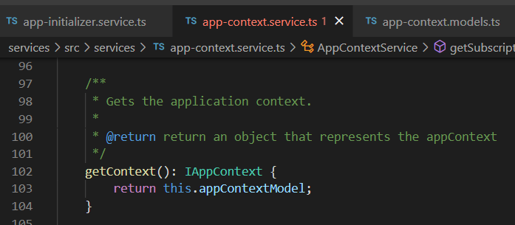



Z. template
new project
ExecuteAsync
square post-it
download
exe
why
A slash
followed
by
two consecutive asterisks
code navigation
collapse/expand code blocks
the only way to move through the code
D:\A1_research\C2_c0dice\B1_jmeter\A1_install
functionalities
introduction
build-exe
entity framework plus
zig help
⊂
4
every key-frame
defines the operation
success

