Slide 1
1. best practices

Slide 2
6. using
what
The `using` statement
should be used when
working with an object
implements
`IDisposable`
`IAsyncDisposable`
these interfaces
provide a mechanism
for
releasing unmanaged resources
when
files
files
need to be closed
after use
DB
database connections
need to be closed
after use
Graphics Objects
Many graphics objects in the `System.Drawing`
namespace
implement `IDisposable`.
These objects often
hold unmanaged resources
that need to be cleaned up
when you're done with them.
free up
system resources
IA
no sources
the `using` statement
provides
a convenient syntax
that ensures
the correct use
of
`IDisposable` objects

Slide 3
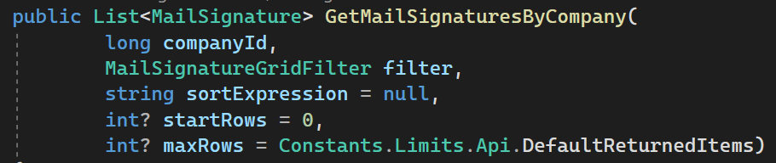
7. parameters
null
the part
of
the instruction
should not be
created
optional
the part
of
the instruction
should be
created
with
default values
if
the parameter type
doesn’t allow for
null values
use
nullable syntax
<type> ?

Slide 4
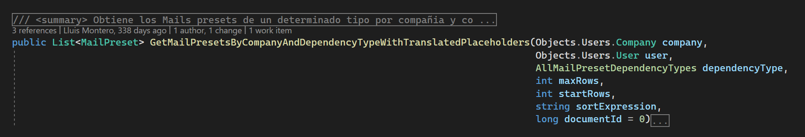
8. indentation
Luis

Slide 5
9. names
Luis
to long

Slide 6
10. processes

Slide 7
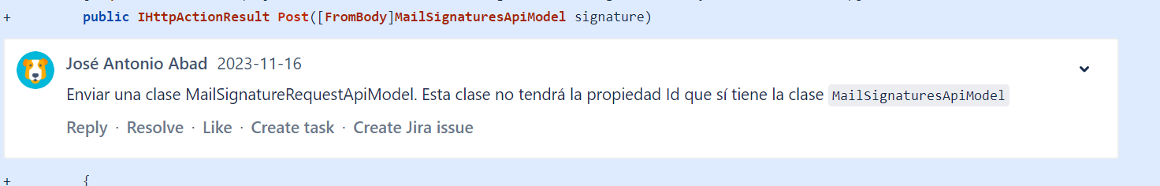
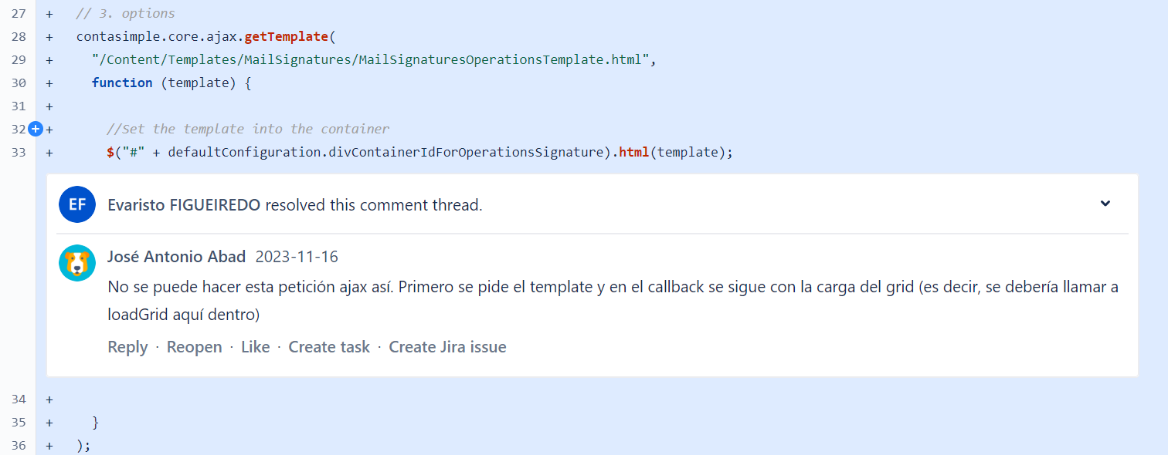
10.1 style/architecture
no onboarding process
no architecture documentation
no style guide
when I create a new file in the project
I copy from an existent one
so I can create the new one according to the rules
style guide
architecture
but the old file that I choose
is outdated
so is not according to the current
style
architecture
so
I create
the new
file
with errors
only in
PR review
I get
a warning
about
the problems
solution
documentation
style
architecture
grooming
share reference files
so I have
to redo
my work
is frustrating
takes
twice
the time
not in
clients
not in
clients
is not systematic
some errors are detected
some others don´t
not in
presets

Slide 8
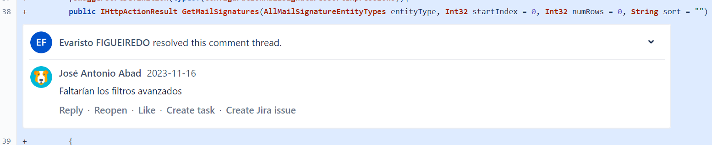
10.2 analysis
no participation
in
analysis
meeting
only in
PR review
I get
a warning
about
the problems
so
I implement
with functional
errors
so I have
to redo
my work
is frustrating
takes
twice
the time
solution
divide the issue in small issues
review smaller steps
errors have less impact

Slide 9
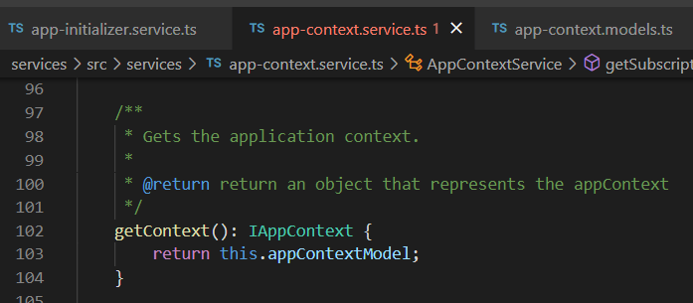






Z. template
new project
ExecuteAsync
square post-it
download
exe
download
exe
why
A slash
followed
by
two consecutive asterisks
D:\A1_research\C2_c0dice\B1_jmeter\A1_install
functionalities
introduction
build-exe
entity framework plus
zig help
⊂
4
every key-frame
defines the operation
success

