Slide 1
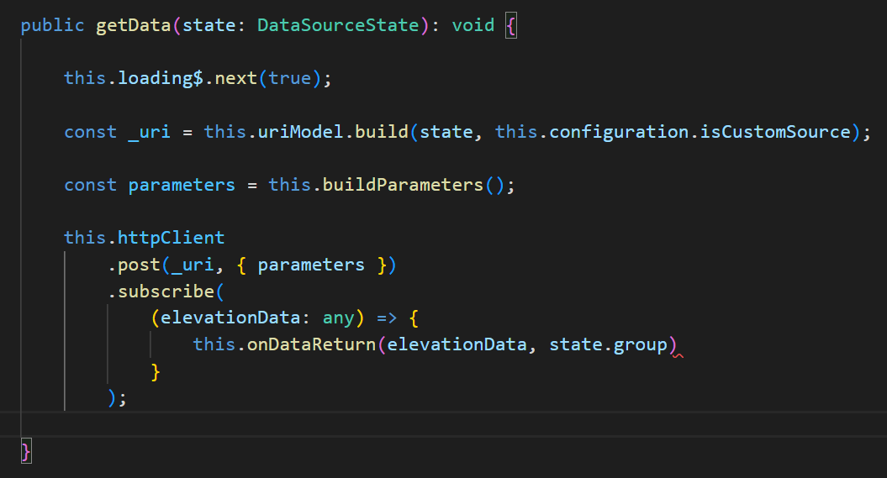
1. async
call back
what
local
create
a function
in
solution
current
execution
context
asynchronous
send
the function
to be
executed
in
asynchronous
execution
context
requires
the execution
of
local code
only when
async code
finishes
problem
function
receives
as parameter
the result
of
the asynchronous
operation

Slide 2
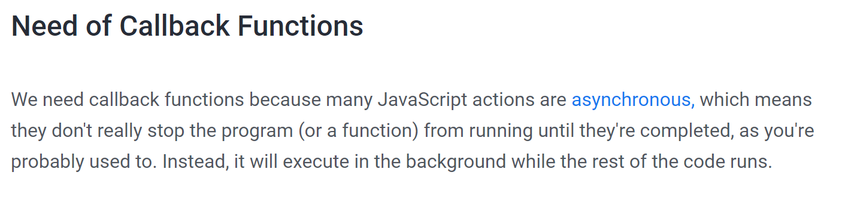
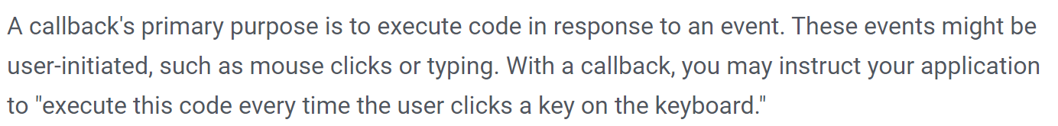

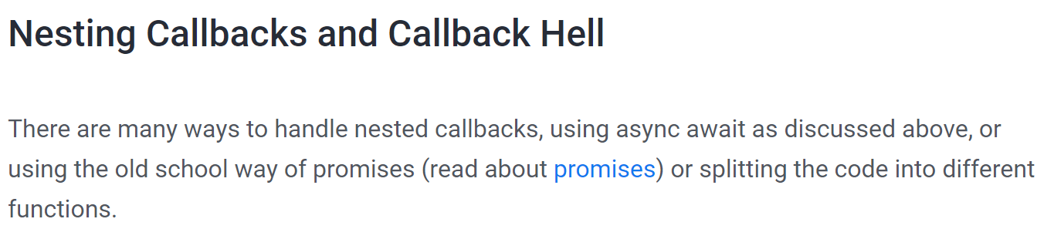

1.1 callback
what
callback-function-in-javascript
clean code and JS callbacks

Slide 3
2. problems

Slide 4
2.1 execution context
what
local
asynchronous
requires
data
from
local EC
function
executed
in
async EC
problem
asynchronous
execution
context
local
execution
context
parameter

Slide 5
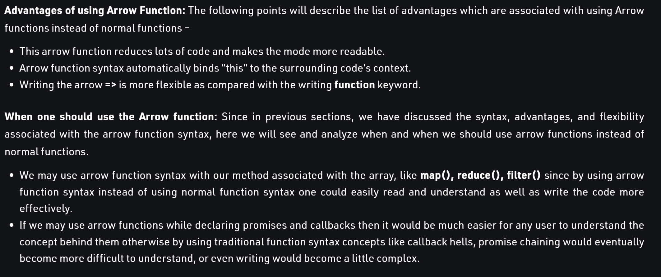
2.1.1 arrow
what
when-should-one-use-arrow-functions

Slide 6
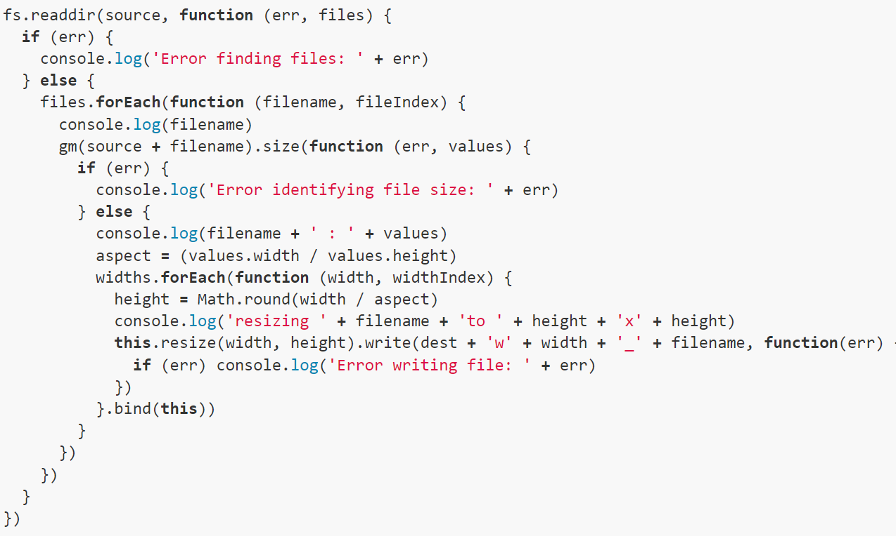
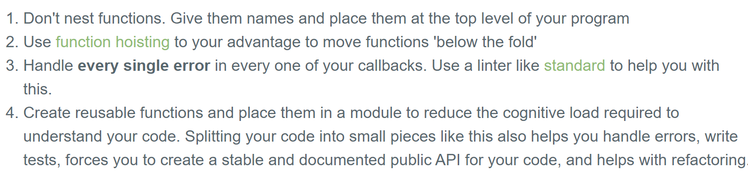
2.2 callback hell
what
Asynchronous JavaScript,
or
JavaScript that uses callbacks,
is
hard to
get right
intuitively
pyramid shape
and
all the }) at the end
callback hell

Slide 7
3. solution

Slide 8
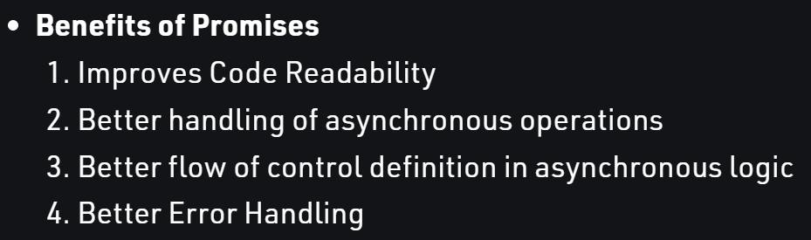
3.1 promises
what
javascript promises

Slide 9
3.1.1 await
what
javascript promises

Slide 10

3.2 reactive
maybe
only
for events?
what
analyse
the advantages
of
using
an observable
instead of a call back
reactive

Slide 11
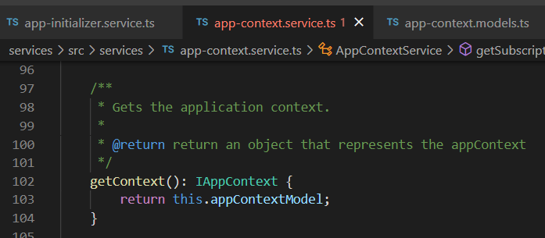
Z. template
new project
⊂
ExecuteAsync
square post-it
A slash
followed
by
two consecutive asterisks
then
a slash
matches
zero
or
more
directories
every key-frame
defines the operation
being executed
d:\research\A2_se\A2_architecthure
success
4
small talk versions and ide

