Slide 1

1. comments
algorithm comments
(//) single line + <index>
explanation comments
(/* */) multiple line character
structural comments
regions + xml (///)
best-practices-for-writing-code-comments

Slide 2

2. structural
C:\Projectes\v2m\Contasimple\develop\cs\Contasimple.Web\Modulos\Bancos\Remesas\Nuevo-recibo.aspx
C:\Projectes\v2m\Contasimple\develop\cs\Contasimple.Web\Content\Templates\Banks\BankReceiptForm.html
this page
is
enormous
navigate
the code
is
really hard
there where already
structural comments
so you also use then

Slide 3
2.1 regions
divide to conquer
crude regions
READ
DAO
manager
controller
tests
same regions
across
multiple entities
allows for
work division
complexity management

Slide 4
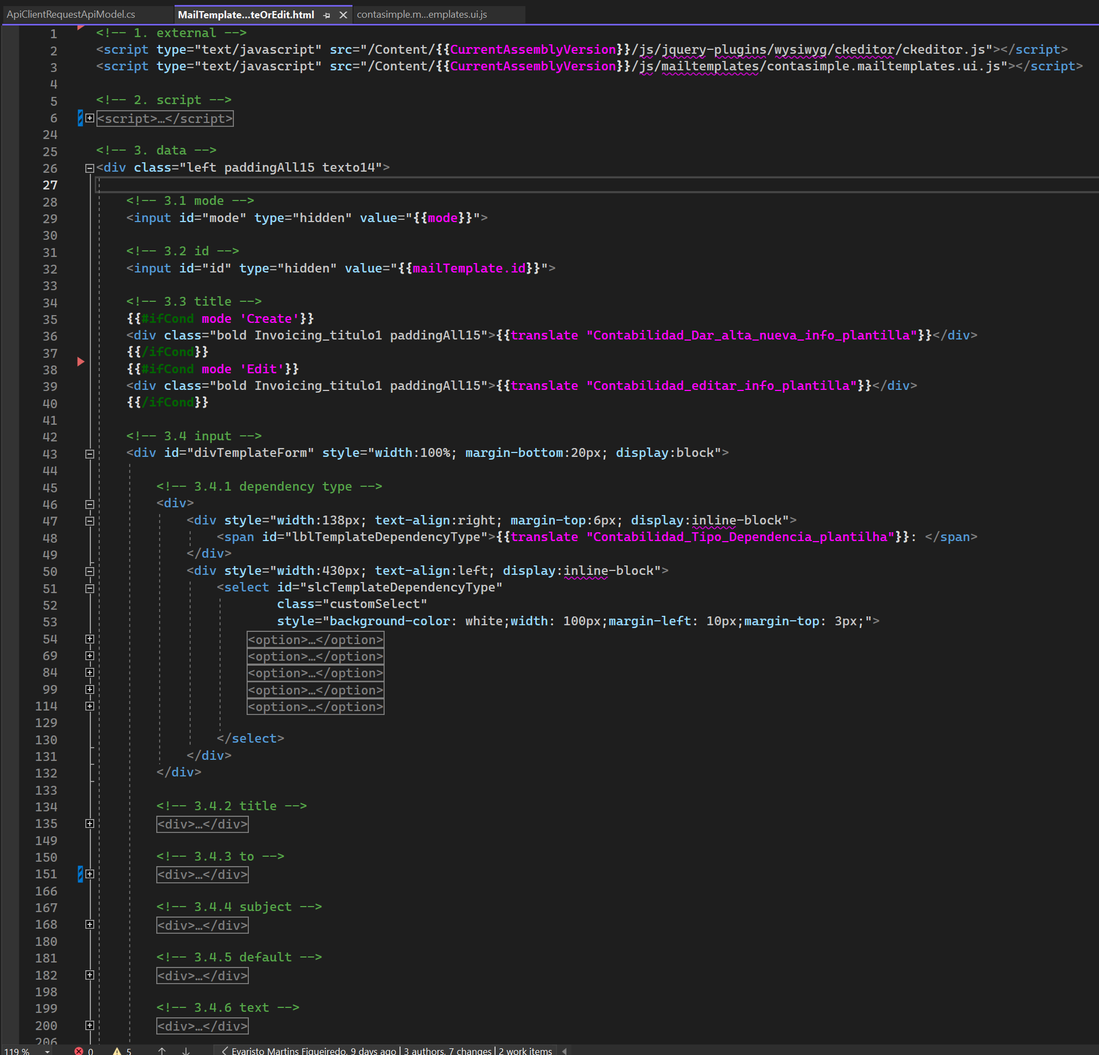
2.2 html
what
collapse all
becomes
very easy
to find
any field
to relate
the elements
with
the screen
to create
a mental model
of
the screen
reasoning
about the
required
changes
example:
new
advanced filter
columns
need
translation keys
for
columns names
find
fields
in edit form

Slide 5
4.2.1 expanded
what
just looking
to
the code
is
not easy
to relate
the elements
with
the screen
have to
look for
tips
id: not very visible color
text: translation confuses
with comments
is
direct
example:
new
advanced filter
columns
color: green
need
translation keys
for
columns names
find
fields
in edit form
structure comments: WHAT
code: how

Slide 6
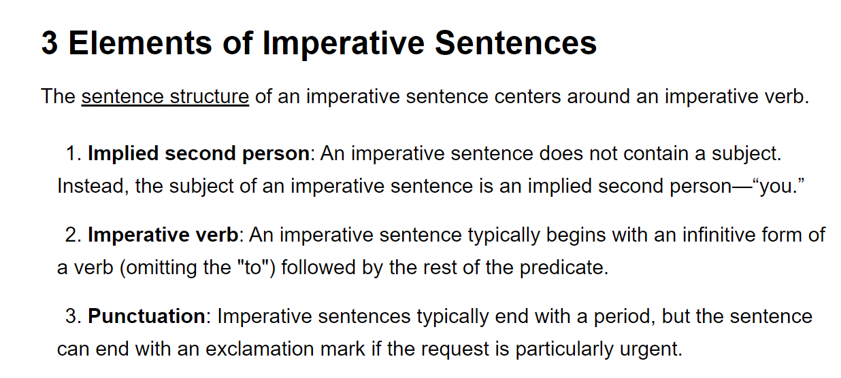
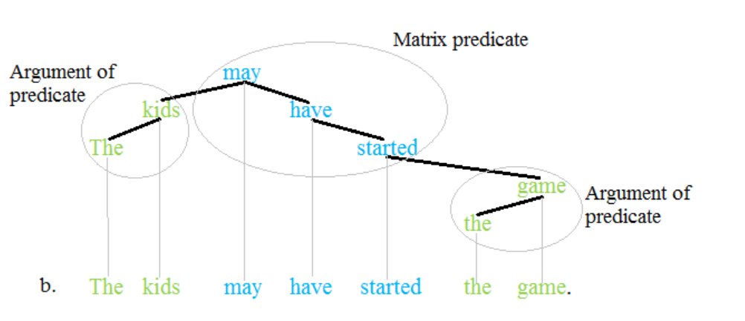
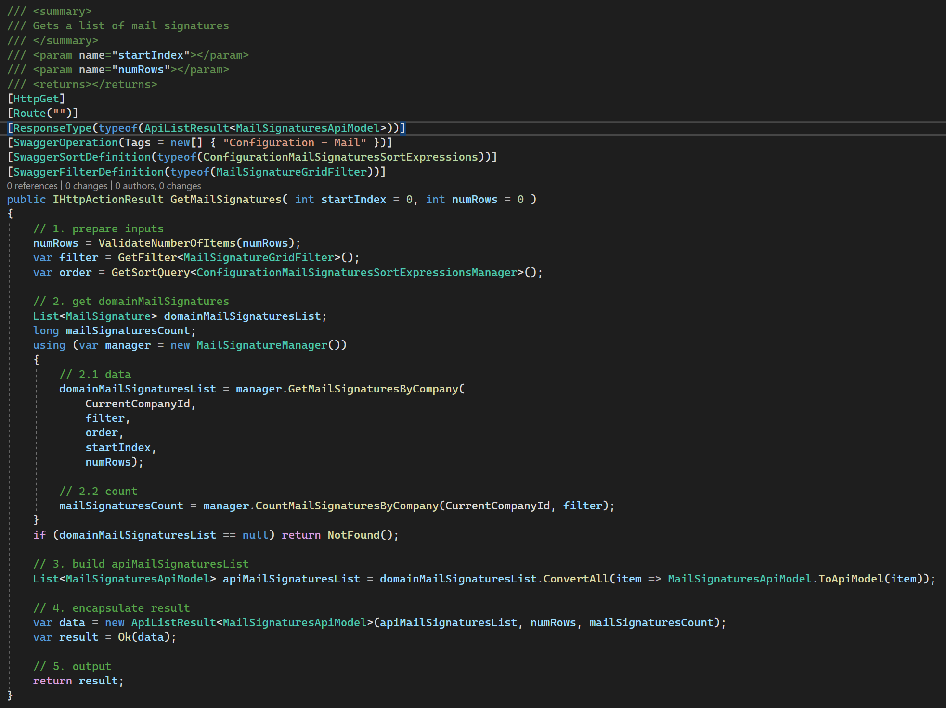
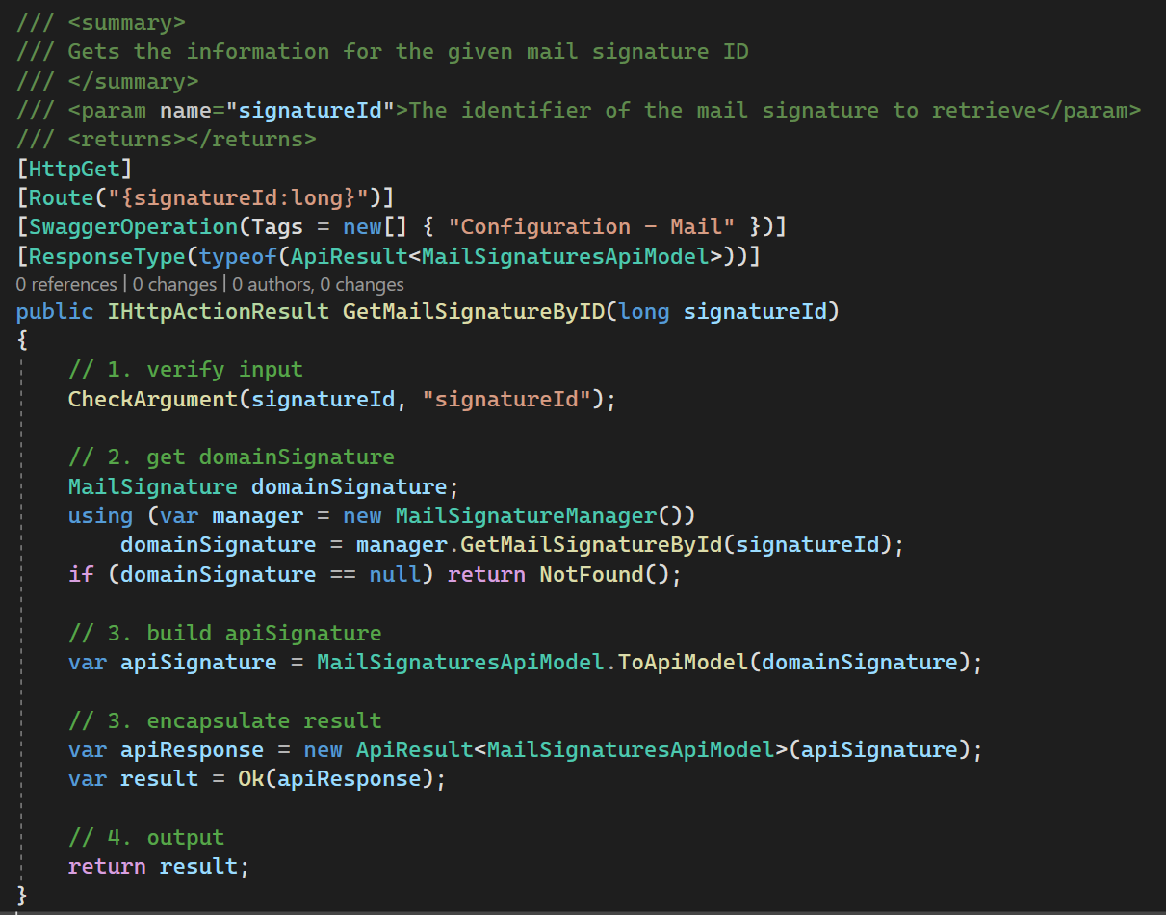
3. algorithm
what
algorithm comments
predicate:
part of a sentence or clause containing a verb and stating something about the subject
predicate
how
code explains the how
why
explanation comments (see bellow)
justifications
for different
types of comments
imperative-sentence

Slide 7
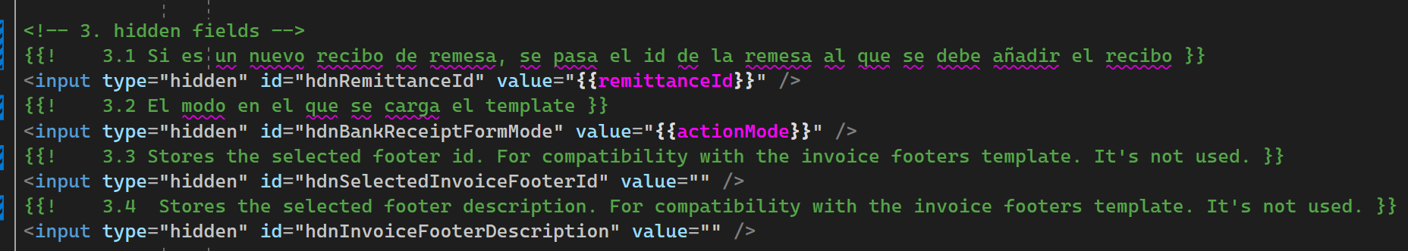
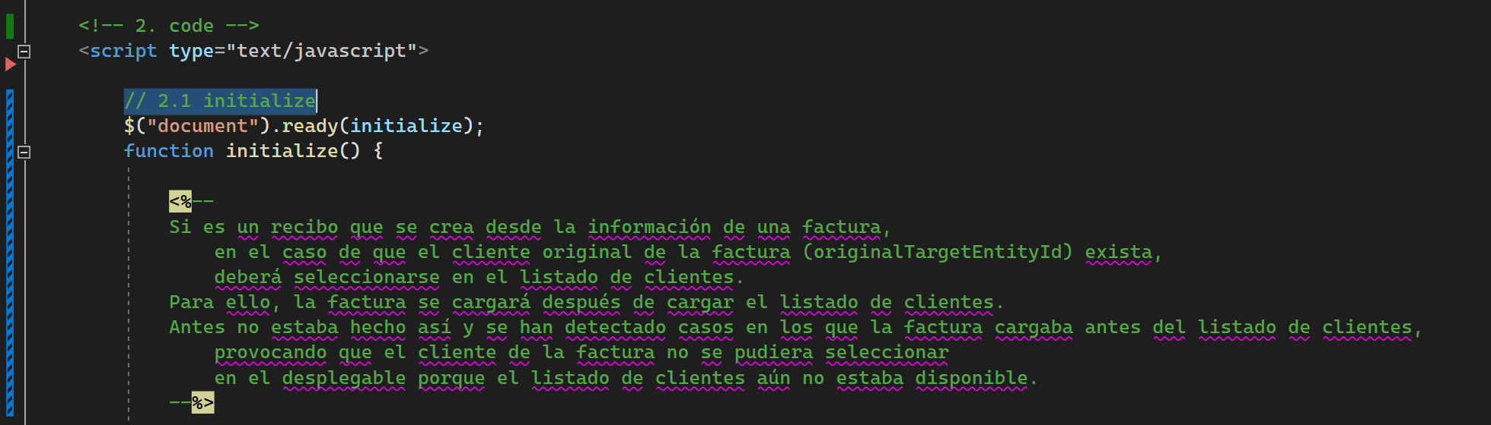
4. explanations
what
this comments
contain
sensible/private
information
should be created
with
template comments
that are removed
in
runtime
handlebars
ASPX

Slide 8
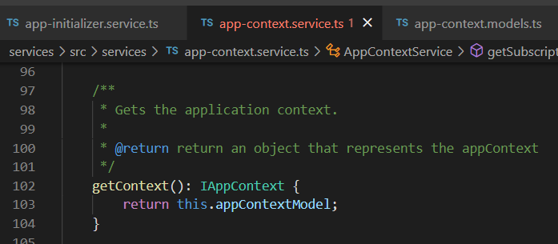




Z. template
new project
ExecuteAsync
square post-it
download
exe
download
exe
why
A slash
followed
by
two consecutive asterisks
D:\A1_research\C2_c0dice\B1_jmeter\A1_install
functionalities
introduction
build-exe
entity framework plus
zig help
⊂
4
every key-frame
defines the operation
success

