Slide 1
1. best practices

Slide 2
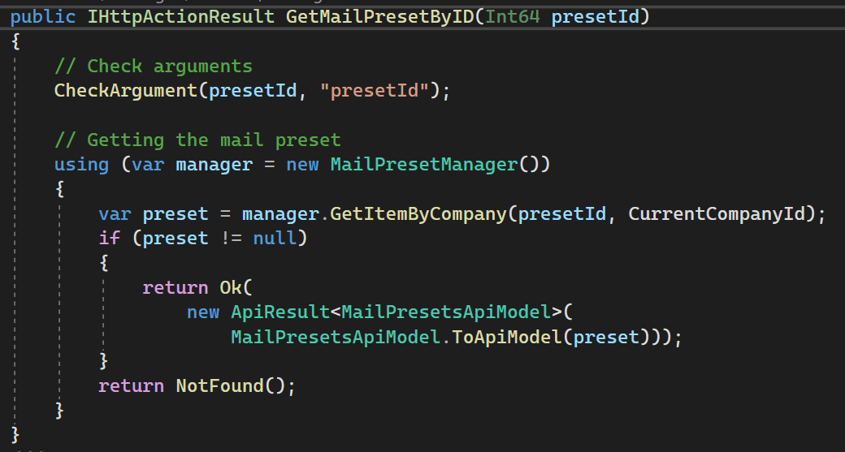
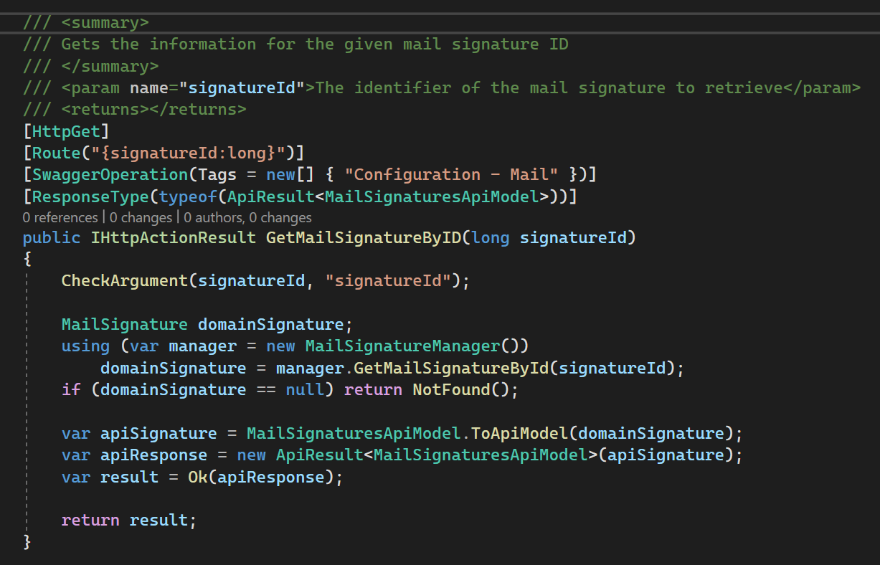
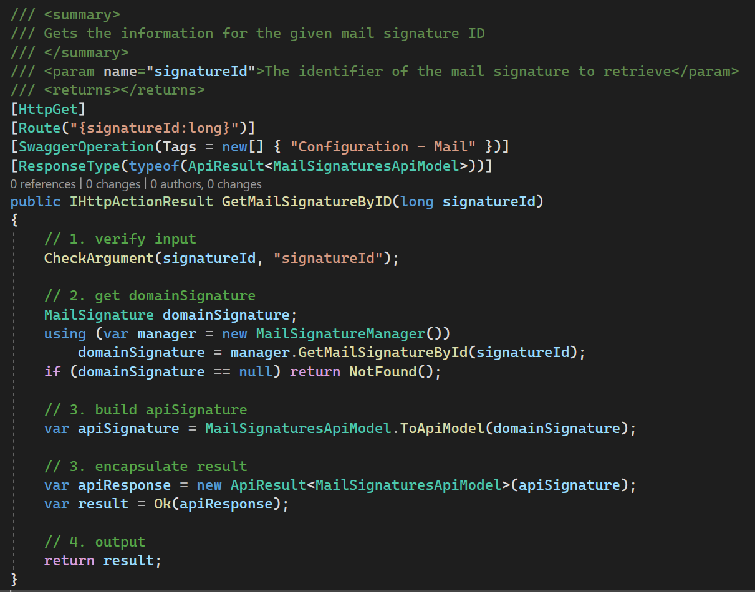
2. empty lines

Slide 3
3. one operation

Slide 4

4. comments
algorithm comments
(//) single line + <index>
explanation comments
(/* */) multiple line character
structural comments
regions + xml (///)
best-practices-for-writing-code-comments

Slide 5

4.1 structural
C:\Projectes\v2m\Contasimple\develop\cs\Contasimple.Web\Modulos\Bancos\Remesas\Nuevo-recibo.aspx
C:\Projectes\v2m\Contasimple\develop\cs\Contasimple.Web\Content\Templates\Banks\BankReceiptForm.html
this page
is
enormous
navigate
the code
is
really hard
there where already
structural comments
so you also use then

Slide 6
4.1.1 regions
divide to conquer
crude regions
READ
DAO
manager
controller
tests
same regions
across
multiple entities
allows for
work division
complexity management

Slide 7
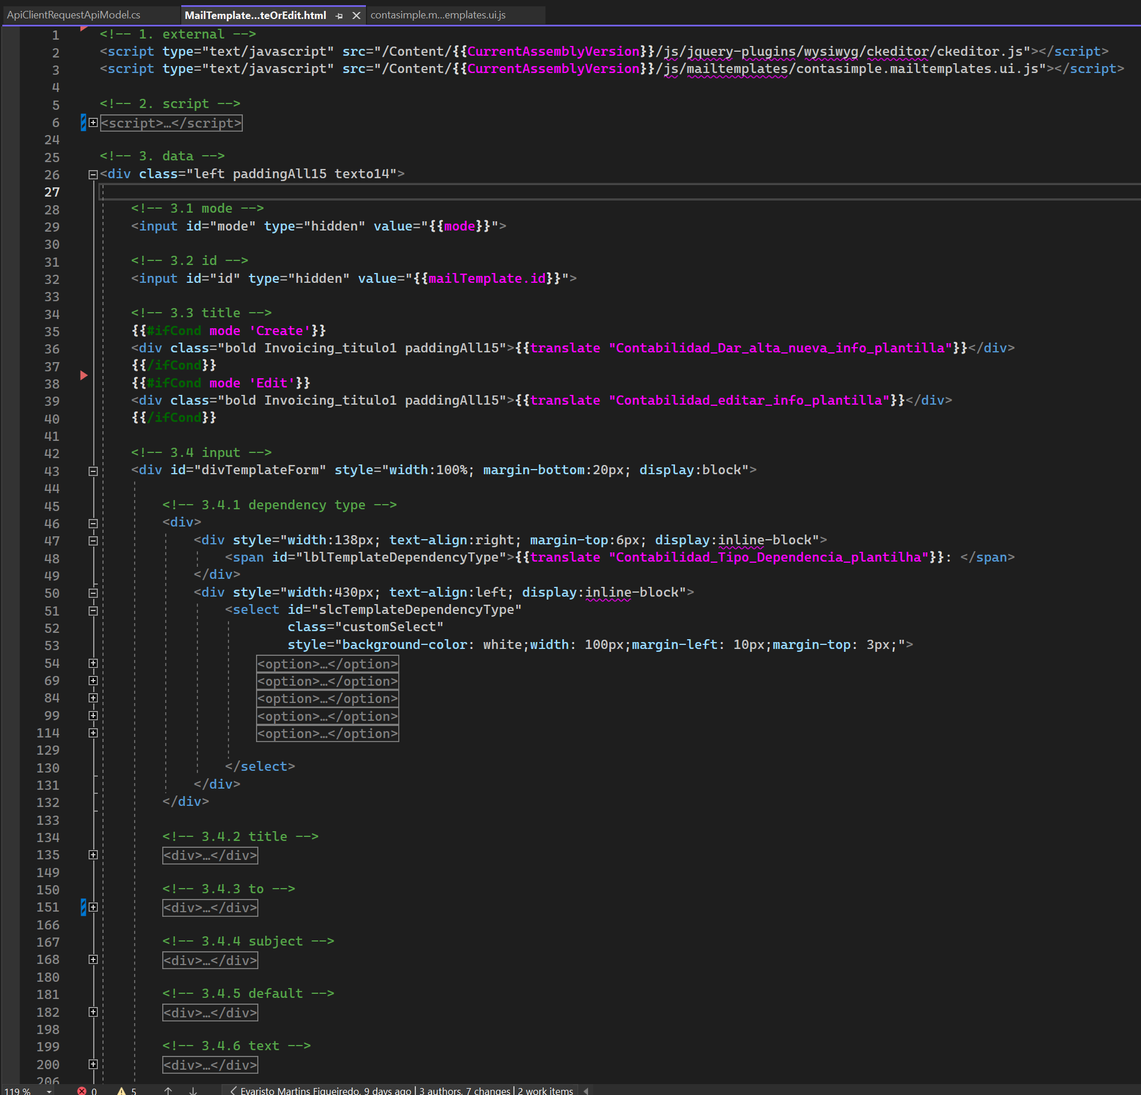
4.1.2 html
what
collapse all
becomes
very easy
to find
any field
to relate
the elements
with
the screen
to create
a mental model
of
the screen
reasoning
about the
required
changes
example:
new
advanced filter
columns
need
translation keys
for
columns names
find
fields
in edit form

Slide 8
4.1.2.1 expanded
what
just looking
to
the code
is
not easy
to relate
the elements
with
the screen
have to
look for
tips
id: not very visible color
text: translation confuses
with comments
is
direct
example:
new
advanced filter
columns
color: green
need
translation keys
for
columns names
find
fields
in edit form
structure comments: WHAT
code: how

Slide 9
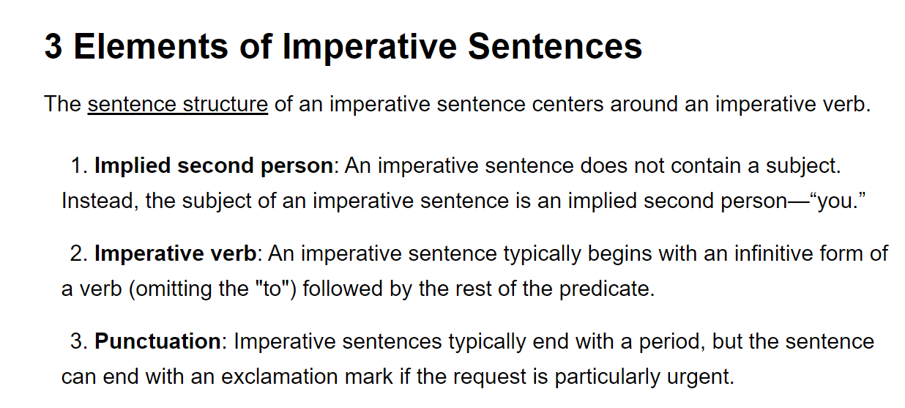
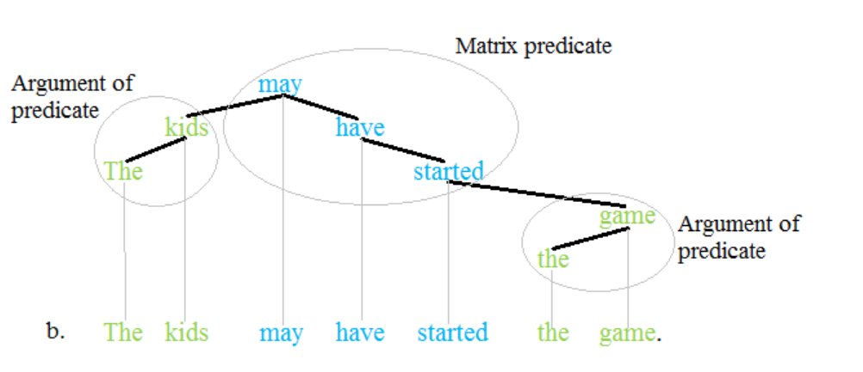
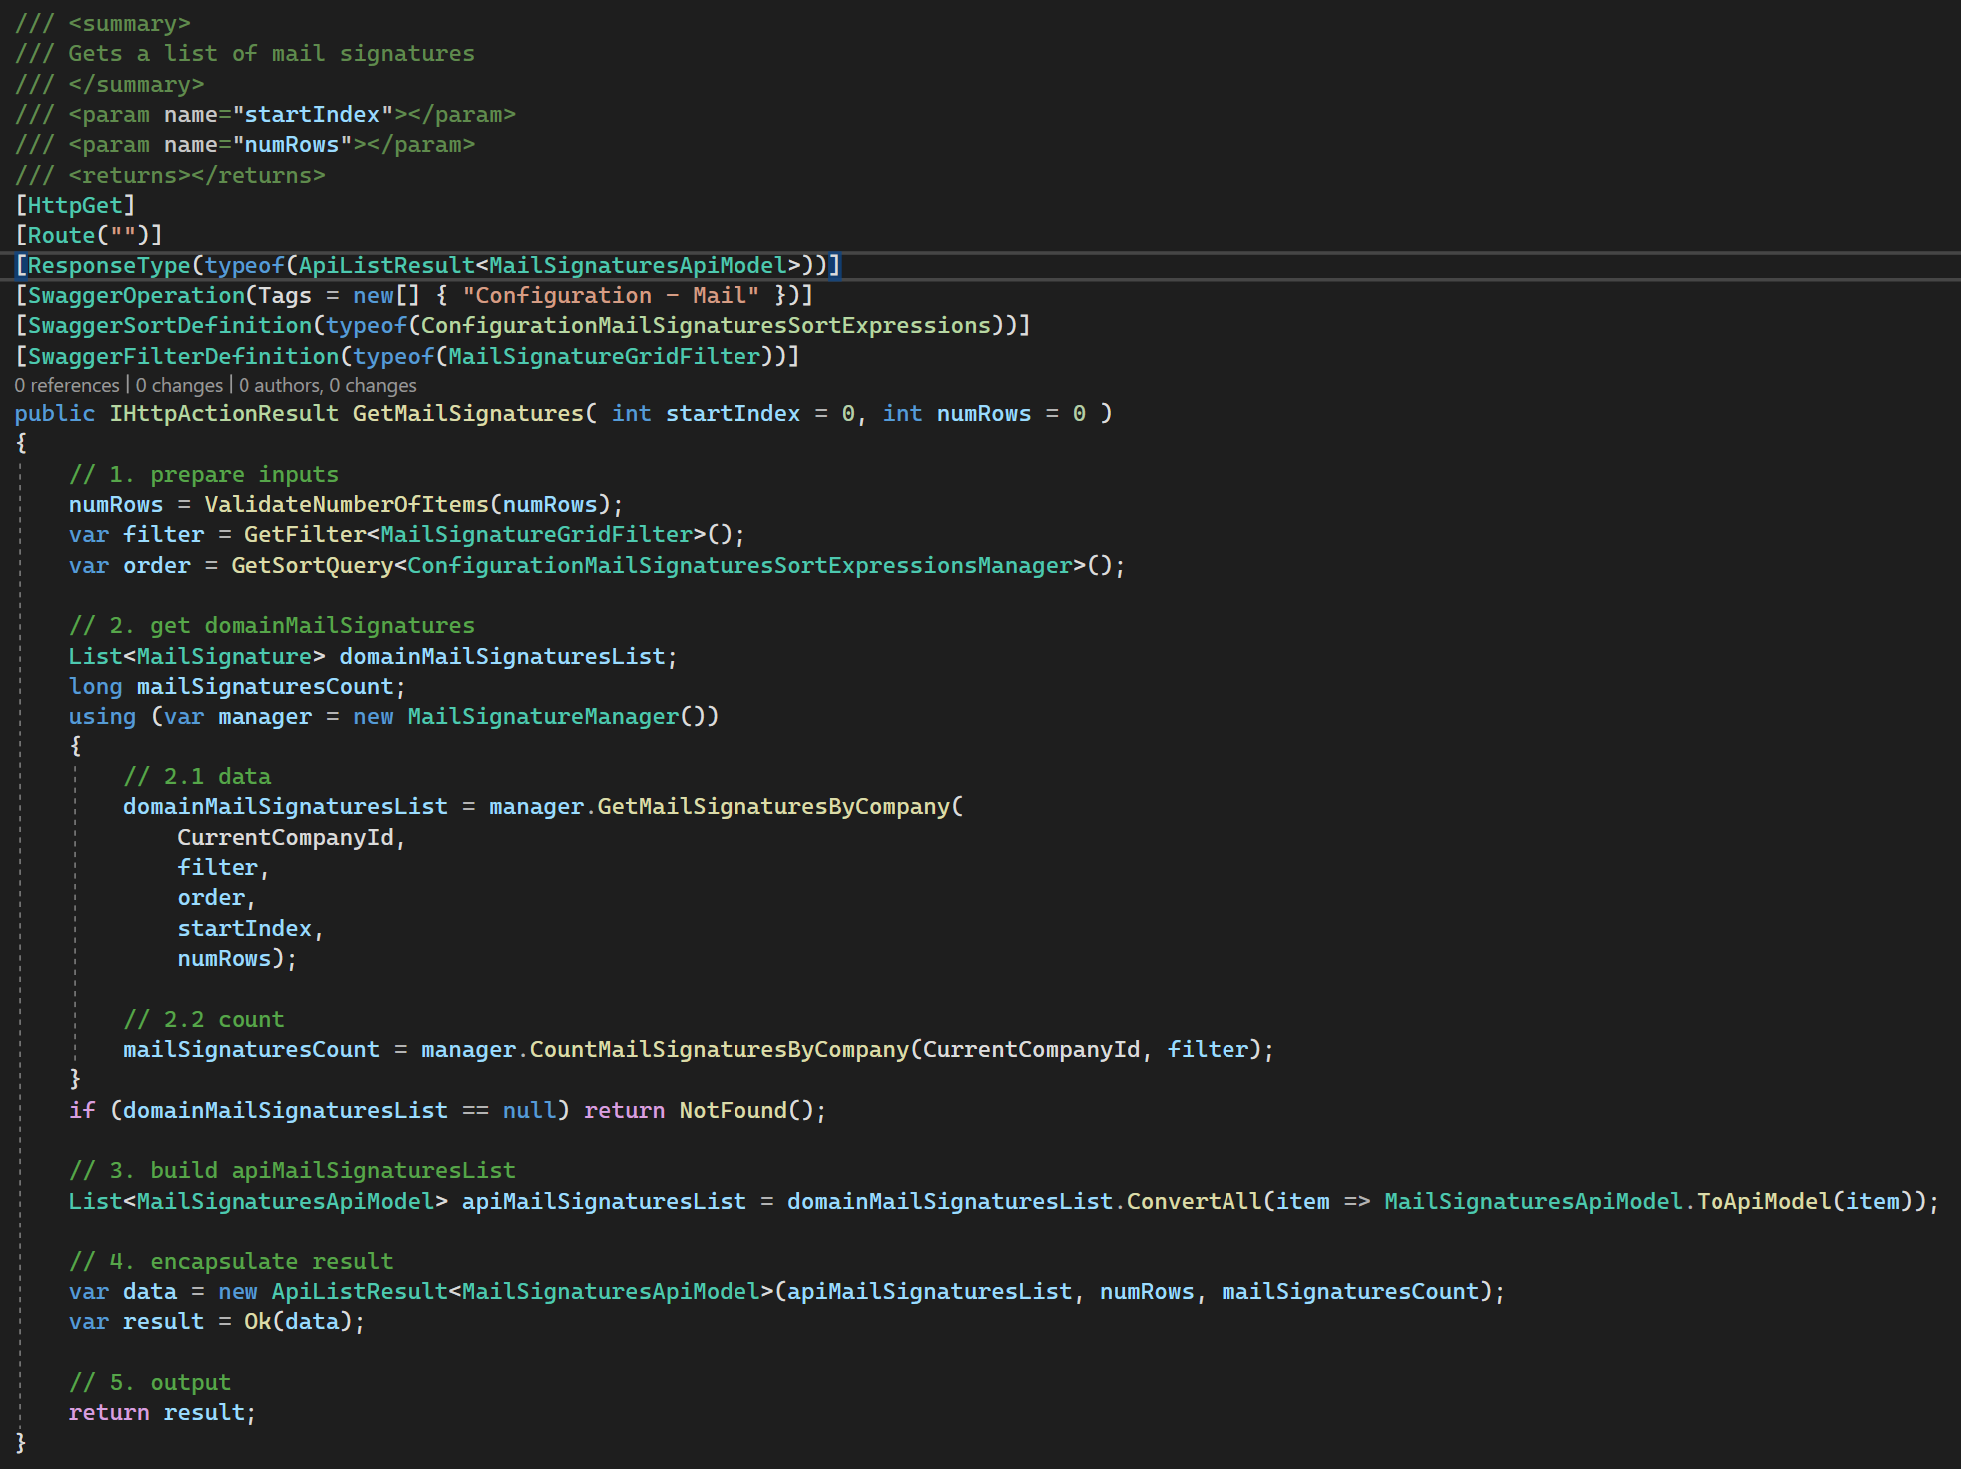
4.2 algorithm
what
algorithm comments
predicate:
part of a sentence or clause containing a verb and stating something about the subject
predicate
how
code explains the how
why
explanation comments (see bellow)
justifications
for different
types of comments
imperative-sentence

Slide 10
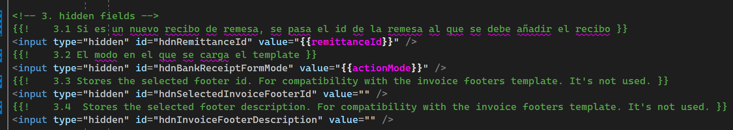
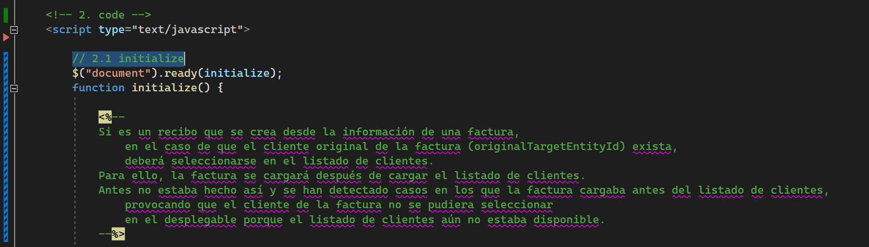
4.3 explanations
what
this comments
contain
sensible/private
information
should be created
with
template comments
that are removed
in
runtime
handlebars
ASPX

Slide 11
5. variables
what
is a concept
one
or
more words
identifies
the
operation result
describes
the operation
by stating
the operation result
starts a group
of
operations
concept:
an entity (name)
in
a specific domain

Slide 12
6. using
what
The `using` statement
should be used when
working with an object
implements
`IDisposable`
`IAsyncDisposable`
these interfaces
provide a mechanism
for
releasing unmanaged resources
when
files
files
need to be closed
after use
DB
database connections
need to be closed
after use
Graphics Objects
Many graphics objects in the `System.Drawing`
namespace
implement `IDisposable`.
These objects often
hold unmanaged resources
that need to be cleaned up
when you're done with them.
free up
system resources
IA
no sources
the `using` statement
provides
a convenient syntax
that ensures
the correct use
of
`IDisposable` objects

Slide 13
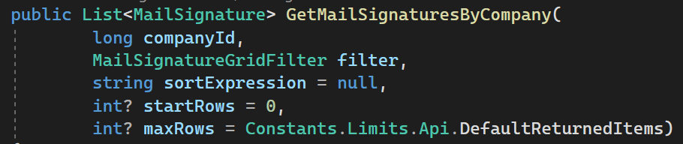
7. parameters
null
the part
of
the instruction
should not be
created
optional
the part
of
the instruction
should be
created
with
default values
if
the parameter type
doesn’t allow for
null values
use
nullable syntax
<type> ?

Slide 14
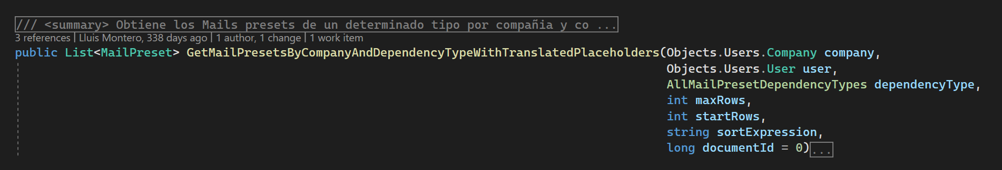
8. indentation
Luis

Slide 15
9. names
Luis
to long

Slide 16
10. processes

Slide 17
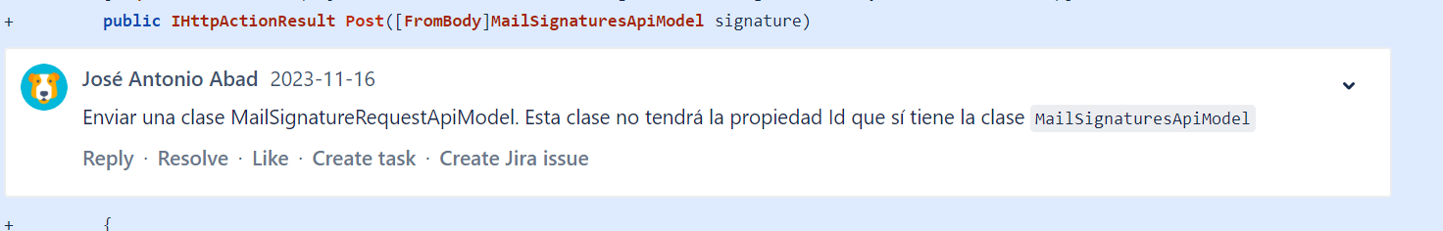
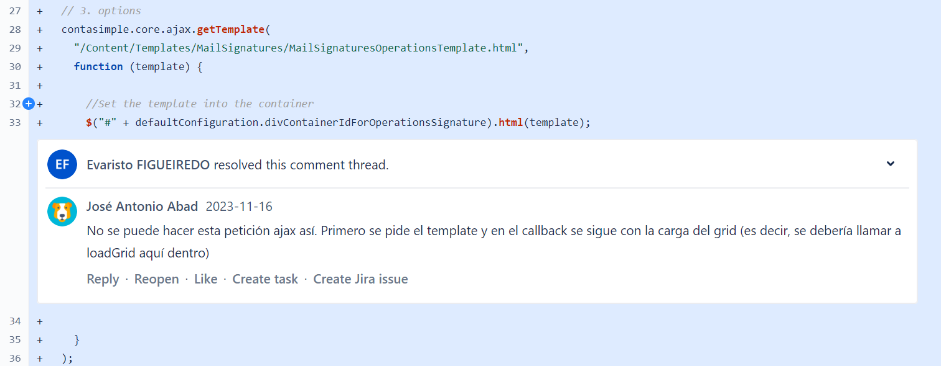
10.1 style/architecture
no onboarding process
no architecture documentation
no style guide
when I create a new file in the project
I copy from an existent one
so I can create the new one according to the rules
style guide
architecture
but the old file that I choose
is outdated
so is not according to the current
style
architecture
so
I create
the new
file
with errors
only in
PR review
I get
a warning
about
the problems
solution
documentation
style
architecture
grooming
share reference files
so I have
to redo
my work
is frustrating
takes
twice
the time
not in
clients
not in
clients
is not systematic
some errors are detected
some others don´t
not in
presets

Slide 18
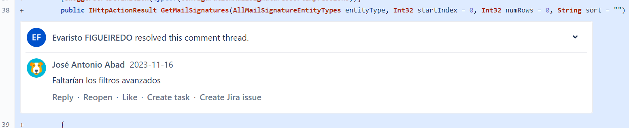
10.2 analysis
no participation
in
analysis
meeting
only in
PR review
I get
a warning
about
the problems
so
I implement
with functional
errors
so I have
to redo
my work
is frustrating
takes
twice
the time
solution
divide the issue in small issues
review smaller steps
errors have less impact

Slide 19
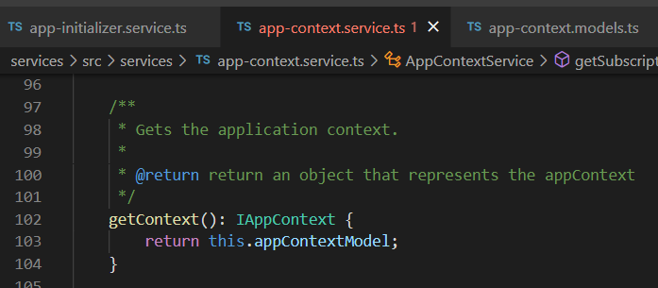




Z. template
new project
ExecuteAsync
square post-it
download
exe
download
exe
why
A slash
followed
by
two consecutive asterisks
D:\A1_research\C2_c0dice\B1_jmeter\A1_install
functionalities
introduction
build-exe
entity framework plus
zig help
⊂
4
every key-frame
defines the operation
success

