Slide 1
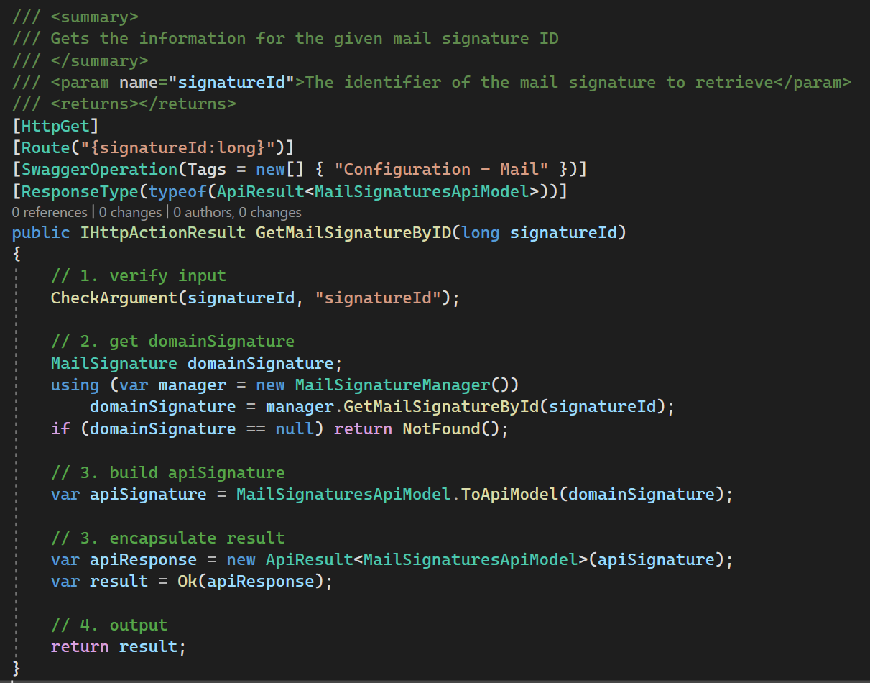
1. variables
what
is a concept
one
or
more words
identifies
the
operation result
describes
the operation
by stating
the operation result
starts a group
of
operations
concept:
an entity (name)
in
a specific domain

Slide 2
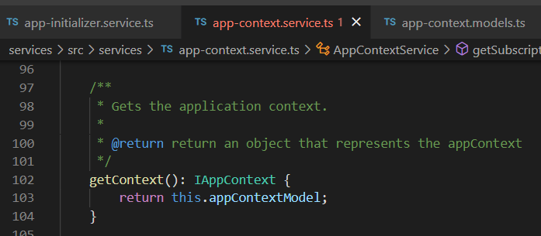






Z. template
new project
ExecuteAsync
square post-it
download
exe
download
exe
why
A slash
followed
by
two consecutive asterisks
D:\A1_research\C2_c0dice\B1_jmeter\A1_install
functionalities
introduction
build-exe
entity framework plus
zig help
⊂
4
every key-frame
defines the operation
success

