Slide 1
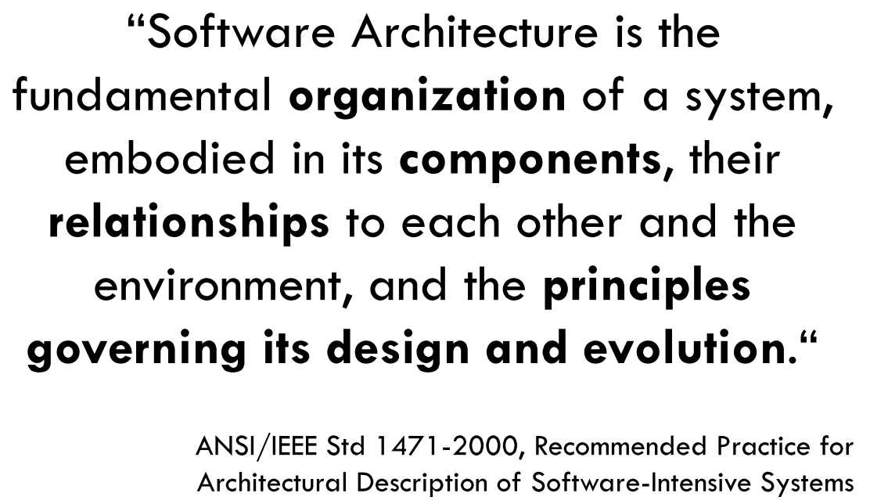

1. architecture
what
there are a lot
of
definitions
see next slide
to
clarification
software architecture

Slide 2

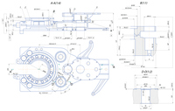
2. meaning
SWE
very new
uses terms
from other
areas
the activity
of
designing
buildings
software
system
arquitetura
estrutura
what
dicionário/priberam/arquitetura
to make
plans
for
something
=
design
projetar
cambridge/dictionary/architecture
cambridge/dictionary/design
a drawing
of
a building software system
that only
shows
its structure
plan
the way
in which
the parts
of
a system
are
arranged
or
organized
=
cambridge/dictionary/plans
planta
components
=
structure
projeto
plans
drawings
from
which something
is
made or built
relationships
cambridge/dictionary/structure
cambridge/dictionary/plans

Slide 3
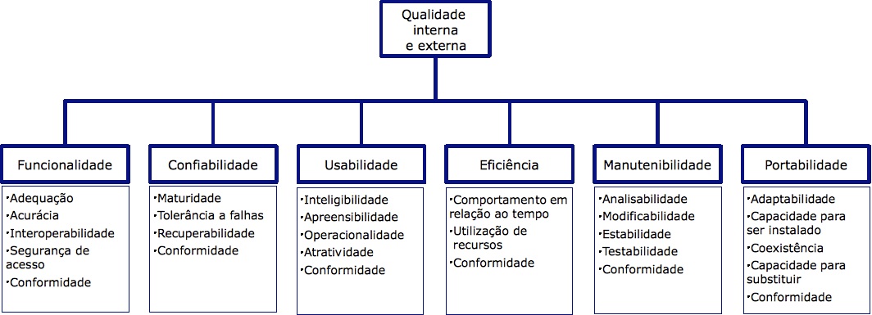
2.1 synopsis
components
design
divide
software
system
in parts
plan
the structure
that organizes
the parts
what
manage
complexity
problem
why
objectives
https://pt.wikipedia.org/wiki/ISO/IEC_9126#Modelo_de_Qualidade_da_Norma_ISO_9126

Slide 4

Z. template
new project
⊂
ExecuteAsync
square post-it
A slash
followed
by
two consecutive asterisks
then
a slash
matches
zero
or
more
directories
every key-frame
defines the operation
being executed
d:\research\A2_se\A2_architecthure
success
4
cambridge/dictionary/architecture

