Slide 1

1. errors
portfolio
architecture

Slide 2

1.1 index
Error Handling Best Practices
What is Good Science?

Slide 3
2. exception
failure vs exception
not every failure
is
an exception
sometimes,
a rejection
can be intentionally
designed behavior
example
if can't fetch some data
because
don't have
the appropriate rights
that's not
an exception
the system behaving
as it was
designed
to behave
a failed result
with an explanation
of why
makes more sense
than an exception

Slide 4
3. messages

Slide 5
3.1 be specific
what
not every failure
is
an exception

Slide 6
4. conclusion
user-friendly
Implementing useful error responses
is not just a matter
of
handling errors
efficiently
it’s about
creating
a more intuitive
and
user-friendly interface
for those who interact
with our API
api error responses results pattern
clear/actionable
by utilizing
the Result pattern
you can provide
clear,
actionable
error messages
that empower
developers
to understand
and
rectify issues
independently
better practices
encourages
better practices
in API design
by avoiding
common anti-patterns
and embracing
a more structured
error-handling method
you can ensure
robustness,
maintainability
scalability

Slide 7
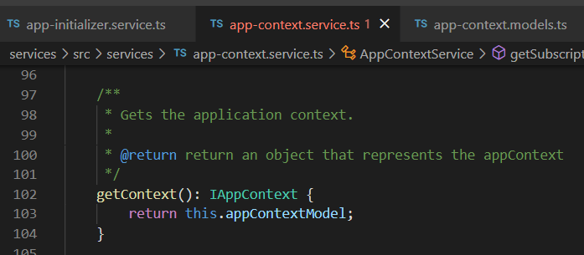


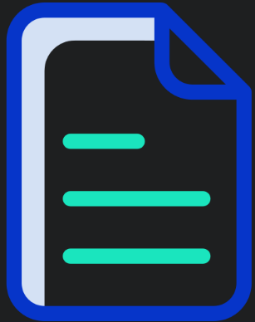

Z. template
new project
ExecuteAsync
square post-it
download
exe
download
exe
why
A slash
followed
by
two consecutive asterisks
D:\A1_research\C2_c0dice\B1_jmeter\A1_install
functionalities
introduction
build-exe
entity framework plus
zig help
⊂
4
every key-frame
defines the operation
success

