Slide 1
1. techniques

Slide 2
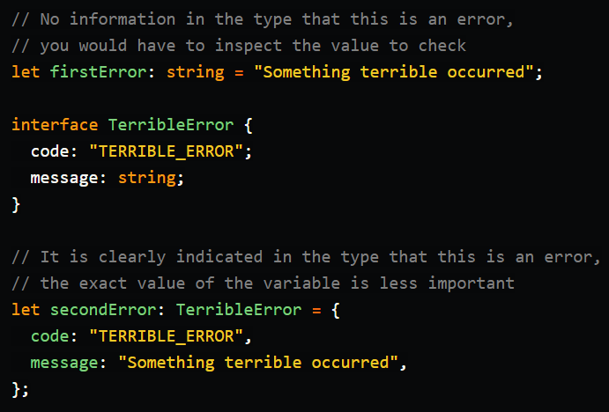
2. type system
to encode
error states
into
the TypeScript
type system
what
No information
in
the type
that
this is
an error,
you would have
to inspect
the value
to
check
simple-and-maintainable-error-handling-in-typescript
why
wrong
It is
clearly indicated
in
the type
that
this is
an error
the exact
value
of
the variable
is
less
important
right
why

Slide 3
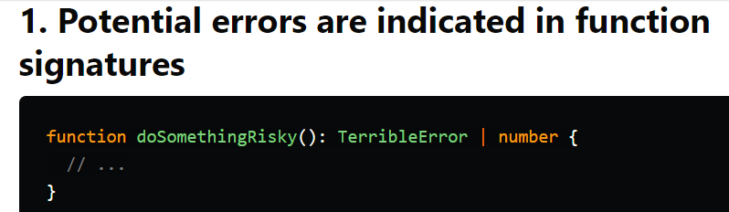

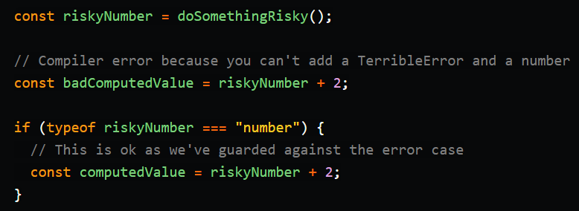
2.1 why [1-2]

Slide 4
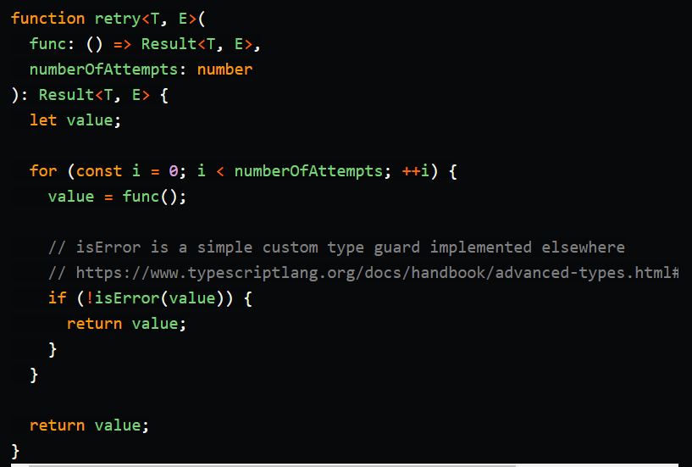
2.1.1 [3]
When you have
a generic type
like Error<E>
where
E is
wrapped data
about
the error
you now have
a generic way
of
handling errors
throughout
your
codebase
You may even
want to go
a step further
and
wrap
the good path
in
some kind
of
Success type
we often use
the pattern
of
a Result type
that is
defined as
something like
type
Result<T, E> = Success<T> | Error<E>
what
why
writing
generic code
call
a potentially
failing
function
with
retries

Slide 5
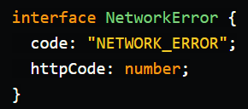

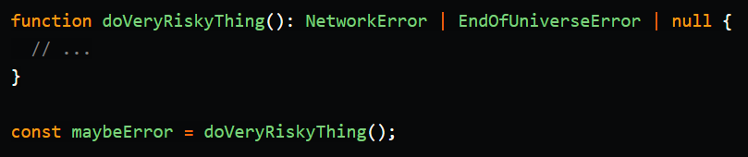
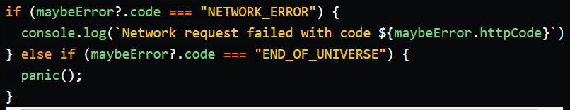
2.1.2 [4]
operations
can fail
in many ways,
which
can also
be encoded
in
these types
error types
can have
different
properties
to
include only
the necessary
information
what
how
These type guards
cause
the type of
maybe Error
to be
narrowed
within
the different scopes

Slide 6
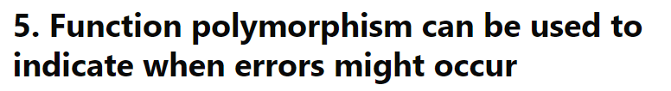

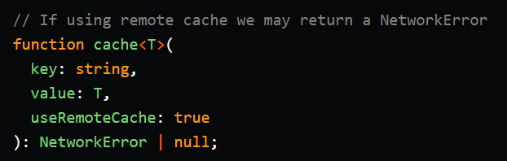
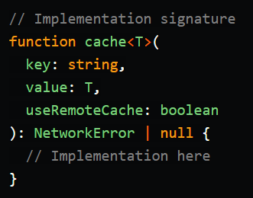
2.1.3 [5]
if having functions
that
are polymorphic
in
arguments
and
return types
you still can write
very general
functions
that
provide
rich information
on
when errors
can occur
what
how

Slide 7
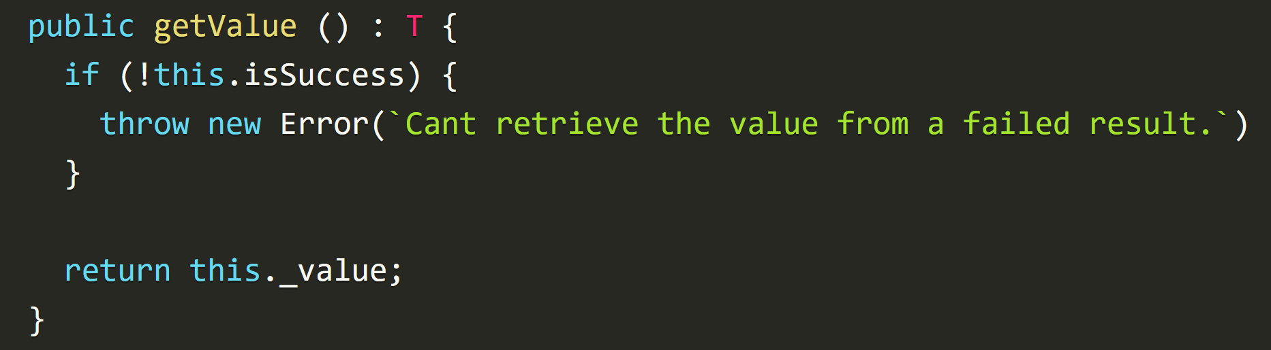
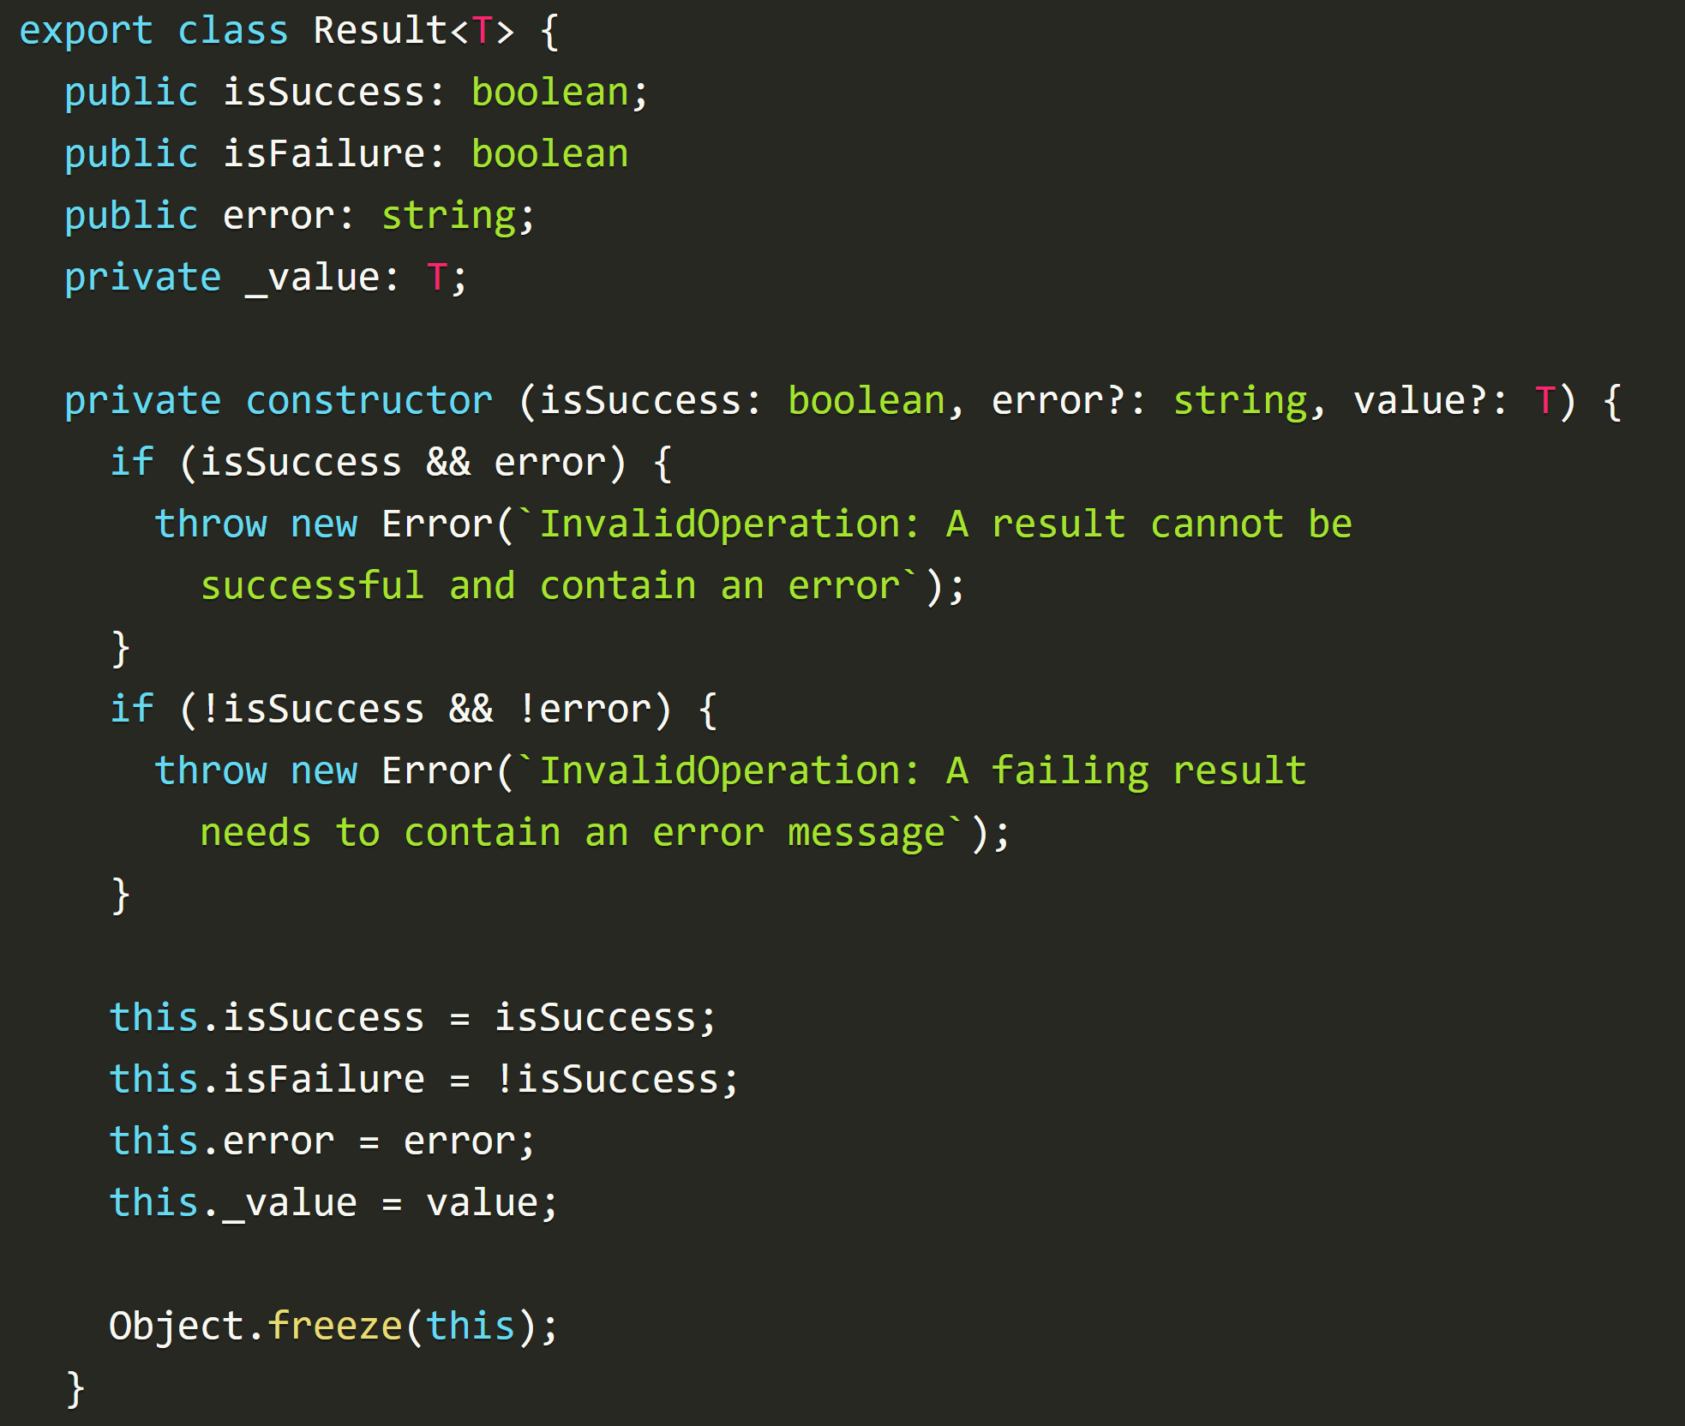
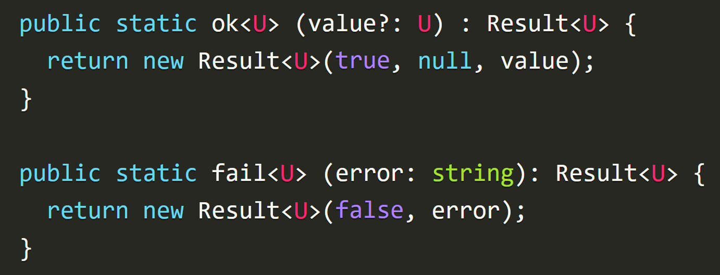
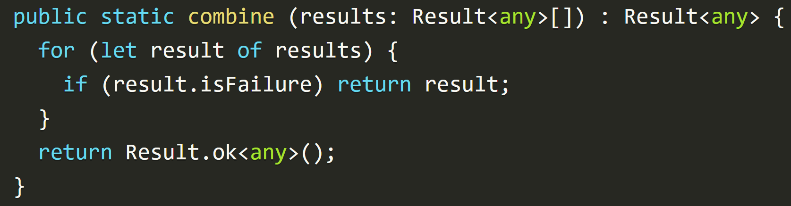
3. result class
what
combine
several results
and determine
the overall
success
or
failure
state
enterprise-typescript-nodejs/handling-errors-result-class
type-safe-error-handling-in-typescript

Slide 8
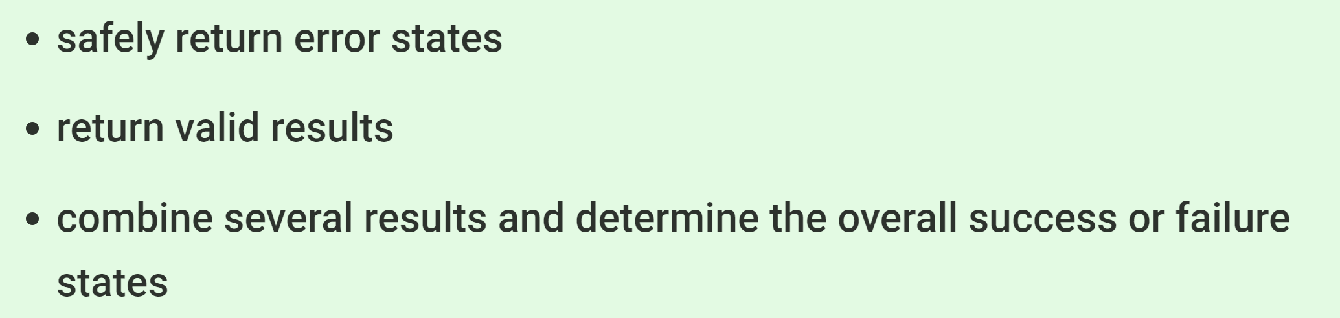
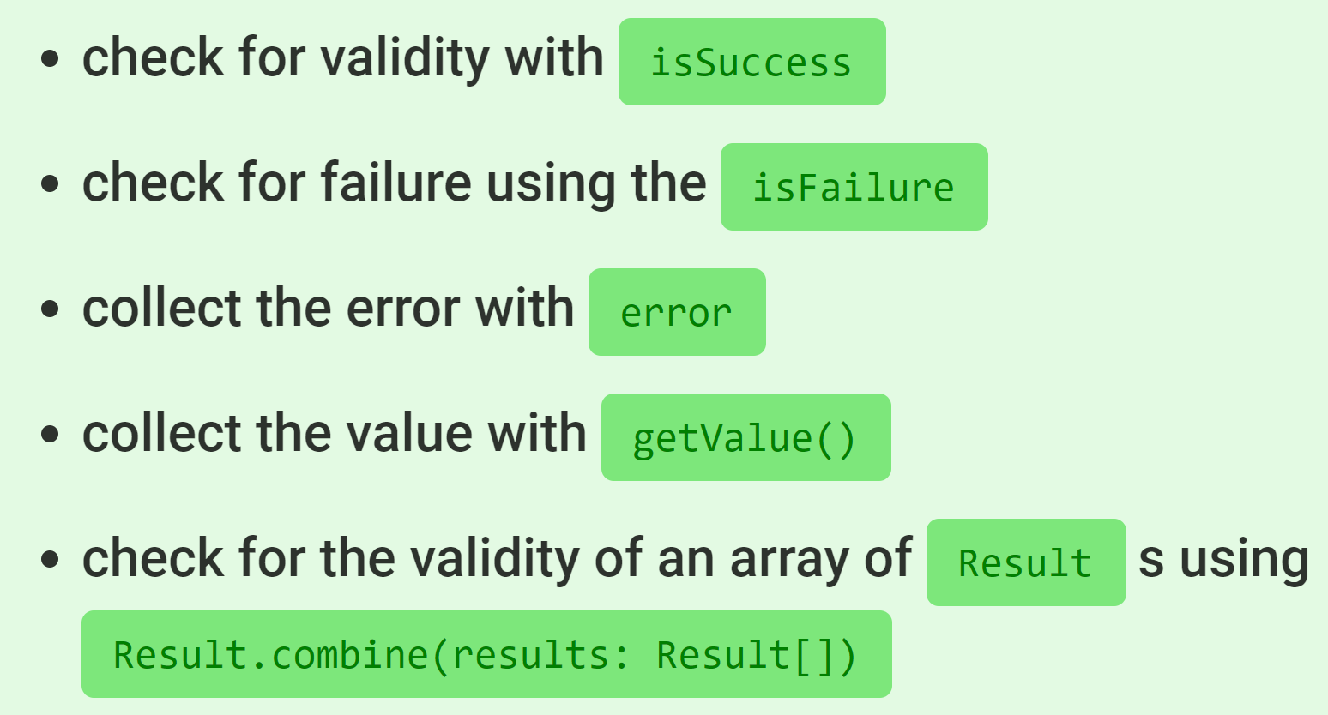
3.1 why

Slide 9

Z. template
new project
⊂
ExecuteAsync
square post-it
A slash
followed
by
two consecutive asterisks
then
a slash
matches
zero
or
more
directories
express
every key-frame
defines the operation
being executed
d:\research\A2_se\A2_architecthure
success
4

