Slide 1

1. patterns
portfolio
architecture

Slide 2
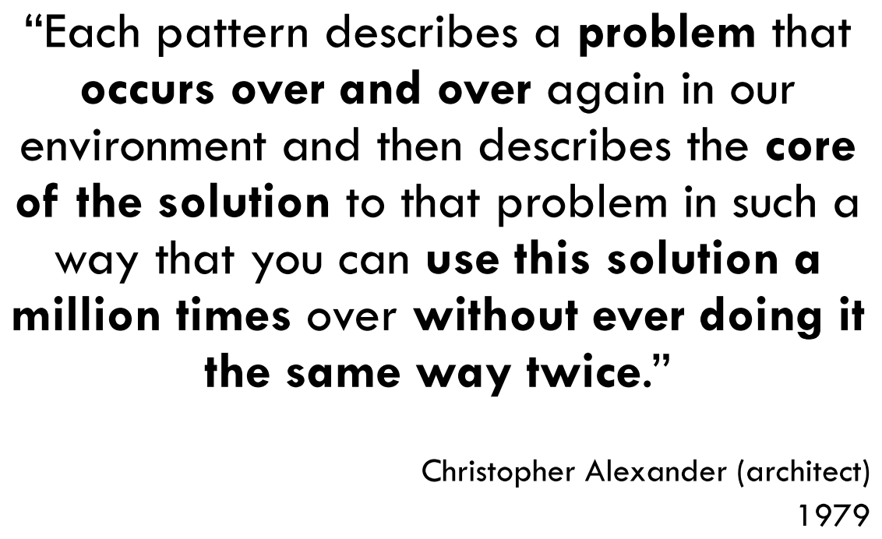


2. what
what
component | description
name | Contributes to the pattern vocabulary
synopsis | Short description of the problem the pattern will solve
forces | Requirements, considerations, or necessary conditions
solution | The essence of the solution
counter forces | Reasons for not using the pattern
related patterns | Possible alternatives in the design
D:\bibliography\A1_calibre\design\Paulo Gandra\A1A3 Design Patterns (12)\A1A3 Design Patterns - Paulo Gandra.pdf
sources
list of all patterns

Slide 3
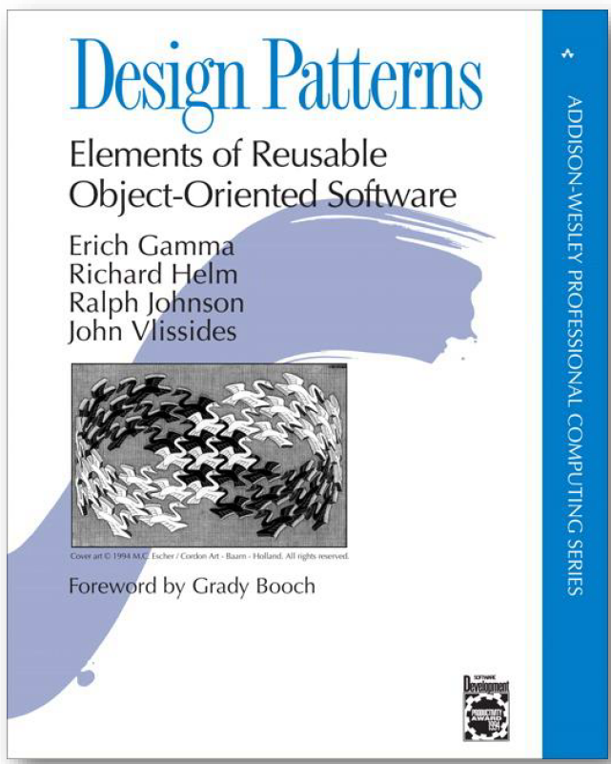
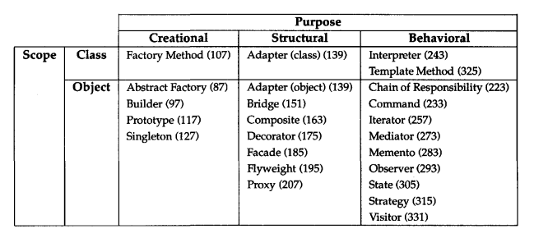
3. gof
what
D:\bibliography\A1_calibre\design\Erich Gamma\A4A8 Design Patterns_ Elements of Re (52)\A4A8 Design Patterns_ Elements - Erich Gamma.pdf
sources
gof patterns
net/design-patterns

Slide 4
3.1 list
Structural Patterns
Adapter | Match interfaces of different classes
Bridge | Separates an object’s interface from its implementation
Composite | A tree structure of simple and composite objects
Decorator | Add responsibilities to objects dynamically
Facade | A single class that represents an entire subsystem
Flyweight | A fine-grained instance used for efficient sharing
Proxy | An object representing another object
Creational Patterns
Abstract Factory | Creates an instance of several families of classes
Builder | Separates object construction from its representation
Factory Method | Creates an instance of several derived classes
Prototype | A fully initialized instance to be copied or cloned
Singleton | A class of which only a single instance can exist
Behavioral Patterns
Chain of Resp. | A way of passing a request between a chain of objects
Command | Encapsulate a command request as an object
Interpreter | A way to include language elements in a program
Iterator | Sequentially access the elements of a collection
Mediator | Defines simplified communication between classes
Memento | Capture and restore an object's internal state
Observer | A way of notifying change to a number of classes
State | Alter an object's behavior when its state changes
Strategy | Encapsulates an algorithm inside a class
Template Method | Defer the exact steps of an algorithm to a subclass
Visitor | Defines a new operation to a class without change

Slide 5
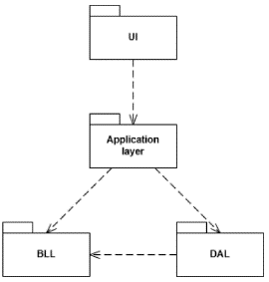
4. isep
D:\bibliography\A1_calibre\design\Paulo Gandra\A1A4 Architectural Patterns (11)\A1A4 Architectural Patterns - Paulo Gandra.pdf
layers
mvc
Pipe and Filter
Distributed applications
Modern web application
Message-based Architectures
Event-driven Architectures

Slide 6
5. microsoft
common-web-application-architectures
monolithic
all-in-one
layers
N-Layer
Clean
containers

Slide 7
6. spa
mpa
have involved little client-side behavior,
but instead have relied on the server for all navigation, queries, and updates the app might need to make
each new operation made by the user would be translated into a new web request,
with the result being a full page reload in the end user's browser
Classic Model-View-Controller (MVC) frameworks typically follow this approach,
with each new request corresponding to a different controller action,
which in turn would work with a model
and return a view
Some individual operations on a given page might be enhanced with AJAX (Asynchronous JavaScript and XML) functionality,
but the overall architecture of the app used many different MVC views and URL endpoints
In addition, ASP.NET Core MVC also supports Razor Pages, a simpler way to organize MVC-style pages
traditional-and-spa-behaviors-supported
spa
involve very few dynamically generated server-side page loads (if any)
many SPAs are initialized within a static HTML file
that loads the necessary JavaScript libraries to start and run the app
these apps make heavy usage of web APIs for their data needs and can provide much richer user experiences
choose
mpa
Your application's client-side requirements are simple or even read-only.
Your application needs to function in browsers without JavaScript support.
Your team is unfamiliar with JavaScript or TypeScript development techniques.
spa
Your application must expose a rich user interface with many features.
Your team is familiar with JavaScript and/or TypeScript development.
Your application must already expose an API for other (internal or public) clients
.SPA frameworks require greater architectural and security expertise
choose-between-traditional-web-and-single-page-apps

Slide 8
6.1 advantages
fast and responsive
since single-page applications don’t update the entire page but only required content,
they significantly improve a website’s speed
most resources (HTML/CSS/Scripts) are only loaded once throughout the lifespan of an application
only data is transmitted back and forth
this is a great advantage,
according to Google research, if a page takes more than 200 milliseconds to load
it can have a potentially high impact on business and sales.
single-page-app-vs-multi-page-app
caching capabilities
cache any local data effectively
sends only one request to a server and then stores all the data it receives
then it can use this data and work even offline
if a user has poor connectivity, local data can be synchronized with the server when the connection allows
linear user experience
provide users with a simple linear experience - like Saucony, for example
contain a clear beginning, middle, and end
the Saucony web app provides an excellent interactive experience using parallax scrolling
and amazing transitions and effects to present the complete customer journey.
scrolling
is convenient and uninterrupted
there’s no need to click on endless links
indeed, the scrolling nature of SPAs makes them perfectly suited for mobile users
who have become accustomed to scrolling.
debugging with Chrome
such apps are developed on frameworks like AngularJS Batarang and React developer tools
these frameworks have their own Chrome developer tools that make debugging much easier
than with MPAs
In addition, SPAs allow you to monitor network operations and investigate page elements
and data associated with them.

Slide 9
6.2 disadvantages
single-page-application-vs-multiple-page-application
SEO optimization
browser history
security issues
scrolling
debugging with Chrome

Slide 10
6.3 history
history-of-the-SPA-single-page-application
jQuery, in late 2006.
knockout.js
flash and Silverlight
angular.js

Slide 11
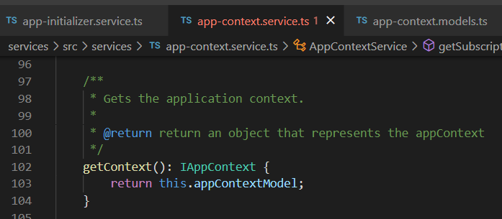



Z. template
new project
ExecuteAsync
square post-it
download
exe
download
exe
why
A slash
followed
by
two consecutive asterisks
D:\A1_research\C2_c0dice\B1_jmeter\A1_install
functionalities
introduction
build-exe
entity framework plus
zig help
⊂
4
every key-frame
defines the operation
success

