Slide 1

1. posa
portfolio
architecture
patterns

Slide 2
1.1 sources

Slide 3
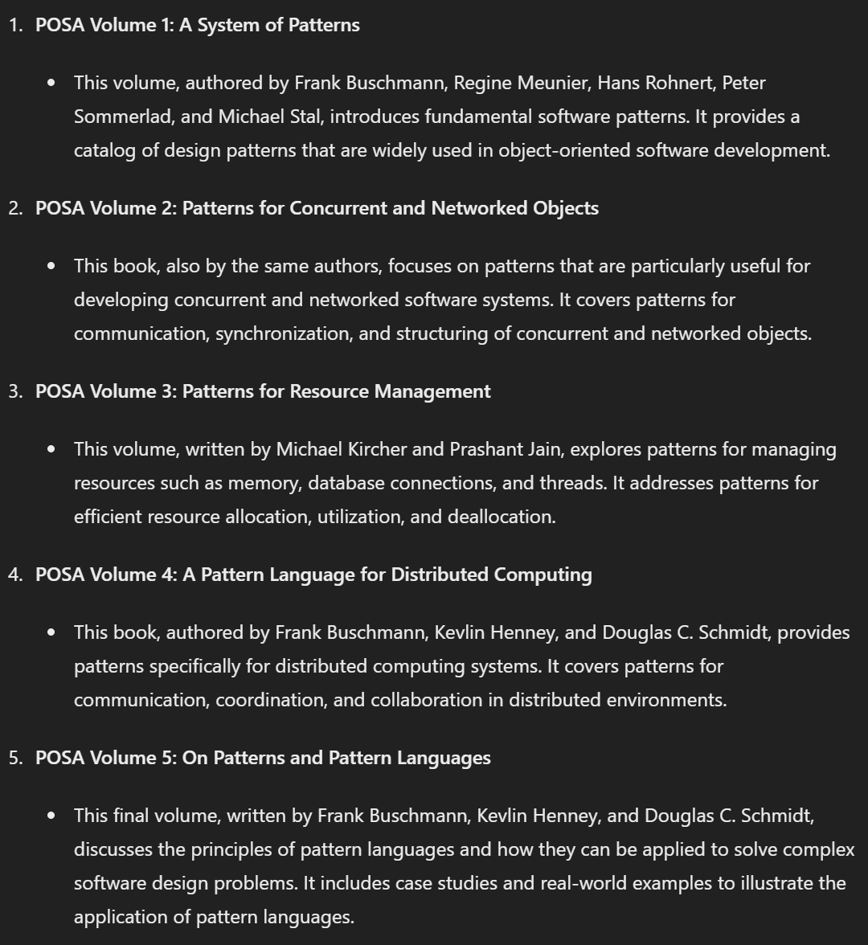


2. what
POSA is a series of books that cover software design patterns and architectural patterns.
These books are well-regarded in the field of software engineering for providing
practical, proven solutions to common design problems.
volume 1
volume 2
volume 4
github

Slide 4
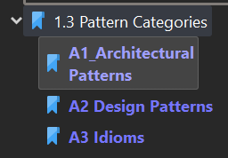
3. categories
what
volume 1

Slide 5
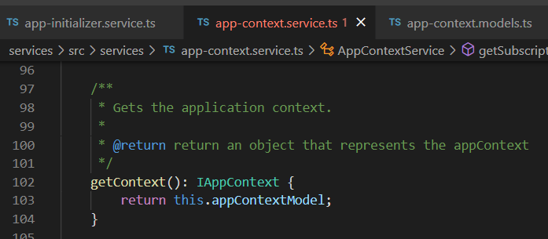



Z. template
new project
ExecuteAsync
square post-it
download
exe
download
exe
why
A slash
followed
by
two consecutive asterisks
D:\A1_research\C2_c0dice\B1_jmeter\A1_install
functionalities
introduction
build-exe
entity framework plus
zig help
⊂
4
every key-frame
defines the operation
success

