Slide 1
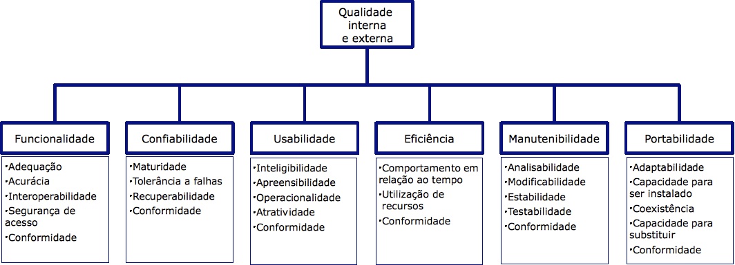
1. quality
ISO/IEC 9126
https://pt.wikipedia.org/wiki/ISO/IEC_9126#Modelo_de_Qualidade_da_Norma_ISO_9126
patterns vs quality
https://pure.rug.nl/ws/files/2809539/2007LNCSHarrison.pdf
patterns classification and analysis
https://iarjset.com/wp-content/uploads/2014/08/IARJSET1-s-hassan-SOFTWARE-PATTERNS-vs-QUALITY-ATTRIBUTES.pdf

Slide 2


ZZ. empty
aggregate
initializeNuklear depends on
nuclear.nk_user_font.with
containers
D:\bibliography\A1_calibre\design\Paulo Gandra\A1A3 Design Patterns (12)\A1A3 Design Patterns - Paulo Gandra.pdf

