Slide 1
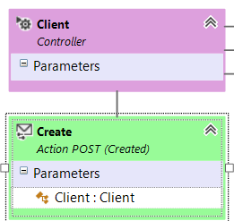
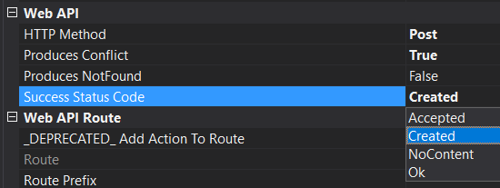
1. ➔rest
2. best practices
2.1 synopsis
3. service error
3.1 how
4. operation result
4.1 how
design
1
2
errors
status codes
in design
the possibilities for errors and status codes
are restricted

Slide 2
2. best practices
1. ➔rest
2.1 synopsis
3. service error
3.1 how
4. operation result
4.1 how
post, put, patch
https://www.moesif.com/blog/technical/api-design/Which-HTTP-Status-Code-To-Use-For-Every-CRUD-App/
A PUT, POST or PATCH call
may make modifications
to fields of the underlying resource
that weren't part of
the provided parameters
(for example: created at or updated at timestamps).
To prevent an API consumer from
having to hit the API again
for an updated representation,
have the API return the updated (or created) representation
as part of the response.
Updates & creation
should return a
resource representation
status code
In case of a POST that resulted in a creation,
use a HTTP 201 status code
and include a Location header
that points to the URL of the new resource.
Both of those should be in addition to
including the newly created resource representation
as the body of the response.
post with creation
should return 201
409 - conflict
https://stackoverflow.com/questions/3825990/http-response-code-for-post-when-resource-already-exists

Slide 3
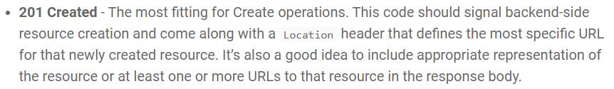

2.1 synopsis
1. ➔rest
2. best practices
3. service error
3.1 how
4. operation result
4.1 how
create
409 - conflict
read
404 – not found
update
404 – not found
delete
404 – not found

Slide 4

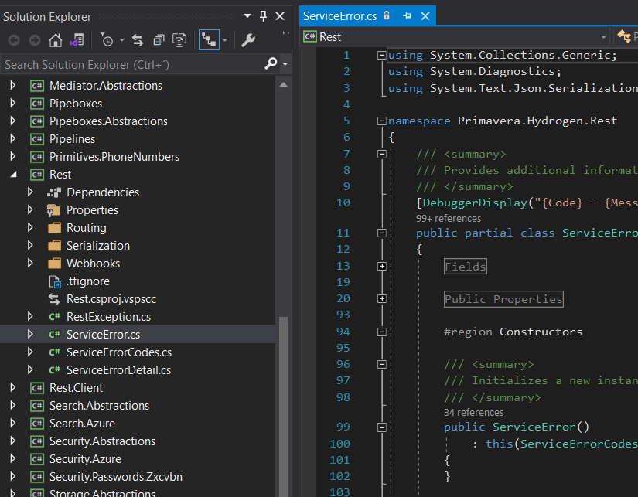
3. service error
1. ➔rest
2. best practices
2.1 synopsis
3.1 how
4. operation result
4.1 how
every API resource should return Service Error as a result
all REST errors must be normalized
what
where
D:\PrjNET\Lithium\Core\Hydrogen\Development-v2\Rest\ServiceError.cs

Slide 5
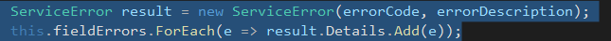

3.1 how
1. ➔rest
2. best practices
2.1 synopsis
3. service error
4. operation result
4.1 how
create
D:\PrjNET\Lithium\Core\Hydrogen\Development-v2\AspNetCore\Mvc\Validation\ApiControllerValidator.cs
return
D:\induction\induction\WebApi\CustomCode\Controllers\ClientController.cs

Slide 6
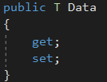
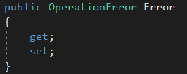
4. operation result
1. ➔rest
2. best practices
2.1 synopsis
3. service error
3.1 how
4.1 how
what
every operation with try should return Operation Result
all errors must be normalized
where
D:\PrjNET\Lithium\Core\Hydrogen\Development-v2\Core\OperationResult.cs
D:\PrjNET\Lithium\Core\Hydrogen\Development-v2\Core\OperationResultOfT.cs

Slide 7


4.1 how
1. ➔rest
2. best practices
2.1 synopsis
3. service error
3.1 how
4. operation result
D:\Induction\Induction\WebApi\CustomCode\Managers\ClientsManager.cs
success
InsertAsync
failure
CreateAsync
d:\induction\induction\WebApi\CustomCode\Controllers\ClientController.cs
success
CreateCoreAsync
failure

Slide 8


Z. template
6. postman
not important because of
composition over extension
description
joão silva
The guy that gave me the computer
ExecuteAsync
every key-frame
defines the operation
being executed
d:\research\A2_se\A2_architecthure
success
4

