Slide 1

1. results
portfolio
architecture

Slide 2

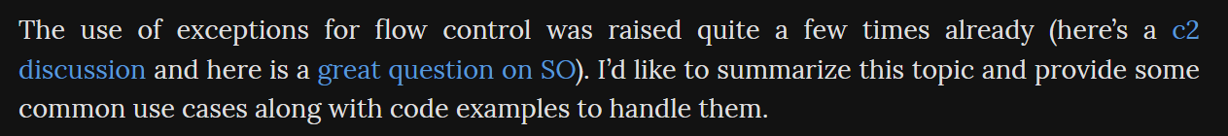
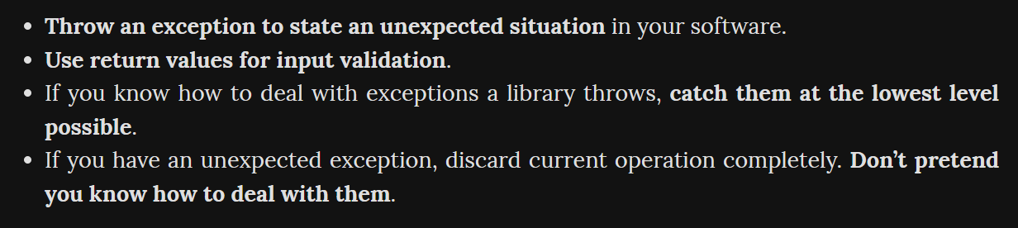
1.1 sources
replace-error-code-with-exception -> drawbacks
Result Pattern in Software Development
Improving API error responses with the Result pattern
Option one: Null checking
Option two: Exceptions as flow control
Option three: The Result pattern
zero cost exceptions
exceptions-for-flow-control
very important
Exceptions for flow control: why not?
Exceptions for input validation
Exceptions are for exceptional situations
How to deal with others' exceptions?
Exceptions and the fail fast principle

Slide 3
2. what
what
is a design approach
that encapsulates
the outcome
of an operation
in a way that
distinctly separates
success
from
failure
unlike traditional methods
where
functions
return null
or
throw exceptions
to signify failure
the Result Pattern
wraps the outcome
in a "Result" object
this object
can either represent
a successful outcome
containing the expected data
or an unsuccessful outcome
with error information
returns pattern

Slide 4
3. why

Slide 5
3.1 not exceptions
failure vs exception
not every failure
is
an exception
sometimes,
a rejection
can be intentionally
designed behavior
example
if can't fetch some data
because
don't have
the appropriate rights
that's not
an exception
the system behaving
as it was
designed
to behave
a failed result
with an explanation
of why
makes more sense
than an exception
more research
in
chat GPT
what
don’t use exceptions
to manage
code execution
exceptions should be thrown
only to
inform of
an error
or
critical situation
drawbacks

Slide 6
3.2 general
why
can significantly
enhance
the quality
and
maintainability
of
code
returns pattern
by explicitly
defining
possible outcomes,
making it easier
to understand
and
handle different
scenarios
clarity and safety
improves code readability
improves safety
encourages thoughtful
error handling
instead of using
exceptions
as a control flow
mechanism
allows errors
to be dealt
with as regular data
reducing the chance
of
unhandled exceptions
error handling
debugging becomes
more straightforward
as the Result object
can carry detailed information
about the failure,
aiding in
identifying
the root cause
of
issues
debugging ease
API consistency
ensures consistency
in responses,
making it easier
for clients to interact
with the service

Slide 7
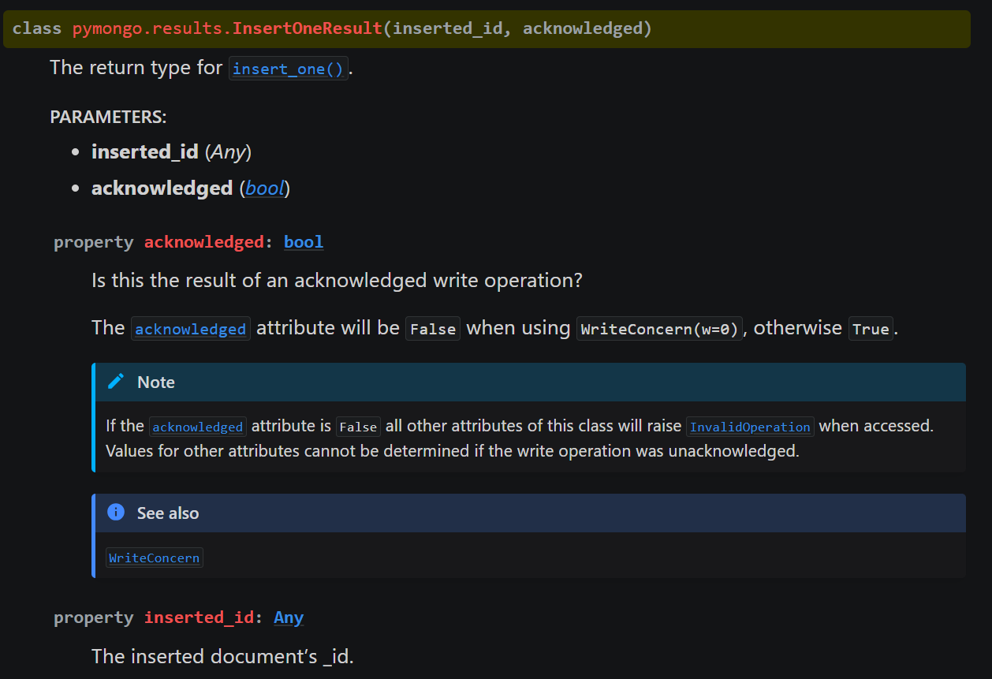
3.3 mongo
what
results – Result class definitions – Pymongo 4.7.3 documentation

Slide 8
3.4 lithium
what
to be done

Slide 9
3.5 no operation in except
what
to be done

Slide 10



4. pending

Slide 11
5. conclusion
why
offering a robust solution
for error handling
and
result management
enhances code clarity,
simplifies debugging,
ensures consistent error handling strategies
as software complexities grow
adopting this pattern
can be pivotal in building
reliable
maintainable,
user-friendly applications
returns pattern

Slide 12
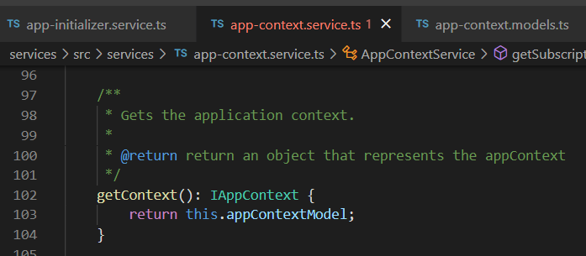




Z. template
new project
ExecuteAsync
square post-it
download
exe
download
exe
why
A slash
followed
by
two consecutive asterisks
D:\A1_research\C2_c0dice\B1_jmeter\A1_install
functionalities
introduction
build-exe
entity framework plus
zig help
⊂
4
every key-frame
defines the operation
success

