Slide 1
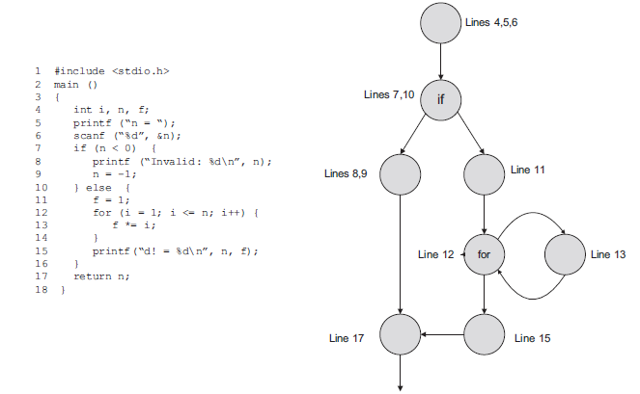
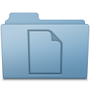
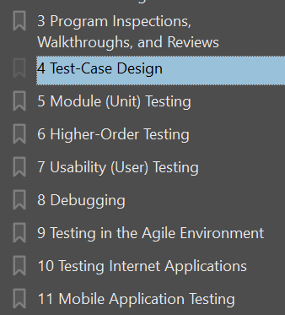
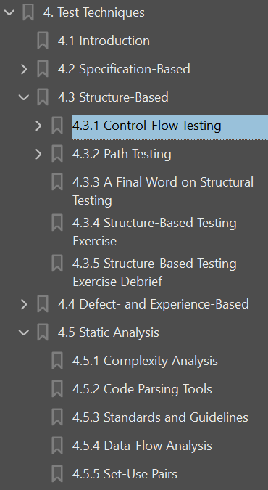
1. ➔ tests
references
D:\A3_bibliograpfy\B2_tests
A1_ISTQB.pdf
A2_the_art.pdf

Slide 2

1.1 index
control flow

Slide 3
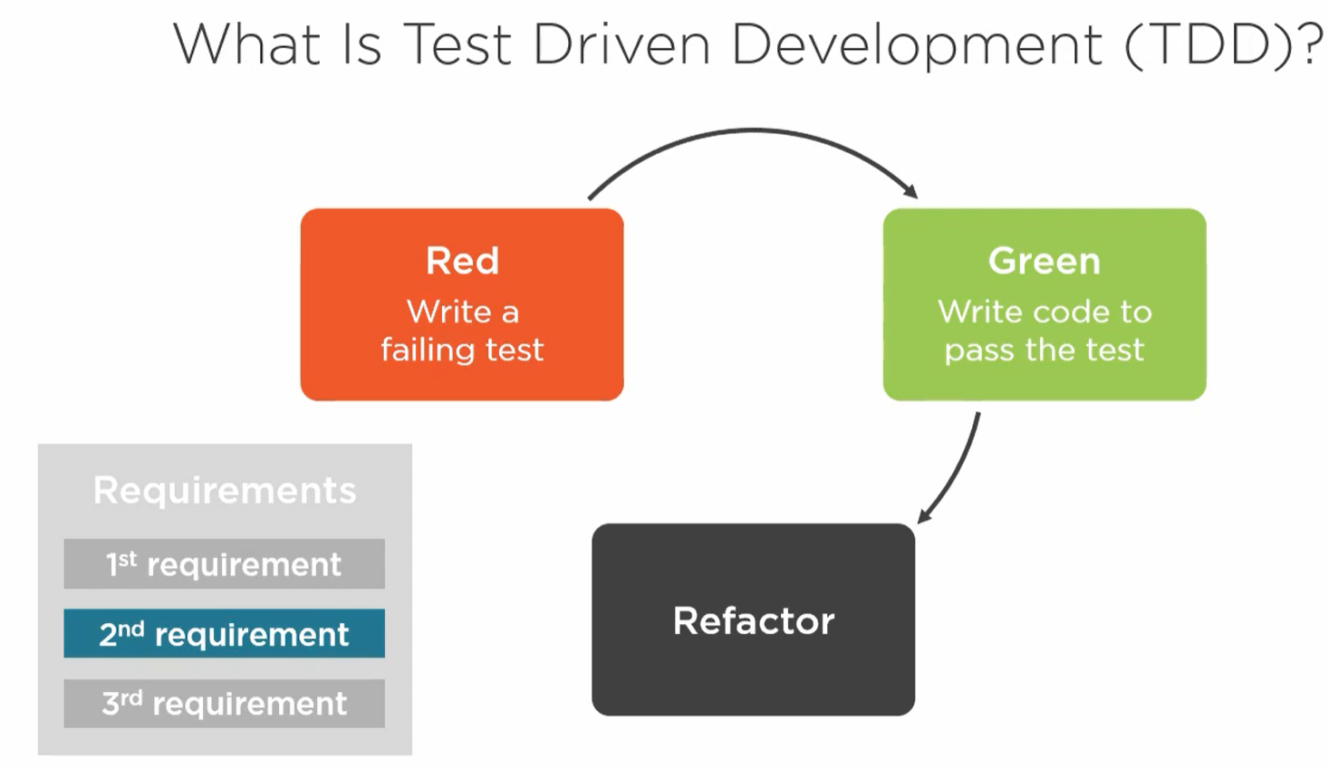
2. tdd
TDD
pluralsight

Slide 4
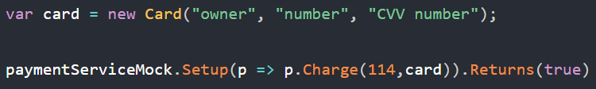
3. mock
what
tutorial
create
instruct
parameters
exact
general
accessing

Slide 5
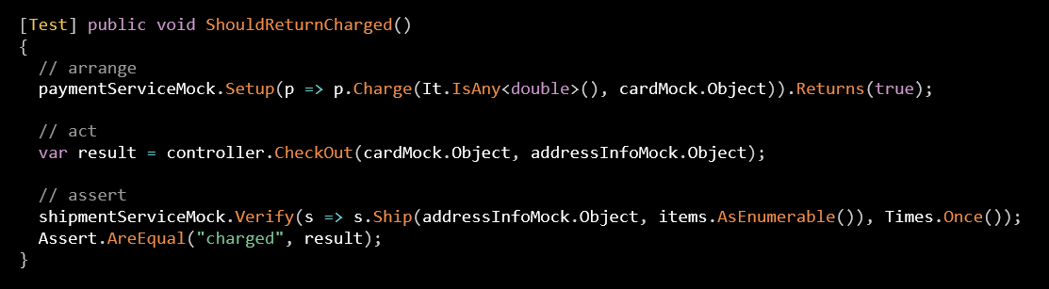
3.1 test
steps

Slide 6
3.2 assert
what
First, we have a Mock assertion.
We see that as we are calling the method Verify()
that
essentially says:
I expect the Ship() method to
have been called
with
an addressInfo object
and
a cartItem list
and
that it was called only once.
The second says
our result
variable
should contain
the value
charged

Slide 7
4. bdd
what
Behavior-driven development
thesis
it is possible to define the behavior of an app
by means of a DSL representing the ubiquitous language (DDD)

Slide 8
5. python

Slide 9
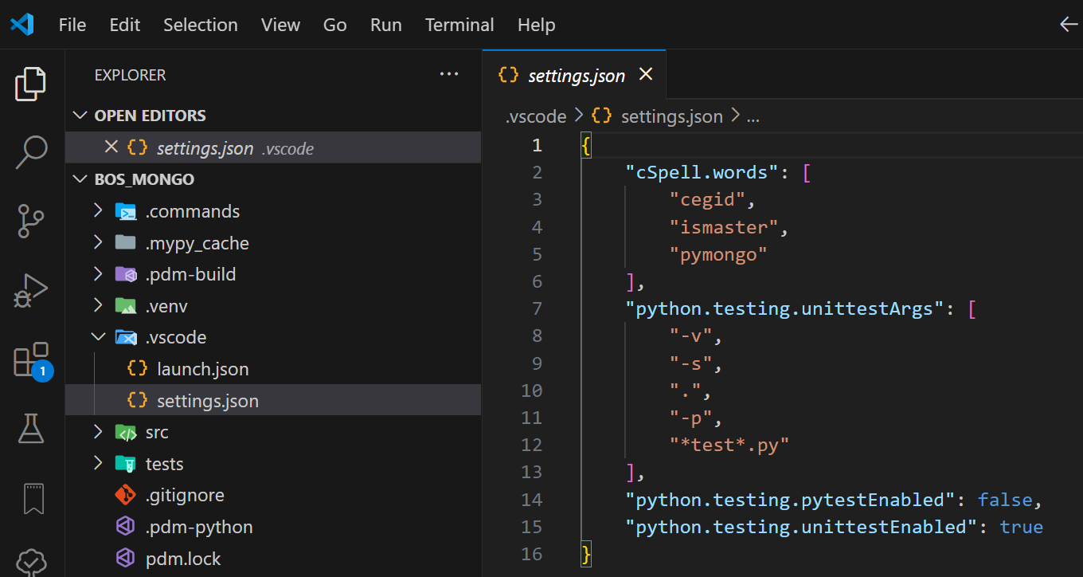

5.1 vsCode
what
python unit tests not discovered in vsCode

Slide 10
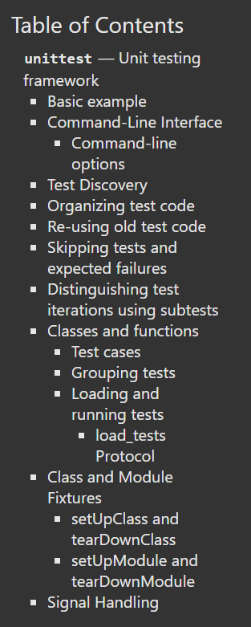
5.2 unit test
what
unit test — Unit testing framework — Python 3.12.4 documentation

Slide 11
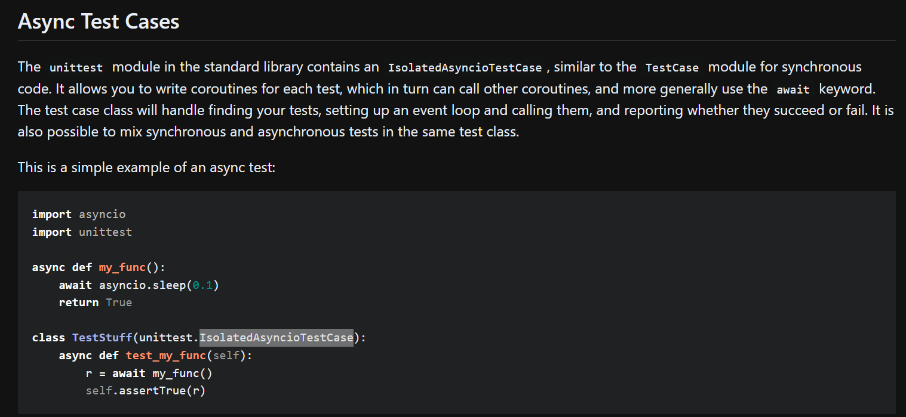
5.3 async
what
Unit Testing Python Asyncio Code

Slide 12
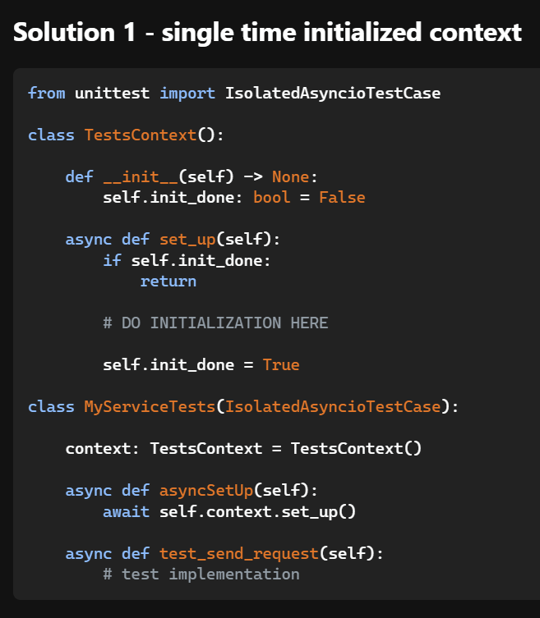
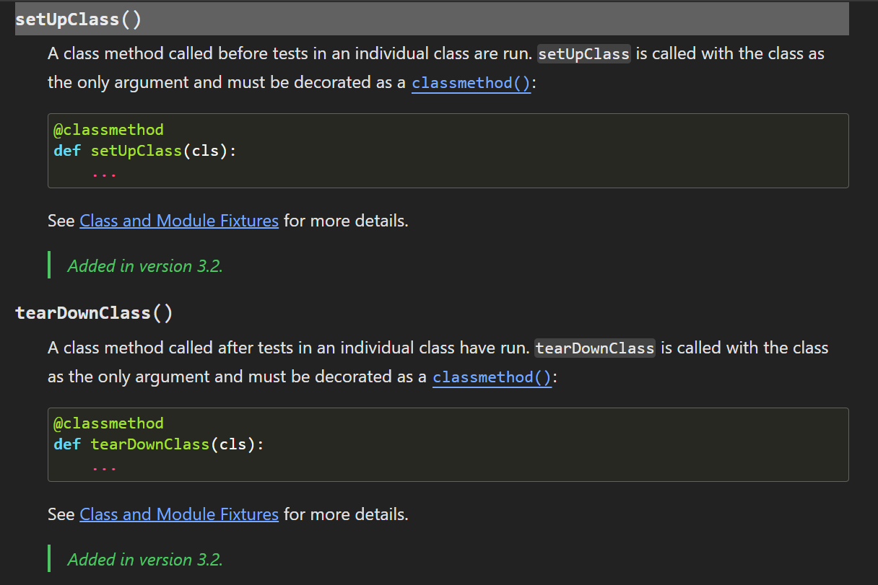
5.3.1 setup class
what
unit test — Unit testing framework — Python 3.12.4 documentation
is there an async equivalent of set Up Class in Python 3.10

Slide 13
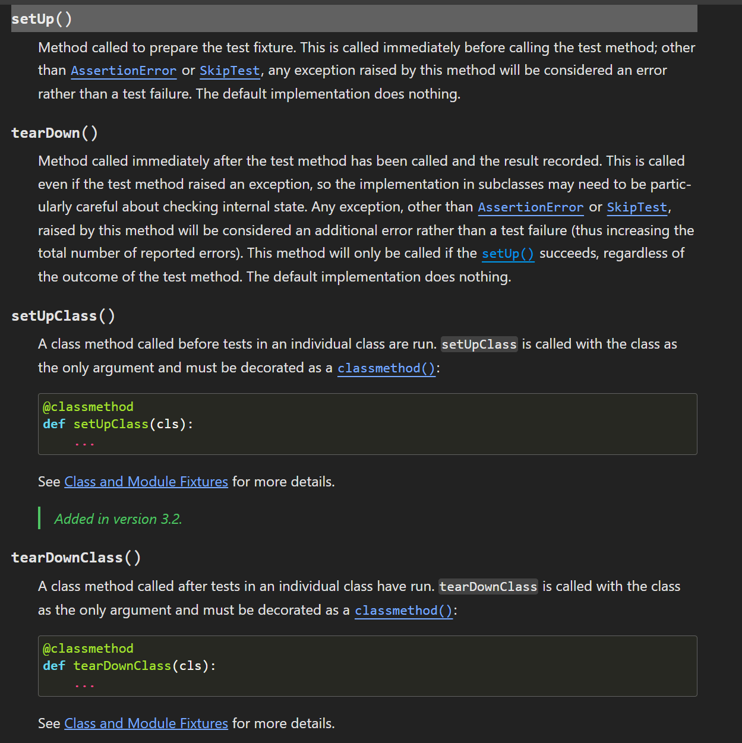
5.4 setup
what
setup

Slide 14
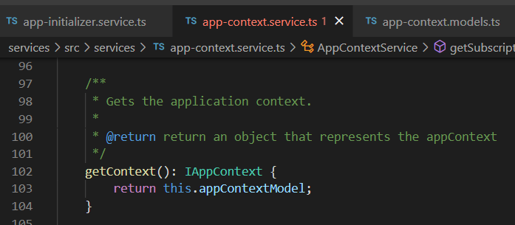


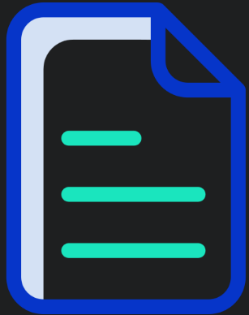

Z. template
new project
ExecuteAsync
square post-it
download
exe
download
exe
why
A slash
followed
by
two consecutive asterisks
D:\A1_research\C2_c0dice\B1_jmeter\A1_install
functionalities
introduction
build-exe
entity framework plus
zig help
⊂
4
every key-frame
defines the operation
success

